Slide 1






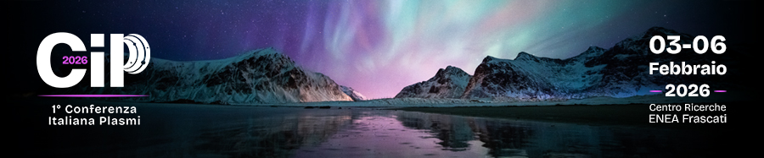
Sun cubE onE (SEE): a CubeSat Mission for High-Energy Solar Observations
Berrilli F., Giovannelli L., Marcelli L., Casolino M., Curti F., De Guzman M. A., Di Tana V., Pattanaro L., Marmonti M., Terracina A., Rossi A., Bruno A., Berretti M., Casara L., Del Moro D., Calchetti D., Cantoresi M., Chierichini S., Giri Nair A., Konow F., Lucaferri L., Nigro G., Penza V., Pucacco G., Reda R., Scardigli S., Tombesi F., Francisco G., V., Mazzotta P., Mugatwala R., Reali E., Albertini M., Benigno N., Iovanna F., Marcanio A., Turi A., Sarnari F., Cavazzuti E., Natalucci S., Urban D., Illiano S., Plainaki C., Carpentiero R.
Once the RTI is formed and we begin Phases C/D/E1, we'll be looking for contributions to SEE science from the Italian solar community (observations and models)

Slide 2
Scientific objectives
Monitor solar flare emission from soft-X to Gamma ray energy range at very high cadence (up to 10 kHz)
Monitor solar activity using full disk images in the Mg II at 280 nm, 4 images / day to better understand solar-terrestrial relations
X/γ-ray payload
UV imager payload

Slide 3
Science requirements for the UV imager and X/γ-ray payloads
TOP LEVEL SCIENCE REQUIREMENTS
Wavelength coverage | From 279 to 281 nm (Mg II line)
Spatial resolution | > 4 arcsec/pixel to resolve magnetic features
Spatial coverage (FOV) | Full disk + 50%, at least 50’ x 50’
Pointing accuracy | 9’ or better
Pointing stability | 20 arcsec Hz or better
Temporal resolution | One image every 6 hours (context imager and segmentation of solar features )
Temporal coverage | Uninterrupted unless eclipses or contingency
SNR | At least 10 considering out of band photons and straylight
TOP LEVEL SCIENCE REQUIREMENTS
Energy coverage | 1,5 keV to 3 MeV
Channels | 4
Spatial resolution | Integrated measure (Sun-as-a-star)
Spatial coverage | Full disk, at least 32’ x 32’
Temporal resolution | Up to 10 kHz
Temporal coverage | Uninterrupted unless eclipses or contingency
Energy resolution | Spectroscopic capabilities
SNR | At least 10 based on lower energy threshold

Slide 4
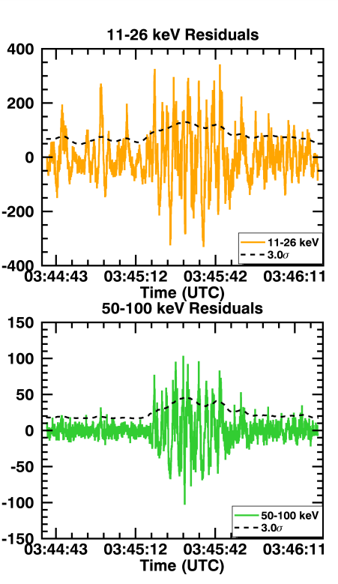
Observations of Fast-Time Variations in X/γ-ray Fluxes during Solar Flares
Subsecond Spikes
Observations have revealed the presence of rapid, subsecond spikes in hard X-ray emissions during solar flares, with some spikes as narrow as 45 ms. These findings impose significant constraints on the timescales associated with nonthermal particle acceleration models.
Spectral Evolution
High-energy γ-ray observations have revealed rapid spectral evolution of accelerated ions on timescales of approximately 30 seconds, mirroring the spectral changes observed in the lower-energy bremsstrahlung continuum.
Late-Phase Emission
An extended late-phase γ-ray emission phenomenon has been identified, occurring subsequent to the impulsive phase and lasting for tens of minutes to tens of hours. This late-phase emission is associated with the occurrence of fast coronal mass ejections.
Credits fast fluctuations in Fermi Gamma-ray Burst Monitor (Fermi GBM) data from two M9.3 class solar flares that occurred on SOL2011-07-30 and SOL2011-08-04. Knuth & Glesener, 2020

Slide 5
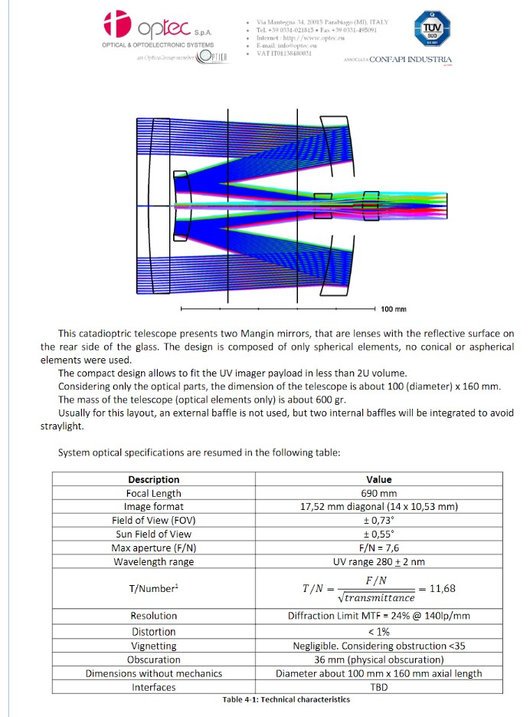
UV Mg II 280 nm Imager
Solar UV irradiance drives atmospheric photochemistry and influences Earth's climate. The variability of this irradiance is closely tracked by the Mg II index, a measure derived from the h and k spectral line cores of magnesium. Consequently, the Mg II index serves as a standard proxy for solar UV variability.
The goal of the SEE mission is to acquire full-disk solar images, enabling the identification and segmentation of magnetic features that drive changes in the Mg II index. This data is critical for advancing both solar physics research and studies of solar-terrestrial connections in geophysics.
The baseline optical layout selected for the telescope, is catadioptric. The choice to use a catadioptric scheme compared to a dioptric scheme allows to have a compact longitudinal size with a good image quality all over the field of view.

Slide 6
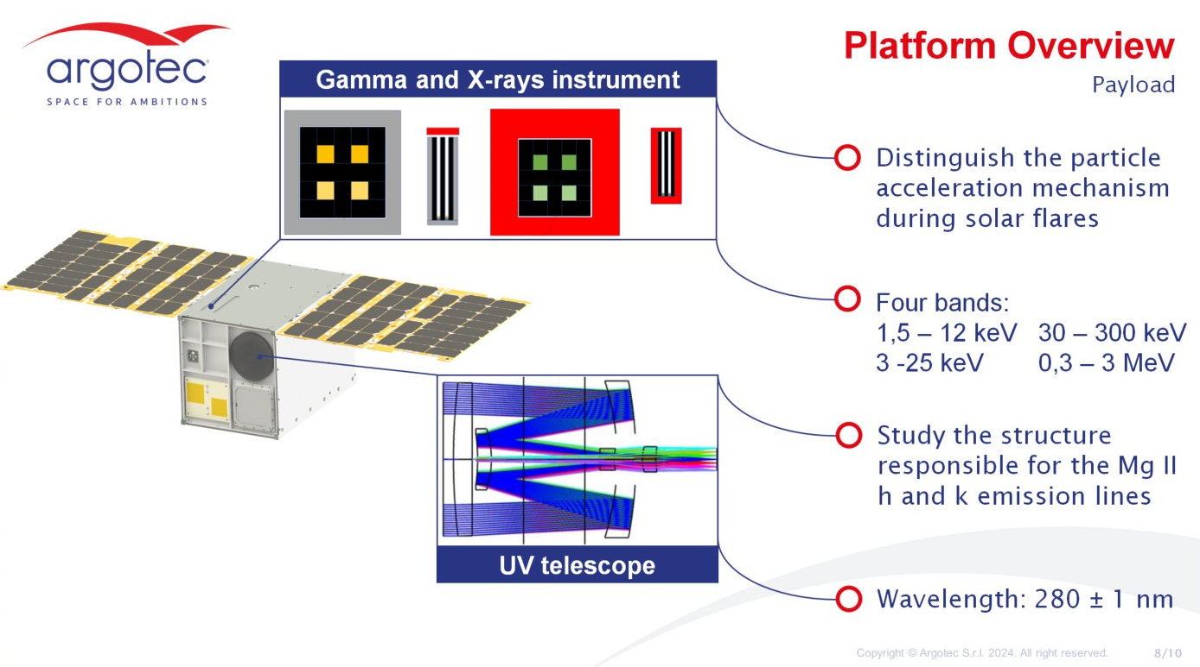
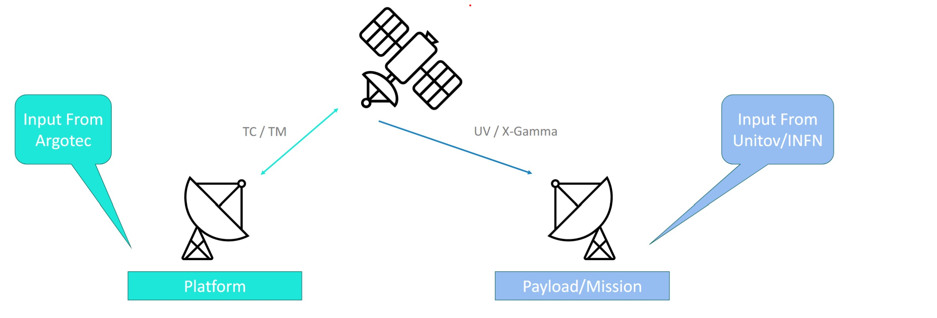
Mission profile
SEE is a 12U CubeSat (up to 24 kg) based on the ARGOTEC HAWK platform (used in LICIACube and ArgoMoon).
The HAWK platform provides: Attitude Determination and Control, Data Handling, Telemetry, Tracking & Command and Thermal Control. Most of the components already have TRL-9.
GS Definition & Operations

Slide 7
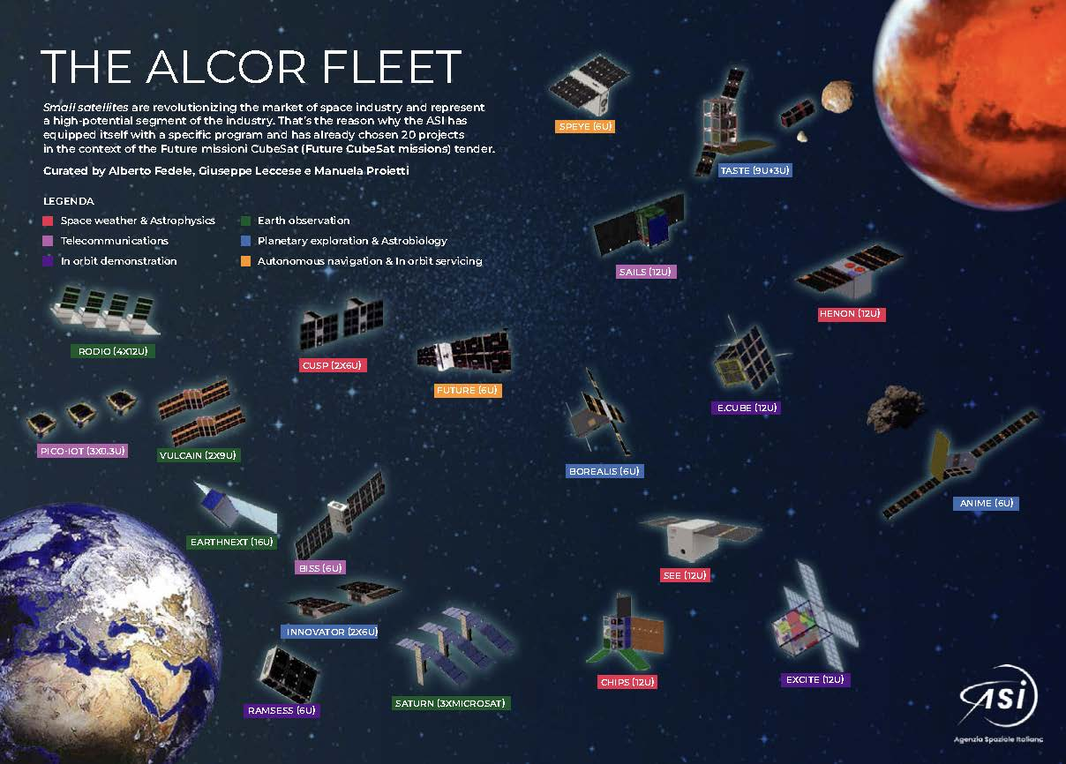
ASI nanosatellite initiative
The Alcor program was established as a dedicated nanosatellite initiative to position Italian space community as a leader in Europe and globally.
It functions as a technological incubator, enabling innovators to develop first prototypes with a customer-oriented approach, autonomously identifying potential users across sectors including civil protection. The program’s twenty missions span all major space domains, Earth observation, telecommunications, in-orbit servicing, space sustainability, astrophysics, and exploration, as well as emerging trends such as cooperative satellite constellations.

Slide 8
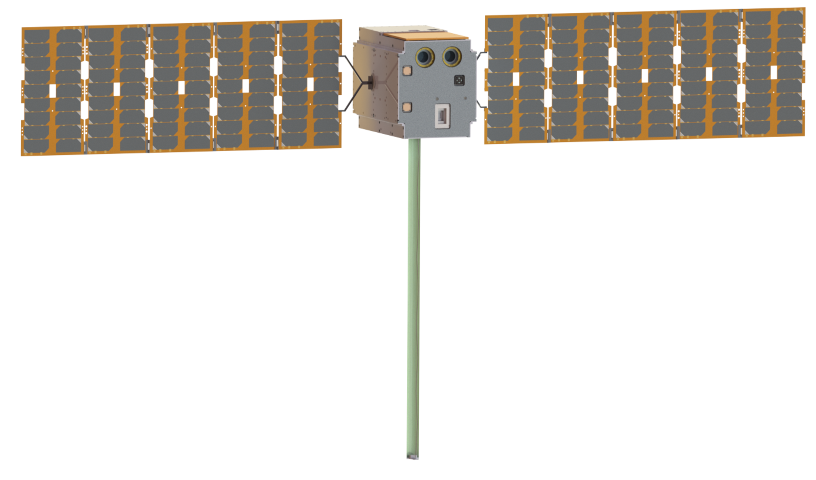
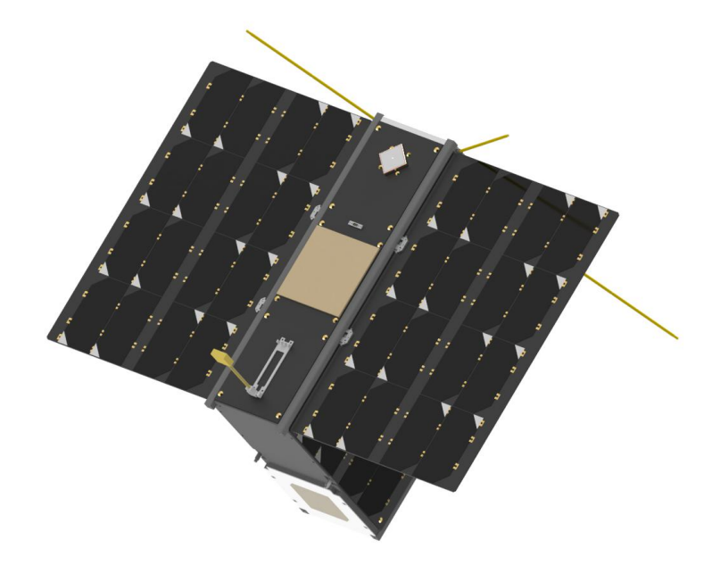
Heliospheric ALCOR missions
Sun CubE OnE (SEE) HENON CUbesat Solar Polarimeter (CUSP)
Payloads:
UV Full Disk Imager
X-ray Detector
γ-ray Detectors
Payloads:
Energetic particle flux telescope (proto/electron/heavy ion)
magnetometer on boom,
Faraday Cup Analyzer
Payloads:
dual-phase Compton scattering polarimeter

Slide 9
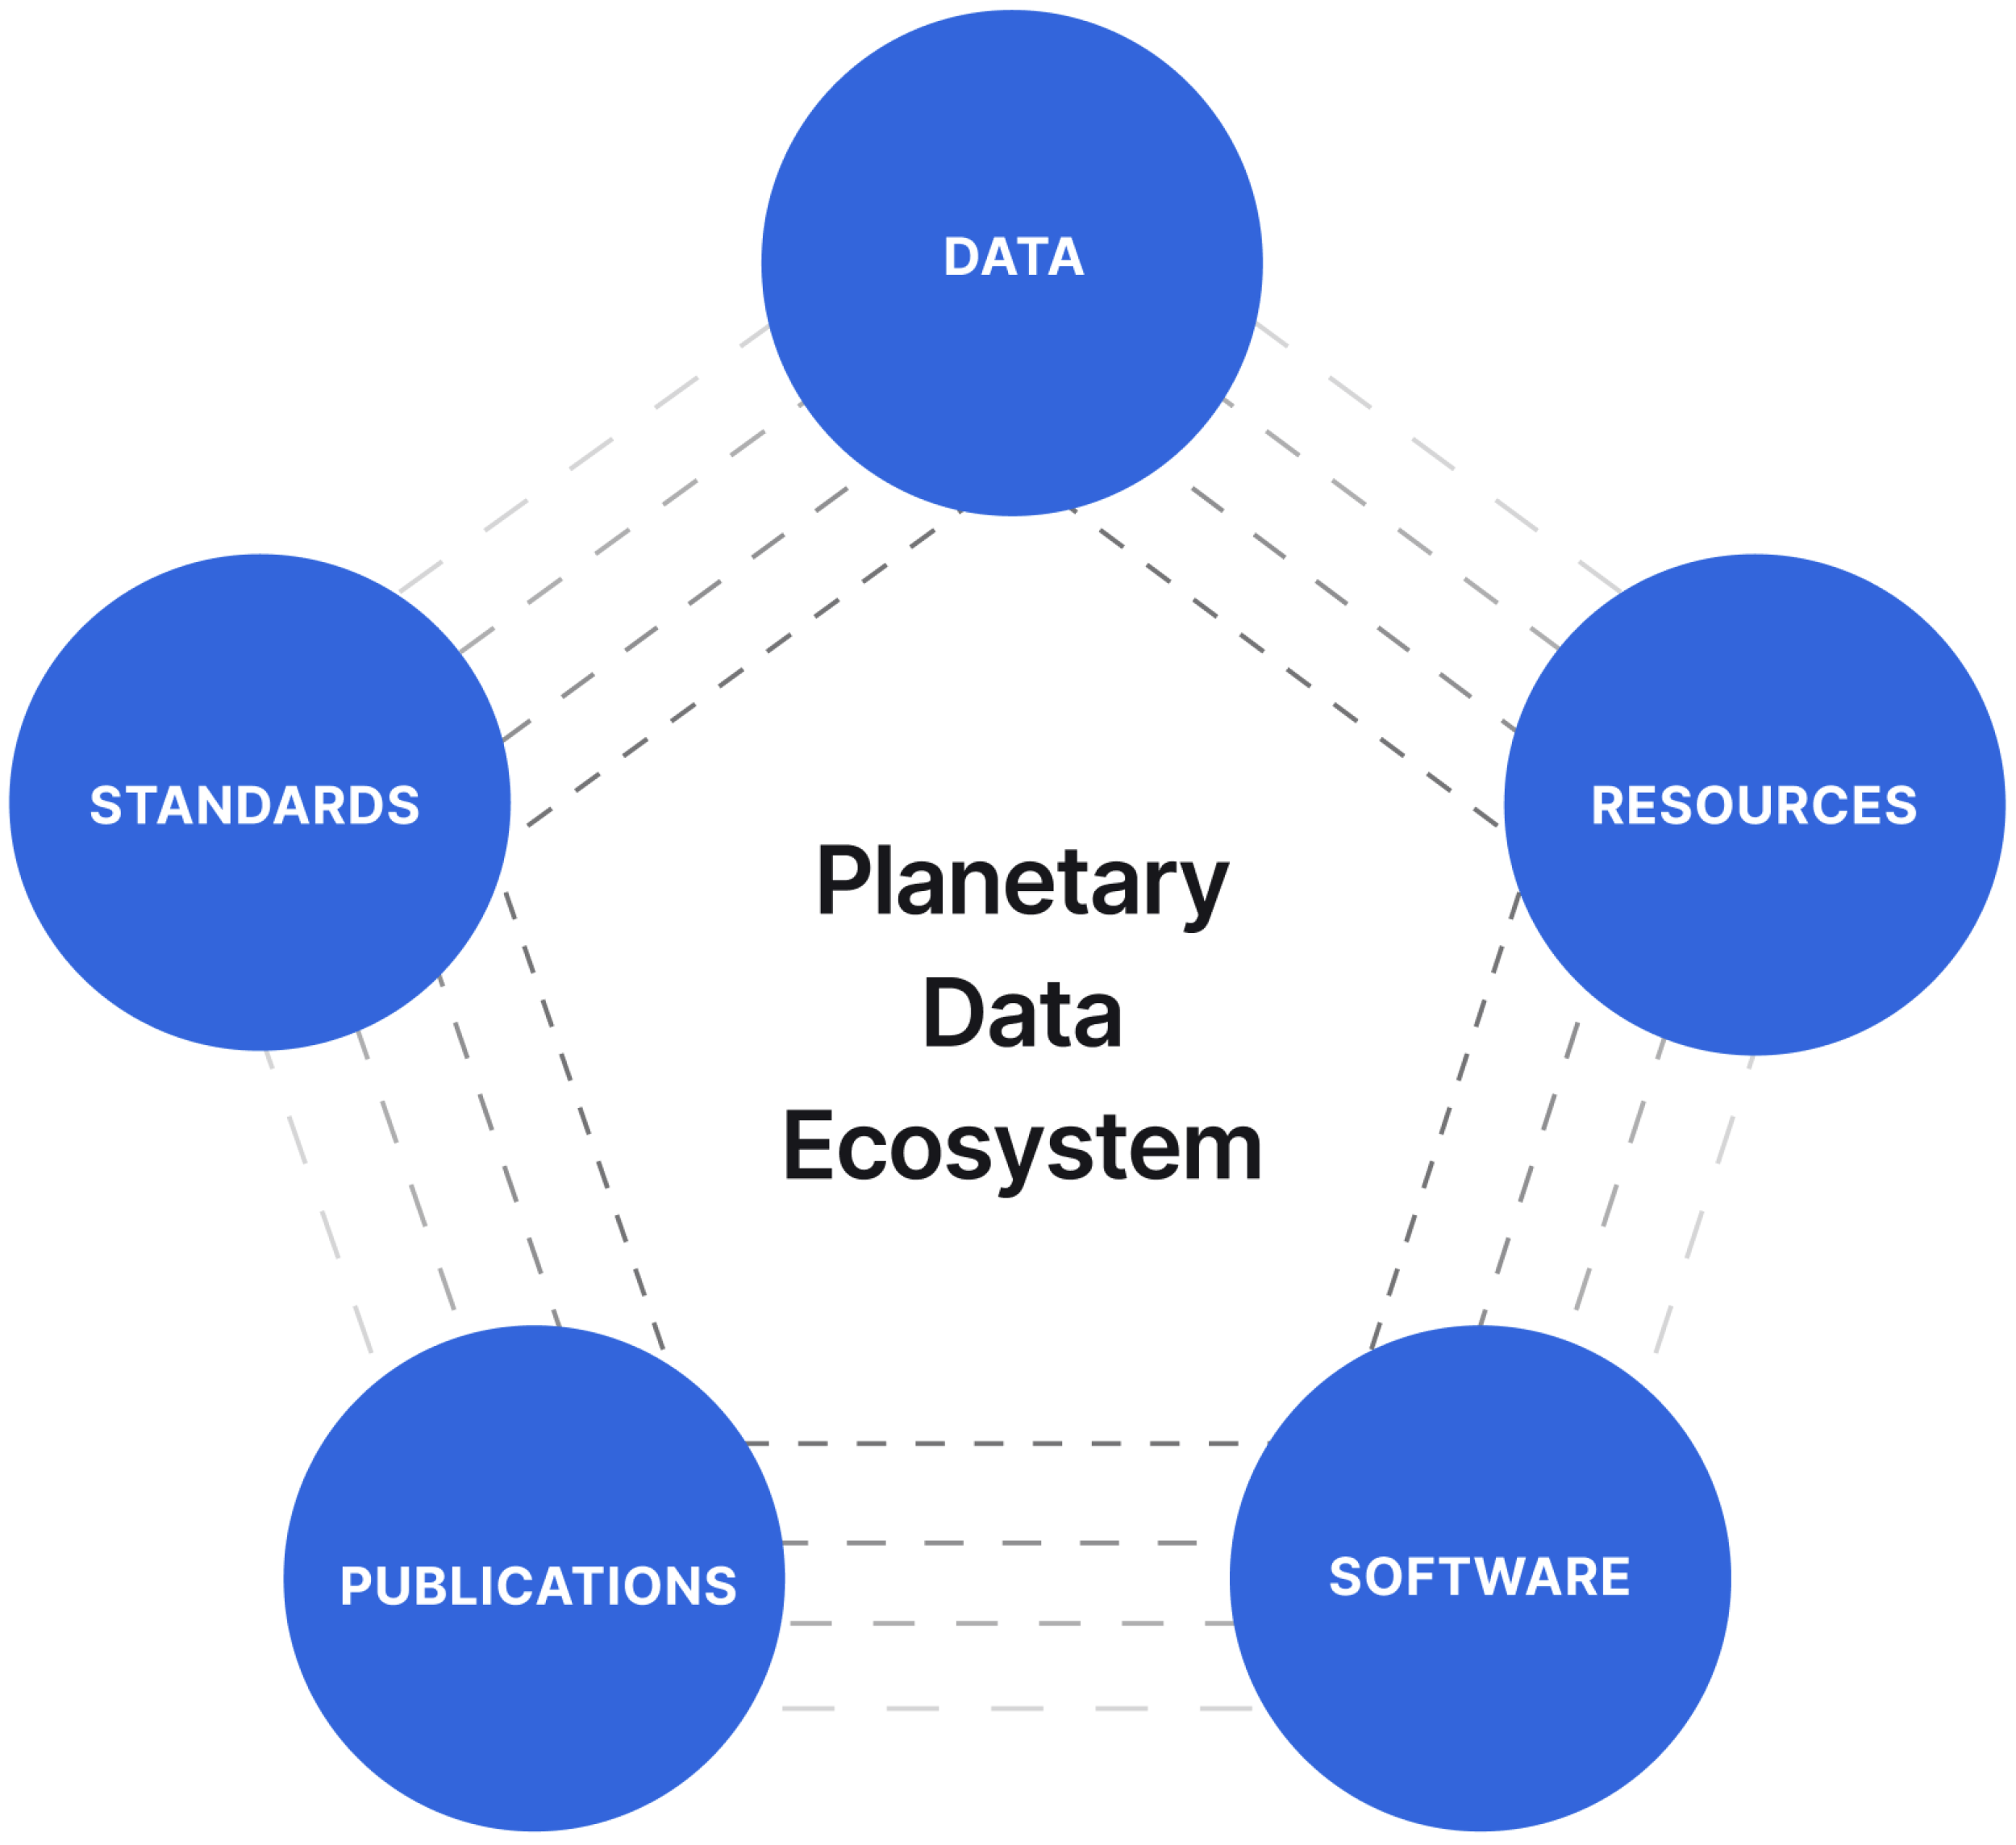
Ecosystem architecture for data from space mission
The ecosystem architecture for data from space mission exploration is a multi-layered, cloud-native framework designed to ingest, process, store, and distribute vast amounts of satellite and planetary data. Key examples, such as the Copernicus Data Space Ecosystem (CDSE) and NASA’s Planetary Data Ecosystem (PDE), transition from traditional, siloed data storage to integrated, open-access environments.
This architecture generally comprises three primary layers:
Infrastructure,
Data/Processing,
Application/Access/Solution.
Credits: https://pds.nasa.gov/home/about/PlanetaryDataSystemRMS17-26_20jun17.pdf

Slide 10
Main Points and Key Takeaways
Pioneering Italian Solar Observation
  The Milestone: SEE marks Italy’s first dedicated solar mission featuring a solar disk imager.
  Strategic Growth: The optimization of the SEE telescope and CMOS camera for UV wavelengths establishes a relevant national technological know-how in a critical spectral range.
Scientific Synergy & Innovation
  Bridging Communities: By focusing on the Mg II line, SEE acts as a scientific bridge, connecting the Heliophysics and Geophysics research communities.
  A New Window into Flares: High-cadence X/Gamma-ray sampling allows us to observe solar flare dynamics with unprecedented temporal resolution, unlocking new insights into particle acceleration.
The Cubesat Revolution in Space Weather
  The Fleet Advantage: The collaboration between SEE, HENON, and CUSP creates a distributed "Cubesat Fleet“ for solar physics and heliospheric space plasma physics
  Innovative Intelligence: This network provides interconnected, multi-messanger data that is essential for modern Solar Physics and Space Weather forecasting.
Building a Future Ecosystem
  Data Architecture: We are laying the groundwork for a robust Ecosystem Architecture, ensuring that data from heliophysics missions is integrated, accessible, and scalable for future space exploration.

