Slide 1



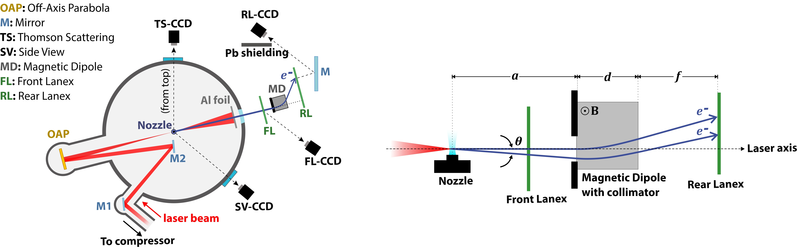
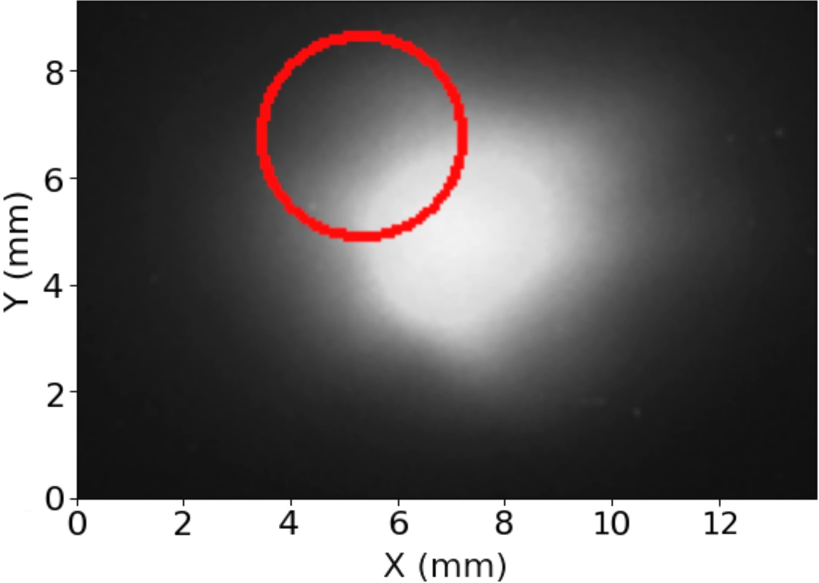
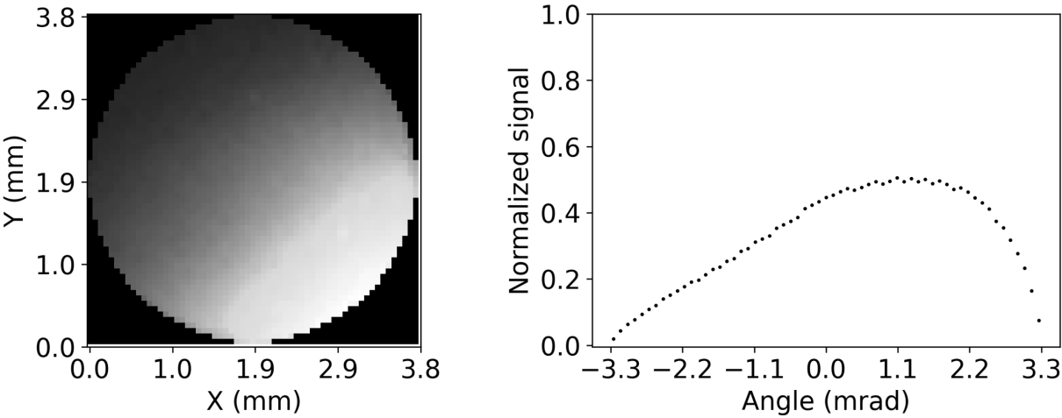
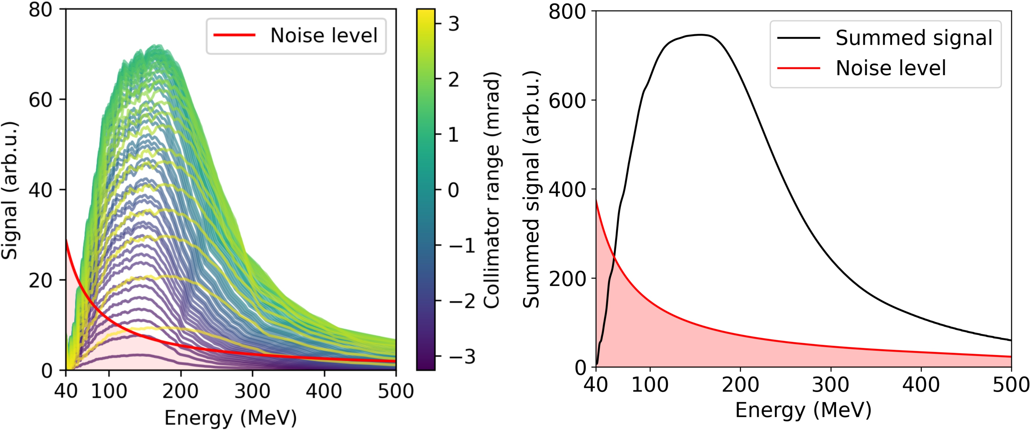
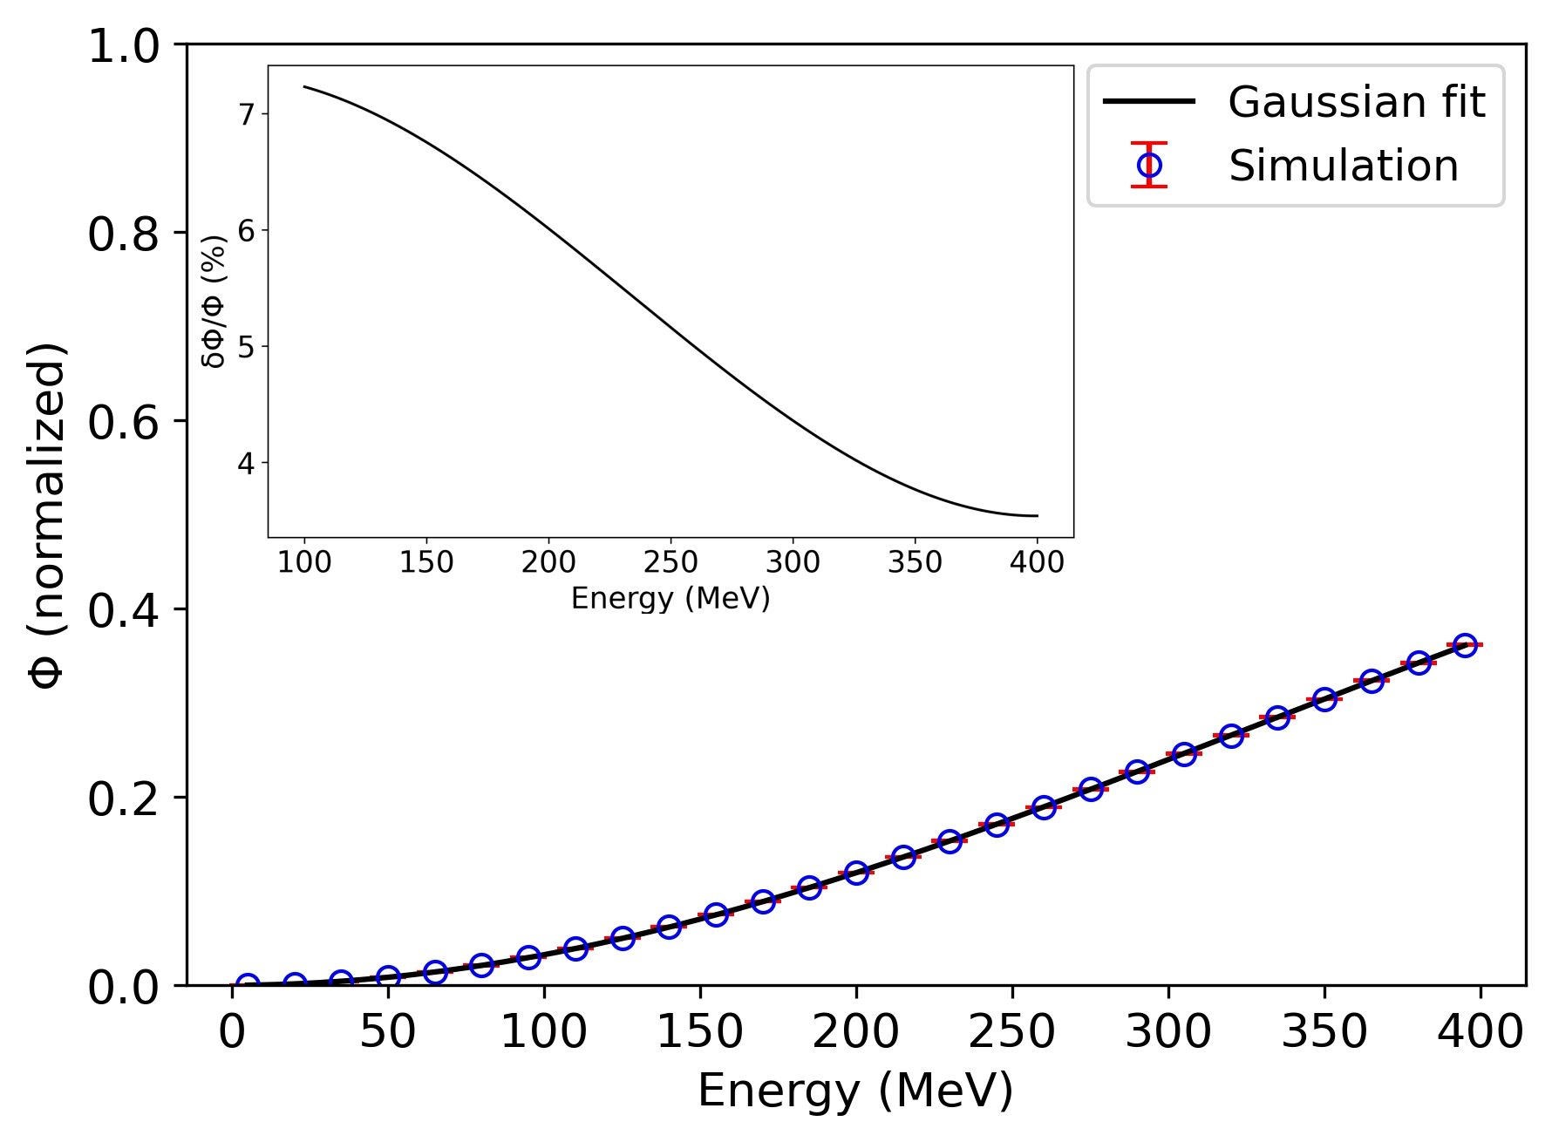
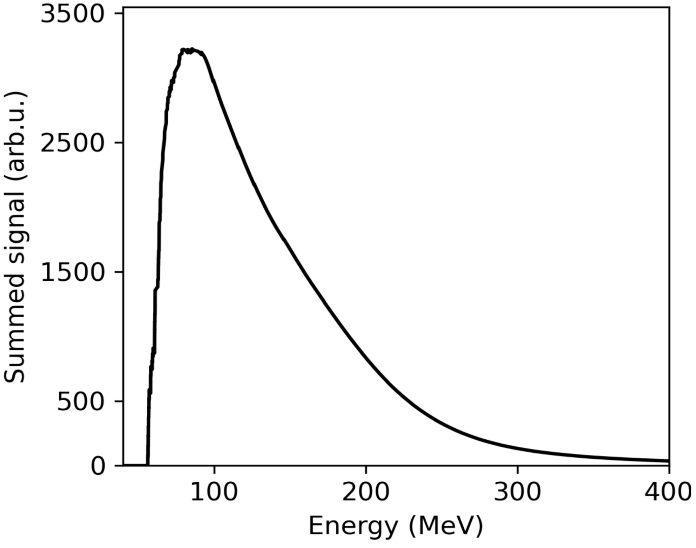
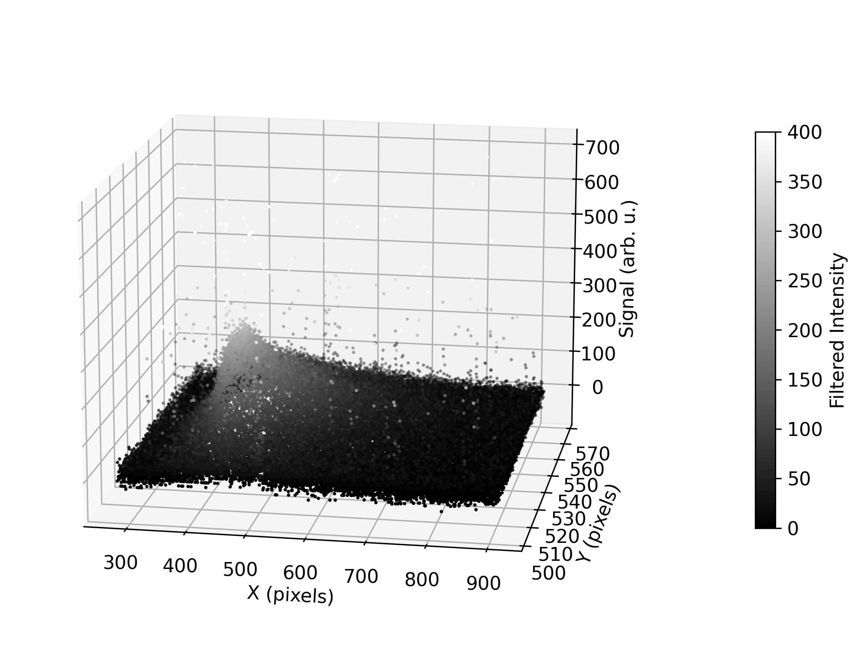
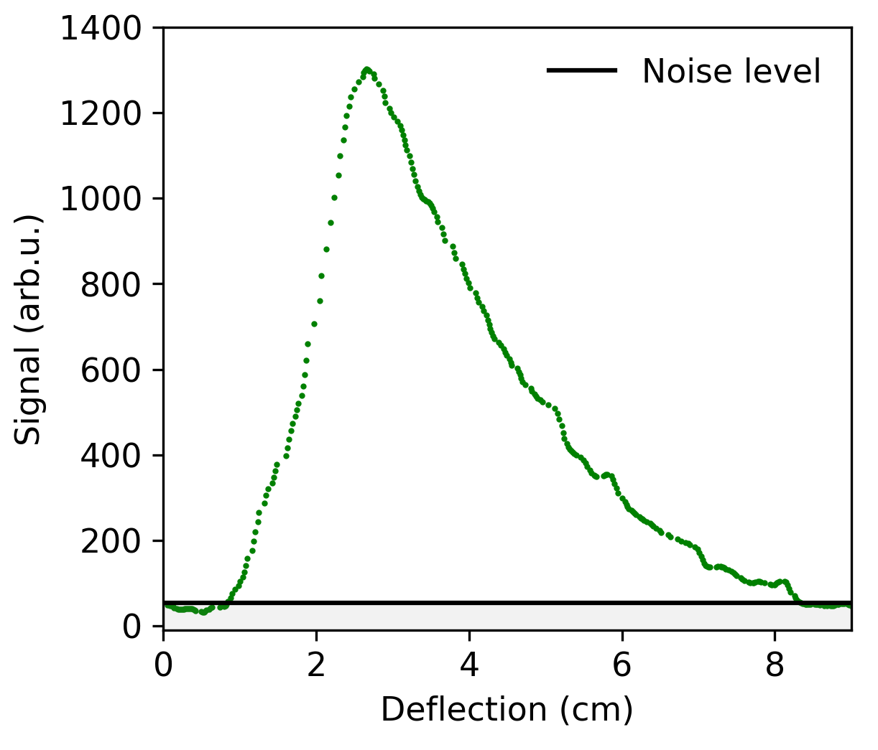
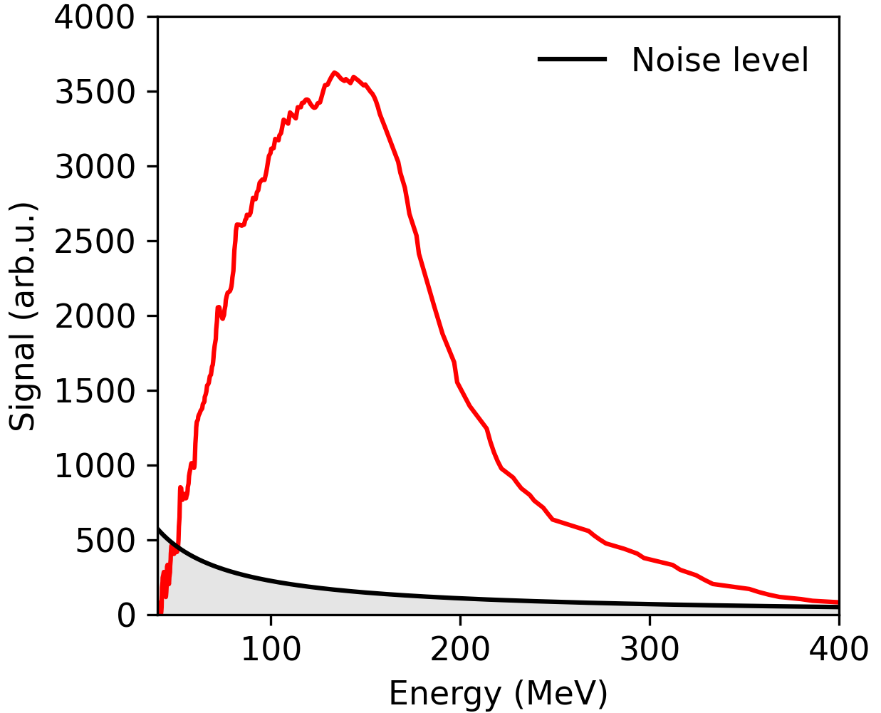














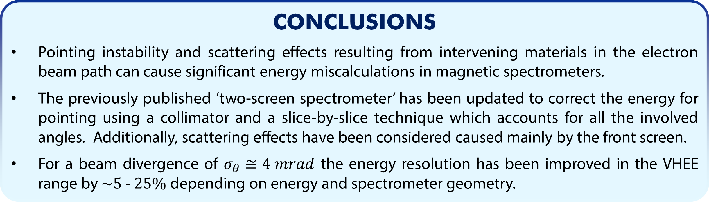



Single-shot spectrometer with pointing angle correction for laser-driven electron beams featuring pointing instability and transverse inhomogeneity
S. G. Vlachos^{1,2*}, L. Labate^{1,3*}, F. Baffigi¹, F. Brandi, G. Bandini¹, L. Fulgentini¹, D. Gregocki^{1,2}, P. Köster¹, D. Palla¹, S. Piccinini¹, M. Salvadori¹, L. A. Gizzi^{1,3}.
¹ Consiglio Nazionale delle Ricerche, Istituto Nazionale di Ottica (CNR-INO), Pisa, Italy.
² Università di Pisa, Dipartimento di Fisica, Pisa, Italy.
³ Istituto Nazionale di Fisica Nucleare (INFN), Sezione di Pisa, Italy.
* e-mail: simongerasimos.vlachos@ino.cnr.it, luca.labate@ino.cnr.it
ABSTRACT
Electron beams produced via Laser Wakefield Acceleration are notoriously known for their pointing instability, which makes the retrieval of the energy spectrum via magnetic spectrometers prone to energy miscalculations. Here, we demonstrate an improved scheme of a previously published spectrometer employing two scintillating screens and a magnetic dipole in between. The first screen provides the pointing angle and is placed upstream of the dipole, while the second one is installed behind the dipole for energy measurements. A collimator is installed in front of the dipole allowing only a portion of the beam to be detected, resulting in an improved energy resolution. For the electrons entering the collimator, a numerical procedure is laid out to retrieve the exact entrance angle of each transverse beamlet, which in turn allows a weighted sum procedure to be carried out to retrieve the final spectrum. We find that the first scintillator screen used in our setup contributes significantly at scattering the impinging electrons. We thus performed Monte Carlo simulations to account for this effect, finally correcting the observed spectrum to retrieve the actual one at the position of the vacuum chamber exit.
SPECTROMETER SETUP
POINTING ANGLE CORRECTION
The front lanex screen is used to calculate the pointing angle and the position of the collimator.
$θ=4 mrad$
$$x\left(0,ρ^{′}\right)$$
$$θ=0$$
$$x\left(θ,ρ\right)$$
Deflection when considering the pointing angle:
$$x\left(θ,ρ\right)≈\left(\frac{a}{2}+b\right)\left(\frac{a}{ρ}\right)+\left[\left(a+b+c\right)+\left(\frac{a}{2}+\frac{3b}{2}\right){\left(\frac{a}{ρ}\right)}^{2}\right]θ+\frac{1}{2}\left[\left(\frac{3a}{2}+3b\right)\left(\frac{a}{ρ}\right)\right]θ^{2} .$$
This should be the same as:
$$x\left(θ,ρ\right)=x\left(0,ρ^{′}\right),$$
with $ρ^{′}$ the misread gyroradius. Solving then for $ρ$:
$$ρ=\left|\frac{\sqrt{A^{2}+DF}+A}{F}\right|,$$
where:
$A=ρ^{′}\left(d^{2}+2df\right)\left(3θ^{2}+2\right),$
$D=4d^{2}θρ^{′}\left(d+3f\right),$
$F=−8ρ^{′}\left(a+d+f−\frac{d^{2}+2df}{2θρ^{′}}\right).$
Each pixel column represents a spectrum weighted by its brightness. Summing all the collected spectra (above noise level) gives the final energy spectrum.
$$∑S_{i}\left(E_{i}\right)$$
$$E_{peak}=147 MeV$$
SCATTERING CORRECTION
The series of aluminum foil, mylar window and Lanex screen affects the divergence of the electron beam. By simulating their scattering effect, the spectrum can be approximated to the position of the front Lanex.
MISREAD SPECTRUM
Fluence reaching the collimator
Final spectrum
The rear lanex signal is filtered to remove hot pixels, and the background is subtracted.
$$E_{peak}=91 MeV$$
Deflected beam
Raw signal
CONCLUSIONS
Pointing instability and scattering effects resulting from intervening materials in the electron beam path can cause significant energy miscalculations in magnetic spectrometers.
The previously published ‘two-screen spectrometer’ has been updated to correct the energy for pointing using a collimator and a slice-by-slice technique which accounts for all the involved angles. Additionally, scattering effects have been considered caused mainly by the front screen.
For a beam divergence of $σ_{θ}≅4 mrad$ the energy resolution has been improved in the VHEE range by $\sim 5$ - $25\%$ depending on energy and spectrometer geometry.
The screen is then calibrated to convert signal from deflection space to energy space.
$$f\left(x\right)$$
Filtered signal
$$S\left(E\right)$$
Misread energy
$$S\left(E\right)=\frac{dx}{dE}f\left(x\right)$$
$$E_{peak}=140 MeV$$
$$E\left(x\right)=\frac{C_{1}}{x}+C_{2}$$
REFERENCES
Cha, H. J. et al. Absolute energy calibration for relativistic electron beams with pointing instability from a laser-plasma accelerator. Rev. Sci. Instrum. 83, 063301 (2012).
Battistoni, G. & others. Overview of the FLUKA code. Ann. Nucl Energy 82, 10–18 (2015).
Ahdida, C. et al. New Capabilities of the FLUKA Multi-Purpose Code. Front. Phys. 9, 788253 (2022).
I-PHOQS
This work was supported by:
EuPRAXIA Advanced Photon Sources – EuAps (IR0000030, CUP I93C21000160006), EU Horizon IFAST project under Grant Agreement No.101004730,
and the PNRR MUR Projects, funded by the European Union – Next Generation EU:
ECS00000017-"Tuscany Health Ecosystem & the LPA – STAR project”,
IR0000016-I-PHOQS.
INTEGRATED INFRASTRUCTURE INITIATIVE
IN PHOTONIC AND QUANTUM SCIENCES
Advanced Photon Sources

