Slide 1
MHD simulations of expanding magnetic clouds in a turbulent interplanetary plasma: virtual spacecraft analysis of magnetic cloud coherence and structure
M. Sangalli¹, S. Landi¹, A. Verdini¹, E. Kilpua², J. Pomoell², S. Good²
¹Department of Physic and Astronomy, University of Florence, Firenze, Italy
²University of Helsinki, Finland

Slide 2
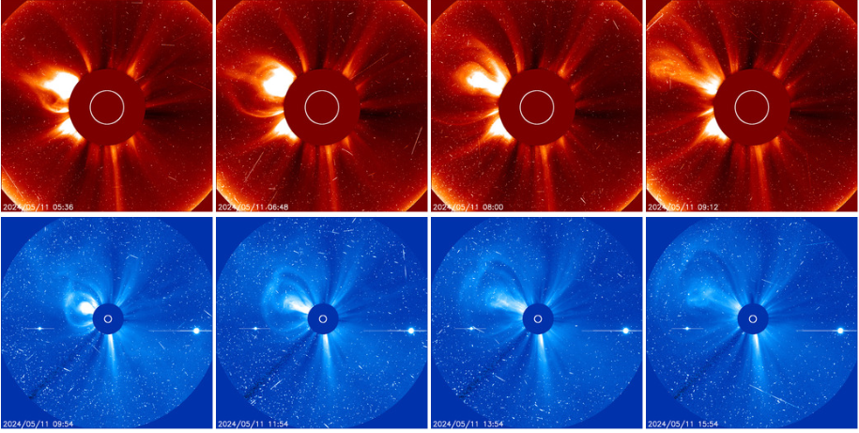

CME, ICME, MC and MO: a brief introduction to acronyms
CMEs (Coronal Mass Ejections) are the most powerful transients driven by the solar atmosphere in the interplanetary medium: they release up to 10¹³ kg of mass with velocities up to about 1000 km/s and associated bulk kinetic energy up to 10³³ erg
ICME are the counterpart in the interplanetary medium of the CME

Slide 3
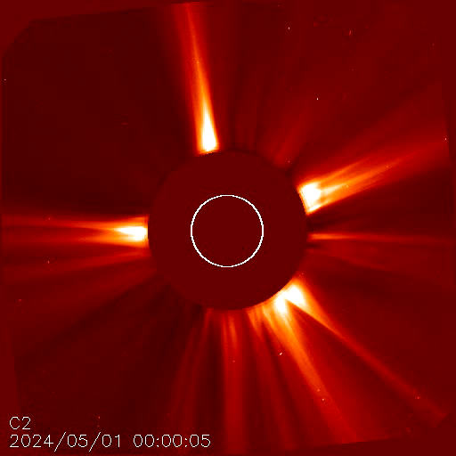
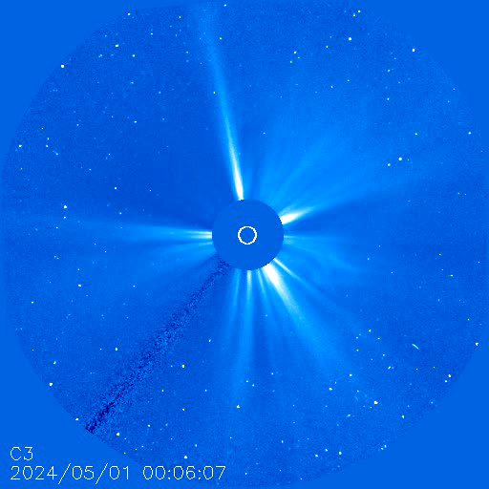
CME, ICME, MC and MB: a brief introduction to acronyms
CMEs (Coronal Mass Ejections) are the most powerful transients driven by the solar atmosphere in the interplanetary medium: they release up to 10¹³ kg of mass with velocities up to about 1000 km/s and associated bulk kinetic energy up to 10³³ erg
ICME are the counterpart in the interplanetary medium of the CME

Slide 4
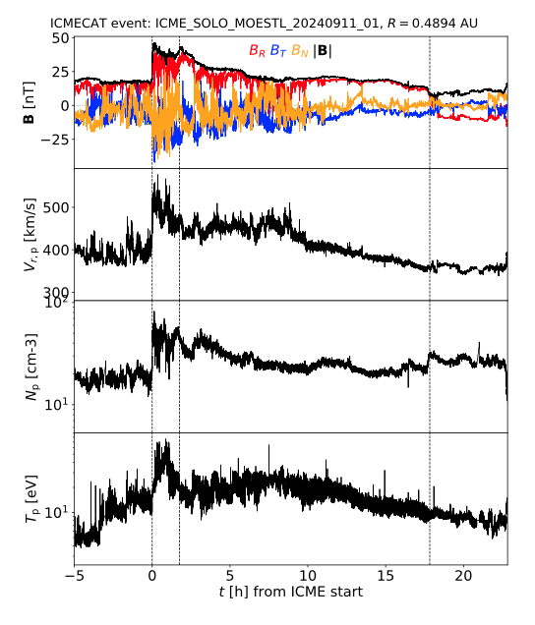
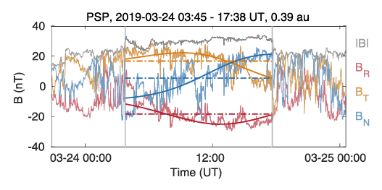
Forward shock
The counterparts in the interplanetary medium (ICMEs) are typically identified by the presence of a forward shock, followed by a sheath cloud.
Behind the sheath a more coherent structure appears, the magnetic cloud (MC) often assuming the shape of a twisted magnetic flux rope. If the structure is less evident is named magnetic ejecta or magnetic obstacles (MO)
Magnetic Cloud
Sheath
Sheaths and MCs are highly dynamical with large fluctuations at many scales
ICME SOLO obs @0.49 AU
Good et al, ApJL 2023

Slide 5
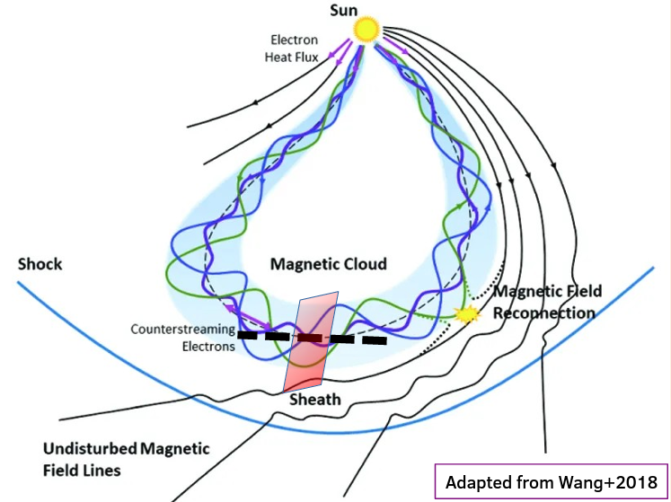
How to simulate local dynamic driven by global evolution in the heliosphere
Small scale (Earth-size) dynamic is driven by the local properties of the plasma (mean quantities and fluctuations)
Moreover the background solar wind fluctuations interact with the ICME at local scales
At the same time the global expansion of the structure themselves changes its characteristic length and time-scales as well as its coherence
Not enough resolution to keep local dynamics in a global simulation

Slide 6
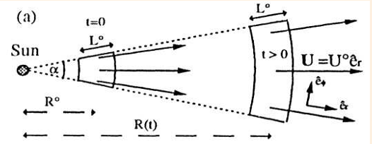
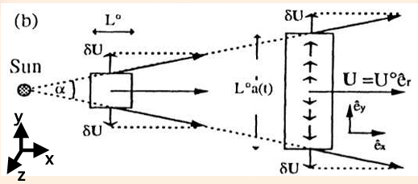
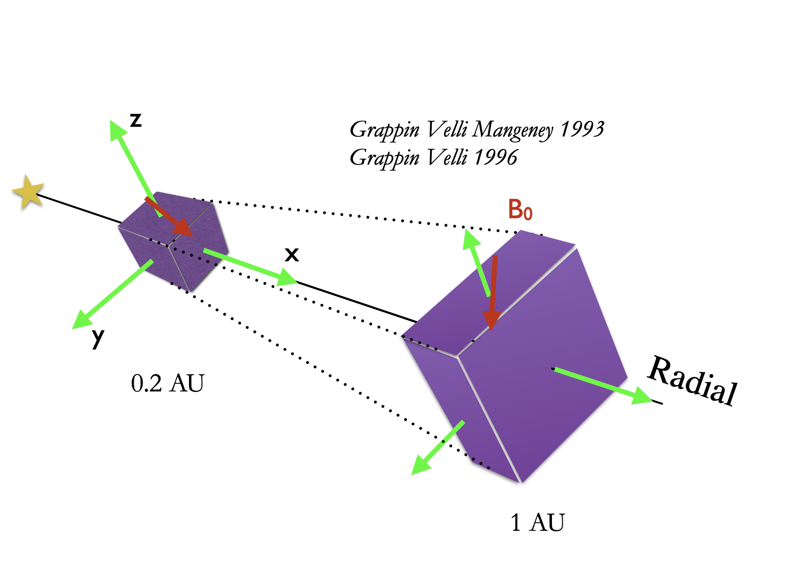
The Expanding Box Model strategy
The solar wind is a spherical flow where a parcel of plasma expands
A local approach can be used where apparent forces work on the fluid element stretching its volume and keeping a cartesian geometry (curvature effects neglected)
Mass flux, angular momentum magnetic flux and energy flux are conserved as the system, expand spherically

Slide 7
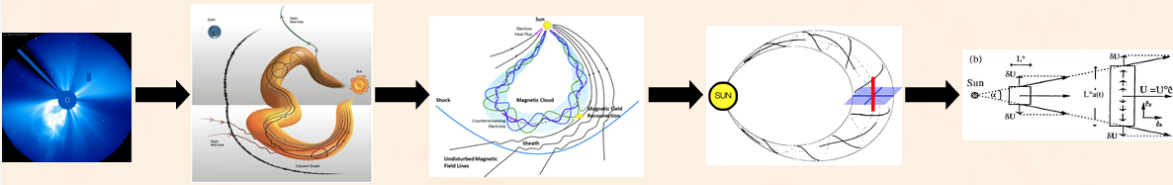
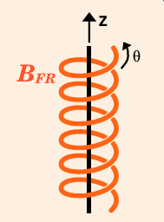
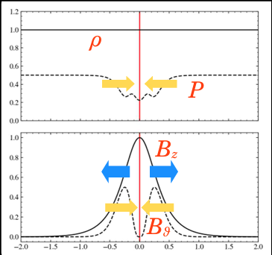
The ICME in the Expanding Box Model (Sangalli et al, A&A 2025)
We assume the ICME as a flux-rope expanding in the solar wind (2.5D invariant along the main axis of the FR)
Two main ingredients:
local equilibrium between gas pressure, magnetic pressure and magnetic tension
Spherical expansion

Slide 8
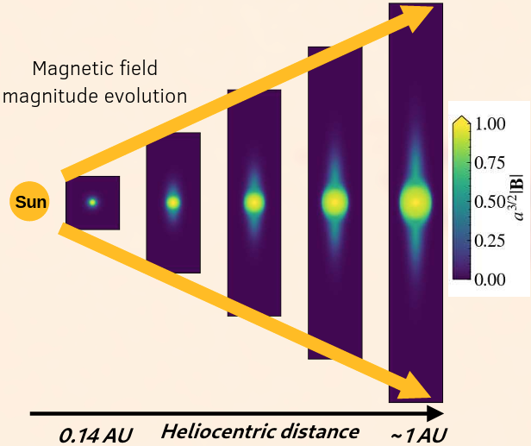
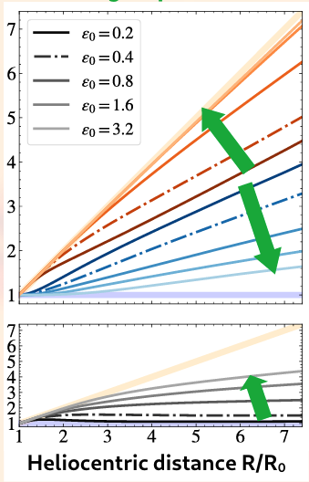
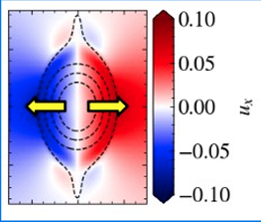
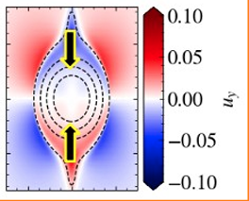
The ICME in the Expanding Box Model (Sangalli et al, A&A 2025)
Effect of the expansion (kinematic) and local dynamics (distortion)
The spherical flow perturbs the internal balance of forces
Over-pressure in the radial (stretching)
Over-tension in the transverse (compression)
Laminar case
Faster expansion -> more kinematic

Slide 9
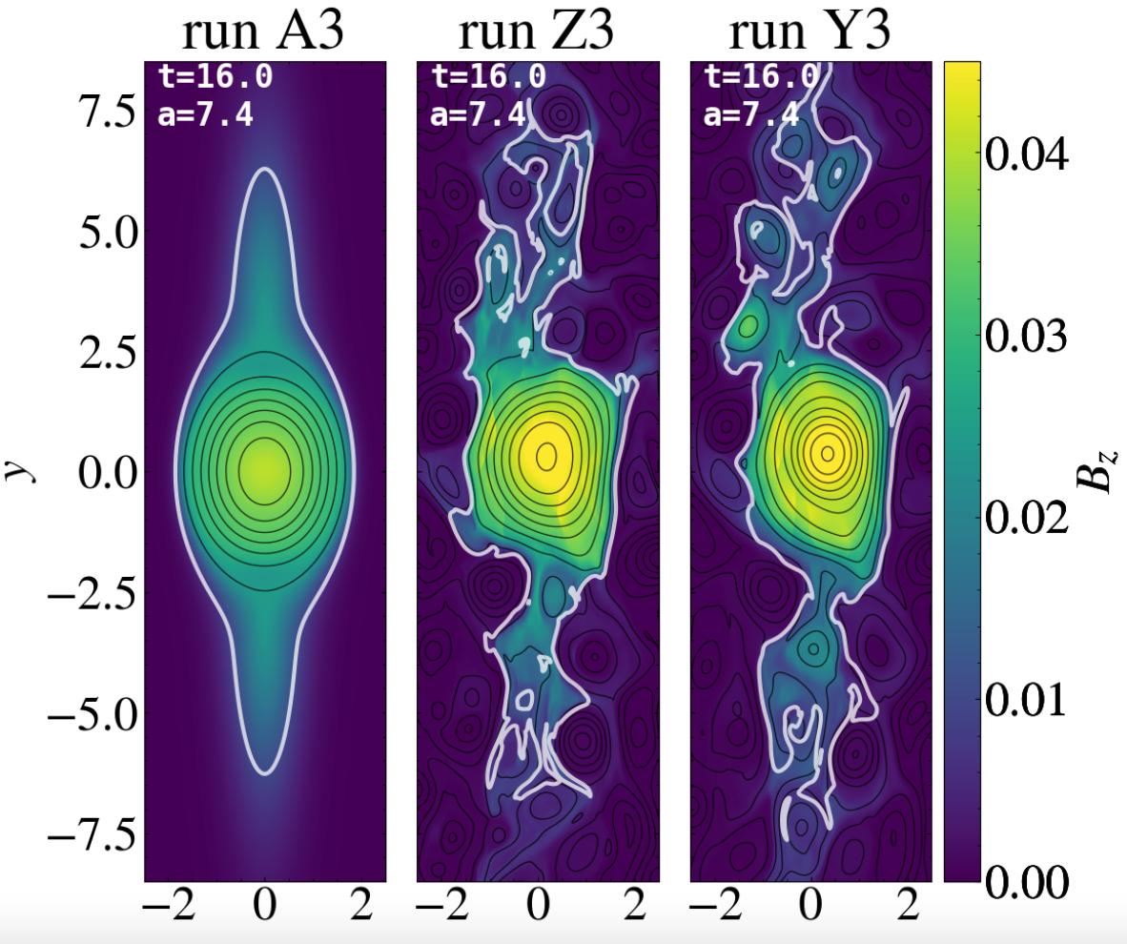
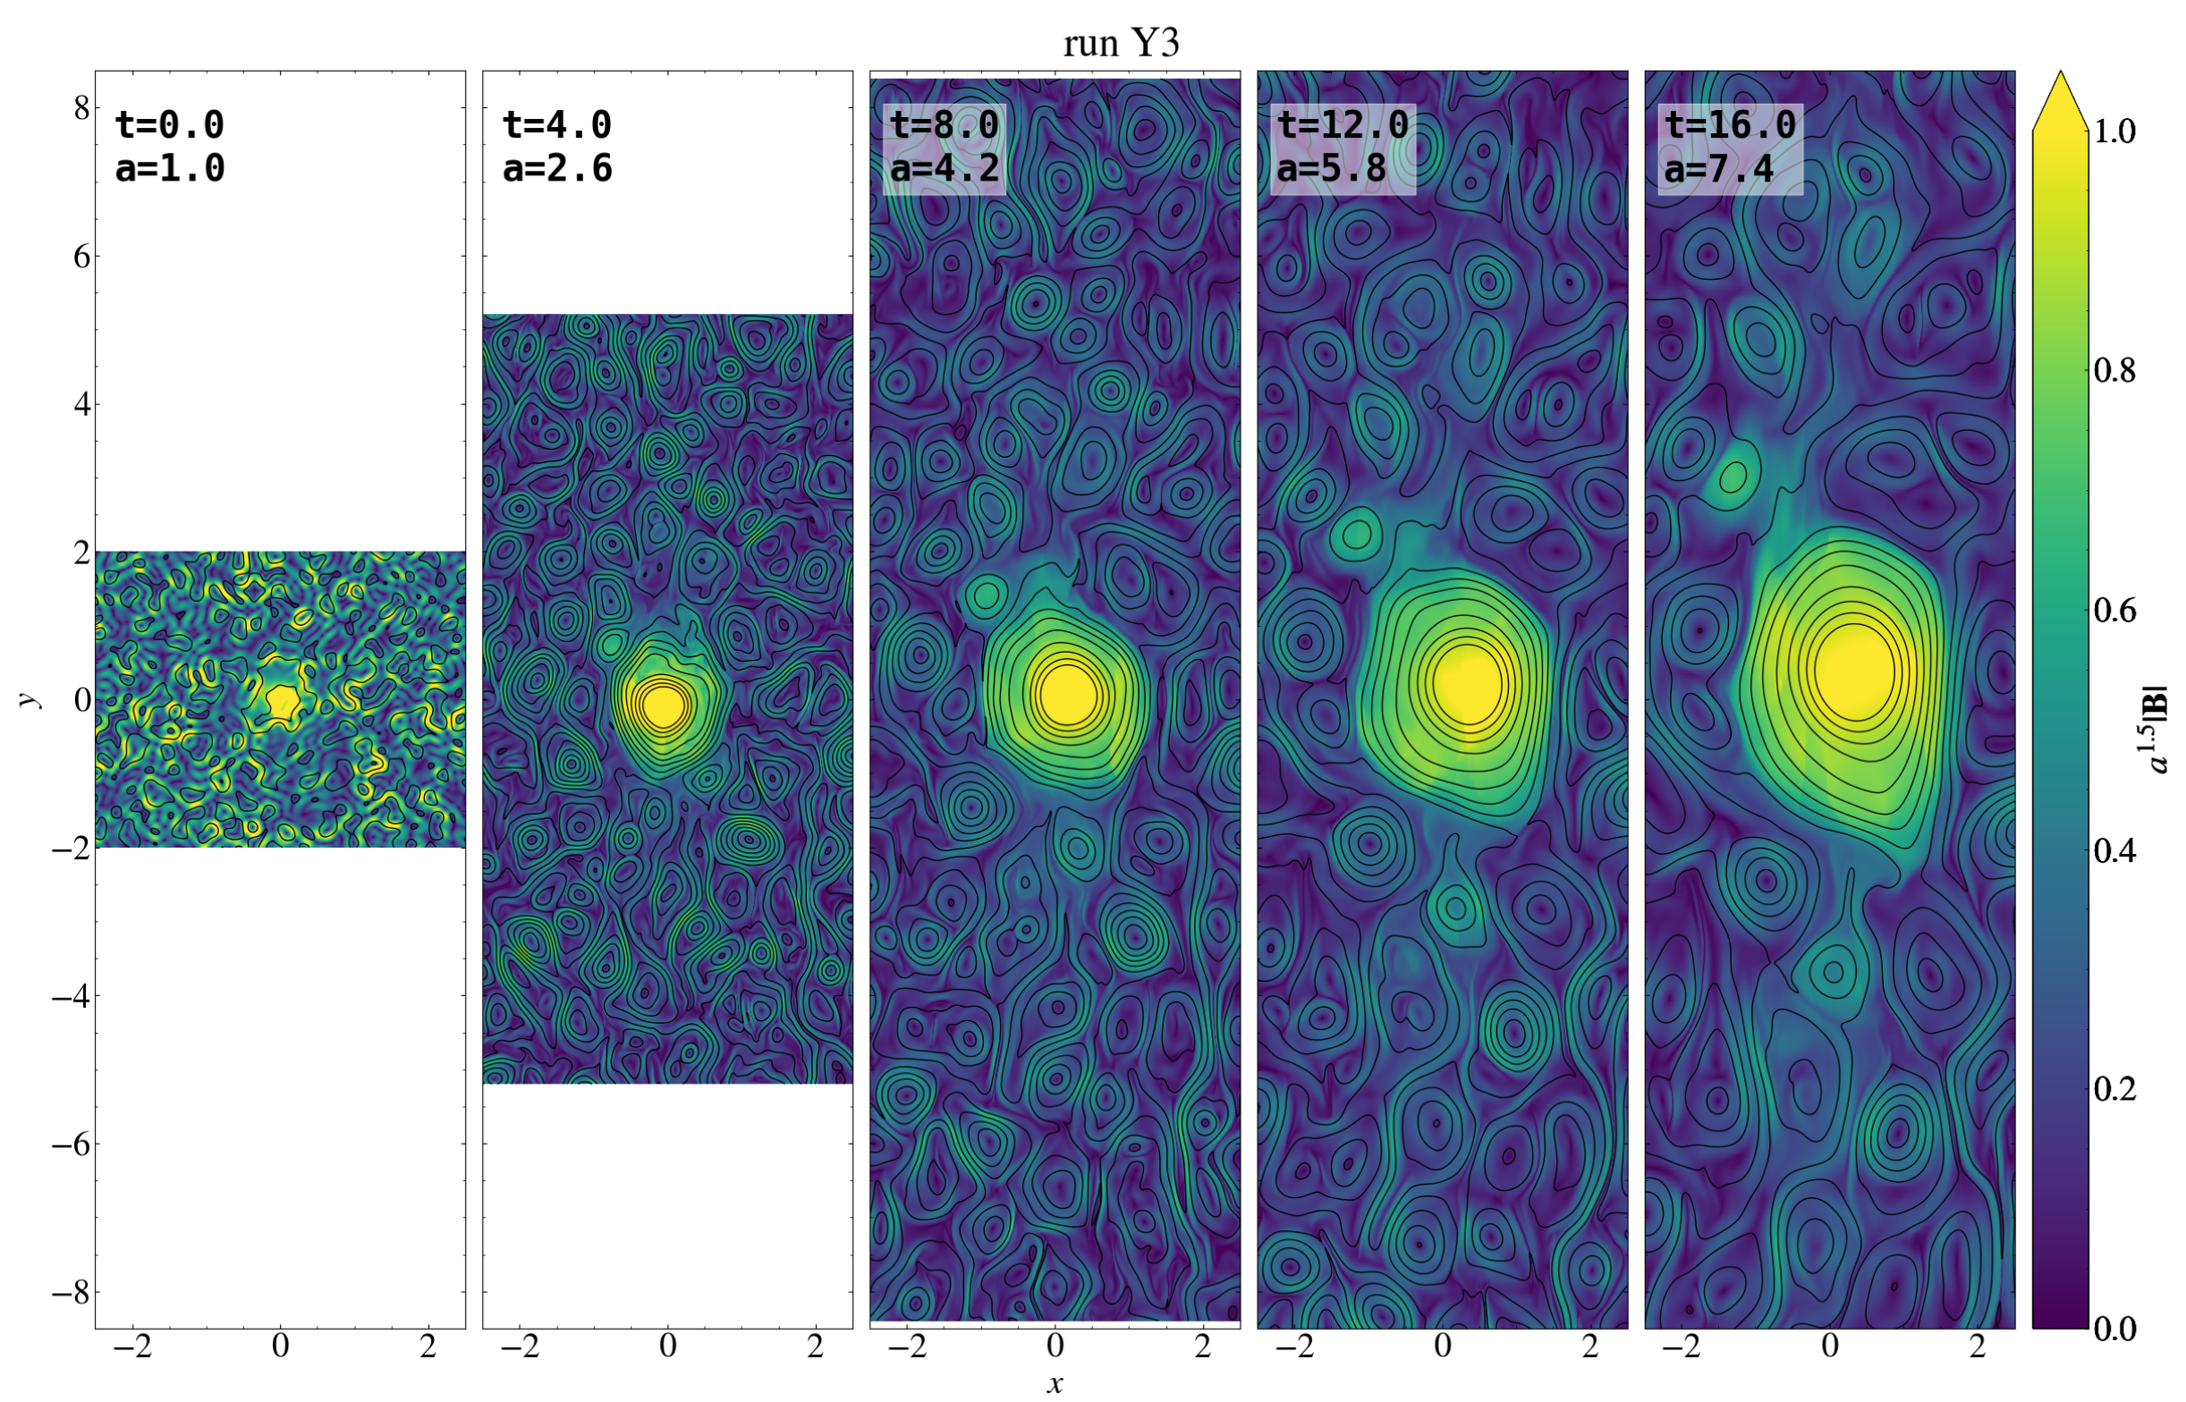
The ICME in the Expanding Box Model (Sangalli et al, A&A 2025)
Turbulent case
Turbulence changes the internal dynamics
Even in presence of strong turbulence the FR keeps its large scale coherency
CME evolution in an expanding and turbulent wind
Strong turbulence may favour detachment of secondary magnetic enhancements.

Slide 10
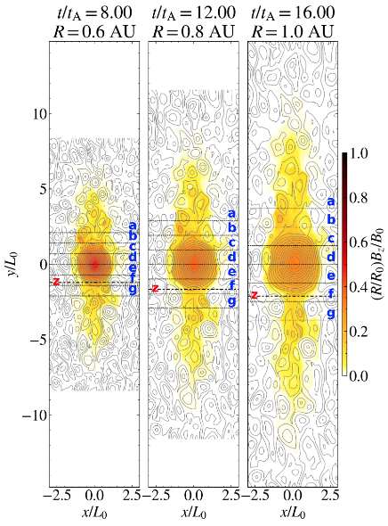
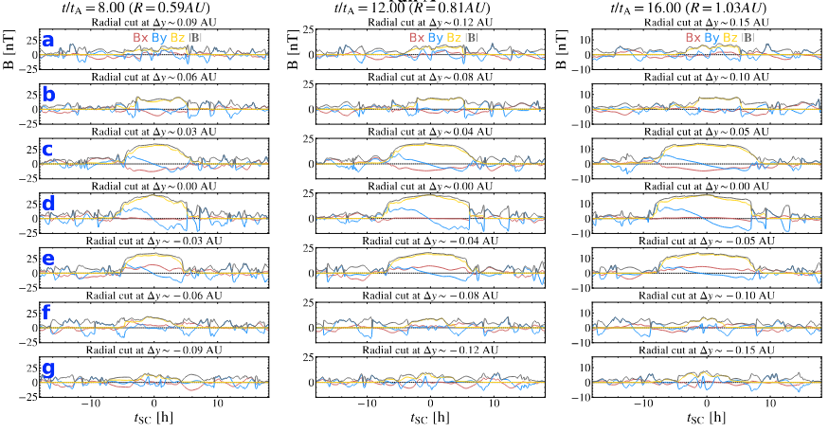
Virtual s/c analysis (Sangalli et al, in prep.)
A s/c colud cross the MC radially (x) at different impact parameters wrt main axis of the FR masuring:
A FR
A Magnetic enhancement with no FR
Almost none

Slide 11
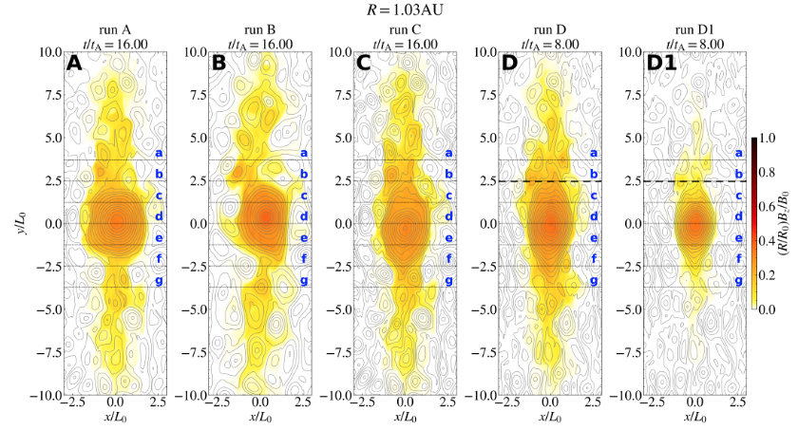
Virtual s/c analysis (Sangalli et al, in prep.)
Different values of turbulence, magnetic tension, MC velocity and confinement of the initial axial MF inside the FR can modify the distortion properties of the MC in the interplanetary medium
Faster and more confined
Reference
Turb ↑︎
Tension ↓
Faster
Stronger turbulence, less tension and faster expansions introduce larger deformations allowing the presence of signatures at larger distances from the center

Slide 12
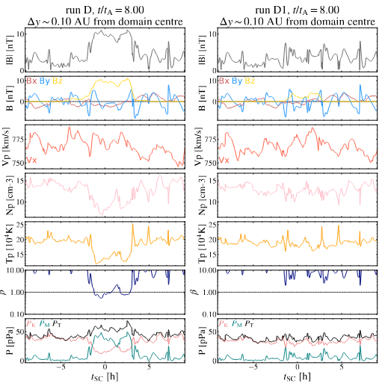
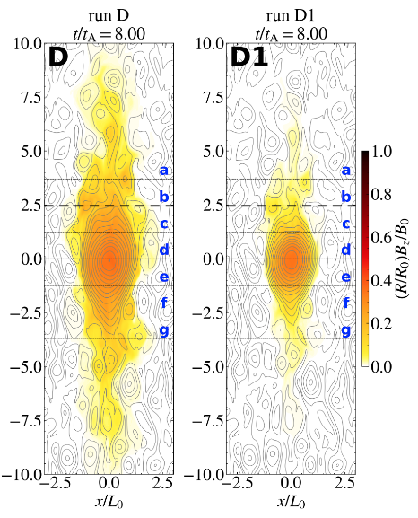
Faster and more confined
Faster
No-MO
MO
Reference
Turb ↑︎
Tension ↓
The presence of MO can be linked to the magnetic properties of the ejecta near the Sun. If the axial field is more confined at the beginning the MO are no more observed

Slide 13
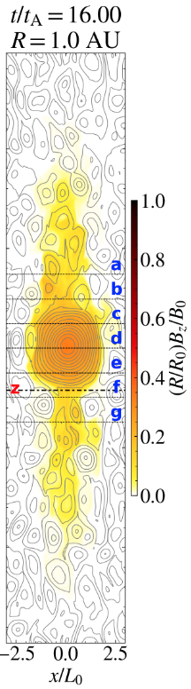
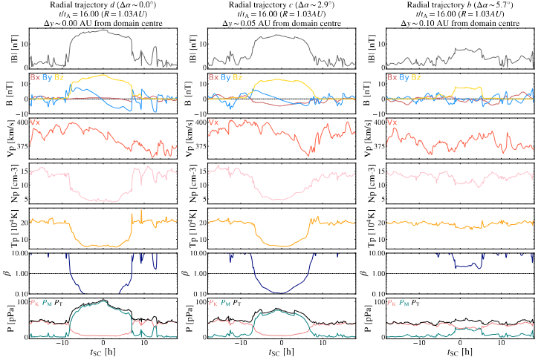
Virtual s/c analysis (Sangalli et al, in prep.)
At say 1 AU a FR or a MO can be observed depending om the impact parameter with respect to the central axis of the FR
A MO measurements can be the signature of a nearby stronger FR of an expanding ICME

Slide 14

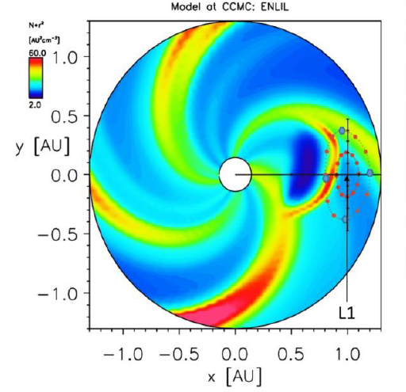
HENON
HEliospheric pioNeer for sOlar and interplanetary threats defeNce
HENON is a pathfinder mission (ASI-ESA) that will explore for the first time ever the DRO orbits bringing a payload tailored for Space Weather operations and science. ITALY: INAF,UNIFI,UNICAL, ARGOTEC, SPACEDYS
1 cubesat 12U that embarks a radiation monitor (REPE) together with magnetic field (MAGIC) and plasma instruments (FARADY CUP)
Using DRO orbits will remain long time upstream of the Earth at a distance much larger than L1 ➔ alerts much earlier (~5 h)
Lunched as Piggybag toward L2 with ESA-PLATO mission (early 2027)
Final orbit at 0.085 AU after about 1 year from the lunch
Depending on HENON results a multiple CubeSat mission can be taken into consideration.

Slide 15
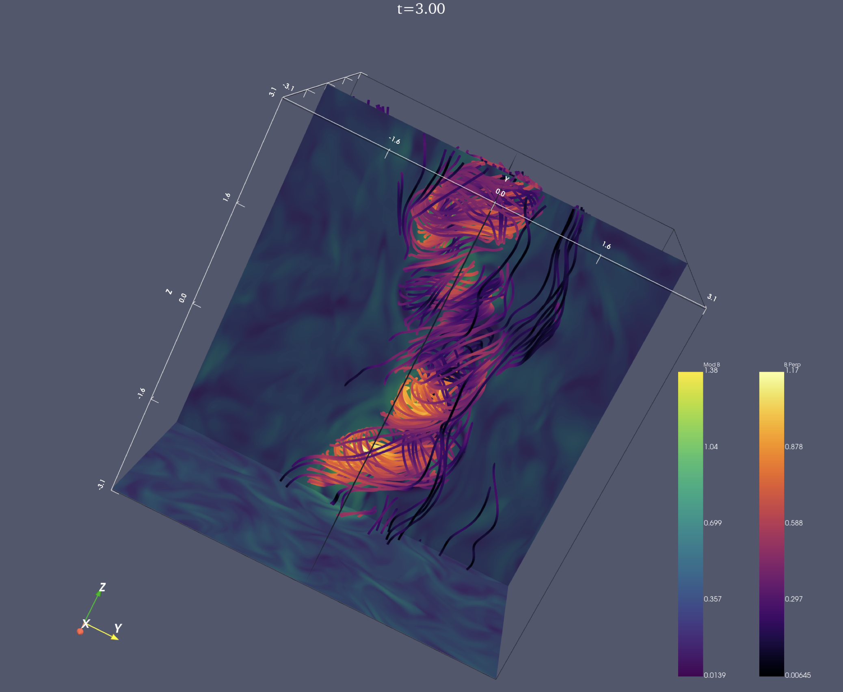
Work in progress 3D analysis
Full 3D simulations could introduce
Finite coherence length along the main axis of the ICME
Deformations due to different interactions with the backroung turbulence
Deformations due to the self-destabilization (kink-sausage instabilities)
Wind shears driven deformations

Slide 16
Conclusions
A magnetic flux rope embedded in a spherical flow develops an internal dynamics, which provide a radial expansion as observed in MC
Strong and relatively long-lived turbulence alters the flux-rope dynamics but it keeps its coherence
Fluctuations may produce the detachment of secondary flux ropes
Virtual S/C crossing shows that the observation of MC or MO could be related to the impact parameter of the s/c with respect the main axis of the MC flux-rope ➔ better interpretation of the data & forecast predictions for future missions (e. g. HENON)
The presence of MO can be related to the initial (launch) condition of the CME in the interplanetary medium

