Slide 1

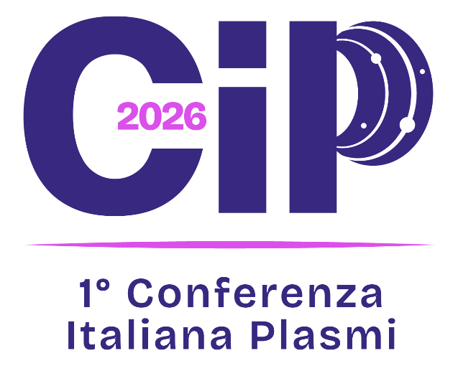
Space Propulsion Unit
Overview of CIRA development in Plasma Electric Propulsion
F. Battista, M. Panelli, D. Ricci, G. Coppola, P. Natale, M. Fragiacomo
CIRA (Italian Aerospace Research Centre) - Via Maiorise, 81043 Capua (CE), Italy, www.cira.it
Feb. 4th, 2026, ENEA Frascati, IT

Slide 2
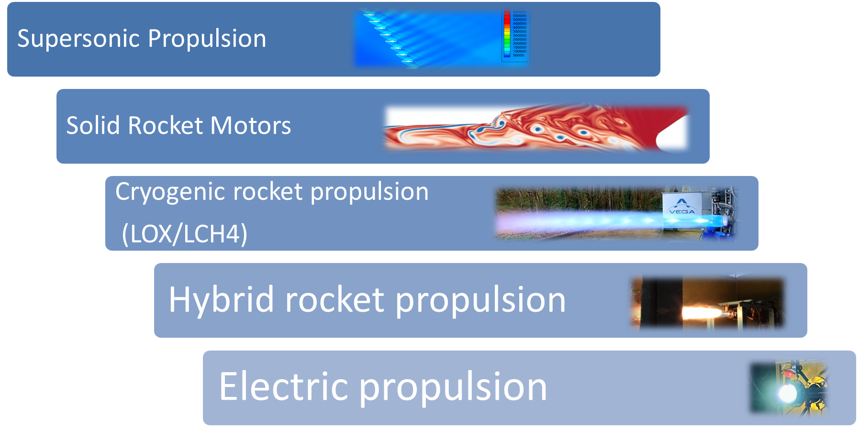





























Space Propulsion Unit
Technical competencies that covers different phases of projects related to propulsion systems development from requirement definition, advanced analysis (CFD,PIC,FEM), design of systems and subcomponents, manufacturing process development and testing
Experience gained since 2011 thanks to the participation at national and international cutting-edge projects
Manage Electric Propulsion Laboratory
Research Fields
Main Partnerships and Cooperations
Hosted about 12 Master students and 3 PhD students per year

Slide 3
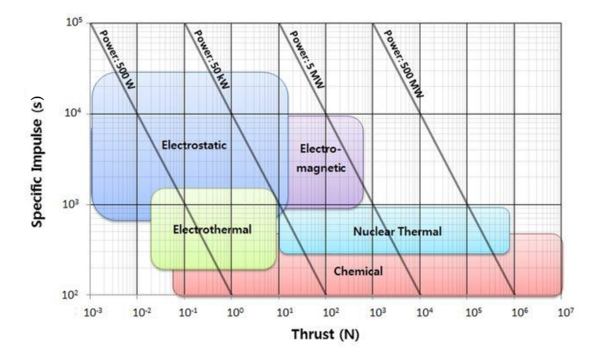
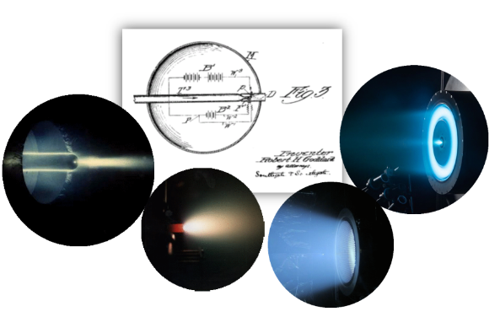
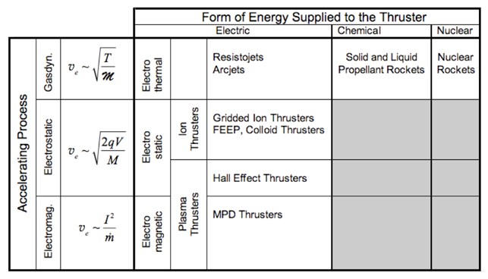
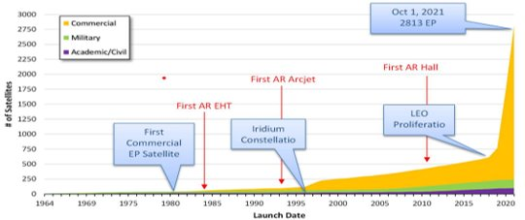
Background: Electric Propulsion
Operates by using electrical energy to accelerate particles, which in turn generates thrust. It reaches very high levels of specific impulse and low thrust
Commonly used for missions requiring high efficiency over long durations, such as satellite station-keeping and attitude control, deorbiting or space exploration.
Electric Propulsion
ElectroThermal
ElectroStatic
ElectroMagnetic
(Jhan, R.G., Physics of Electric Propulsion, McGraw-Hill, New York, 1968)
(Frongello, B.R. et al. Spacecraft Electric Propulsion at an Inflection Point, AIAA 2021-4151)
Notes:
Main advantages ​
High specific impulse ​
High efficiency (fuel and mass savings)​
Long running times or large radii of action​
Multiple ignitions​
High accuracy of thrust, modulation​
Re-usability ​
Easiness of thrust distribution​
Compactness of lay-out
Main disadvantages​
Very low thrust ​
Acceleration takes time​
Potential life time issues

Slide 4
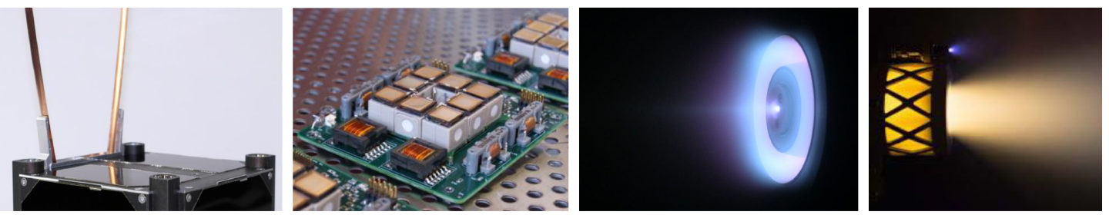
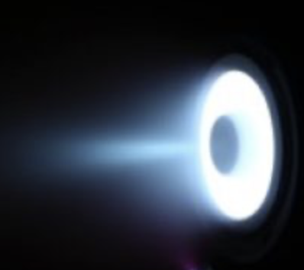
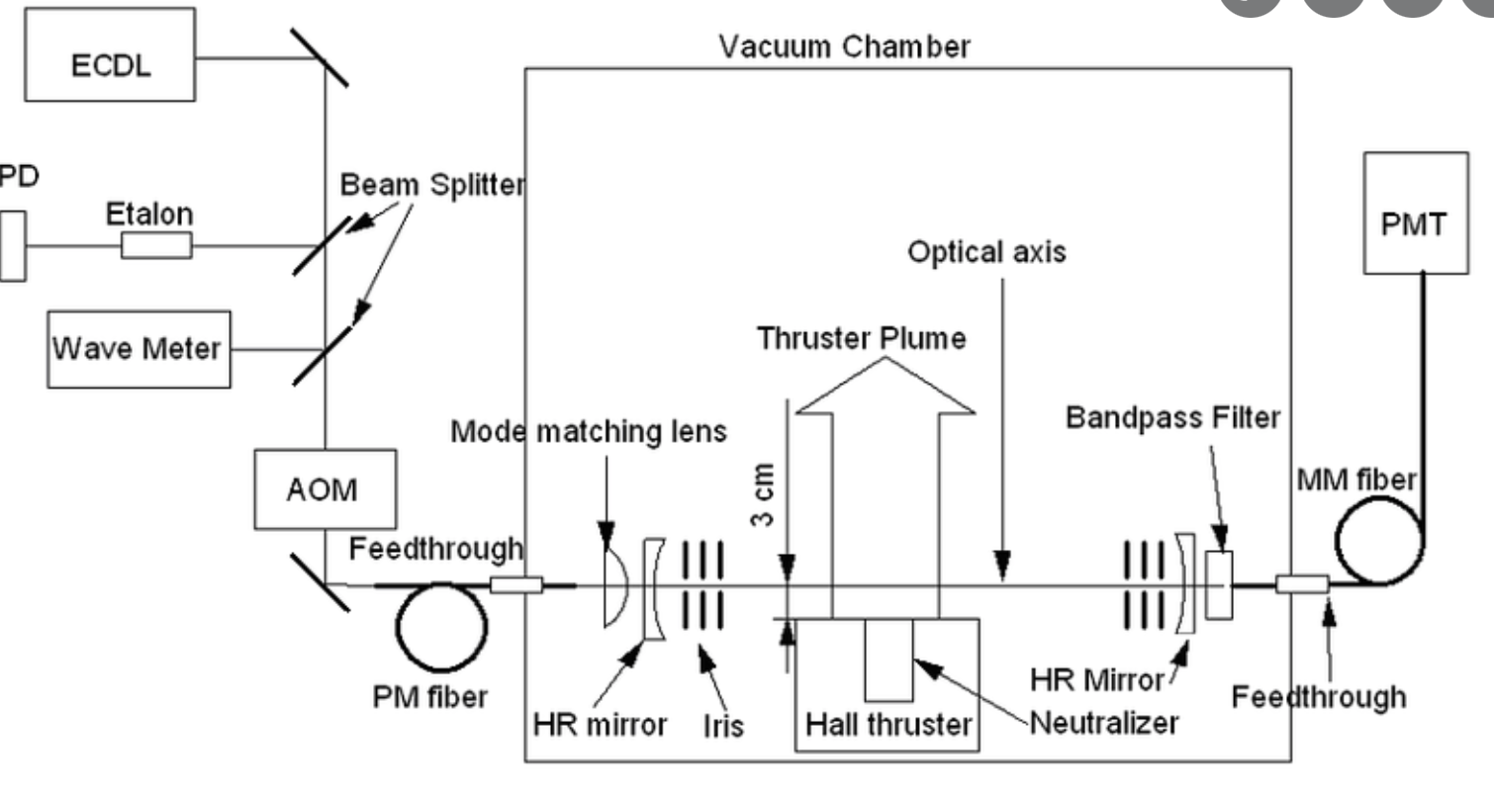
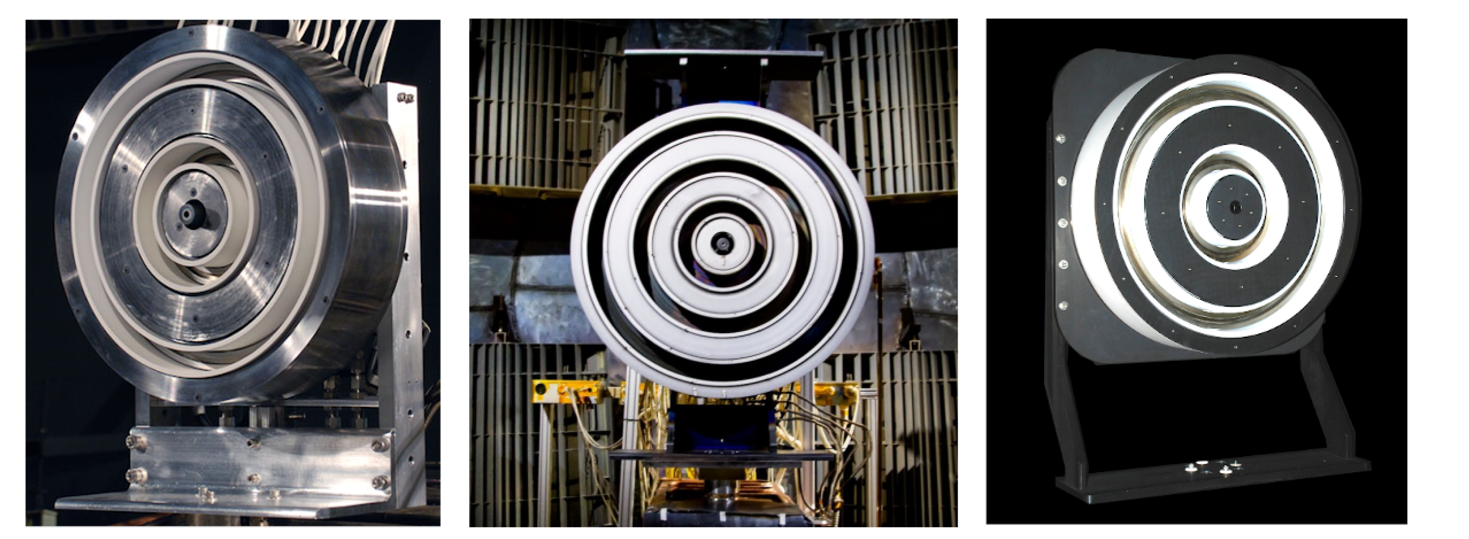
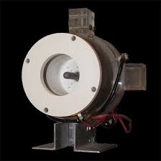
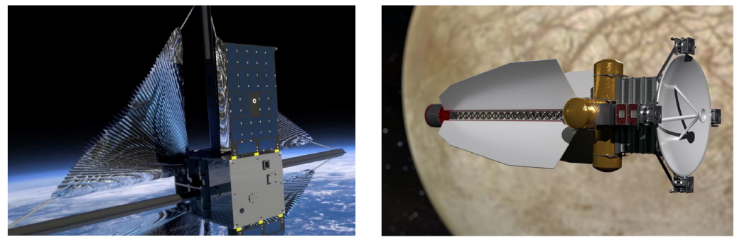
Programma Nazionale di Ricerche Aerospaziali
Investments in Electric Propulsion
Low Power Electric propulsion (LPEP)
images from open literature
Facility upgrades
Diagnostics
Design & Analysis
Upgrade of current facility (MSVC) capabilities and availability
Small vacuum chamber (SSVC) for subsystem development
New closed clean area for integration
  Cavity Ring Down Spectroscopy
  DLIF system
  New Thrust stands
  New Probes
Consolidation of thruster testing activities
New experimental thrusters
Advanced numerical code
Design and realization of a brand new simulator devoted to high power thrusters (>10 kW)
High Power Electric propulsion (HPEP)
Development of experimental thrusters and diagnostic for research purposes
The X2, X3, and N30 nested Hall thrusters
(Jorns, B. Future Directions for Electric Propulsion Research, Aerospace 2020, 7, 120)
Innovative Technologies (MATI)
To improve TRL of innovative solutions
To explore Disruptive technologies in Electric Propulsion
Notes:
In particular, going in detail for each project LPEP is devoted mainly to the upgrade of the MSVC laboratory and to further develop small scale hall thrusters; HPEP is mainly focused to the realization of a Large scale facility and MATI is the project devoted to to investigate alternatives for electric propulsion and to improve low TRL solutions.

Slide 5
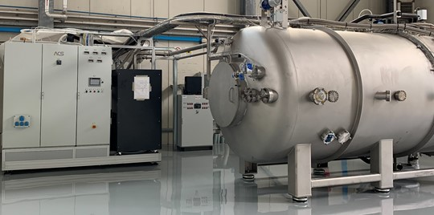
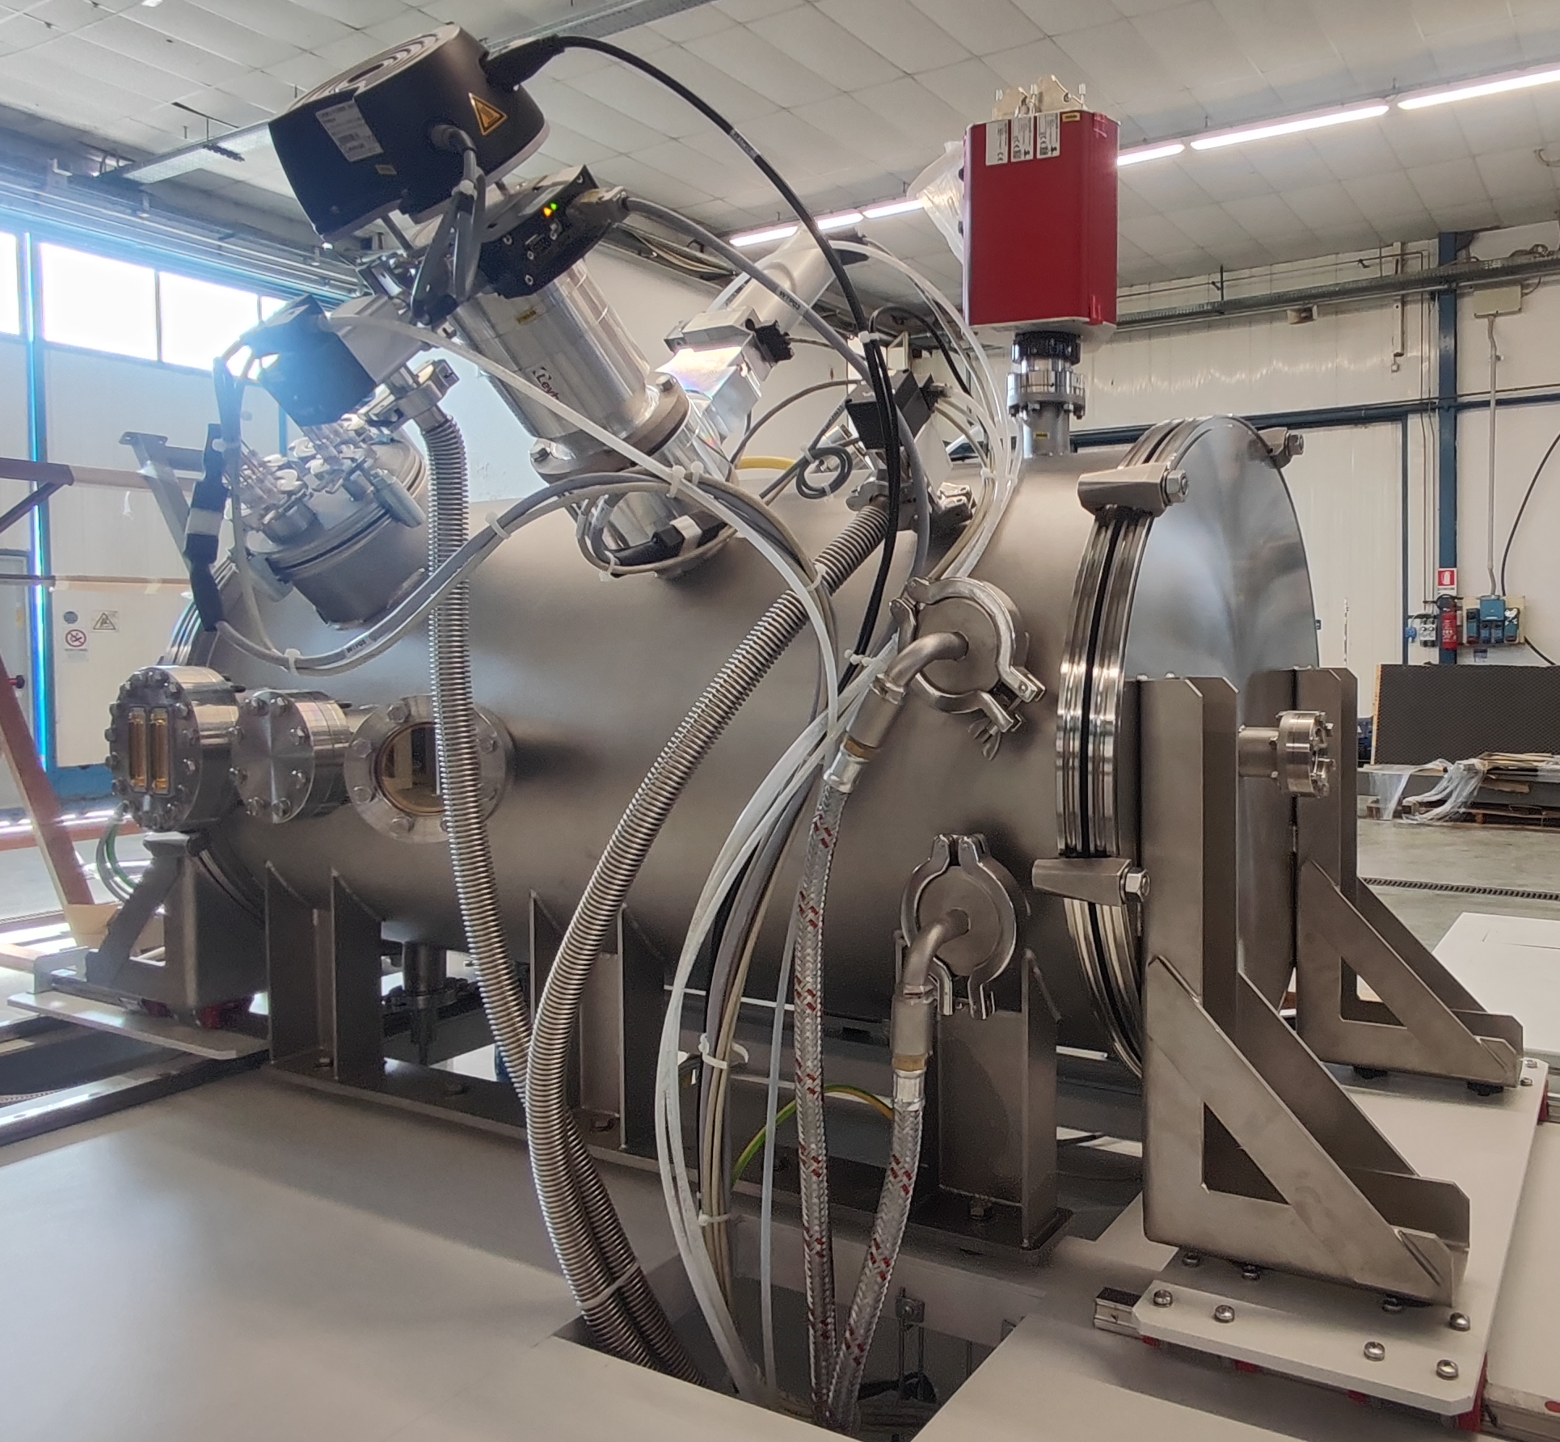
Electric Propulsion Laboratory
Main features
Medium Scale Vacuum Chamber (MSVC)
AIMS
Enabling the start of planned R&D activities on engines up to 5 kW (to improve experimental, design and analysis capabilities; to test advanced diagnostics; to research on innovative materials, propellants, technologies; to evaluate performance, to characterize plume, to perform lifetime tests)
Integrating test infrastructures, currently available in Italy and commercially oriented, with an advanced facility
Promoting the Cooperation with other National and International actors
SSVC (Small Scale Vacuum Chamber)
AIMS
Conceived for R&D activities on cathodes and micro-propulsion
Installation: end of 2025
MAIN FEATURES
Dimensions: 0.5 m- diameter x 1.0 m-long
Pumping speed: 8000 l/s (Xe), one cryopanel
Vacuum Performance: 1 e⁻⁷ mbar (ultimate pressure)
MAIN FEATURES
Dimension: 2 m-diameter x 4.5 m-long
Pumping speed: up to about 80,000 l/s (Xe) and fully cooled
Vacuum Performance: 5e⁻⁸ mbar (ultimate pressure); < 4.0e⁻⁵ mbar (working)

Slide 6
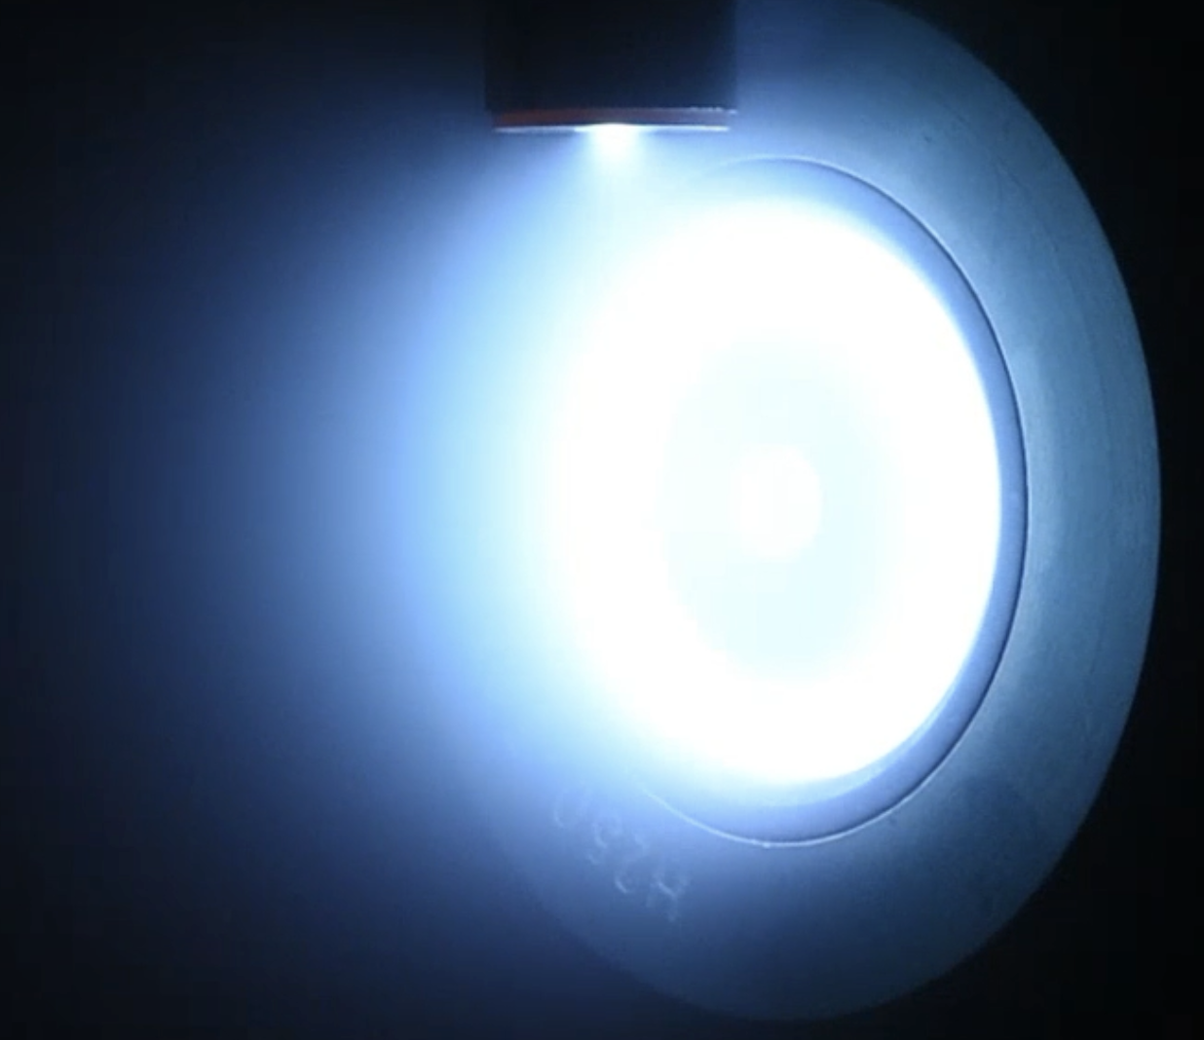
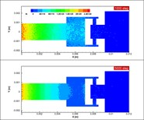
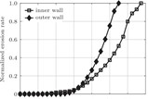
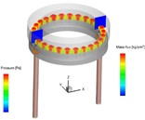
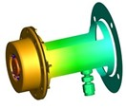
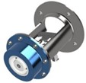
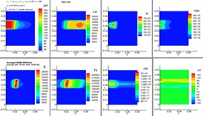
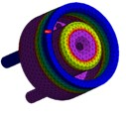

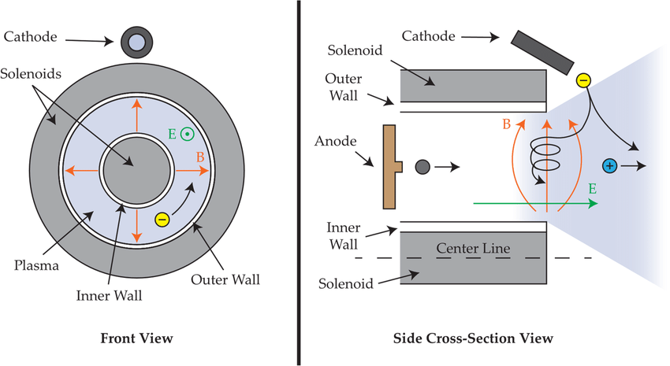
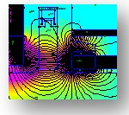
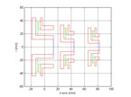
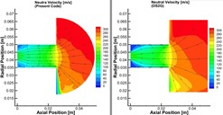
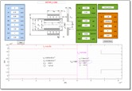
Development of Laboratory Hardwares
Hall Effect Thruster (HET)
The Experimental Thrusters line has been established to improve knowledge on design and modeling aspect of electric propulsion
Competences cover the activities from design to AIT and post-test investigations
Some HARDWARE has been designed and manufactured to verify design and manufacturing processes (thrusters and cathodes)
Proprietary design NUMERICAL TOOLS have been developed
Gas Dynamic design
Assmbly Manufacturing and integration
Plasma modeling
Magnetic field modeling and optimization
Thermo-structural modeling
Erosion phenomena modeling
Testing
Scaling and pre-design

Slide 7
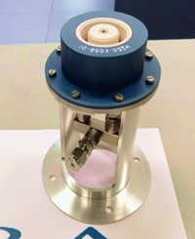
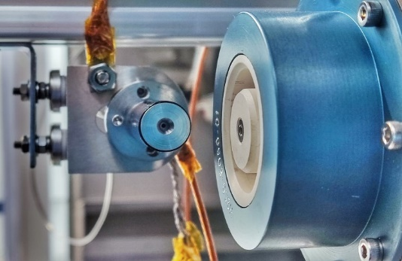
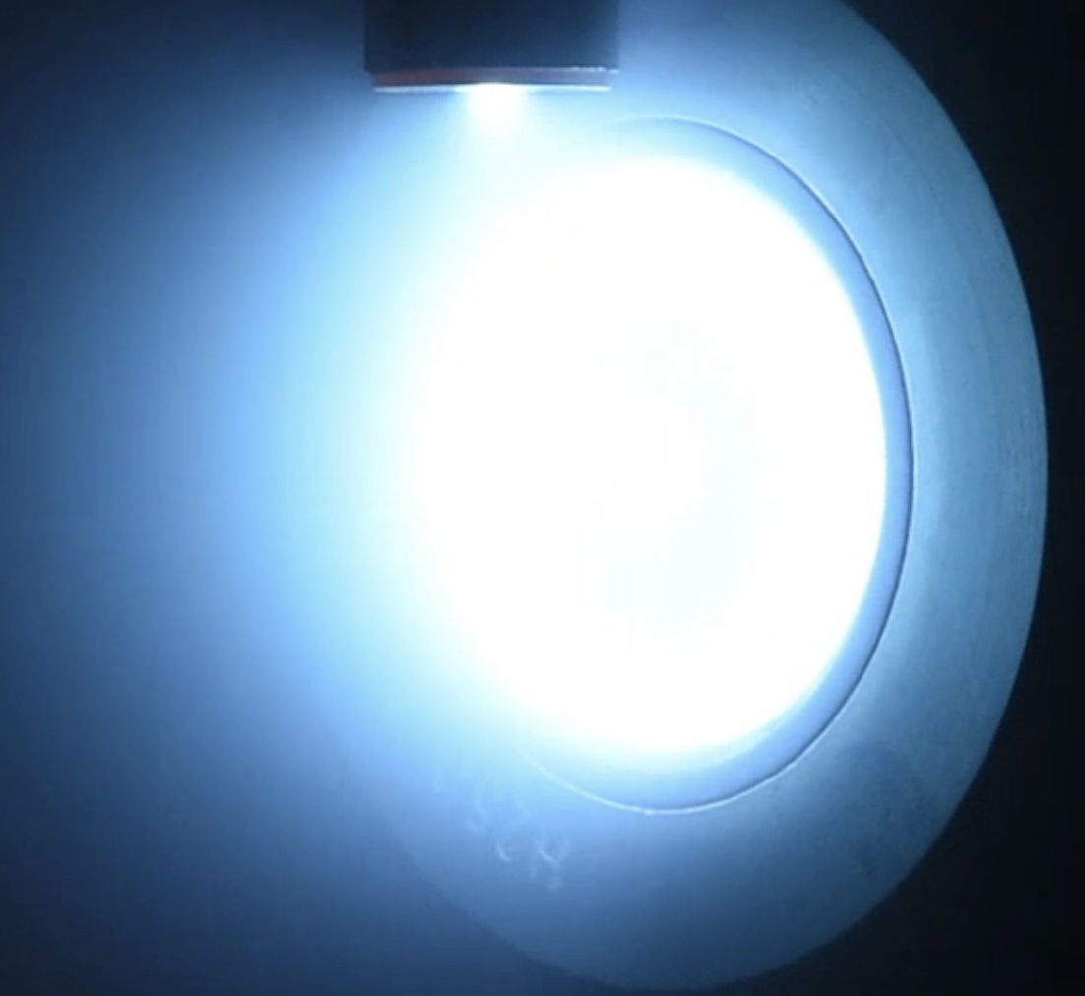
Development of Laboratory Hardwares
CRHET-250
CRHET-250 is a 250W Hall Effect Thruster (HET), designed and manufactured by CIRA. Three Units, namely MarK (MK) are currently available and further two ones will be shortly ready after configuration optimization analyses.
CRHET-250
Discharge Power | 250 W
Thrust | 11 mN
Specific Impulse | 1250 s
Propellant | Xe/Kr
Cathode Location | External
Thruster Mass | 0.45 kg
MK1
  About 100 ignitions
  > 100h of cumulated firing time
  At least 50h of continuous firing
MK2
  currently under test
MK1 [1] Experimental Results @ 0.6 mg/s
Discharge Power | 150W-300W
Thrust | 7.5 -10 mN
Specific Impulse | 1300-1550 s
Propellant | Xenon
MK3
Experimental Campaigns goals
Ignition strategy
Optimization of cathode position
Electrical Characteristics Study
Performance Tests
Improvement of thrust balance arrangement
Endurance tests
Performance optimization through diagnostics
On going
Completed
MK1: experimental set-up
MK2: High ionization regime

Slide 8
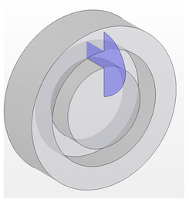
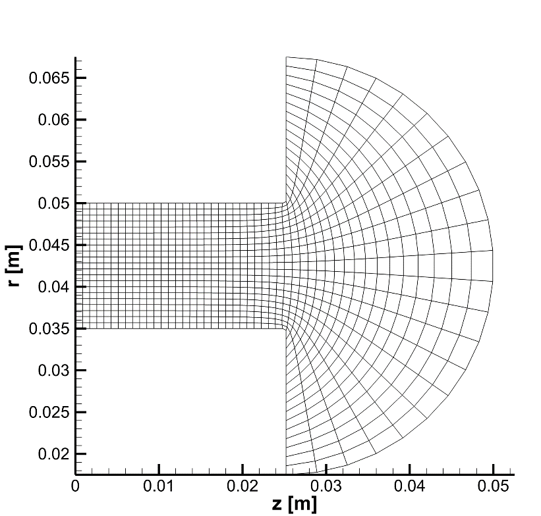
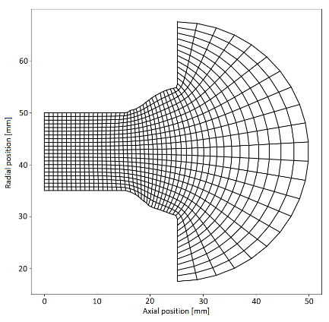
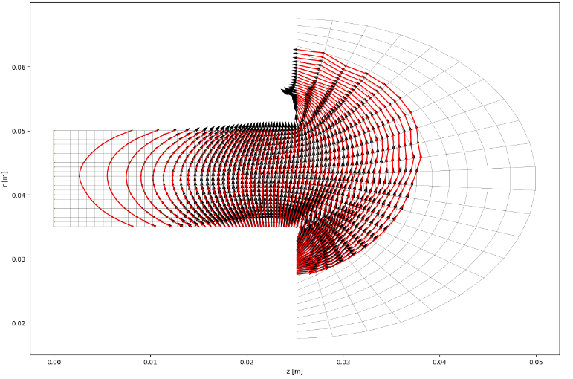







NUMERICAL ACTIVITIES
HYPICFLU2 (HYbrid Particle-In-Cell + FLUid) [4]
Automatic Elliptic PIC Mesh Generator
2D axis-symmetric (radial-axial)
Unsteady
Domain: channel + near plume (semicircular)
PIC: neutrals and ions (only primary ionization)
  Wall BC: neutrals diffuse-reflect; ions recombined
Fluid approach: electrons – thermalized potential
  Dirichlet: (Te, V) @ cathode & Anode (Te)
Wall Sheath: Charge Saturation Regime included
Bohm Forcing Condition at domain boundary
Neglected collisions: neutral-neutral, ion-neutral, ion-ion, elettron-electron.
Semi-empirical Electron Mobility model:
Parallelized (mpi4py)
Domain
Possibility to mesh domains with eroded channel wall’s profile
$$k_{out}$$
$$μ_{e}=\frac{m_{e}(ν_{en}+ν_{ei}+ν_{w} )}{e B^{2}}+\frac{k}{16 B }$$
$$k_{in}$$
$$θ$$
$k=f(k_{in},k_{out},θ, z^{∗})$
$$z^{∗}$$
Notes:
Stiamo lavorando ad un modello di mobilità elettronica diverso.

Slide 9
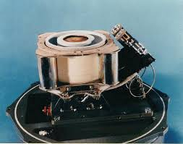
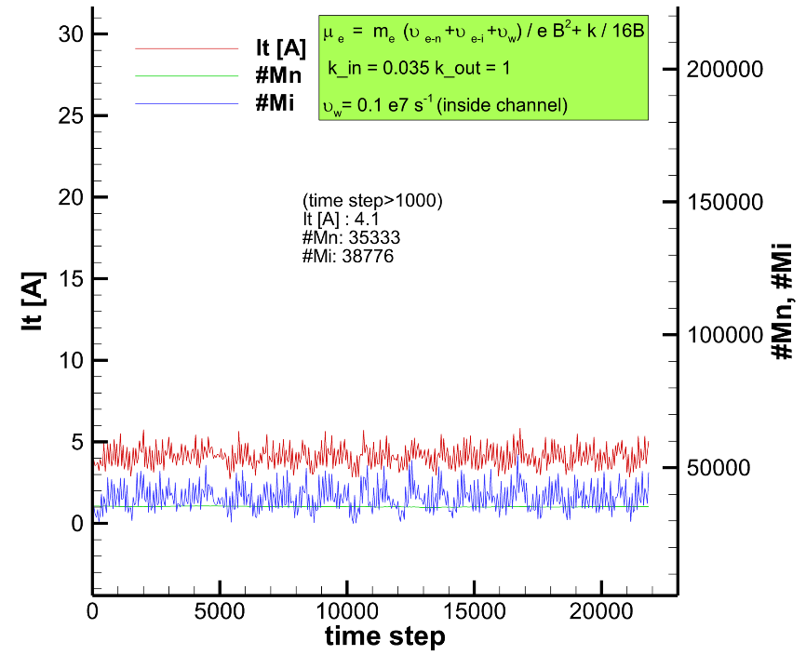
NUMERICAL ACTIVITIES
HYPICFLU2 [4] - Validation: SPT100
 | EXP. [2] | NUM. [3] | HYPICFLU2 [4]
Discharge Current [A] | 4.5 | 4.5 | 4.1
Power [W] | 1350 | 1350 | 1207
Ion exhaust velocity [km/s] | 15.7 | 17 | 16.2
Mass flow rate [mg/s] | 5.29 | 5 | 4.67
Specific Impulse [s] | 1600 | 1733 | 1646
Thrust [mN] | 83 | 85 | 75
Efficiency [%] | 50 | 55 | 50
Computational Time
22000 timesteps completed in 5h
Using 1 node (36cpus) of CIRA cluster (Turing): dual socket Xeon E5-2697 v4 @ 2.30GHz tot: 1440 core
Nominal Operating Point [2]
Outer radius [mm] | 50
Inner radius [mm] | 35
Channel length [mm] | 25
Max magnetic field value [G] (coils) | 180
Mass flow rate (Xe) [mg/s] | 5.3
Discharge Voltage [V] | 300 V
Discharge Current [A] | 4.5
Discharge Power [W] | 1350
Specific impulse [s] | 1600
Efficiency [%] | 50
Low current (i.e. power) due to low mobility with respect the reference; (improvement cab be achieved by modifying the mobility function empirical parameters)
Low Thrust due to lower ion flow rate at the cathode line
Breathing mode freq.
20 kHz

Slide 10
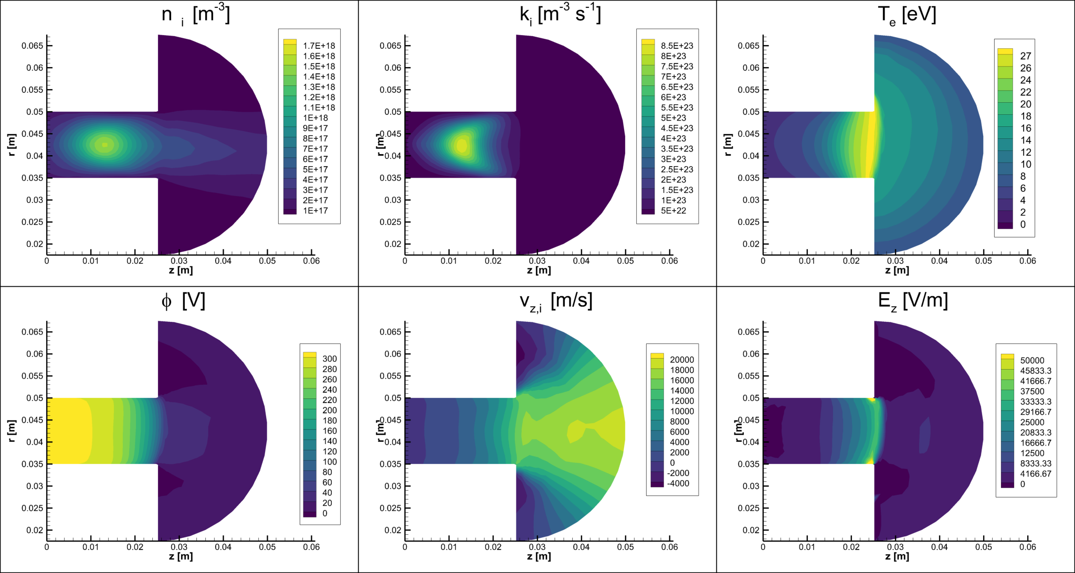
NUMERICAL ACTIVITIES
HYPICFLU2 [4] - Validation: SPT100
Time averaged [time window 1ms] contour plots of:
plasma density (n_{i}): peak within the channel
electron temperature (Te): peak toward channel exit
potential (ɸ): sharp decreasing at the channel exit

Slide 11
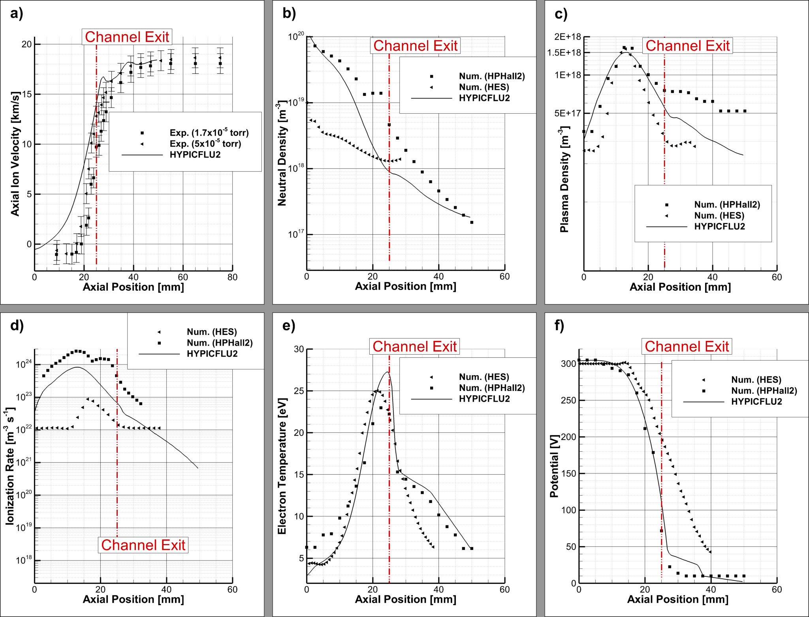
NUMERICAL ACTIVITIES
HYPICFLU2 [4] - Validation: SPT100
Profiles extracted along the mean centerline
Peak similar to HPHall2 [3]/HES [5]
Lower density in the plume (HPHall2)
Trend similar to HPHall2
Peak higher than HPHall2/HES

Slide 12
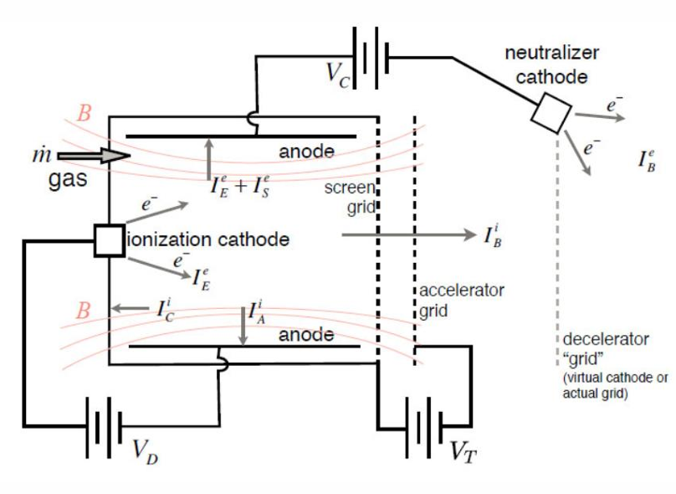
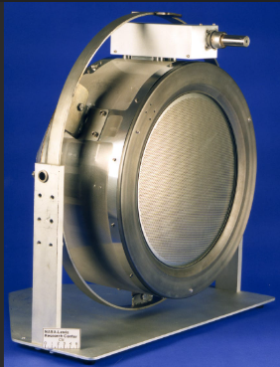
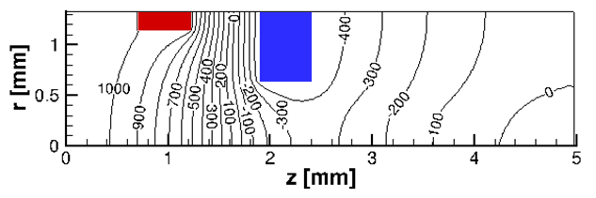
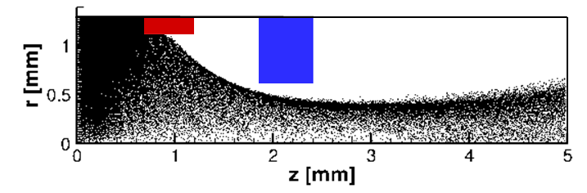
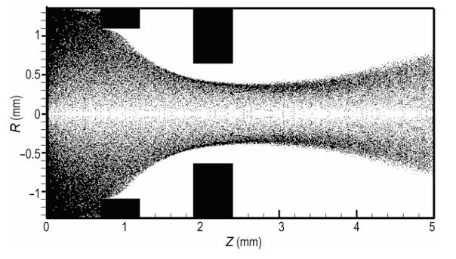


NUMERICAL ACTIVITIES
Gridded Ion Thruster (GIT) Optic System
$$φ_{sc}=1000 V$$
$$φ_{ac}=−500 V$$
Plasma Potential (V)
Optic System
Ion velocity
GosPIC: Hybrid Particle-In-Cell approach [6]
Representation of ions by macroparticles
Modeling of electrons as an isothermal fluid
Assumptions
Xenon ions
2D axisymmetric domain with a uniform mesh, representing half of a single aperture of a grid set
Complete ionization of plasma
No charge-exchange ions (CEX)
Metallic grids
Reference Test Case
(Zhong et al., Numerical Simulation of Ion Extraction Through Ion Thruster Optics, Plasma Science and Technology. 2010)

Slide 13
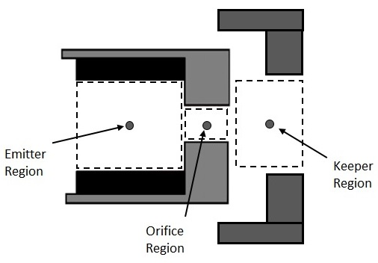
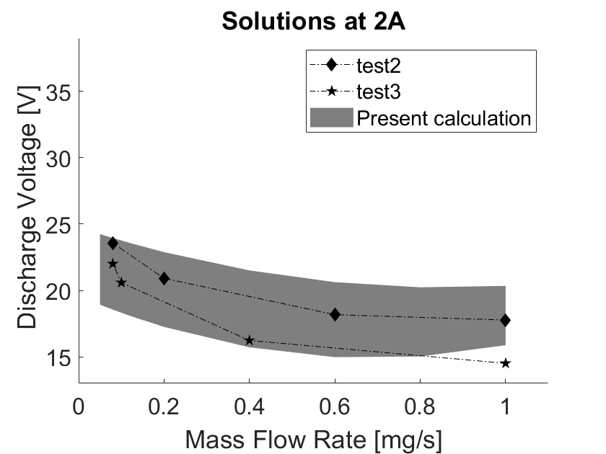
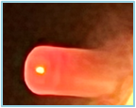
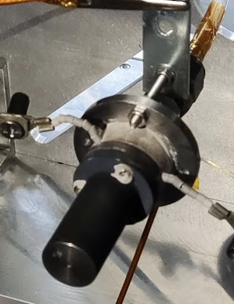
NUMERICAL ACTIVITIES
Orificed Hollow Cathode Reduced Plasma Model (0D)
Particle Swarm Optimizator (PSO) used to solve non linear system of equations for plasma
CR-CAT Orificed Hollow Catode [7]
CR-CAT
Discharge Current | 1 A
Discharge Voltage | 14.2 V
Mass Flow Rate | 0.097 mg/s
Propellant | Xenon
Preliminary Orificed Hollow Cathode (OHC) design tool [8]

Slide 14
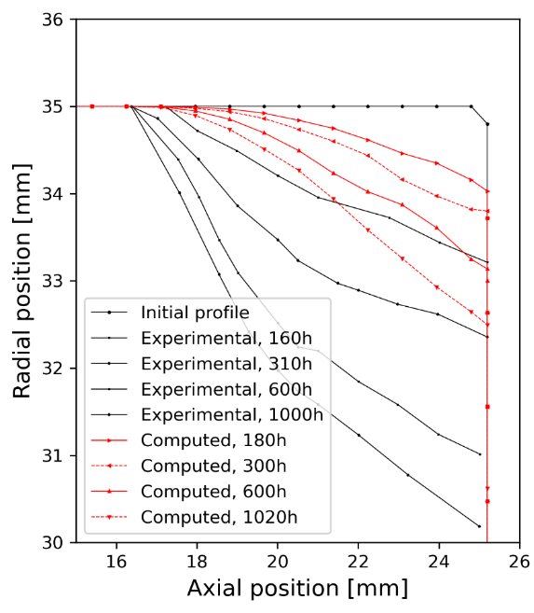
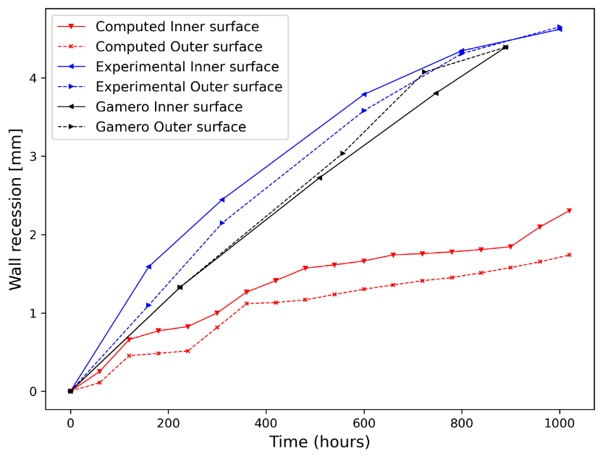

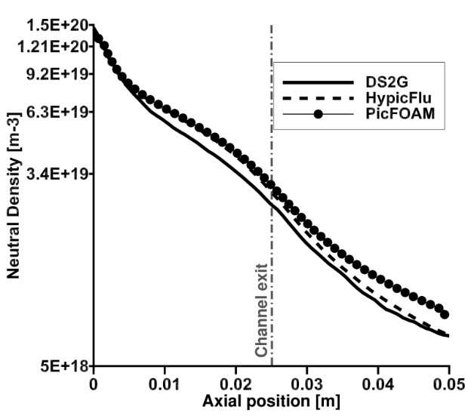


NUMERICAL ACTIVITIES
Air Breathing (AB) EP / HET Wall Erosion
AB - HET: Plasma-OFF simulations
HET wall channel Erosion [4]
Air-Breathing thrusters captures air in Very Low Earth Orbit (VLEO) through an intake and conveying it to the accelerator channel.
N₂ - O₂ mixture flowing into HET’s channel []
Sputtering Yield (Xe-BNSiO₂)
$$Y_{i}=f\left(E,θ\right)C_{T}$$
Empirical coeffiecient to include temperature effect
Underprediction vs. experiments: 50-60 %
But the erosion rate decreases with time

Slide 15




NUMERICAL ACTIVITIES
Prelminary Design Tools
Plasma Model
Other Models (Thermal, Magnetics)
Curve Fitting Approach
Magneto Plasma Dynamic Thruster (MPDT)
Helicon Plasma Thrusters (HPT) [11]
Gridded Ion Thruster (GIT) [12]
High‑Efficiency Multistage Plasma Thruster (HEMPT) [13]

Slide 16




PROTOTYPE DESIGN
HPT – MPDT
We are going to build two laboratory demonstrators to be tested in MSVC
HPT [14]
MPD
$P_{in}$ = 1 kW
Propellant mass flow rate: 3-5 mg/s (Argon)
Antenna Configuration: toroidal
Applied Field : 0.06 T
$P_{in}$ = 4.5 kW
Propellant mass flow rate: 10 mg/s (Argon)
Configuration : AF-MPDT
Applied Field : 0.2 T

Slide 17
Conclusions
  Electric Propulsion Laboratory:
    Medium Vacuum Scale Chamber (MSVC) – 5kW Plasma Thrusters
    Small Scale Vacuum Chamber (SSVC) – Cathodes and micro plasma propulsion
  Hardware Design:
    Hall Effect Thruster (CR-HET250) – Designed/Tested
    Helicon Plasma Thruster (HPT) – Design on going
    Magneto Plasma Dynamic (MPD) - Design on going
  Numerical Activities:
    Hall Effect Thrusters (HET) – HPYCFLU2 / Wall Erosion by plasma
    Gridded Ion Thrusters (GIT) - GosPIC
    GIT, HPT, MPD, High‑Efficiency Multistage Plasma Thruster (HEMPT) - Global Models

Slide 18

Workshop
  Plasma simulations (HET, MPD, HPT)
  Code-code comparison
  Air Breathing Electric Propulsion: simulations and experiments
  Sputtering evaluation:
    Xenon-Borisil (BN-SIO2); Temperature: 30 -600°C; Impact angle: 0-85°; Energy: 10-250 eV
  Intrusive or Optical Diagnostics for plasma
  Electron Mobility Modeling

Slide 19
References
Natale P., Ricci, D. Coppola G. and Battista F., Experimental Evaluation of Hall Effect Thrusters in Ultra- High Vacuum for Space Applications, In Proceedings of the 11th European Conference for AeroSpace Sciences, Rome (Italy), 2025, 10.13009/EUCASS2025-501
Mitrofanova, O.A., Gnizdor, R.Y., Murashko, V.M., Koryakin, A.I., Nesterenko, A.N.: New generation of SPT-100. In Proceedings of the 32nd International Electric Propulsion Conference,Wiesbaden, Germany, 11–15 September 2011. IEPC-2011-041
Hofer, R.R., Mikellides, I.G., Katz, I., Goebel, D.M.: Wall sheath and electron mobility modeling in hybrid-PIC Hall thruster simulations. In Proceedings of the 43rd AIAA/ASME/SAE/ASEE Joint Propulsion Conference and Exhibit, Cincinnati, OH, 8–11 July 2007. AIAA 2007-5267, https://doi.org/10. 2514/6.2007-5267
Passet, M., Panelli, M., Battista, F., Numerical Modeling of Erosion in Hall Effect Thrusters, Particles 2024, 7(1), 121-143, https://doi.org/10.3390/particles7010007
Kawashima, R., Komurasaki, K., Schonherr, T., Koizumi, H., Hybrid Modeling of a Hall Thruster Using Hyperbolic System of Electron Conservation Laws. In Proceedings of the 34th International Electric Propulsion Conference, Hyogo-Kobe, Japan, 4–10 July 2015; IEPC-2015-206
Manzo, A., Felicioni, F., Panelli, M., Battista, F., GosPIC: A Particle-In-Cell code for simulating plasma behaviour in ion thruster optics 28th AIDAA International Congress and the 10th CEAS Aerospace Europe Conference, Turin, 1-4 Dec. 2025
Panelli, M., Battista, F., Smoraldi, A., Fragiacomo, M., Development of a cathode for low-power Hall Effect Thruster AIAA Propulsion and Energy Forum 2021, August 9-11, 2021
Coppola, G., Panelli, M., Battista, F., Solution of Orifice Hollow Cathode Plasma Model Equations by Means of Particle Swarm Optimization, Appl. Sci. 2024, 14(13), 5831; https://doi.org/10.3390/app14135831
Bruno, F., Simulation of Air Breathing Hall Effect Thruster by means of picFoam, In Proceedings of the 11th European conference for aeronautics and space sciences (EUCASS), Rome (Italy), 30 Jun- 4 Jul 2015
Gamero Castano e Ira Katz, Estimation of Hall Thruster Erosion Using Hall , International Electric Propulsion Conference, Princeton University, October 31 – November 4, 2005, IEPC-2005-303
Coppola, G., Panelli, M., Battista, F., Preliminary design of helicon plasma thruster by means of particle swarm optimization AIP Advances 13, 055209 (2023) https://doi.org/10.1063/5.0149430
Alifano, F., Panelli, M., Battista, F., Preliminary Design Tool for Medium-Low-Power Gridded Ion Thrusters Appl. Sci. 2023, 13, 5600. https://doi.org/10.3390/app13095600
Puca, N., Panelli, M., Battista, F. A Methodology for the Preliminary Design of a High‑Efficiency Multistage Plasma Thruster Aerotecnica Missili e Spazio, Journal of Aerospace and Science Technology, Mar 2024, https://link.springer.com/article/10.1007/s42496-024-00203-x
Felicioni, F., Coppola, G., Fragiacomo, M., Battista, F., Souhair, N., Ponti, F. ,Numerical modelling and design of an experimental setup for a Helicon Plasma Thruster 28th AIDAA International Congress and the 10th CEAS Aerospace Europe Conference, Turin, 1-4 Dec. 2025

Slide 20






Overview of CIRA development in Plasma Electric Propulsion
Thank you for listening!
Info:
Dr. Francesco Battista, Space propulsion unit Head
f.battista@cira.it
Dr. Panelli Mario, Researcher
m.panelli@cira.it
www.cira.it

