Slide 1
Simulation of Low Temperature, Weakly Ionized Plasmas with Applications to the Electric Power Industry
A. Villa, B. Crippa, A. Scotti, G. Buccella, D. Fasani
23/12/2025

Slide 2

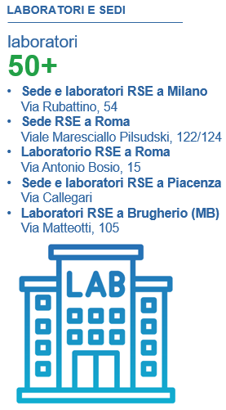
RSE
RSE S.p.A. (Ricerca sul Sistema Energetico) is a company within the GSE Group, controlled by the Ministry of Economy and Finance. It provides support to the Ministry of the Environment and Energy Security (MASE) and to the Regulatory Authority for Energy, Networks and Environment (ARERA).
RSE finances its research programs through:
the research system fund (Rds)
EU projects
contracts with third parties (institutions, companies, … )
RSE has five departments:
EUT - efficient use of energy for end uses and the territory
SFE - sustainable development and energy sources
SSE - development of energy systems
TGM - generation technologies and materials
TTD - transmission and distribution technologies

Slide 3
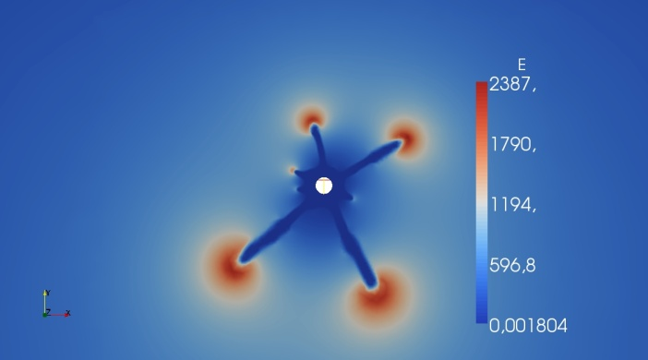
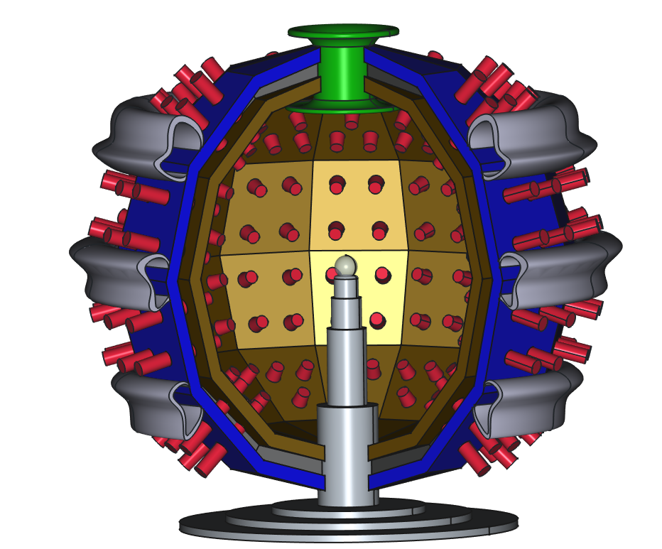


Plasma-related research fields
Cold – Weakly Ionized
Inertial fusion
RSE participates in research on inertial confinement fusion, contributing in several areas such as:
neutronic design
analysis of new materials
reaction chamber design
plasma and plasma - laser interaction
RSE has several research agreements with other partners such as ENEA and CNR-INO (a joint Ph.D. project has been funded).
RSE has developed models for the simulation of the initiation and propagation of electrical discharges, with applications to the power system for predicting the onset of the corona effect and the ageing of insulating polymer materials.

Slide 4
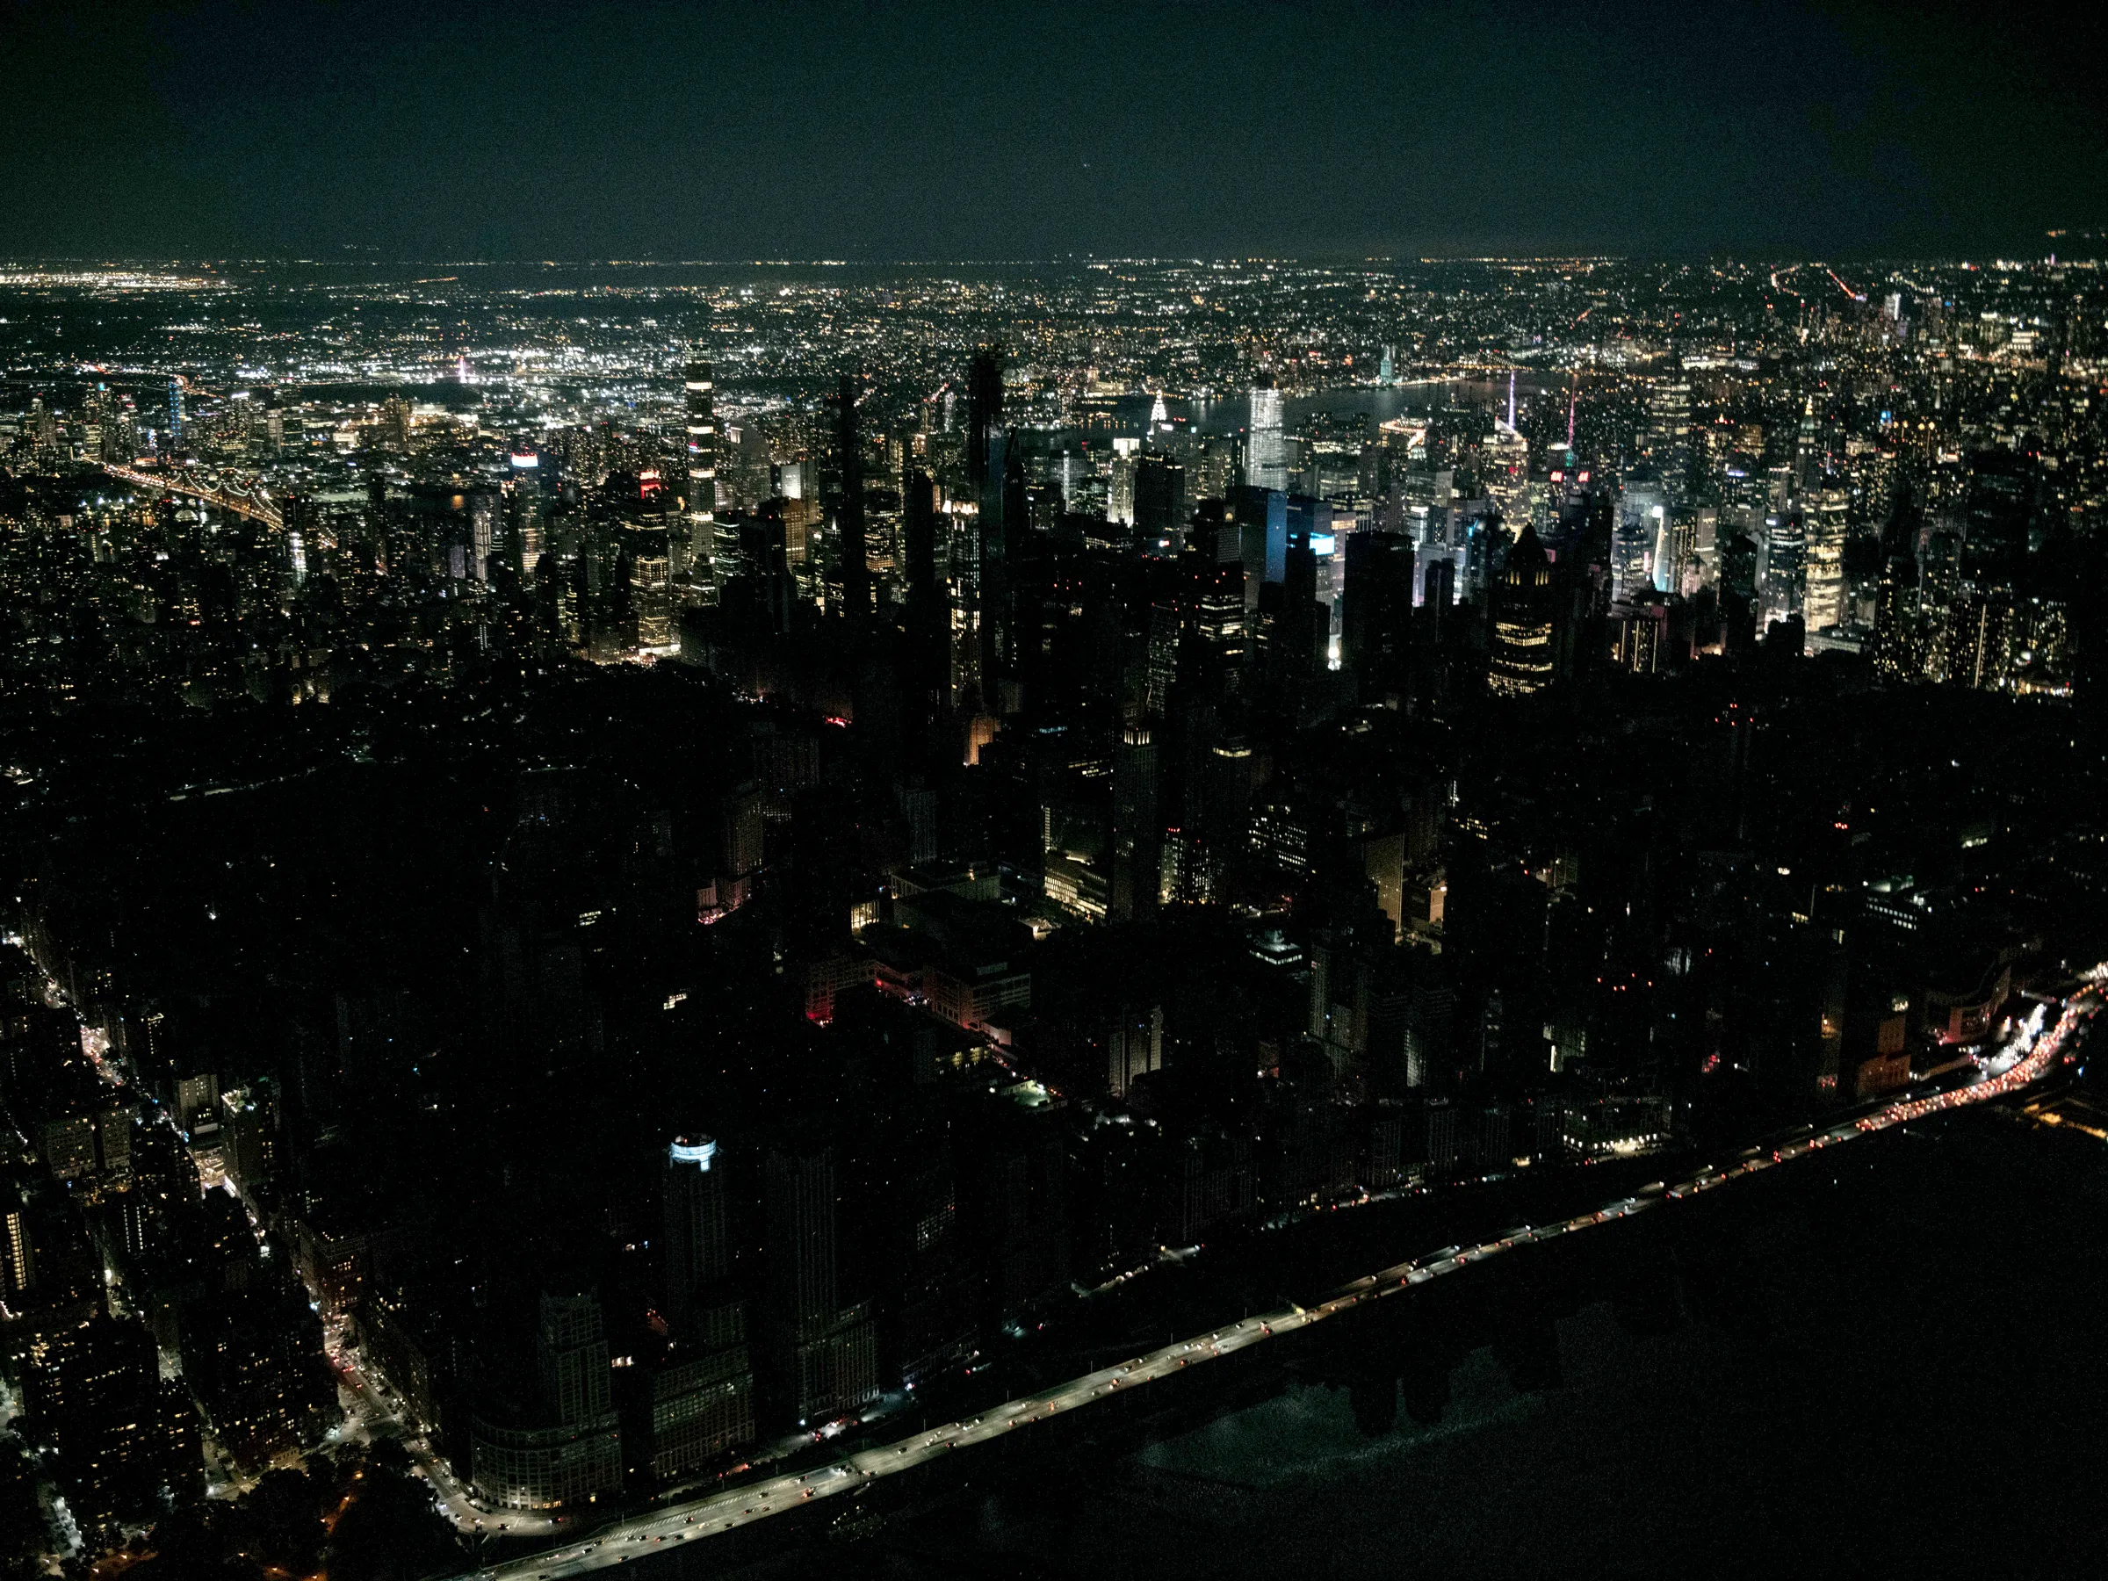
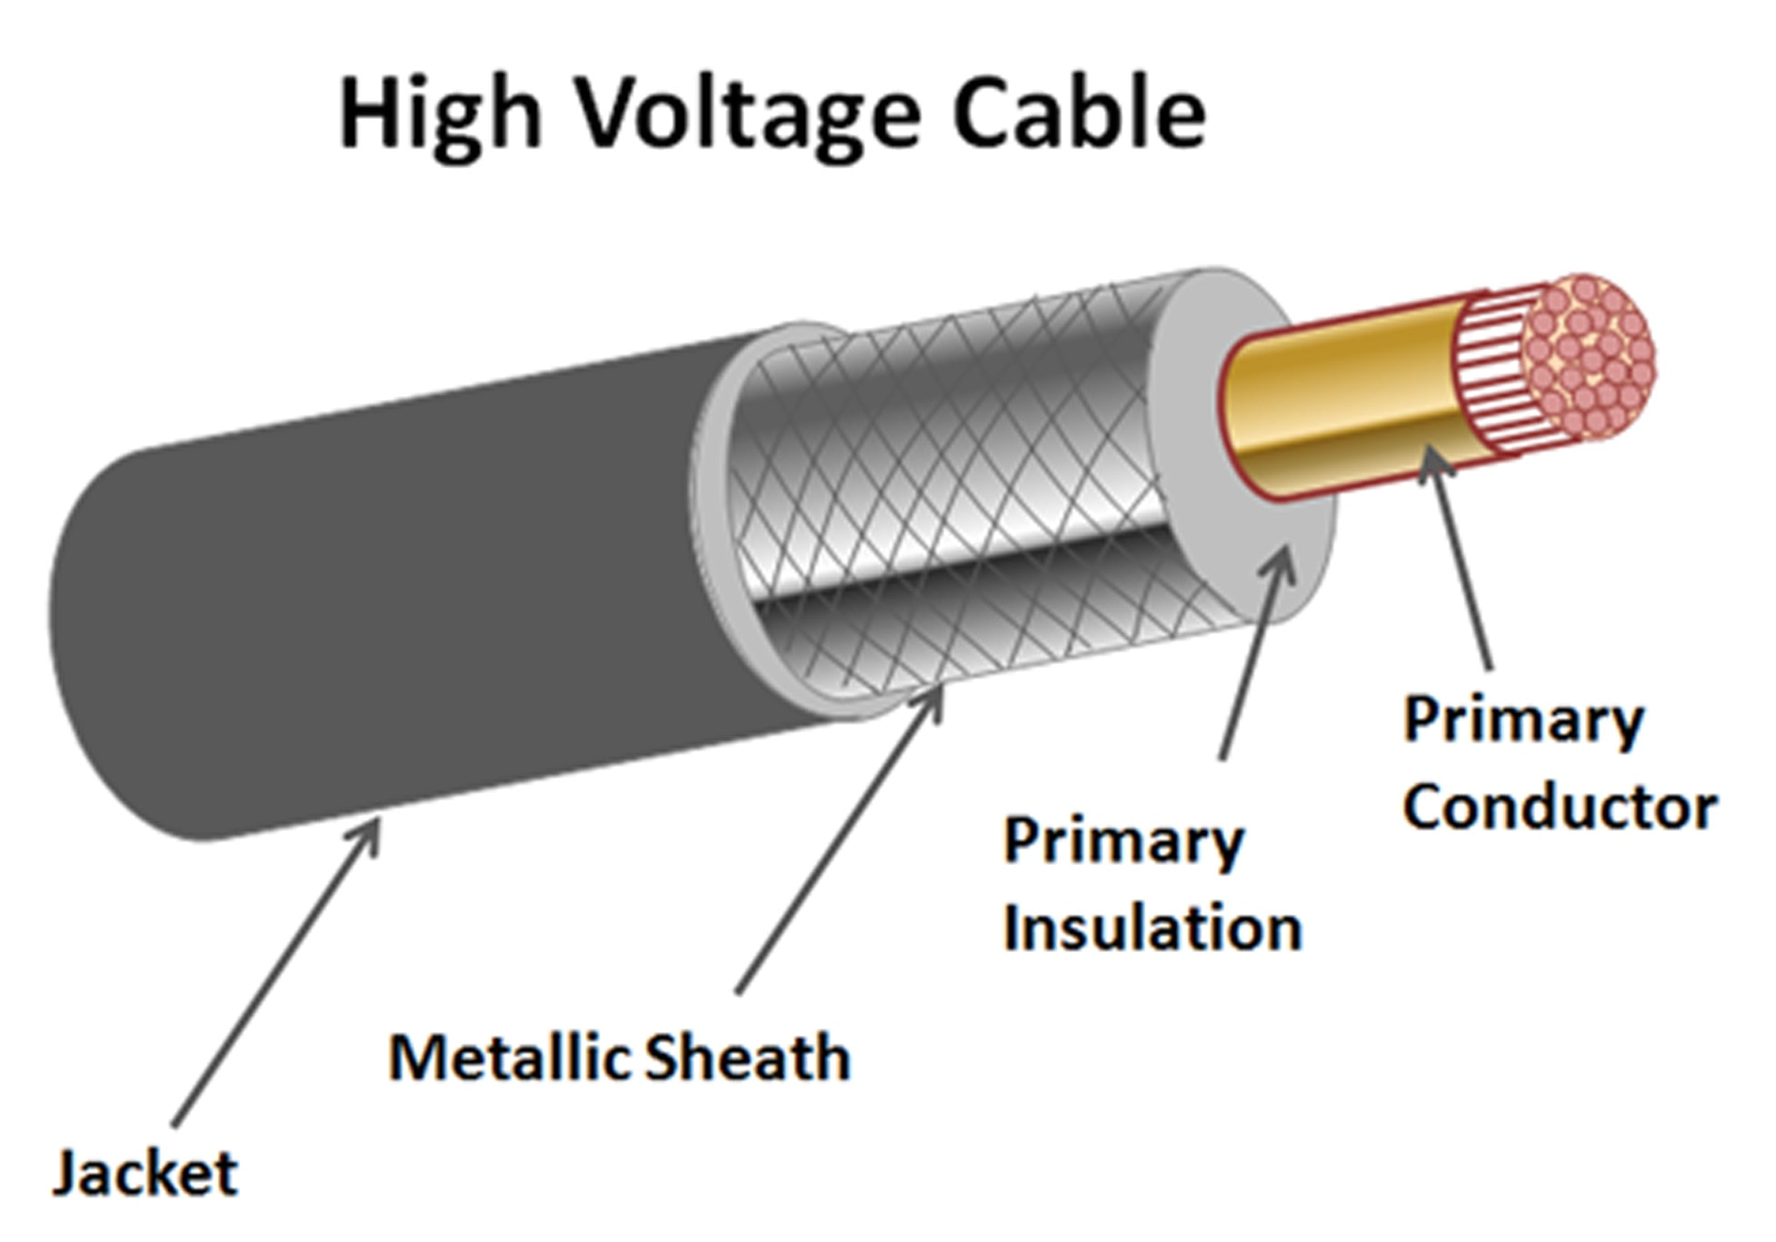
Blackout
Why a blackout takes place:
Big events, like Spain (April, 2025)
Small localized events -> insulation fault
What are the causes:
Space Charge accumulation (DC)
Partial Discharges (AC)

Slide 5
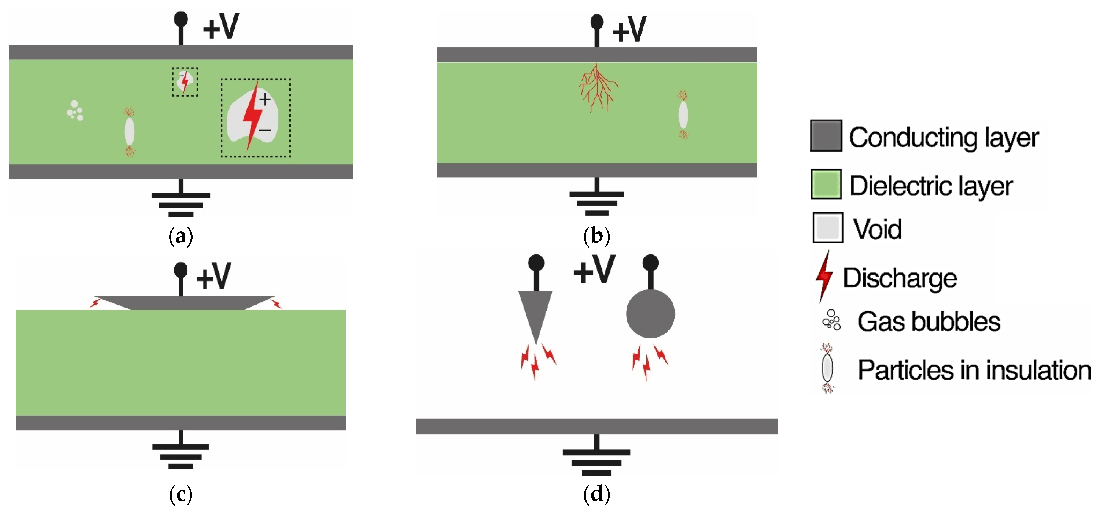
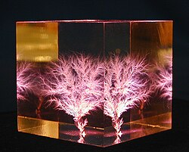
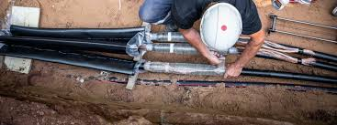
Partial discharges
Internal, gas-filled, defect;
High electric field;
Partial Discharges (1-1000) for each period
Propagation of the defect (Treeing)
Carbonization of the branches

Slide 6
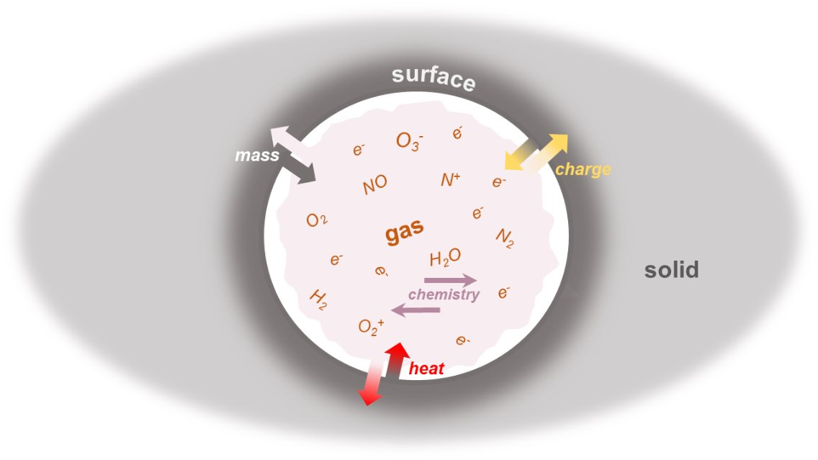
Aim of the research
PDs measurement devices:
Amperometers
Antenna
Microphones
Problems:
correlation between defects and signals
plan maintenance
Targets:
predict correlation defect/signals
evaluate evolution of the defect
Predict propagation rate
Model
Predict instrument signals

Slide 7
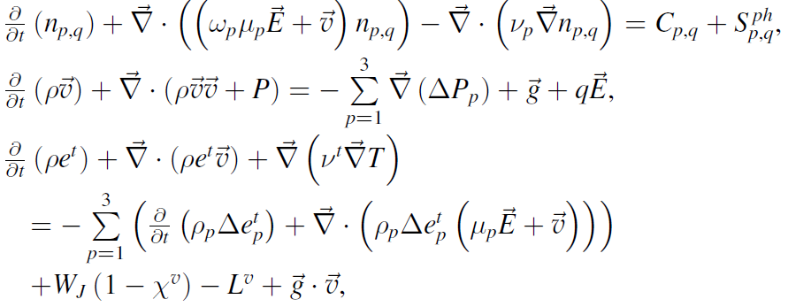
Gas
Groups:
Electrons
Negative ions
Positive ions
Neutral particles

Slide 8
Gas-Solid Interface
Charge transfer:
Electron trapping
Ion neutralization
Schottky emission
Secondary electron emission
Mass transfer:
Adsorption
Abstraction
Sputtering
Dissociative electron attachment
Localized breakdown

Slide 9
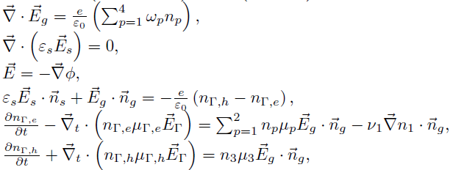
Electric field

Slide 10
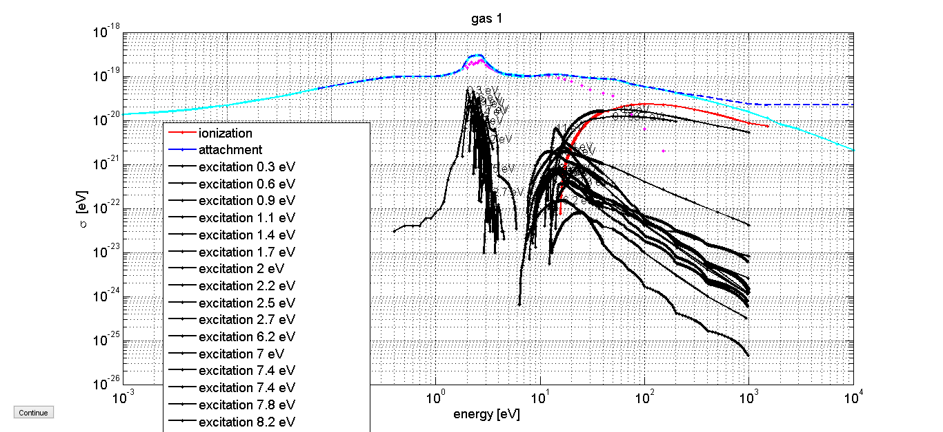

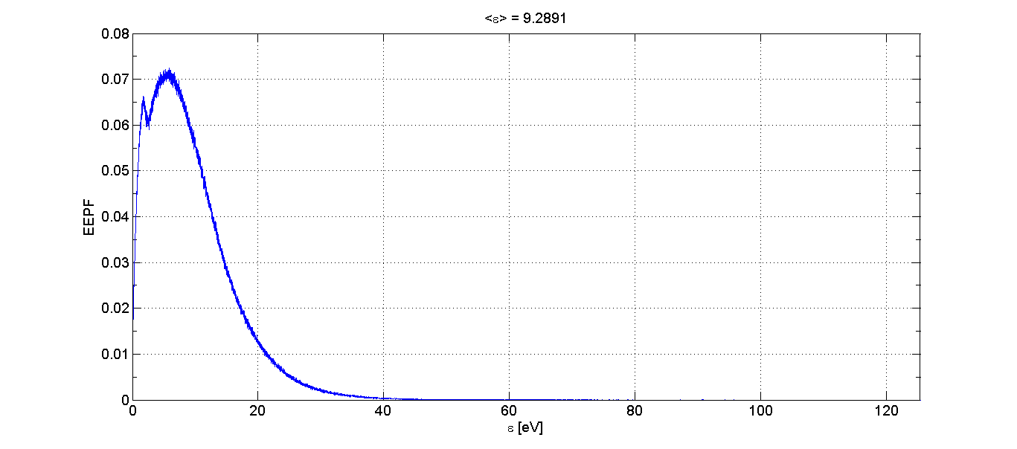
Multiscale-Gas
Physical parameters:
Electronic mobility
Electronic diffusion
Ionic mobility
Chemical reactions:
Attachment
Vibration excitation
Electronic excitation
Dissociation
Ionization
Quenching
Charge transfer
Recombination
Neutral reactions

Slide 11
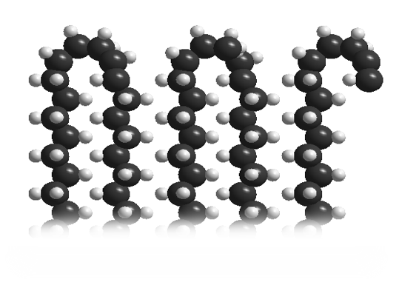
Multiscale-Surface
Schottky emission:
Evaluation of the work function
Experimental evidences W=1.3 eV
DFT -> chemical defects, surplus charge (1 electron every 10^5 sites)
PE + C=O
Other defects
Pristine PE
CB
Vacuum en.
0.97 eV
e
Fermi en.
Energy
VB

Slide 12
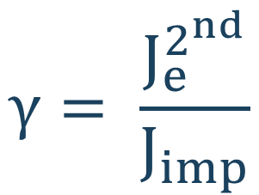
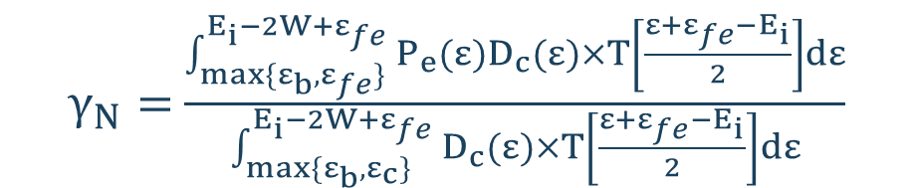
Multiscale-Surface
Secondary electron emission:
Auger neutralization
Experimental evidence 0.01
Theoretical estimations are uncertain
e⁻
$$γ= \frac{J_{e}^{2^{nd}}}{J_{imp}}$$
Secondary electrons’ current
Impinging species’ current
$γ_{N}=$ $\frac{\int_{max⁡\{ε_{b},ε_{fe}\}}^{E_{i}−2W+ε_{fe}}{P_{e}(ε)D_{c}(ε)×T\left[\frac{ε+ε_{fe}−E_{i}}{2}\right]dε}}{\int_{max⁡\{ε_{b},ε_{c}\}}^{E_{i}−2W+ε_{fe}}{D_{c}(ε)×T\left[\frac{ε+ε_{fe}−E_{i}}{2}\right]dε}}$

Slide 13
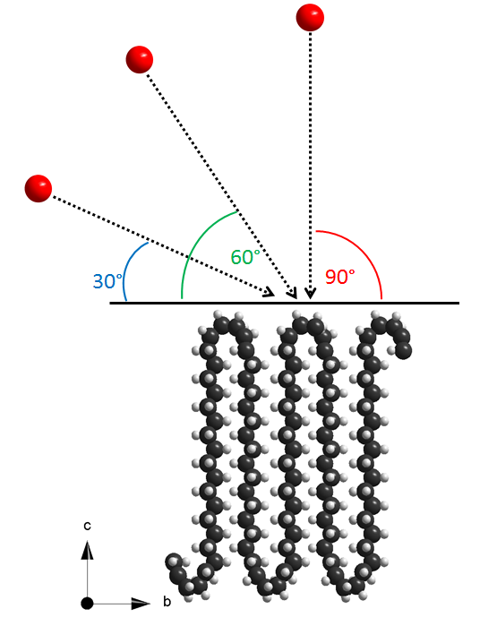
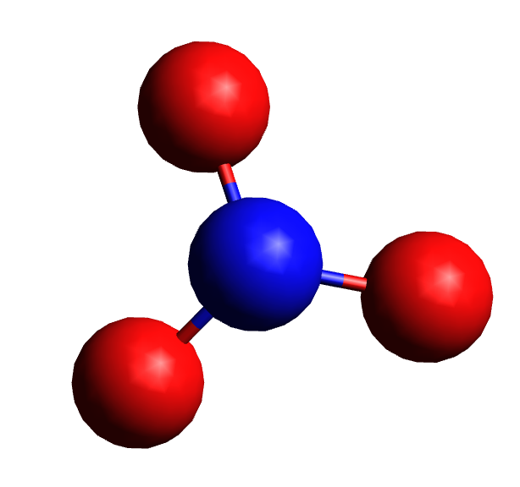
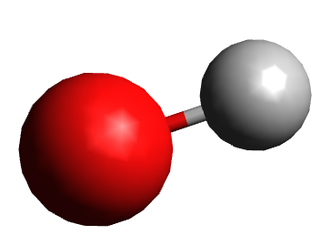
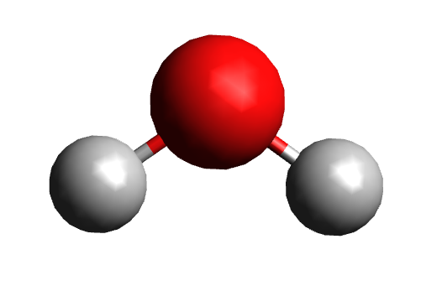
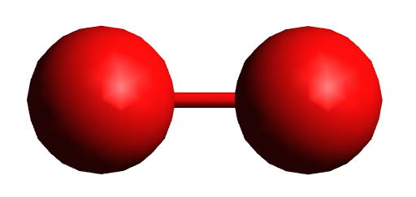
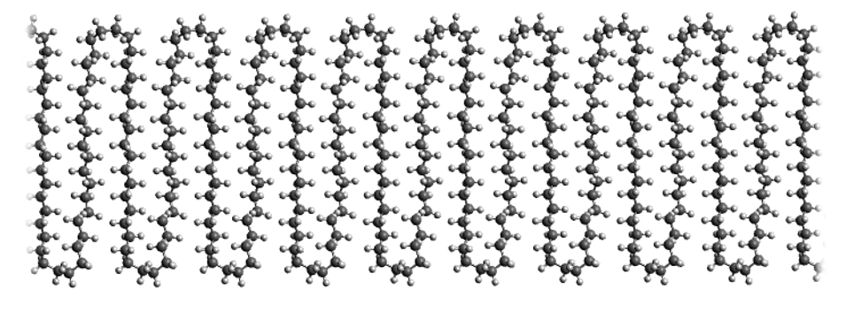
Multiscale-Surface
HΨ=EΨ
F=ma
Born-Oppenheimer Molecular Dynamics (BOMD)

Slide 14
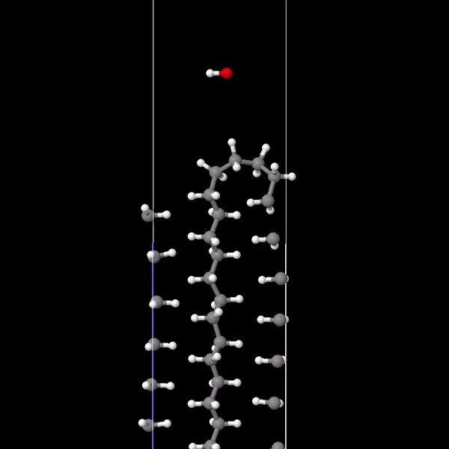
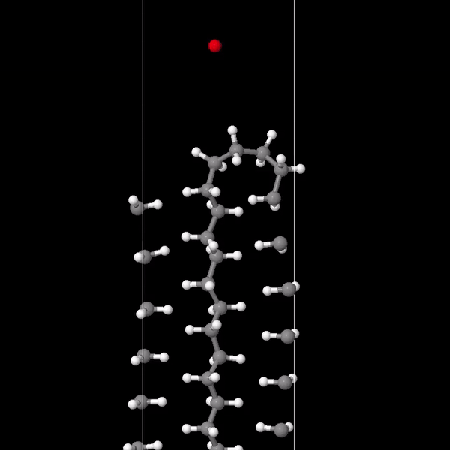
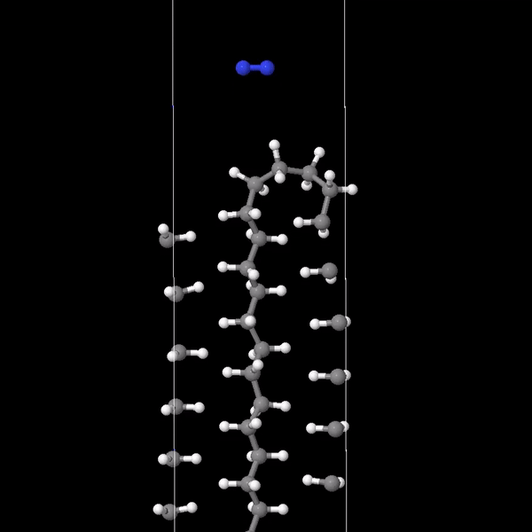
Multiscale-Surface
Possible chemical reactions
Sputtering
Electric field (Impact energy)

Slide 15
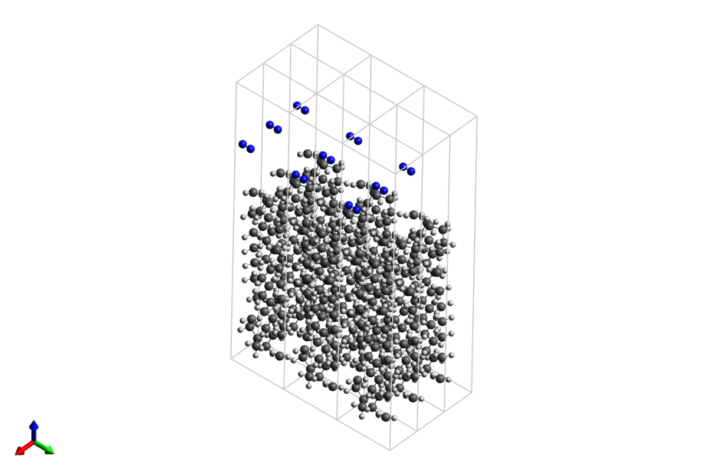
Multiscale-Surface

Slide 16
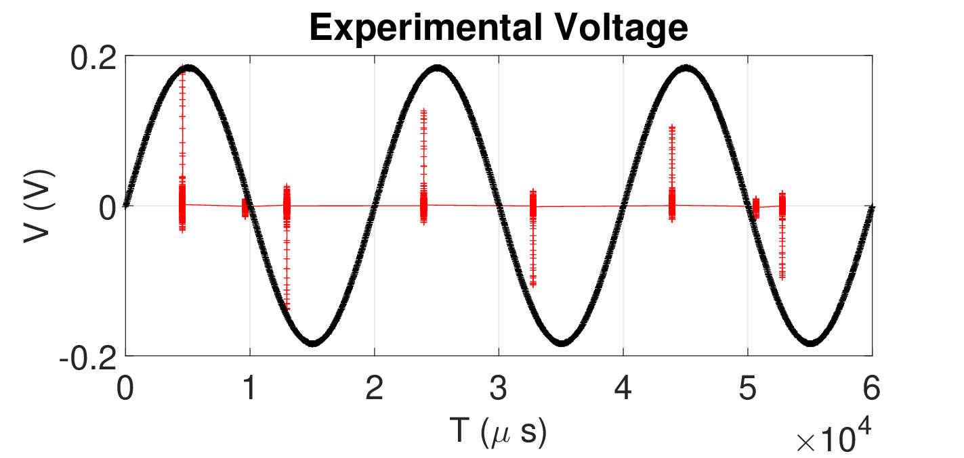
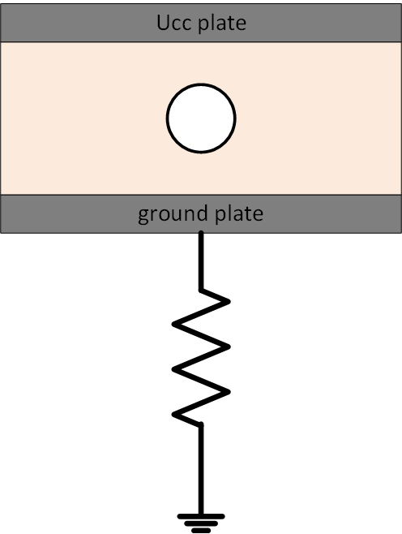
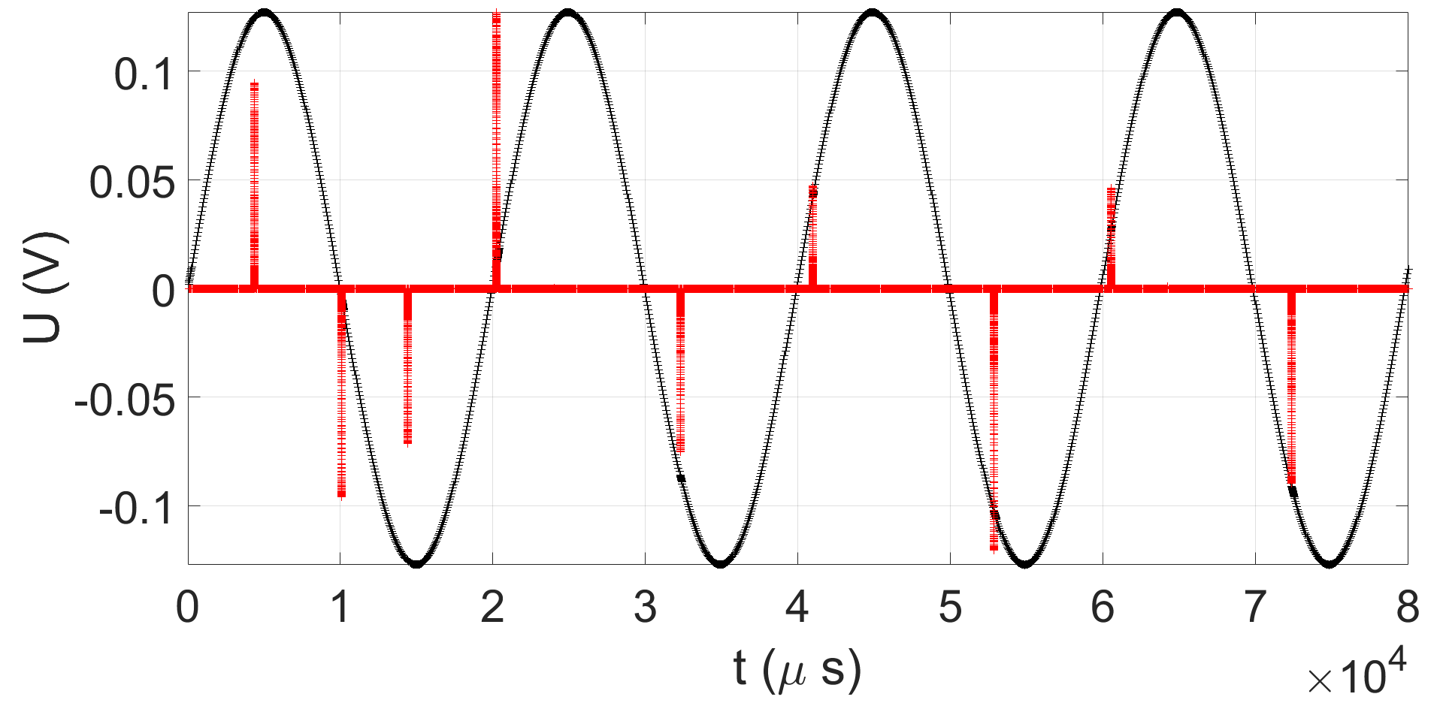
Validation-Void
2 mm insulating layer
1 mm sphere
R = 100 ohm
V = 4.41 kV (AC)
A PDE-based partial discharge simulator – A. Villa, L. Barbieri, M. Gondola, A.R. Leon-Garzon, R.Malgesini – JCP 345, 687-705

Slide 17
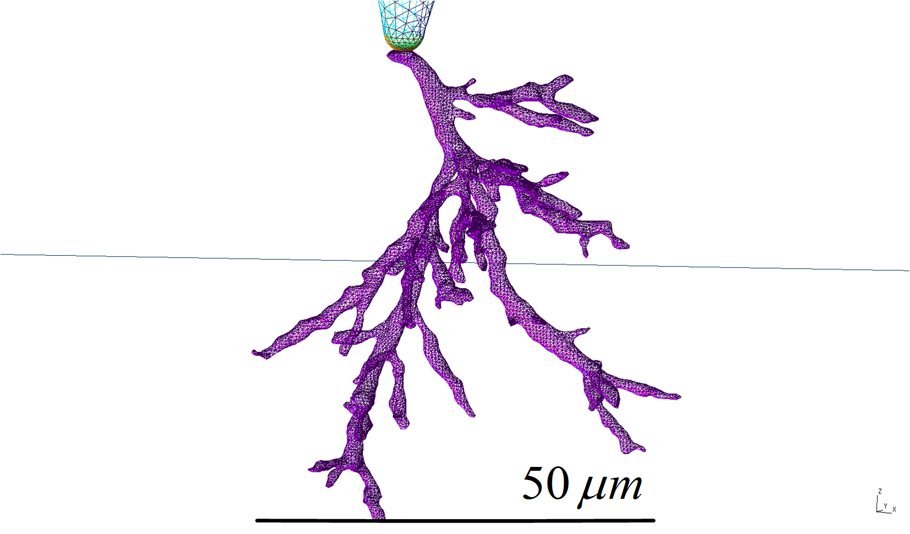
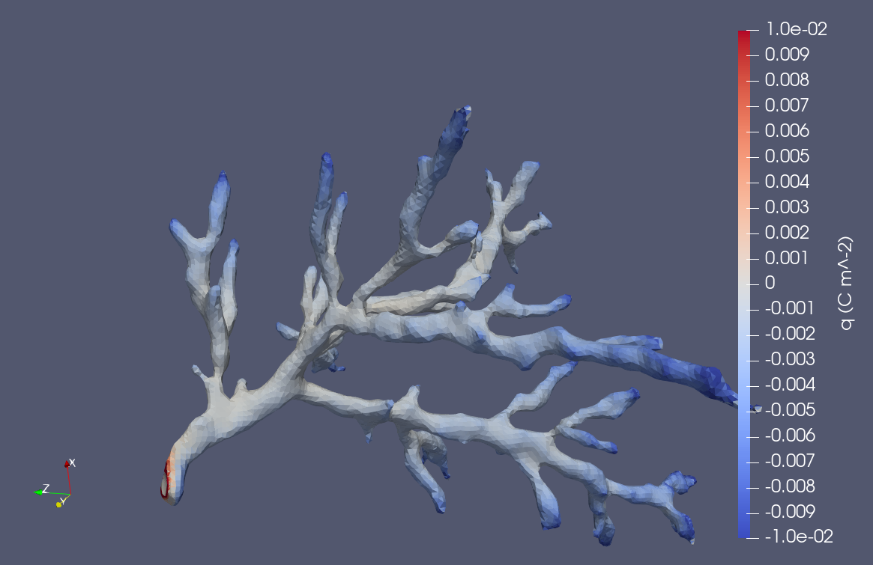
Treeing
1.2 ms
Point-Needle configuration
Gap 2 mm
10 kV r.m.s
Geometry obtained with a CAT scanner
Treeing inception phase

Slide 18
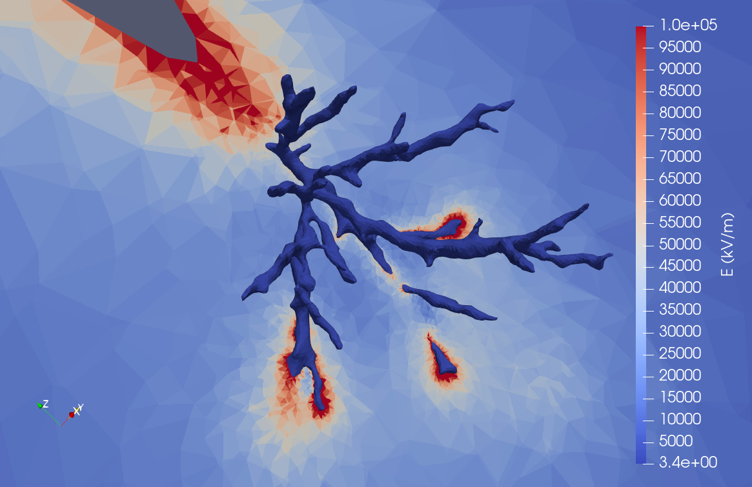
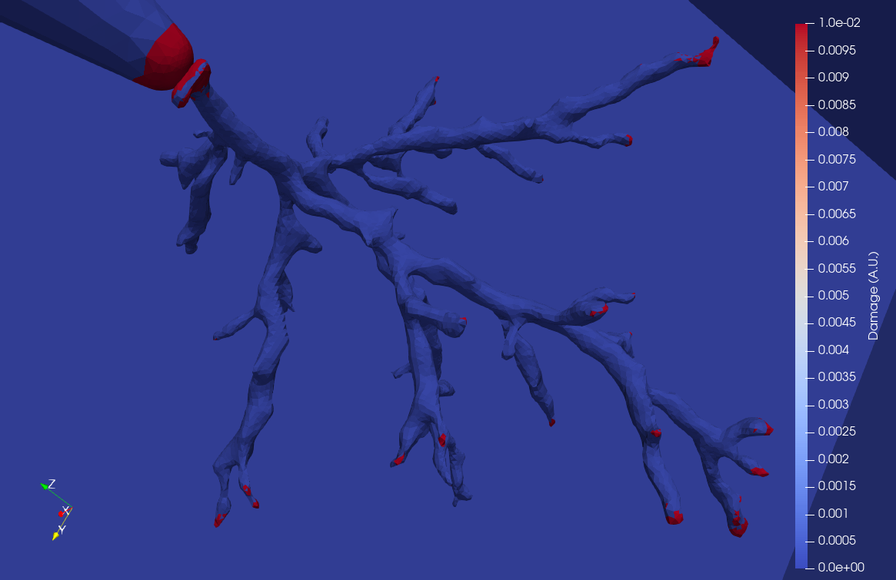
Treeing

Slide 19

Andrea Barbareschi Villa
Andrea.villa@rse-web.it

