Slide 1



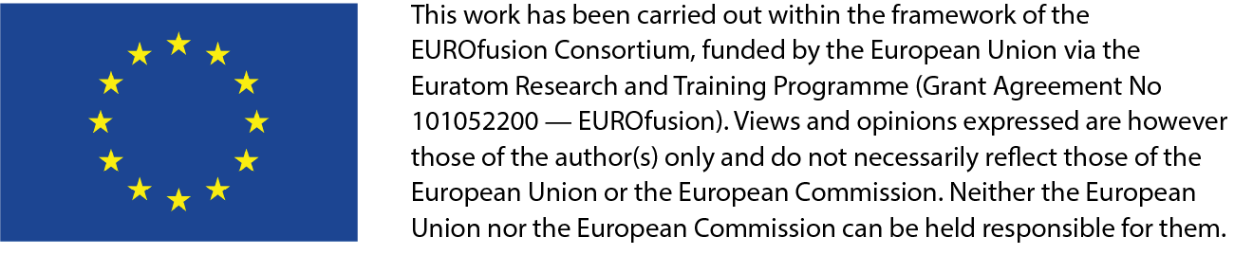
Phase space transport in burning plasmas
Matteo Valerio Falessi^{1,2}, P. Lauber³, S. Briguglio, A. Bottino³, L. Chen^{4,5}, T. Hayward-Schneider³, G. Meng³, A. Mishchenko⁶, Z. Qiu⁴, G. Wei⁴
¹ Center for Nonlinear Plasma Science and C.R. ENEA Frascati, C.P. 65, 00044 Frascati, Italy
² National Institute for Nuclear Physics, Rome Department, P.le A. Moro, 5, 00185 Roma, Italy
³ Max-Planck-Institut fur Plasma Physics, 95748 Garching, Germany
⁴ Inst. for Fusion Theory and Simulation and Department of Physics Zhejiang University, Hangzhou 310027, China
⁵ Dept. Physics and Astronomy, University of California, Irvine, CA 92697- 4575, USA
⁶ Max-Planck-Institut fur Plasma Physics, Greisfwald, Germany
This work was supported in part by the Italian Ministry of Foreign affairs and International Cooperation, grant number CN23GR02

Slide 2

Transport processes in burning plasmas
Predicting the dynamics of a burning plasma on long time scales, comparable with the energy confinement time or longer, is essential in order to understand next generation fusion experiments, e.g., ITER;
the crucial role of energetic particles Zonca et al. 2015; Chen and Zonca 2016, must be properly described;
a first-principle-based, self-consistent approach is crucial;
extending gyrokinetic simulations to these time scales is a challenging task from the computational resource point of view, i.e., $∼{10}^{24}$grid points;
simplifying assumptions based on physics understanding and first principles must be introduced;

Slide 3

Transport processes in burning plasmas
Predicting the dynamics of a burning plasma on long time scales, comparable with the energy confinement time or longer, is essential in order to understand next generation fusion experiments, e.g., ITER;
the crucial role of energetic particles Zonca et al. 2015; Chen and Zonca 2016, must be properly described;
a first-principle-based, self-consistent approach is crucial;
extending gyrokinetic simulations to these time scales is a challenging task from the computational resource point of view, i.e., $∼{10}^{24}$grid points;
simplifying assumptions based on physics understanding and first principles must be introduced;
Matteo Valerio Falessi | CIP 2026 | Frascati | 03/02/2026 – 06/06/2025 | Page 3

Slide 4
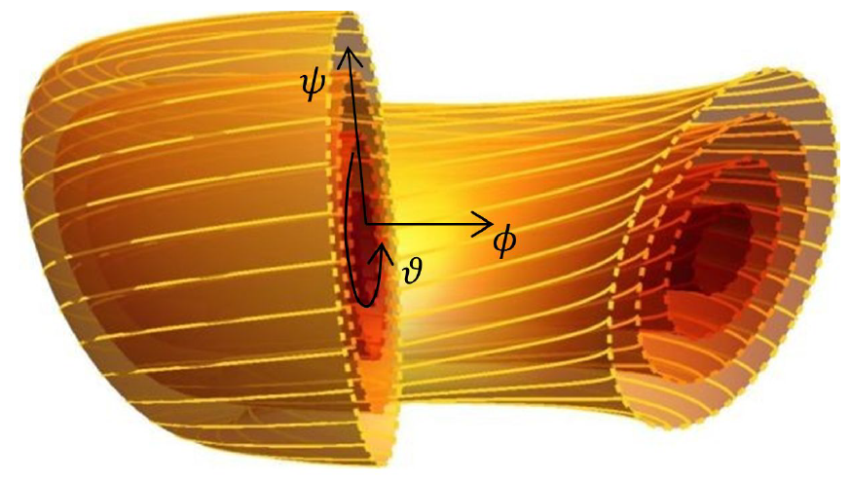
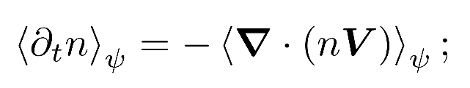

Transport processes in burning plasmas
Transport equations define the evolution of radial profiles
consistent with a slowly evolving ($ω^{−1}∂_{t} \log{p_{0}}∼δ^{2}$) equilibrium distribution function;
Implicit separation of scales between equilibrium and fluctuations;
Local Maxwellian is assumed;
Need for generalization!!!
Matteo Valerio Falessi | CIP 2026 | Frascati | 03/02/2026 – 06/06/2025 | Page 4

Slide 5
Transport processes in burning plasmas
Transport equations define the evolution of radial profiles
consistent with a slowly evolving ($ω^{−1}∂_{t} \log{p_{0}}∼δ^{2}$) equilibrium distribution function;
Implicit separation of scales between equilibrium and fluctuations;
Local Maxwellian is assumed;
Need for generalization!!!
Matteo Valerio Falessi | CIP 2026 | Frascati | 03/02/2026 – 06/06/2025 | Page 5

Slide 6
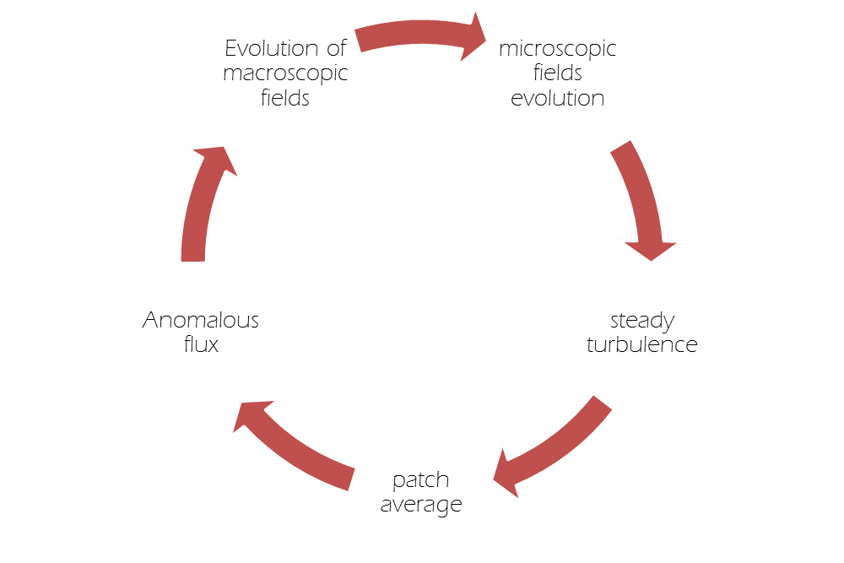
Transport processes in burning plasmas
Transport equations define the evolution of radial profiles
consistent with a slowly evolving ($ω^{−1}∂_{t} \log{p_{0}}∼δ^{2}$) equilibrium distribution function;
Implicit separation of scales between equilibrium and fluctuations;
Local Maxwellian is assumed;
Need for generalization!!!
Matteo Valerio Falessi | CIP 2026 | Frascati | 03/02/2026 – 06/06/2025 | Page 6

Slide 7
Transport processes in burning plasmas
Transport equations define the evolution of radial profiles
consistent with a slowly evolving ($ω^{−1}∂_{t} \log{p_{0}}∼δ^{2}$) equilibrium distribution function;
Implicit separation of scales between equilibrium and fluctuations;
Local Maxwellian is assumed;
Need for generalization!!!
Matteo Valerio Falessi | CIP 2026 | Frascati | 03/02/2026 – 06/06/2025 | Page 7

Slide 8
Transport processes in burning plasmas
Transport equations define the evolution of radial profiles
consistent with a slowly evolving ($ω^{−1}∂_{t} \log{p_{0}}∼δ^{2}$) equilibrium distribution function;
Implicit separation of scales between equilibrium and fluctuations;
Local Maxwellian is assumed;
Need for generalization!!!
Matteo Valerio Falessi | CIP 2026 | Frascati | 03/02/2026 – 06/06/2025 | Page 8

Slide 9
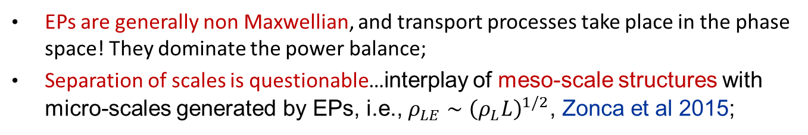
Transport processes in burning plasmas
EPs are generally non Maxwellian, and transport processes take place in the phase space! They dominate the power balance;
Separation of scales is questionable…interplay of meso-scale structures with micro-scales generated by EPs, i.e., $ρ_{LE}∼{\left(ρ_{L}L\right)}^{1/2}$, Zonca et al 2015;
different small but finite distortions w.r.t. local thermodynamic equilibrium may evolve very differently due to collisionless behaviors and resonances;
interaction with thermal plasma over long timescales can modify bulk transport processes;

Slide 10
Transport processes in burning plasmas
EPs are generally non Maxwellian, and transport processes take place in the phase space! They dominate the power balance;
Separation of scales is questionable…interplay of meso-scale structures with micro-scales generated by EPs, i.e., $ρ_{LE}∼{\left(ρ_{L}L\right)}^{1/2}$, Zonca et al 2015;
different small but finite distortions w.r.t. local thermodynamic equilibrium may evolve very differently due to collisionless behaviors and resonances;
interaction with thermal plasma over long timescales can modify bulk transport processes;
Matteo Valerio Falessi | CIP 2026 | Frascati | 03/02/2026 – 06/06/2025 | Page 10

Slide 11
Transport processes in burning plasmas
EPs are generally non Maxwellian, and transport processes take place in the phase space! They dominate the power balance;
Separation of scales is questionable…interplay of meso-scale structures with micro-scales generated by EPs, i.e., $ρ_{LE}∼{\left(ρ_{L}L\right)}^{1/2}$, Zonca et al 2015;
Small but finite distortions w.r.t. local thermodynamic equilibrium may evolve very differently due to collisionless behaviors and resonances;
interaction with thermal plasma over long timescales can modify bulk transport processes;

Slide 12
Transport processes in burning plasmas
EPs are generally non Maxwellian, and transport processes take place in the phase space! They dominate the power balance;
Separation of scales is questionable…interplay of meso-scale structures with micro-scales generated by EPs, i.e., $ρ_{LE}∼{\left(ρ_{L}L\right)}^{1/2}$, Zonca et al 2015;
Small but finite distortions w.r.t. local thermodynamic equilibrium may evolve very differently due to collisionless behaviors and resonances;
interaction with thermal plasma over long timescales can modify bulk transport processes;

Slide 13
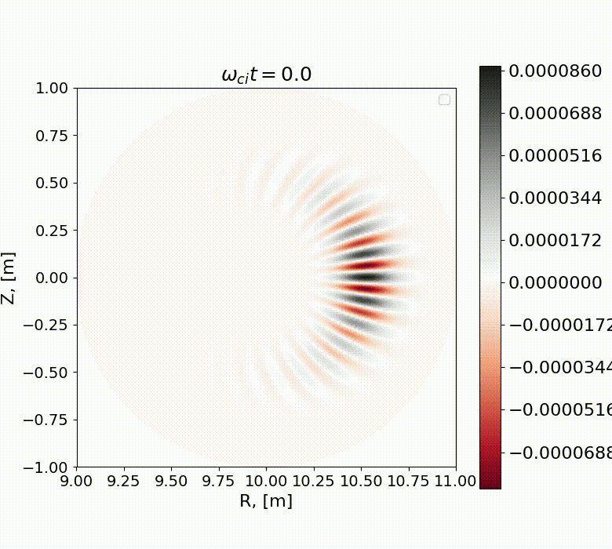
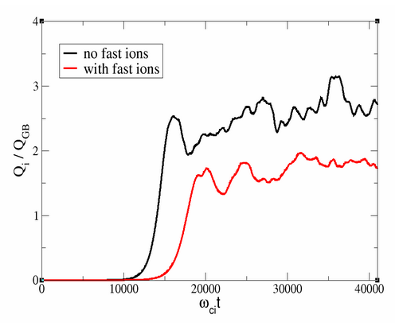
Neighboring nonlinear equilibria
Nonlinear gyrokinetic simulations with ORB5 code demonstrate clear reduction in the heat flux for both the bulk ions and the electrons
Matteo Valerio Falessi | CIP 2026 | Frascati | 03/02/2026 – 06/06/2025 | Page 13

Slide 14
Neighboring nonlinear equilibria
Nonlinear gyrokinetic simulations with ORB5 code demonstrate clear reduction in the heat flux for both the bulk ions and the electrons
Matteo Valerio Falessi | CIP 2026 | Frascati | 03/02/2026 – 06/06/2025 | Page 14

Slide 15
Neighboring nonlinear equilibria
Nonlinear gyrokinetic simulations demonstrate clear reduction in the heat flux in the presence of EPs.
Matteo Valerio Falessi | CIP 2026 | Frascati | 03/02/2026 – 06/06/2025 | Page 15

Slide 16
Purpose statement
We aim at 1. providing the general expressions describing EPs (plasma) dynamics on long time scales (transport) and 2. introducing a framework to solve these equations within different levels of reduced dynamics.
By means of this approach it will be possible to:
define the concept of nonlinear equilibrium;
describe the physics of burning plasmas where alpha particles will play a key role in transport studies by interacting with thermal components;
the derivation, see Falessi 2017; Falessi and Zonca 2019, Falessi et al 2023 is based on the Phase space zonal structures theory, see Chen and Zonca 2016.

Slide 17
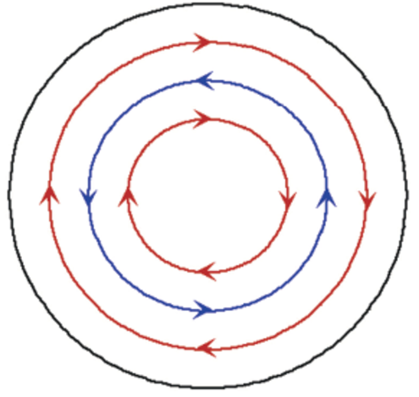
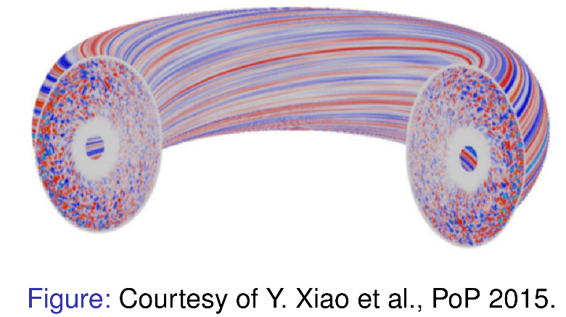
Phase Space Zonal Structures
Coupling between fluctuating fields can generate zonal flows and zonal fields;
Crucial elements for regulating turbulent fluxes e.g., by scattering instability turbulence to shorter radial wavelength stable domain…
zonal structures in the density and temperature profiles are unaffected by rapid collision-less dissipation;
collision-less undamped fluctuations in the phase space are called phase space zonal structures Chen and Zonca 2016, Falessi and Zonca 2019;
Matteo Valerio Falessi | CIP 2026 | Frascati | 03/02/2026 – 06/06/2025 | Page 17

Slide 18
Phase Space Zonal Structures
Coupling between fluctuating fields can generate zonal flows and zonal fields;
Crucial elements for regulating turbulent fluxes e.g., by scattering instability turbulence to shorter radial wavelength stable domain…
zonal structures in the density and temperature profiles are unaffected by rapid collision-less dissipation;
collision-less undamped fluctuations in the phase space are called phase space zonal structures Chen and Zonca 2016, Falessi and Zonca 2019;
Matteo Valerio Falessi | CIP 2026 | Frascati | 03/02/2026 – 06/06/2025 | Page 18

Slide 19
Phase Space Zonal Structures
Coupling between fluctuating fields can generate zonal flows and zonal fields;
Crucial elements for regulating turbulent fluxes e.g., by scattering instability turbulence to shorter radial wavelength stable domain…
zonal structures in the density and temperature profiles are unaffected by rapid collision-less dissipation;
collision-less undamped fluctuations in the phase space are called phase space zonal structures Chen and Zonca 2016, Falessi and Zonca 2019;
Matteo Valerio Falessi | CIP 2026 | Frascati | 03/02/2026 – 06/06/2025 | Page 19

Slide 20
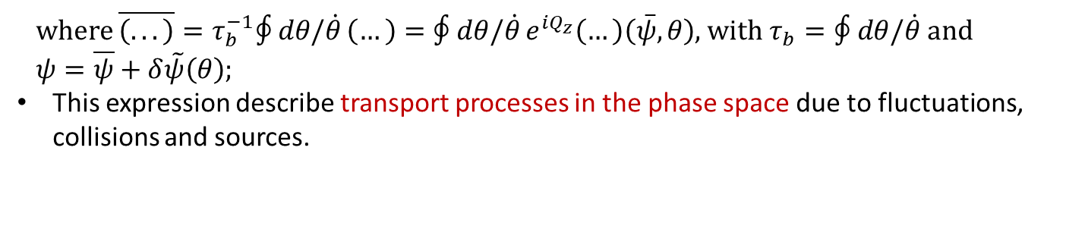
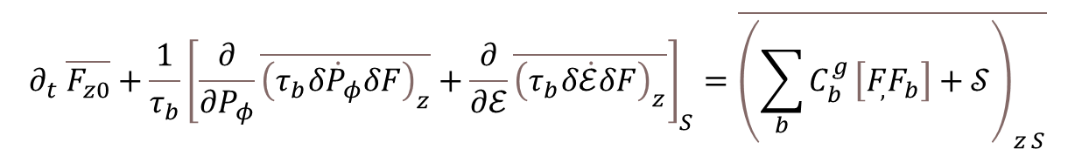
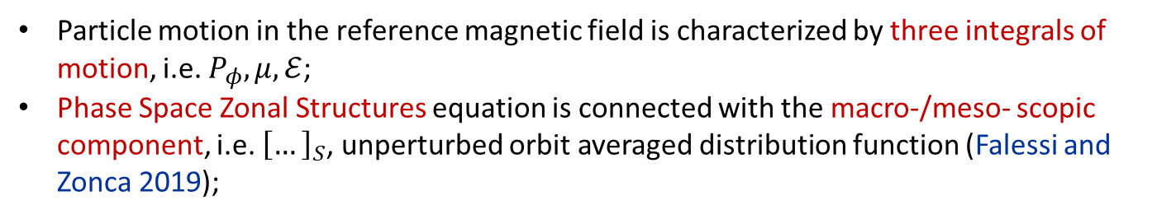
Orbit averaging
Particle motion in the reference magnetic field is characterized by three integrals of motion, i.e. $P_{φ},μ, ℰ$;
Phase Space Zonal Structures equation is connected with the macro-/meso- scopic component, i.e. ${\left[…\right]}_{S}$, unperturbed orbit averaged distribution function (Falessi and Zonca 2019);
$$∂_{t} \overline{F_{z0}}+\frac{1}{τ_{b}}{\left[\frac{∂}{∂P_{φ}}\overline{{\left(τ_{b}δ{\dot{P}}_{φ}δF\right)}_{z}}+\frac{∂}{∂ℰ}\overline{{\left(τ_{b}δ\dot{ℰ}δF\right)}_{z}}\right]}_{S}=\overline{{\left(\sum_{b}{C_{b}^{g}}\left[F_{,}F_{b}\right]+𝒮\right)}_{z S}}$$
where $\overline{\left(...\right)}=τ_{b}^{−1}∮dθ/\dot{θ} \left(…\right)=∮dθ/\dot{θ} e^{iQ_{z}}\left(…\right)\left(\overset{‾}{ψ},θ\right)$, with $τ_{b}=∮dθ/\dot{θ}$ and
$ψ=\overline{ψ}+δ\tilde{ψ}\left(θ\right)$;
This expression describe transport processes in the phase space due to fluctuations, collisions and sources.
Matteo Valerio Falessi | CIP 2026 | Frascati | 03/02/2026 – 06/06/2025 | Page 20

Slide 21
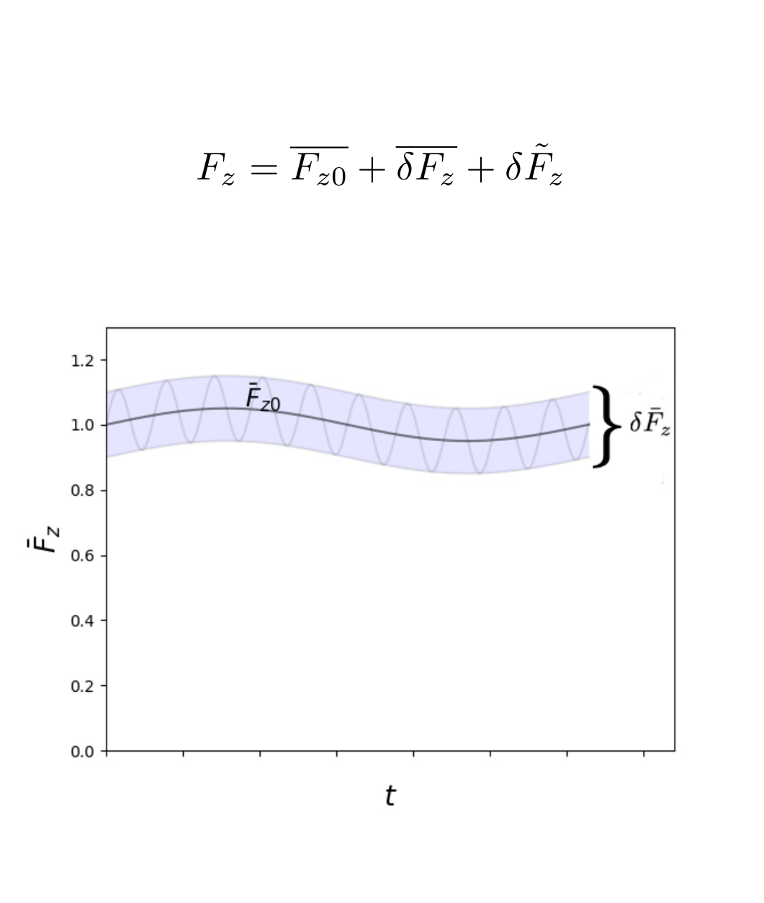
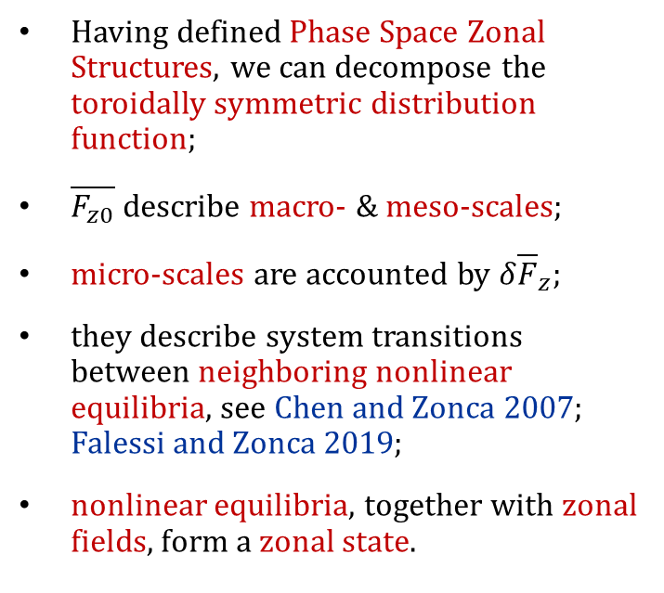
Neighboring nonlinear equilibria
Having defined Phase Space Zonal Structures, we can decompose the toroidally symmetric distribution function;
$\overline{F_{z0}}$ describe macro- & meso-scales;
micro-scales are accounted by $δ{\overline{F}}_{z}$;
they describe system transitions between neighboring nonlinear equilibria, see Chen and Zonca 2007; Falessi and Zonca 2019;
nonlinear equilibria, together with zonal fields, form a zonal state.
Matteo Valerio Falessi | CIP 2026 | Frascati | 03/02/2026 – 06/06/2025 | Page 21

Slide 22
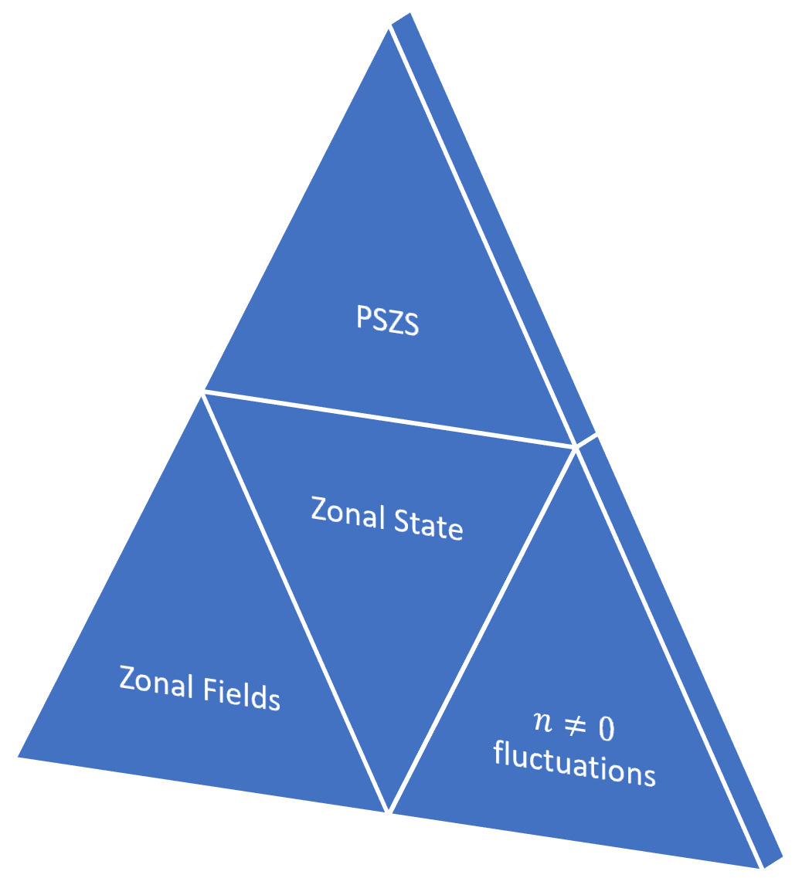
Zonal state

Slide 23
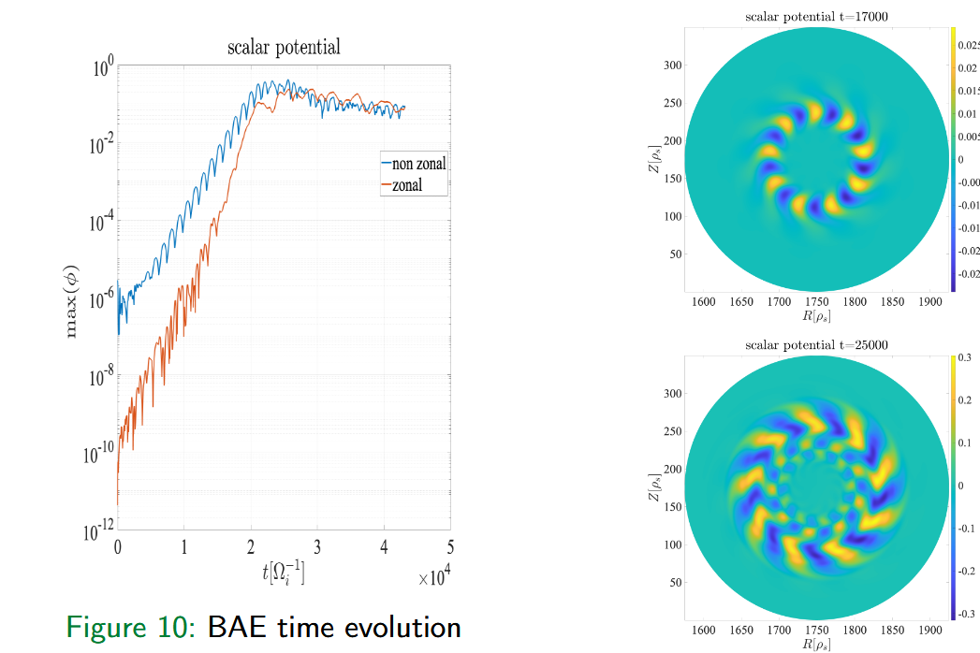
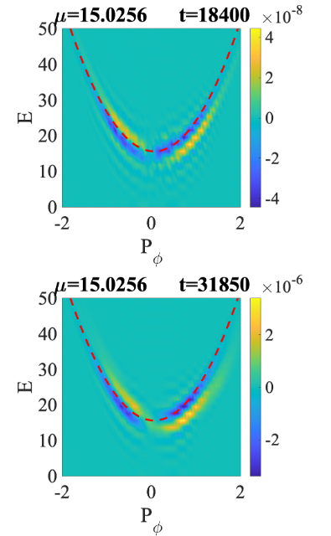
Neighboring nonlinear equilibria
J. Sama et al. Invited talk @ Varenna 2024
Matteo Valerio Falessi | CIP 2026 | Frascati | 03/02/2026 – 06/06/2025 | Page 23

Slide 24
Neighboring nonlinear equilibria
J. Sama et al. Invited talk @ Varenna 2024
Matteo Valerio Falessi | CIP 2026 | Frascati | 03/02/2026 – 06/06/2025 | Page 24

Slide 25
Neighboring nonlinear equilibria
J. Sama et al. Invited talk @ Varenna 2024
Matteo Valerio Falessi | CIP 2026 | Frascati | 03/02/2026 – 06/06/2025 | Page 25

Slide 26
Neighboring nonlinear equilibria
J. Sama et al. Invited talk @ Varenna 2024
Matteo Valerio Falessi | CIP 2026 | Frascati | 03/02/2026 – 06/06/2025 | Page 26

Slide 27
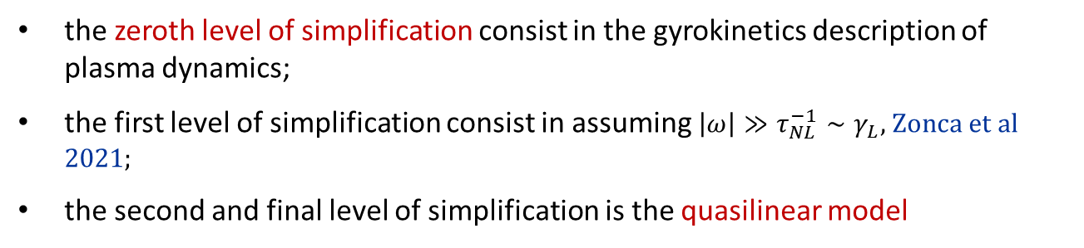
Reduced transport models
PSZS transport is studied by means of a hierarchy of verified and validated reduced models within an EUROfusion Enabling Research Project with P. Lauber as P.I.;
explicit expression of EP fluxes in PSZS equations have been calculated within the following hierarchy of simplifying assumptions:
the zeroth level of simplification consist in the gyrokinetics description of plasma dynamics;
the first level of simplification consist in assuming $\left|ω\right|≫τ_{NL}^{−1}∼γ_{L}$, Zonca et al 2021;
the second and final level of simplification is the quasilinear model
Matteo Valerio Falessi | CIP 2026 | Frascati | 03/02/2026 – 06/06/2025 | Page 27

Slide 28
Reduced transport models
DAEPS (Y. Li et al 2020, G. Wei et al 2025)
Ballooning decomposition for fluctuations;
Based on fish-bone like dispersion relation;
Mode structure decomposition, separation of radial envelope and parallel mode structure;
Calculate nonlinear fluxes by the DSM model or a saturation rule.
LIGKA-HAGIS (Lauber et al 2007)
Fourier decomposition for fluctuations;
Solve linear gyrokinetic equation;
Assume fluctuations amplitude, e.g., kick-model or quasilinear;
Use IMAS-coupled EP stability WF (HAGIS/LIGKA) to calculate Phase Space Zonal Structures fluxes.

Slide 29
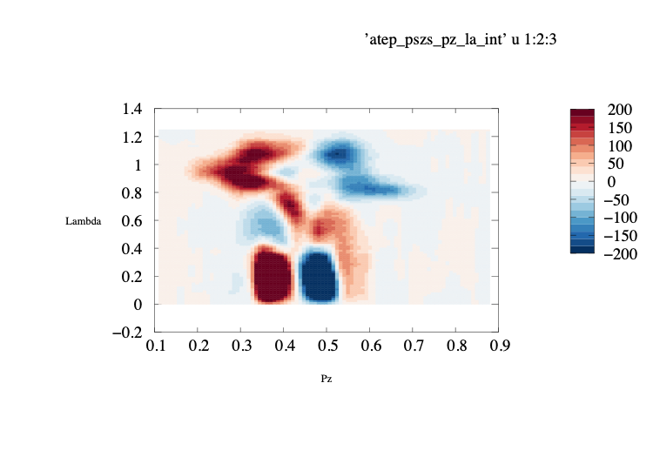
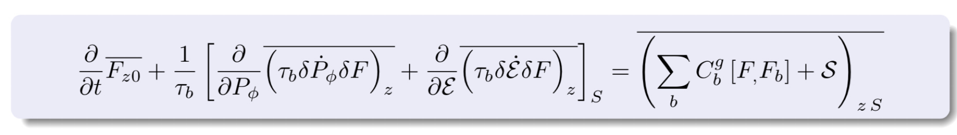
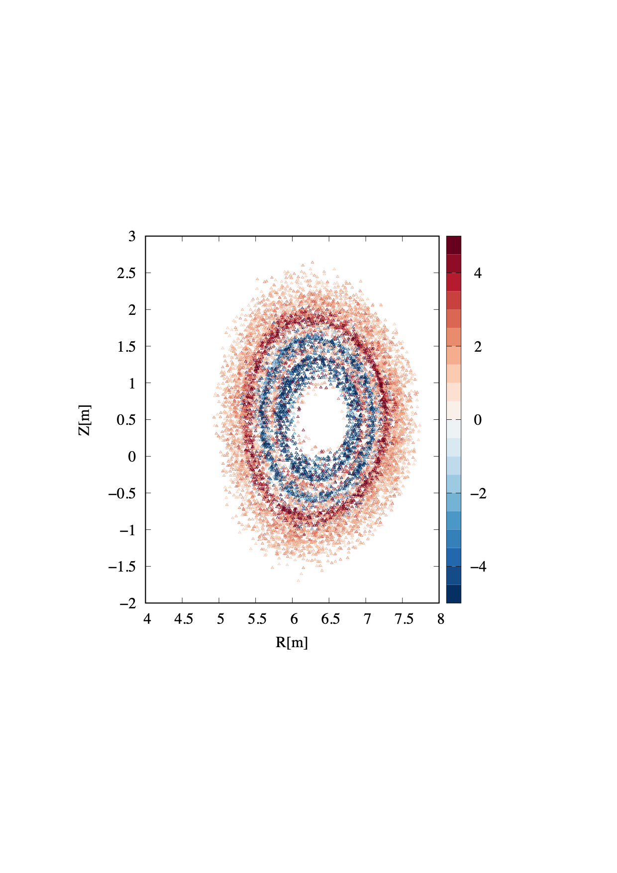
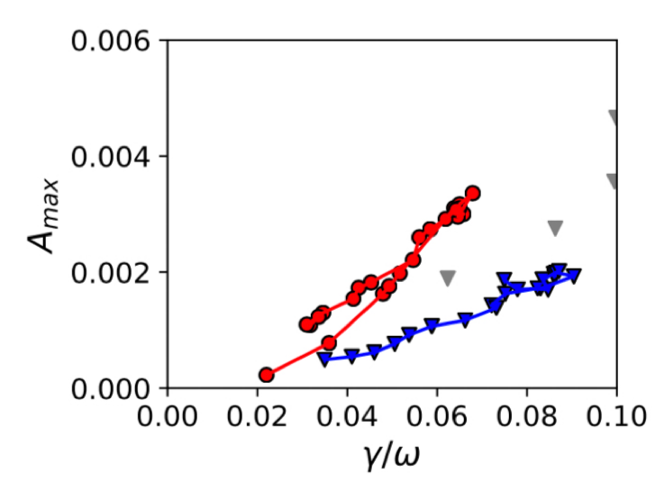

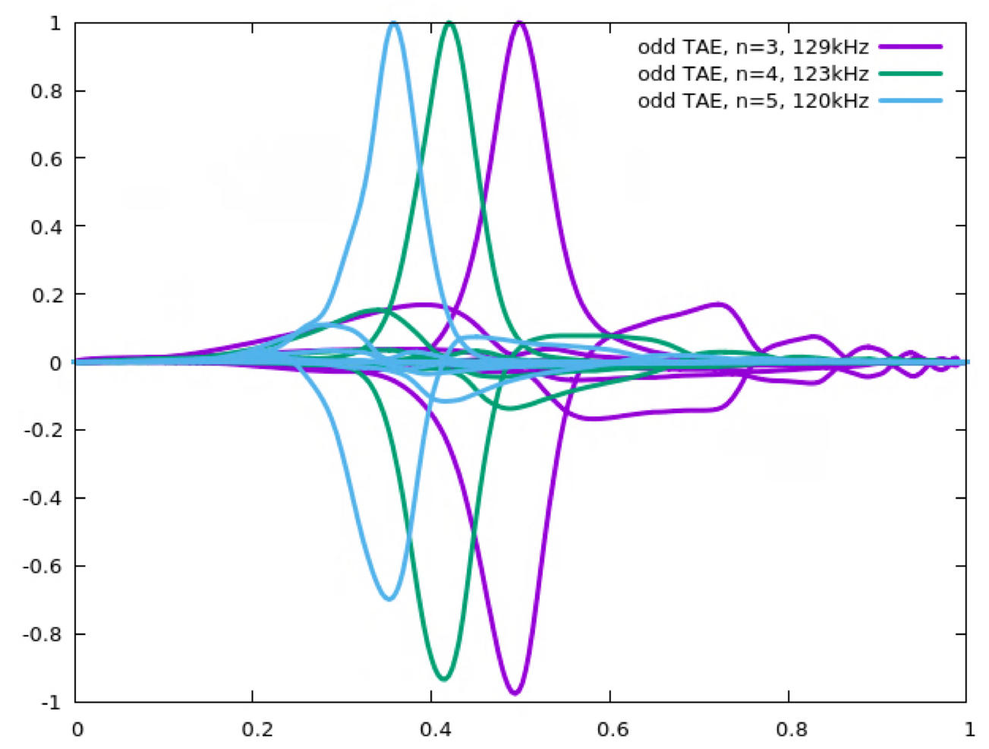
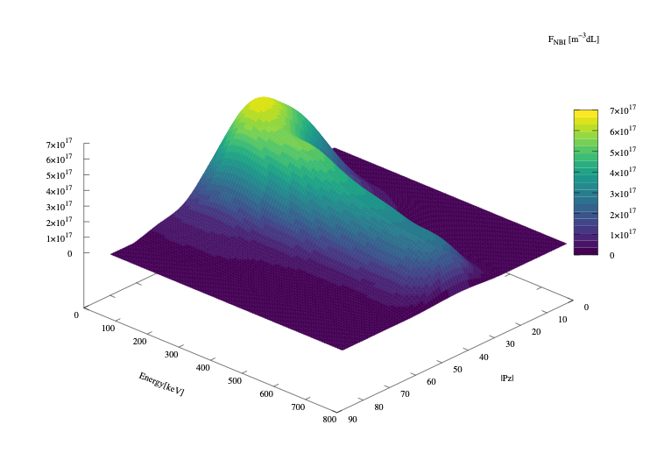

ATEP: kick model limit
orbit+zonal averaging
<dPΦ/dt>
Λ=μB/E
calculate PSZS
rho_pol_norm
saturation rule/E
use
NL code/model
for intensity closure
advance
FEP
and return
updated distribution IDS,
or its moments
calculate
D(r,E)
or
or kick
model
calculate
linear mode
spectrum
EP WF: LIGKA [20]
ATEP code
[Ph. Lauber, G. Meng,2022]
FEP (CoM)
t
t+1
mhd_linear
distributions
core profiles
transport code
core_transport
time →
equilibrium
time
Matteo Valerio Falessi | CIP 2026 | Frascati | 03/02/2026 – 06/06/2025 | Page 29

Slide 30
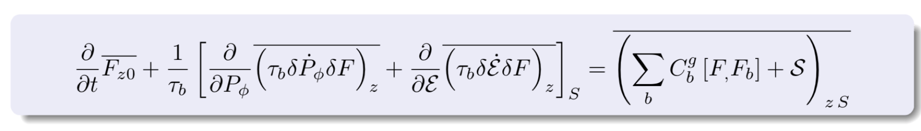
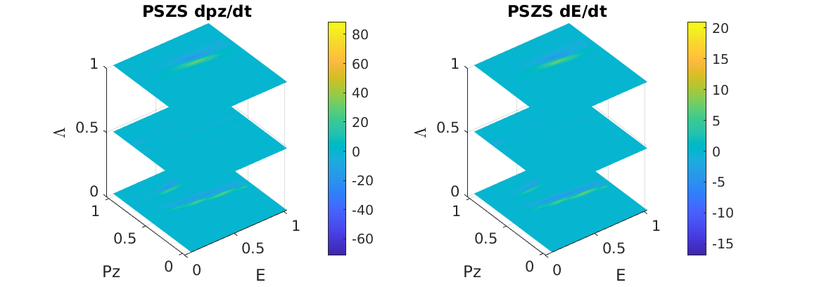
Phase Space fluxes
G. Meng et al. Invited talk @ EPS 2024 Salamanca
Matteo Valerio Falessi | CIP 2026 | Frascati | 03/02/2026 – 06/06/2025 | Page 30
Notes:
Mettere imagine a Maggiore risoluzione

Slide 31

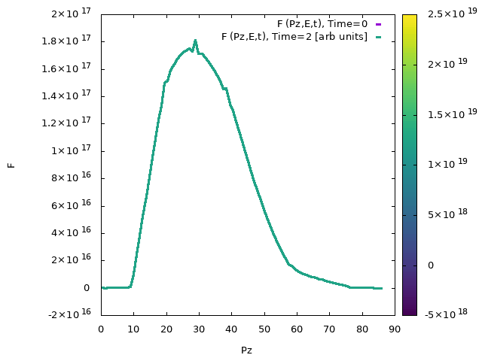
PSZS evolution
ATEP code: solve transport equation for PSZS with sources and collisions, Lauber 2022
ITER plasma from H&CD WF by M. Schneider
Matteo Valerio Falessi | CIP 2026 | Frascati | 03/02/2026 – 06/06/2025 | Page 31

Slide 32
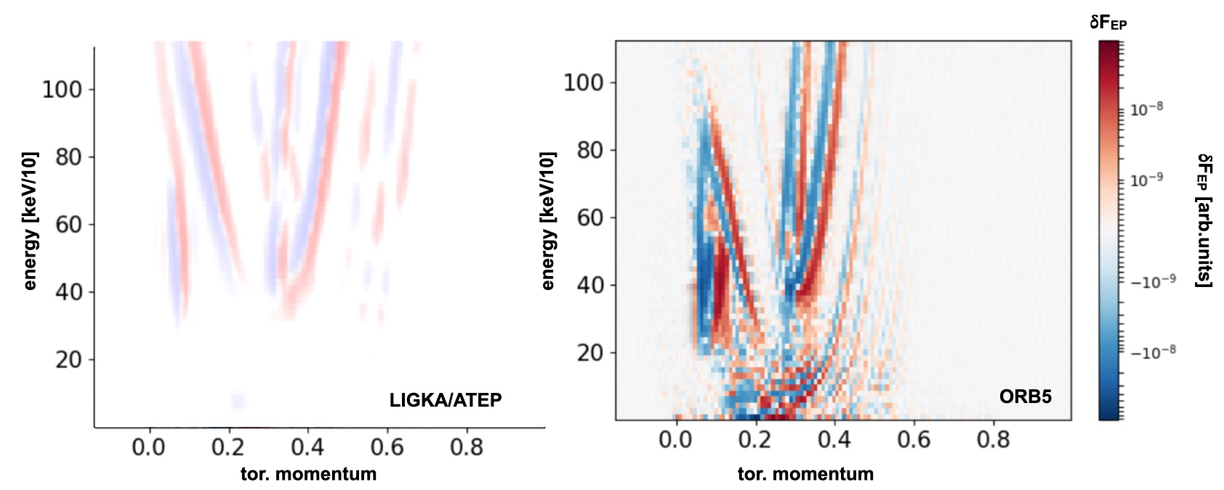
PSZS moments
Phase-space fluxes computed with ATEP 3D and ORB5 demonstrate a good level of consistency

Slide 33
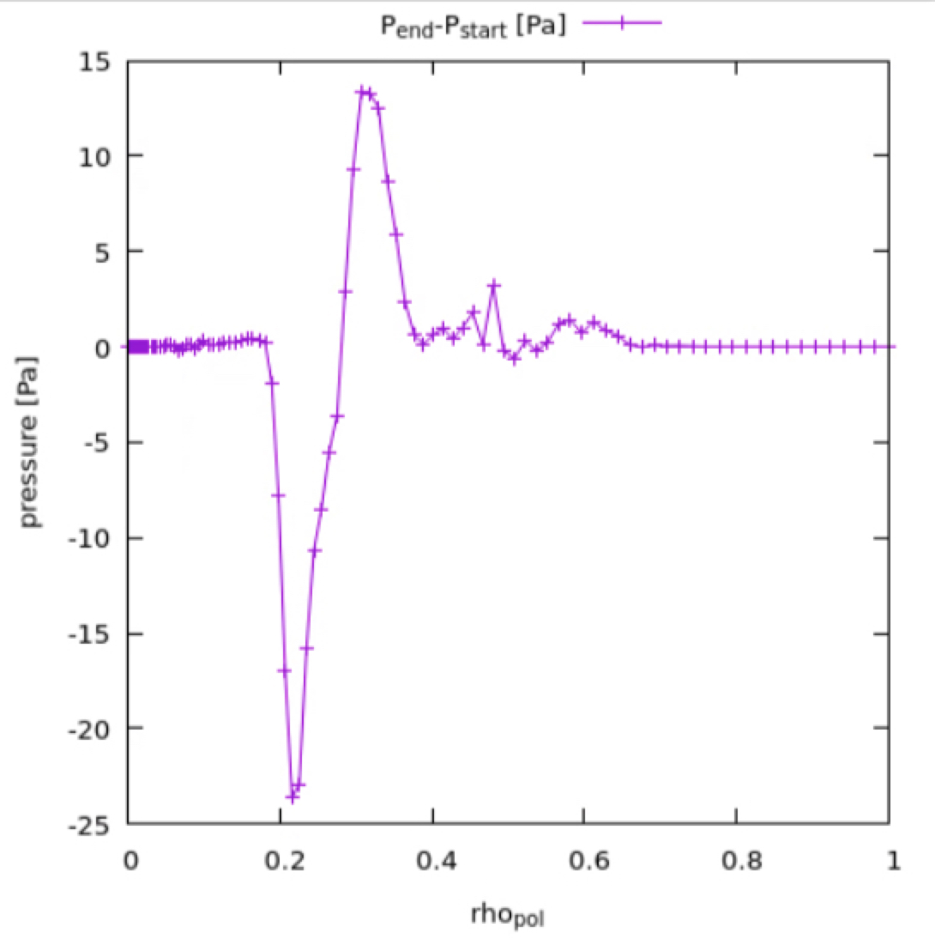
PSZS moments
Mapping to 1d profile of PSZS;
The CGL equilibrium can be readily constructed Falessi et al NJP 2023;
transport is zonal by construction;
Next step is the calculation of the corresponding magnetic equilibrium;

Slide 34
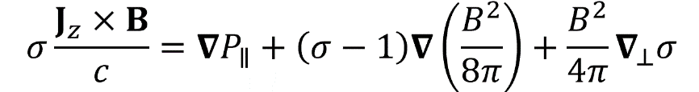
PSZS moments
Mapping to 1d profile of PSZS;
The CGL equilibrium can be readily constructed Falessi et al NJP 2023;
Next step is the calculation of the corresponding magnetic equilibrium;

Slide 35
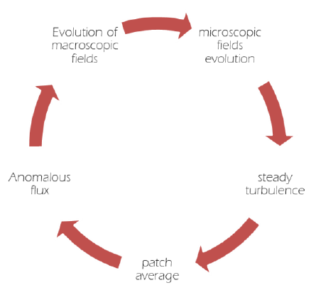

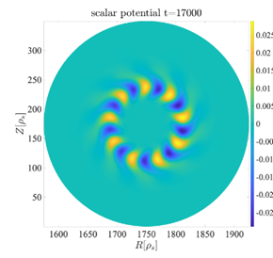
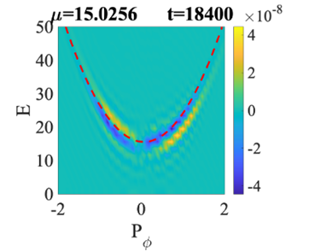
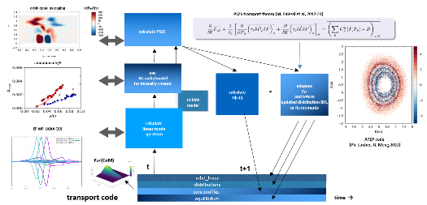
Summary & Conclusions
Need of predictive transport models on timescales comparable with magnetic fusion experiments, i.e., ITER, properly describing EPs;
we have shown how to describe meso-scales and non-Maxwellian distribution functions using appropriate phase transport equations;
we have introduced the concept of zonal state to describe the evolution of the plasma between neighboring nonlinear equilibria;
we have introduced a framework which allow to study EP phase space transport over long time scales.
Matteo Valerio Falessi | CIP 2026 | Frascati | 03/02/2026 – 06/06/2025 | Page 35

Slide 36
Summary & Conclusions
Need of predictive transport models on timescales comparable with magnetic fusion experiments, i.e., ITER, properly describing EPs;
we have shown how to describe meso-scales and non-Maxwellian distribution functions using appropriate phase transport equations;
we have introduced the concept of zonal state to describe the evolution of the plasma between neighboring nonlinear equilibria;
we have introduced a framework which allow to study EP phase space transport over long time scales.
Matteo Valerio Falessi | CIP 2026 | Frascati | 03/02/2026 – 06/06/2025 | Page 36

Slide 37
Summary & Conclusions
Need of predictive transport models on timescales comparable with magnetic fusion experiments, i.e., ITER, properly describing EPs;
we have shown how to describe meso-scales and non-Maxwellian distribution functions using appropriate phase transport equations;
we have introduced the concept of zonal state to describe the evolution of the plasma between neighboring nonlinear equilibria;
we have introduced a framework which allow to study EP phase space transport over long time scales.
Matteo Valerio Falessi | CIP 2026 | Frascati | 03/02/2026 – 06/06/2025 | Page 37

Slide 38
Summary & Conclusions
Need of predictive transport models on timescales comparable with magnetic fusion experiments, i.e., ITER, properly describing EPs;
we have shown how to describe meso-scales and non-Maxwellian distribution functions using appropriate phase transport equations;
we have introduced the concept of zonal state to describe the evolution of the plasma between neighboring nonlinear equilibria;
we have introduced a framework which allow to study EP phase space transport over long time scales.
Matteo Valerio Falessi | CIP 2026 | Frascati | 03/02/2026 – 06/06/2025 | Page 38

Slide 39


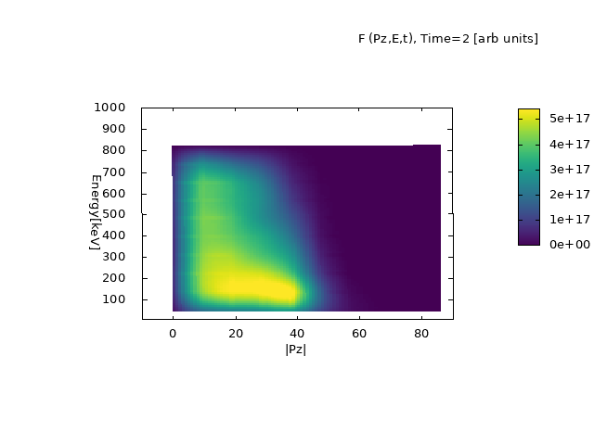
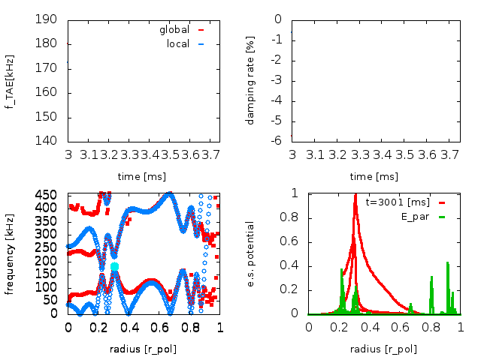



ATEP: Quasilinear model
<dPz/dt>
ATEP code: solve transport equation for PSZS with sources and collisions Lauber 2022
Λ=μB/E
calculate PSZS
rho_pol_norm
saturation rule: HAGIS or ORB5
use
NL code/model
for intensity closure
advance
FEP
and return
updated distribution IDS,
or its moments
calculate
D(r,E)
or
calculate
linear mode
spectrum
EP WF (LIGKA)
t
t+1
core_transport
equilibrium
transport code
mhd_linear
time
distributions
39
Matteo Valerio Falessi | FISMAT 2025| Venezia | 07/06/2025 – 11/06/2025 | Page 39

Slide 40
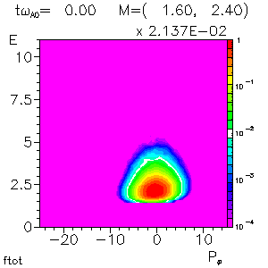
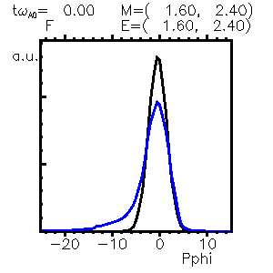
PSZS diagnostic in HMGC
Courtesy of S. Briguglio
Matteo Valerio Falessi | FISMAT 2025| Venezia | 07/06/2025 – 11/06/2025 | Page 40
Notes:
- Referenza briguglio

Slide 41
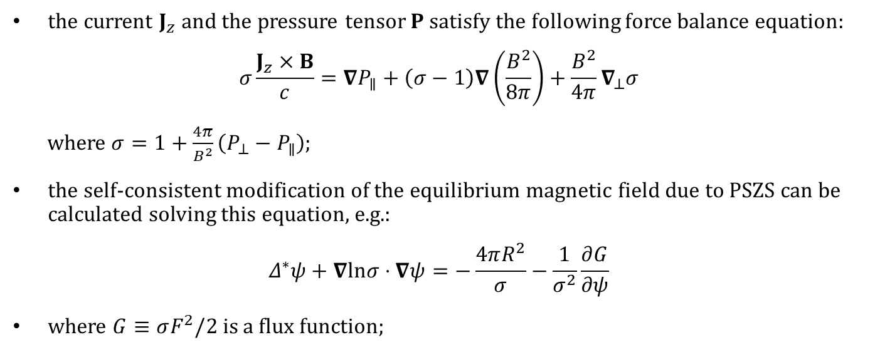
Zonal fields: macro- /meso- scopic component
the current $J_{z}$ and the pressure tensor $P$ satisfy the following force balance equation:
$$σ\frac{J_{z}×B}{c}=∇P_{∥}+\left(σ−1\right)∇\left(\frac{B^{2}}{8π}\right)+\frac{B^{2}}{4π}∇_{⊥}σ$$
where $σ=1+\frac{4π}{B^{2}}\left(P_{⊥}−P_{∥}\right)$;
the self-consistent modification of the equilibrium magnetic field due to PSZS can be calculated solving this equation, e.g.:
$$Δ^{∗}ψ+∇lnσ⋅∇ψ=−\frac{4πR^{2}}{σ}−\frac{1}{σ^{2}}\frac{∂G}{∂ψ}$$
where $G≡σF^{2}/2$ is a flux function;
Matteo Valerio Falessi | FISMAT 2025| Venezia | 07/06/2025 – 11/06/2025 | Page 41

Slide 42

Reduced transport models
PSZS transport is studied by means of a hierarchy of verified and validated reduced models within an EUROfusion Enabling Research Project with P. Lauber as P.I.;
explicit expression of EP fluxes in PSZS equations have been calculated within the following hierarchy of simplifying assumptions:
the zeroth level of simplification consist in the gyrokinetics description of plasma dynamics;
the first level of simplification consist in assuming $\left|ω\right|≫τ_{NL}^{−1}∼γ_{L}$, Zonca et al 2021;
the second and final level of simplification is the quasilinear model
Matteo Valerio Falessi | SIF 2024 | Bologna | 09/09/2024 – 13/09/2024 | Page 42

Slide 43
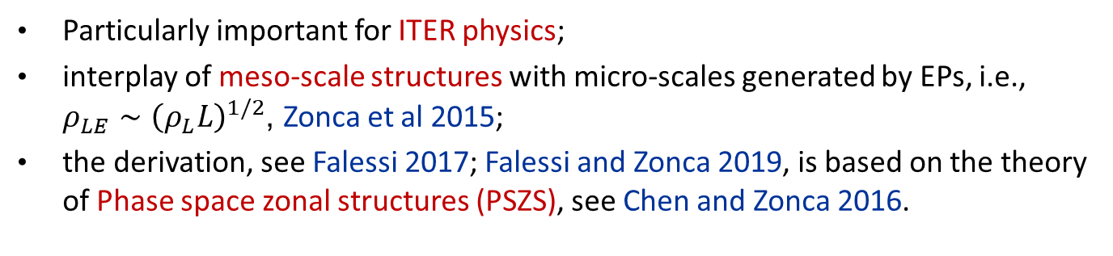
Transport processes in burning plasmas
EPs are generally non Maxwellian, and transport processes take place in the phase space!
Separation of scales is questionable…
Particularly important for ITER physics;
interplay of meso-scale structures with micro-scales generated by EPs, i.e., $ρ_{LE}∼{\left(ρ_{L}L\right)}^{1/2}$, Zonca et al 2015;
the derivation, see Falessi 2017; Falessi and Zonca 2019, is based on the theory of Phase space zonal structures (PSZS), see Chen and Zonca 2016.

Slide 44
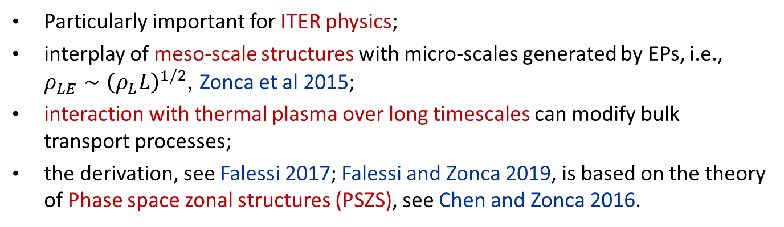
Transport processes in burning plasmas
EPs are generally non Maxwellian, and transport processes take place in the phase space!
Separation of scales is questionable…
Particularly important for ITER physics;
interplay of meso-scale structures with micro-scales generated by EPs, i.e., $ρ_{LE}∼{\left(ρ_{L}L\right)}^{1/2}$, Zonca et al 2015;
interaction with thermal plasma over long timescales can modify bulk transport processes;
the derivation, see Falessi 2017; Falessi and Zonca 2019, is based on the theory of Phase space zonal structures (PSZS), see Chen and Zonca 2016.

Slide 45


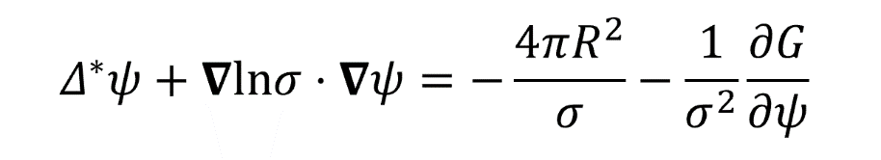
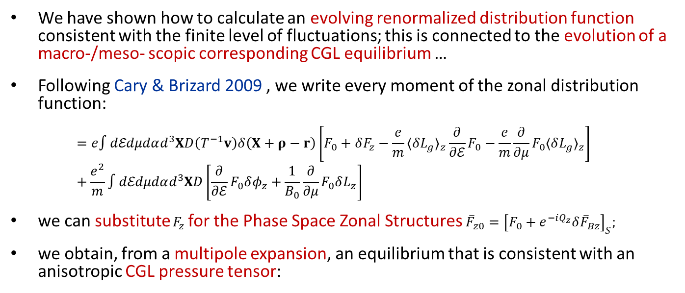
Zonal fields
We have shown how to calculate an evolving renormalized distribution function consistent with the finite level of fluctuations; this is connected to the evolution of a macro-/meso- scopic corresponding CGL equilibrium …
Following Cary & Brizard 2009 , we write every moment of the zonal distribution function:
$$=e∫dℰdμdαd^{3}XD\left(T^{−1}v\right)δ\left(X+ρ−r\right)\left[F_{0}+δF_{z}−\frac{e}{m}⟨δL_{g}⟩_{z}\frac{∂}{∂ℰ}F_{0}−\frac{e}{m}\frac{∂}{∂μ}F_{0}⟨δL_{g}⟩_{z}\right] +\frac{e^{2}}{m}∫dℰdμdαd^{3}XD\left[\frac{∂}{∂ℰ}F_{0}δφ_{z}+\frac{1}{B_{0}}\frac{∂}{∂μ}F_{0}δL_{z}\right]$$
we can substitute $F_{z}$ for the Phase Space Zonal Structures ${\overset{‾}{F}}_{z0}={\left[F_{0}+e^{−iQ_{z}}δ{\overset{‾}{F}}_{Bz}\right]}_{S}$;
we obtain, from a multipole expansion, an equilibrium that is consistent with an anisotropic CGL pressure tensor:

Slide 46
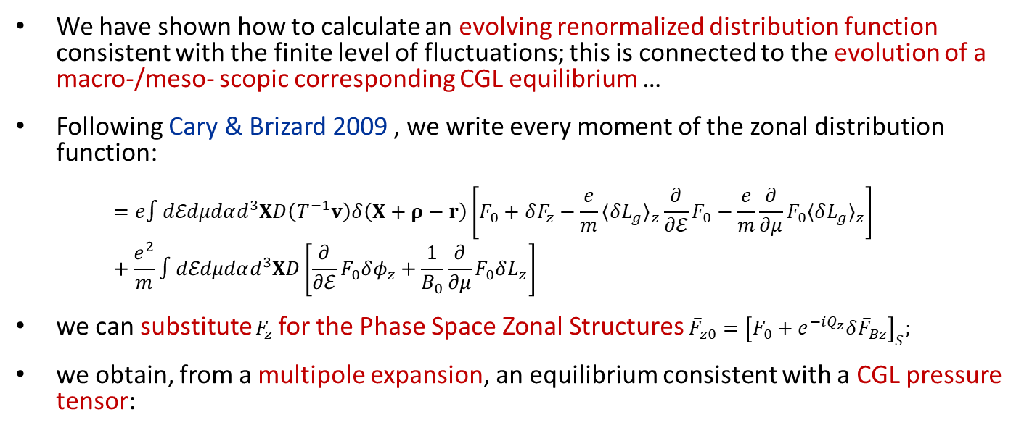
Zonal fields
We have shown how to calculate an evolving renormalized distribution function consistent with the finite level of fluctuations; this is connected to the evolution of a macro-/meso- scopic corresponding CGL equilibrium …
Following Cary & Brizard 2009 , we write every moment of the zonal distribution function:
$$=e∫dℰdμdαd^{3}XD\left(T^{−1}v\right)δ\left(X+ρ−r\right)\left[F_{0}+δF_{z}−\frac{e}{m}⟨δL_{g}⟩_{z}\frac{∂}{∂ℰ}F_{0}−\frac{e}{m}\frac{∂}{∂μ}F_{0}⟨δL_{g}⟩_{z}\right] +\frac{e^{2}}{m}∫dℰdμdαd^{3}XD\left[\frac{∂}{∂ℰ}F_{0}δφ_{z}+\frac{1}{B_{0}}\frac{∂}{∂μ}F_{0}δL_{z}\right]$$
we can substitute $F_{z}$ for the Phase Space Zonal Structures ${\overset{‾}{F}}_{z0}={\left[F_{0}+e^{−iQ_{z}}δ{\overset{‾}{F}}_{Bz}\right]}_{S}$;
we obtain, from a multipole expansion, an equilibrium consistent with a CGL pressure tensor:

Slide 47
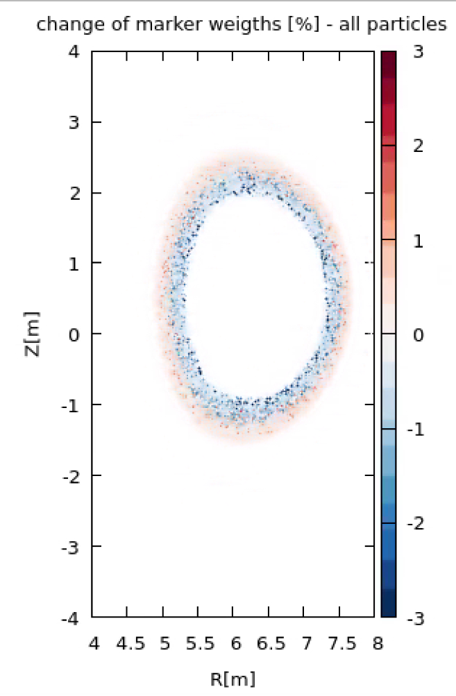
PSZS moments
Mapping to 1d profile of PSZS;
The CGL equilibrium can be readily constructed Falessi et al 2023 sub;
transport is zonal by construction;
Next step is the calculation of the corresponding magnetic equilibrium;
ATEP code: solve transport equation for PSZS with sources and collisions, Lauber 2022

Slide 48
Purpose statement
We aim at 1. providing the general expressions describing EPs (plasma) dynamics on long time scales (transport) and 2. introducing a framework to solve these equations within different levels of reduced dynamics.
By means of this approach it will be possible to:
define the concept of nonlinear equilibrium;
describe the physics of burning plasmas where alpha particles will play a key role in transport studies by interacting with thermal components;
the derivation, see Falessi 2017; Falessi and Zonca 2019, is based on the Phase space zonal structures theory, see Chen and Zonca 2016.
Matteo Valerio Falessi | SIF 2024 | Bologna | 09/09/2024 – 13/09/2024 | Page 48

Slide 49
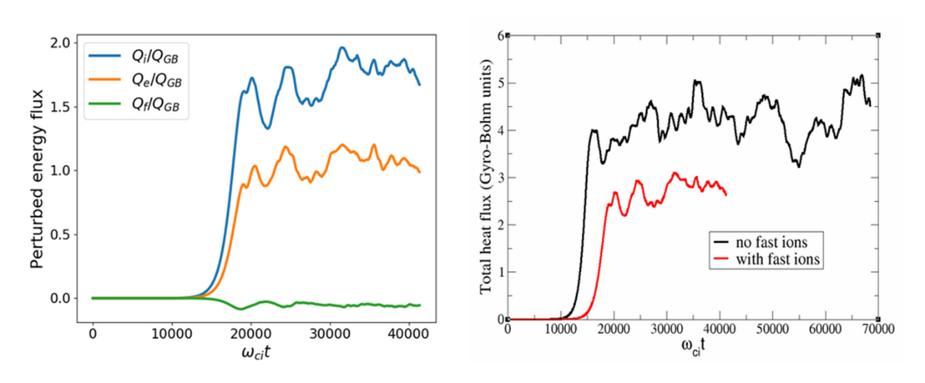
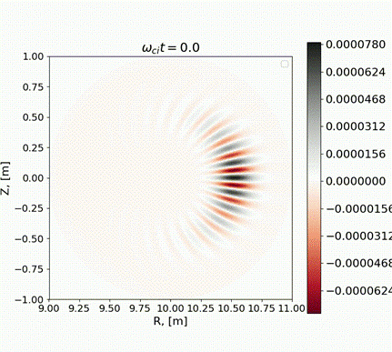
Neighboring nonlinear equilibria
Nonlinear gyrokinetic simulations with ORB5 code demonstrate clear reduction in the heat flux for both the bulk ions and the electrons
Matteo Valerio Falessi | FISMAT 2025| Venezia | 07/06/2025 – 11/06/2025 | Page 49

