Slide 1
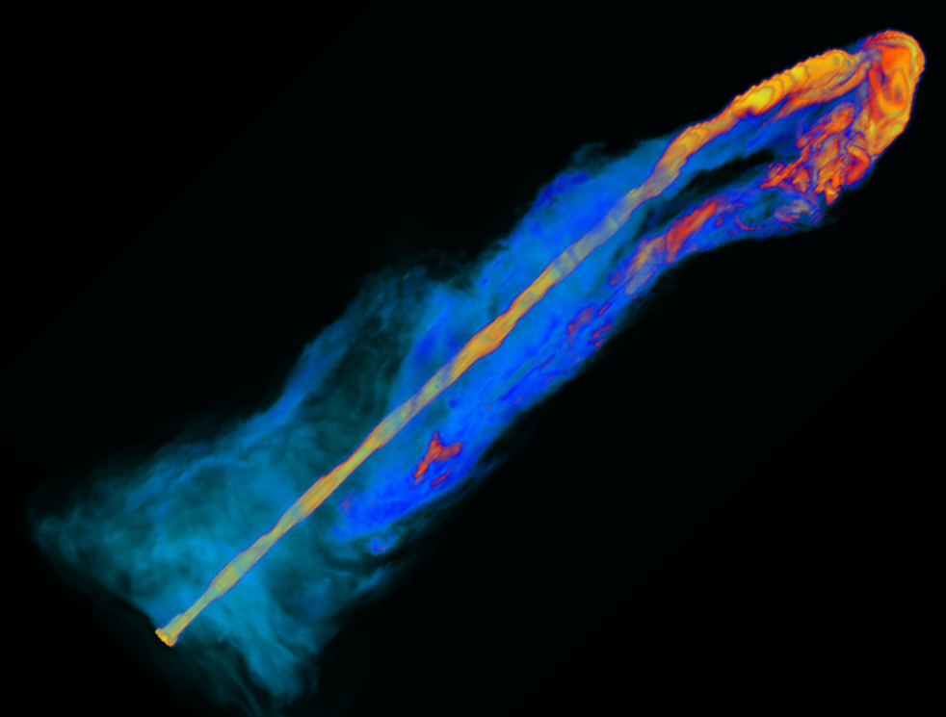
ASTROPHYSICAL JET MODELING
Paola Rossi,
G. Bodo,A.Costa,S.Massaglia,
A. Mignone, A. Suriano and C. Zanni

Slide 2
1. What we mean by jet ?
Astrohysical jets are collimated supersonic (relativistic) flows
along which mass, momentum, energy and magnetic flux are
channeled from several astrophysical objects to outer medium.
2. Where do we find jets ?
Astrohysical jets are present in many astronomical objects, they
span a wide range of spatial scales: on stellar scale we find them
in the solar corona, in the first phases of stellar evolution (YSO) or
in the last phases of stellar evolution (X-ray binaries, X-ray transients,
Pulsars, GRBs …). On the extragalactic scale (AGN jets)
3. Why do we study jets ?
On one side they can provide information about their sources,
on the other side they may have a strong impact on the surrounding
medium.

Slide 3
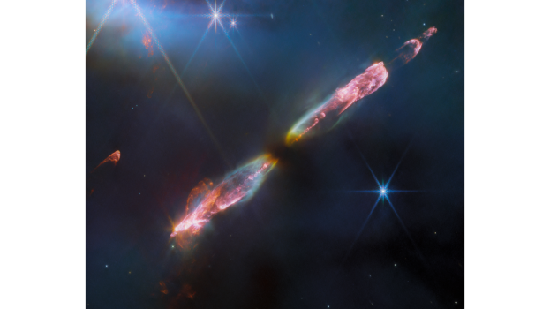
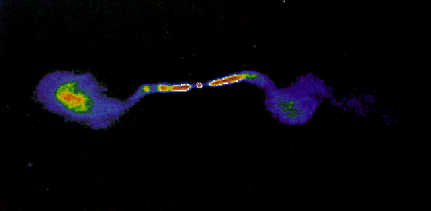
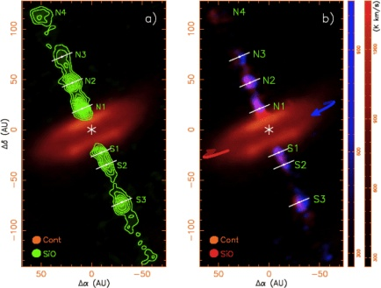

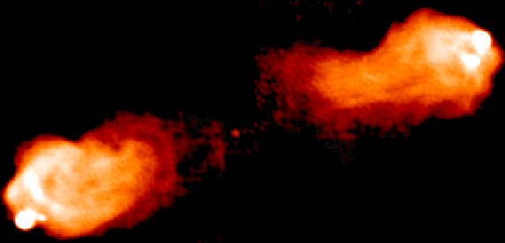
Stellar jets
AGN jets
HH 211
3C 449
VLA
Ray & Ferreira,2021
HH 212
Cygnus A
VLA
Crab nebula
X-ray: NASA/CXC/SAO
Optical: NASA/STSCI
IR: NASA/JPL/Caltech

Slide 4
Similarities and differences
 | YSO jet <= pc | AGN jets > kpc
Central object | Star | SMBH
Radiation | Thermal | Non-Thermal
Spectrum | Optical, IR | Radio to gamma rays
Compositions | (e-,p+) | (e-,p+), (e-,e+), e.m.
Jet power | 10³⁰⁻³³ erg/s | 10⁴⁰⁻⁴⁷ erg/s
Mach Number | 20-40 | >> 1 (relativistic)
Density ratio (jet/am) | ca 1 | <<1

Slide 5
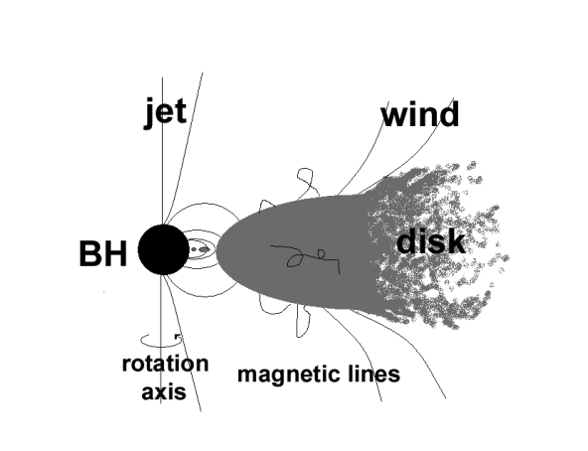
The jet-disk paradigm
Ingredients:
Central object creating a strong gravitational field
Accretion disk
Magnetic field (turbulent in the disk, ordered in magnetosphere)
Strongly collimated outflow along the rotation axis
Collimated wind arising from the disk
Star
Accretion and ejection are strongly connected

Slide 6
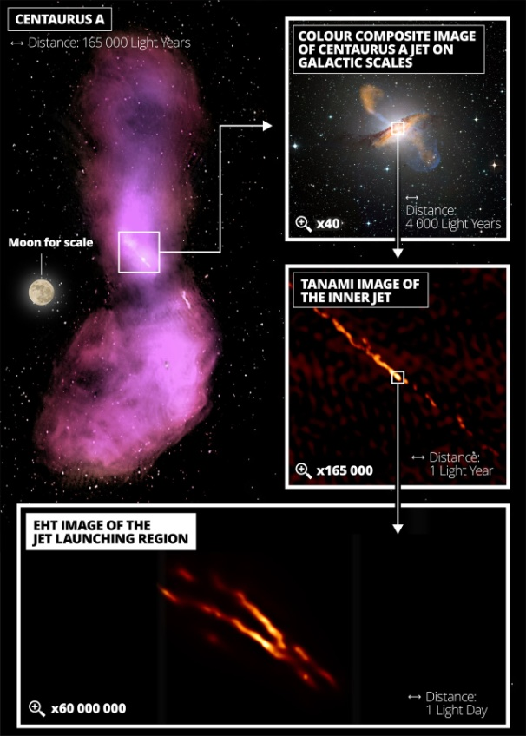
How can we approach the jet physics?
500 kpc
10kpc
• Launching phase:acceleration
from BH/disk and collimation
• Propagation phase:
confinement and stability
• Termination: Termination
interaction with external medium
• High-energy electron
acceleration
10¹⁵ cm
1-100 kpc
> 100 kpc (3 x 10²³ cm)
10⁴ cm
5 pc
0.01 pc

Slide 7
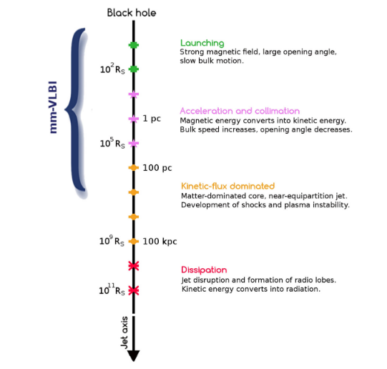
Launching phase:
Acceleration either from disk or BH
And collimation
Propagation phase:
Confinement and stability
Termination:
Interaction with external medium
Non thermal emission:
High energy electron acceleration
Modeling through relativistic MHD simulation

Slide 8
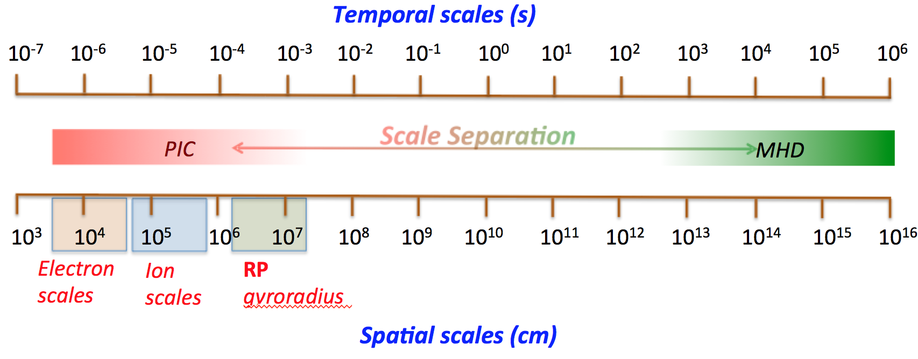
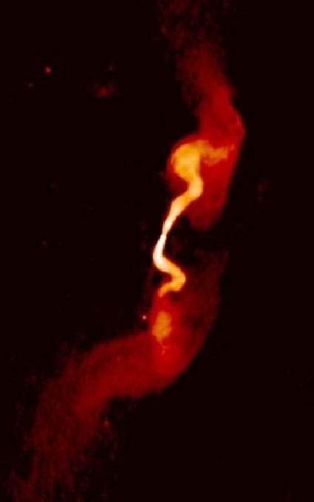
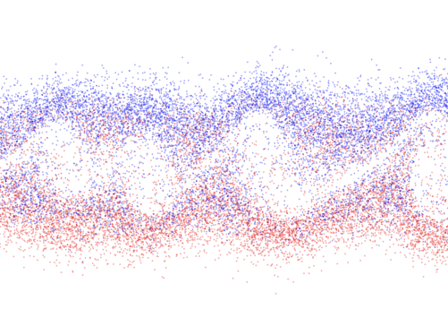
Astrophysical environments involve physical processes operating at extremely different spatial and temporal scales, and complex interactions between plasmas and radiation.
Kinetic
Fluid
10 ¹ → 10 ² s
10⁴ → 10⁷ cm
10¹⁰ → 10¹⁵ s
10¹⁸ → 10²⁴ cm
How we can connect?
Particles acceleration
And radiation processes
Ideal MHD modeling
No resistivity, no viscosity
PLUTO code

Slide 9
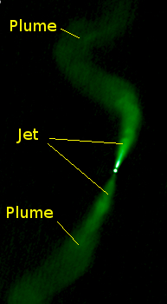
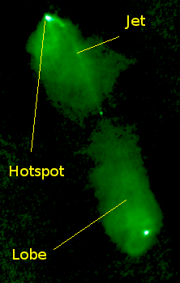
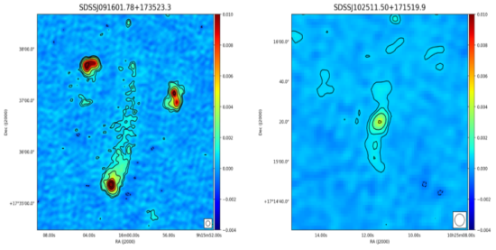
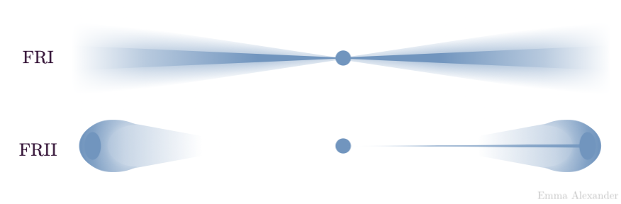
Warning!!!
Also the macrophysics involves a huge range of scale
LOFAR
3C 98
VLA
3C 31
VLA
Multiscale approach
Turbulent propagation
up to 100 kpc
Launching region
10¹⁵ cm
Propagation region with
deceleration < 1 kpc
At the base all jets start
relativistic with similar
Lorentz factor
(Giovannini+, 2001)
Termination shock,
hot spot
Propagation region with
No Deceleration 1-100 kpc

Slide 10
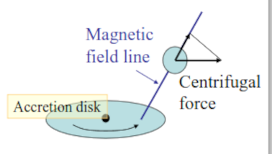
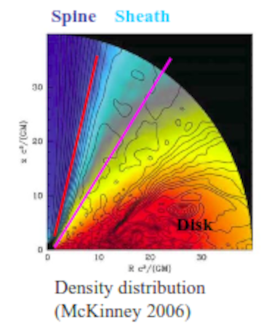
Launching phase
Origin:
BH (Blandford & Znajek 1977) → extraction of BH rotational energy
Disk (Blandford & Payne 1982) → magnetocentrifugal acceleration
Main ingredients:
Rotation
Magnetic field
Many GRMHD simulations of jet formation (Port+,2019…)
suggest that :
jet spine (Poynting flux jet) is driven by BZ process may be
surrounded by a broad sheath wind driven by the magnetic
field anchored in the accretion disk.
Open problem:
How the Poynting flux turn in a matter dominated jet?
Possibility: CD instability due to the toroidal magnetic field
Review Mizuno,2022

Slide 11
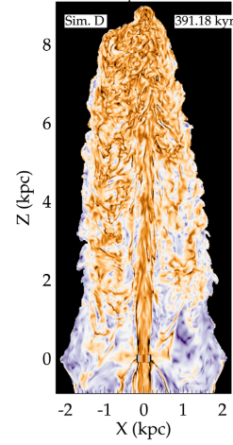
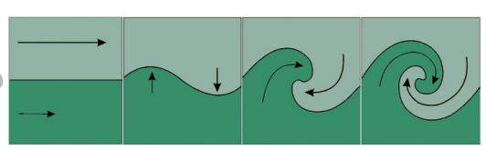

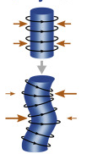
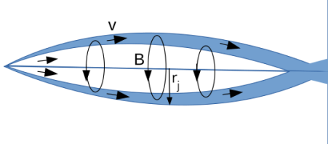
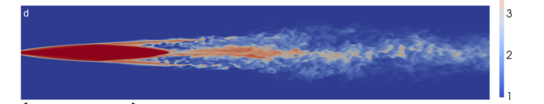
The MHD ins. are very important
in determining morphology,
dynamics and emission properties
of astrophysical jets.
Propagation phase
KELVIN HELMHOLTZ
CURRENT DRIVEN
CENTRIFUGAL

Slide 12
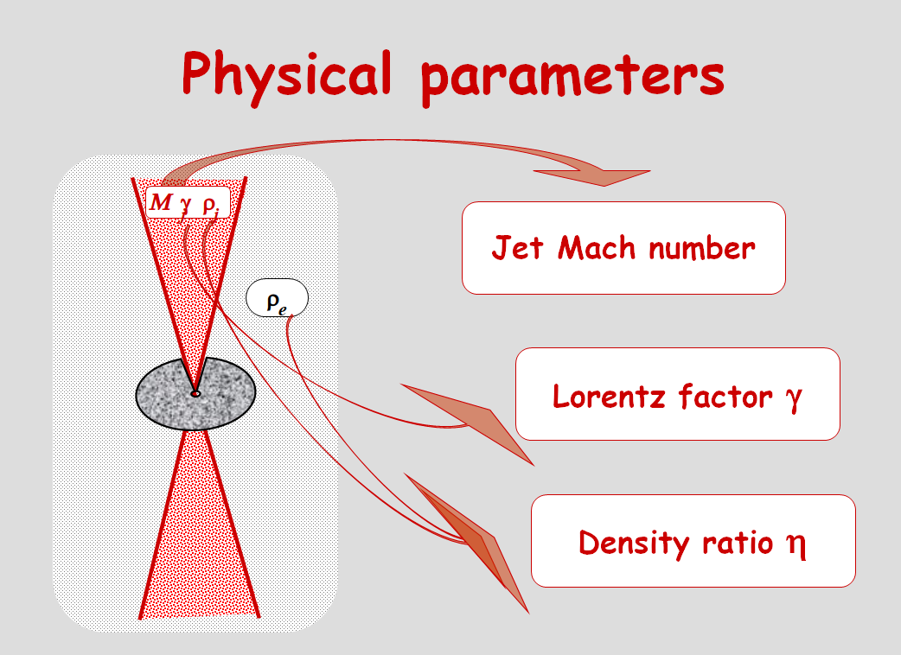

Is it possible to decelerate a relativistic jet to sub-relativistic
speed in the first kpc?
3C 98
VLA
Deceleration
Our purposes are to study
3C 31
VLA
How entrainment develops
pc
kpc
10
-2
-4
10
,10
43
45
10
,10
erg s
-1
Constant external density
inside the galaxy core

Slide 13
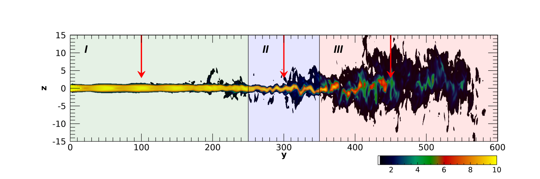
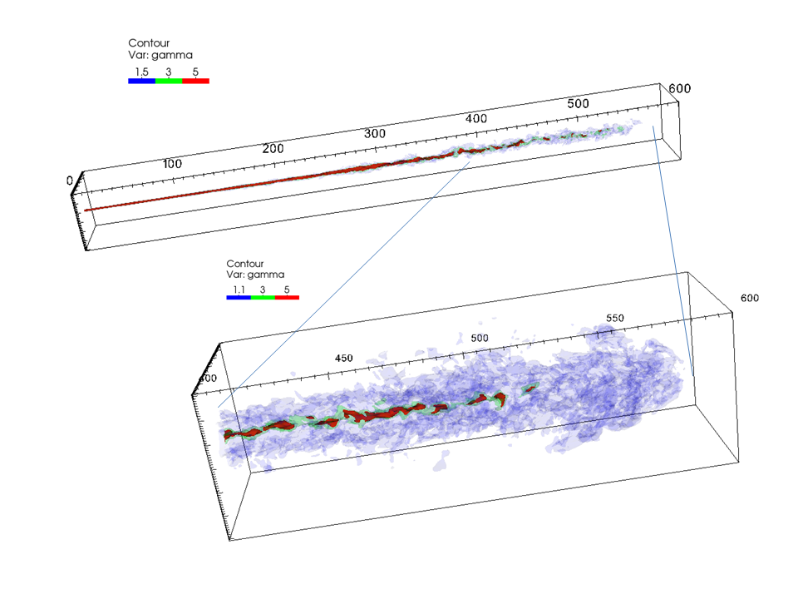
Jet instabilities: growth length-scale increases
with Lorentz factor and Mach number
Lorentz factor
Non linear growth
Mixing and mass entrainment
Jet deceleration
I ricollimation shocks
II growth of instabilities
III mixing and jet breaking
Rossi+, 2008,2020,2024

Slide 14
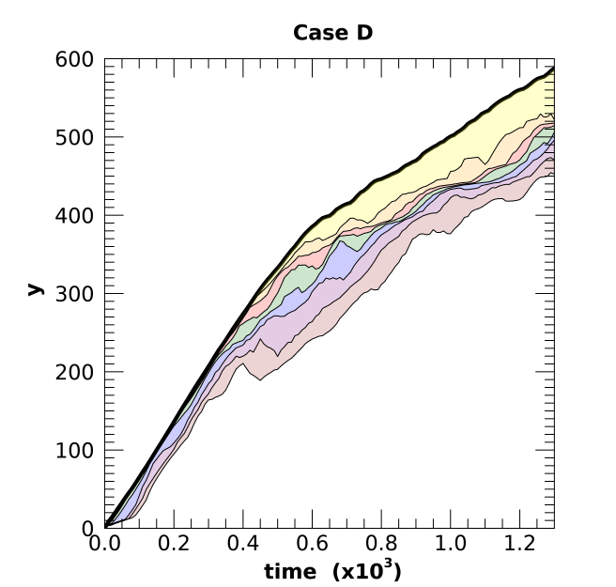
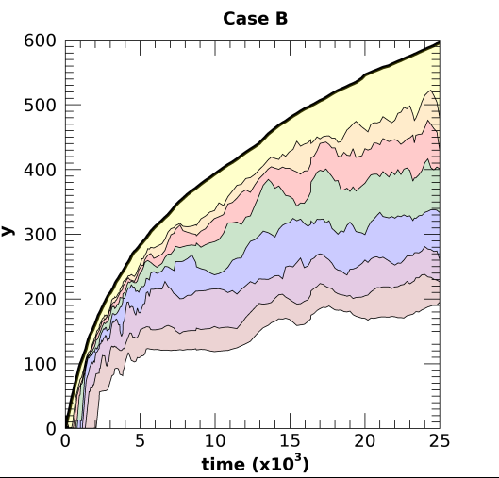

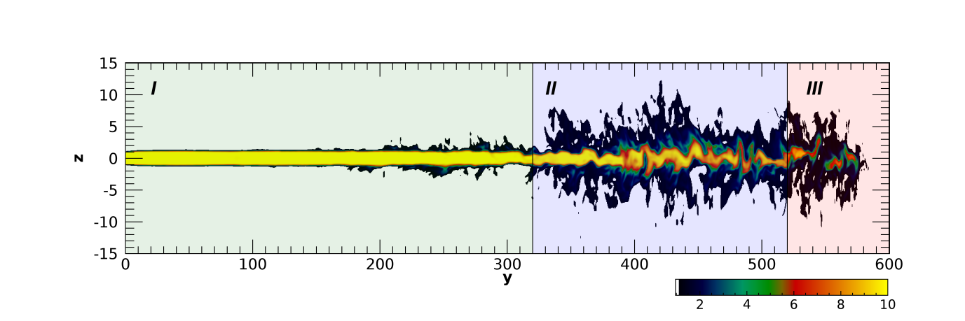
Each curve shows, as a
function of time, the distance
up to which relativistic material
(γ>5) carries more than certain
fraction of the initial momentum
flux: 70%,60%,50%......10%
Strong deceleration
Strong entrainment
Steady state
Time unit:
Weak deceleration
Weak entrainment
No Steady state

Slide 15
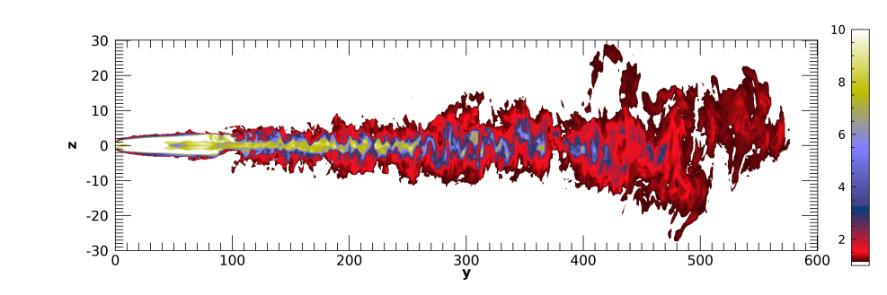
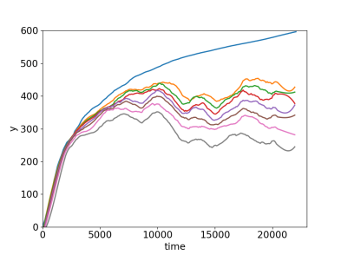
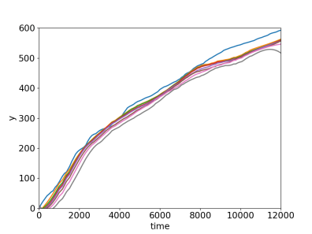
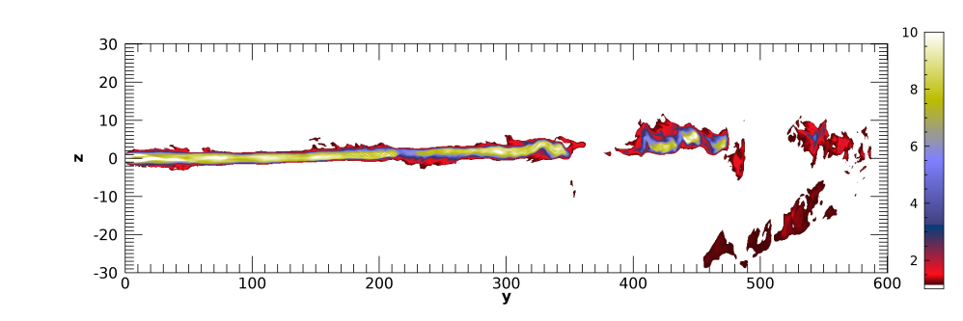
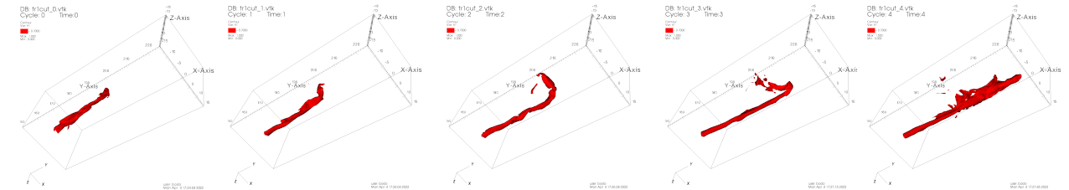
Magnetic effects
Magnetic field reduces
entrainment, stabilizing
KH inst. .
New inst. (current-driven)
starts deforming the jet
without deceleration.

Slide 16
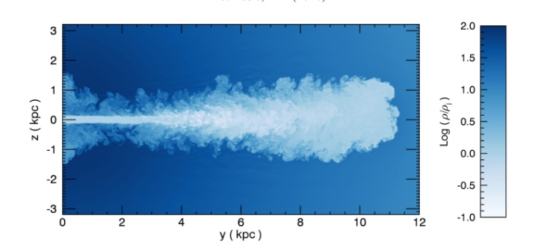
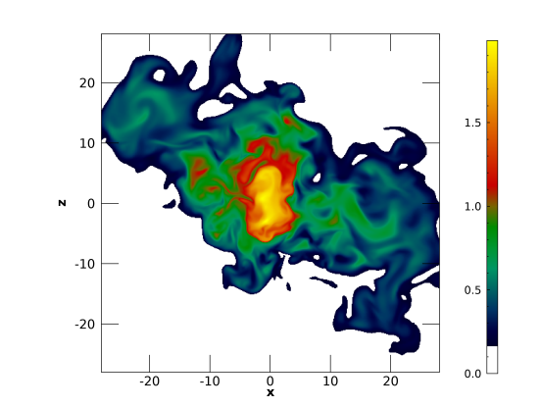

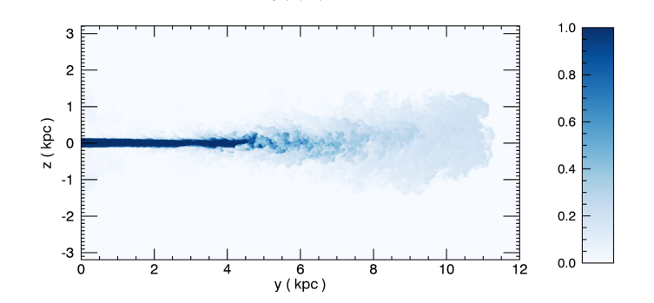
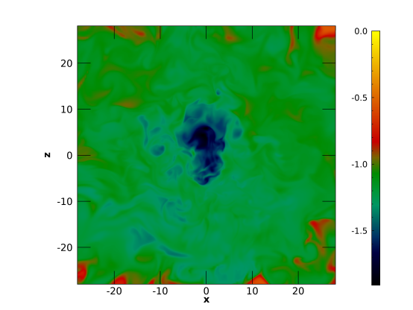

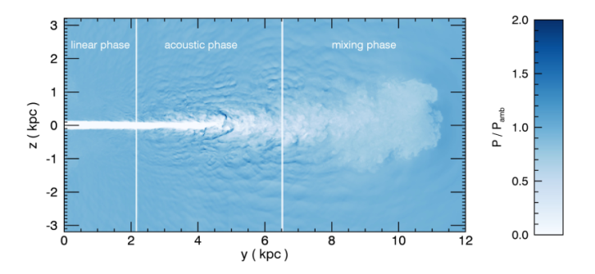
Turbulent propagation starting from 1 kpc
density
Mach number
Initial conditions:
tracer
We perform a set of simulations with similar conditions
Density
(0.06 c)
pressure
Non-relativistic with 3 different
external density stratification
(Massaglia et al. 2016)

Slide 17
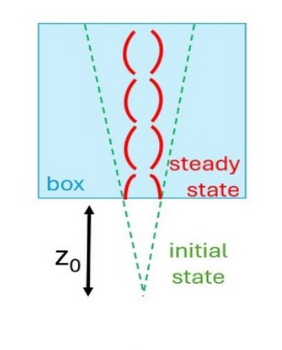
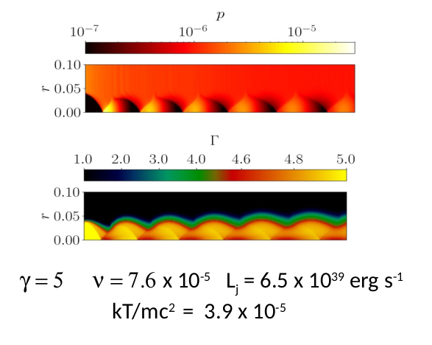
LOFAR
For the very low power jet (FR0) can we find a mechanism that stop the
Jet at even smaller distance?
The external pressure or the wind surrounding the jet may collimate the jet inducing a series of recollimation shocks
2D studies of recollimation process show a formation of a chain of recollimation shocks , but in 3D this structure results to be unstable. The mechanism is the centrifugal inst. Connected with the curvature of the fluid
streamlines.

Slide 18
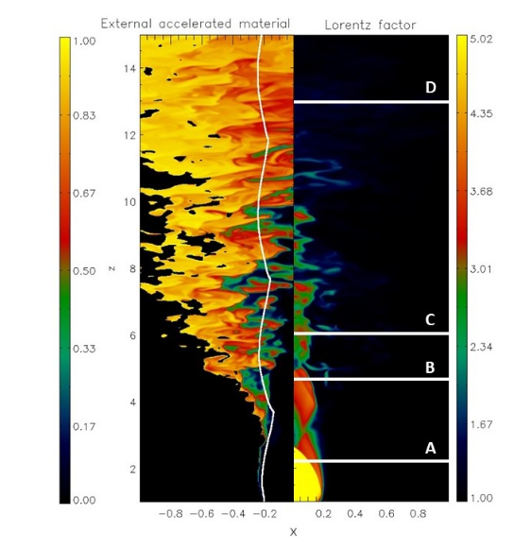
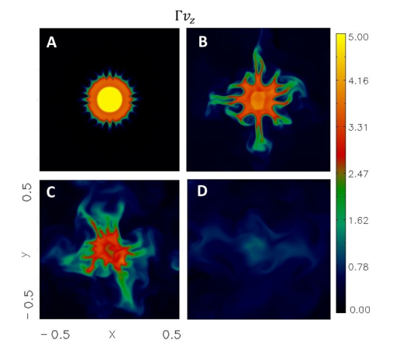
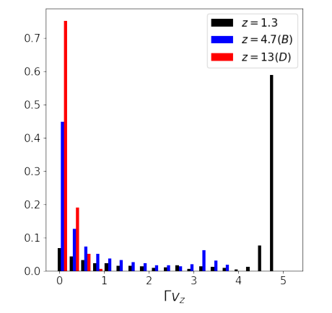
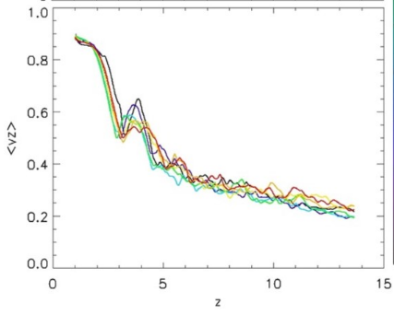
RECOLLIMATION SHOCKS AND FR0
Power 10⁴⁰ erg s⁻¹
Entrainment
Relativistic (γ = 5) up to about 3pc
Mildly relativistic up to about 10 pc
Subrelativistic at larger distances
Quasi steady-state
Costa+, 2024,2025

Slide 19
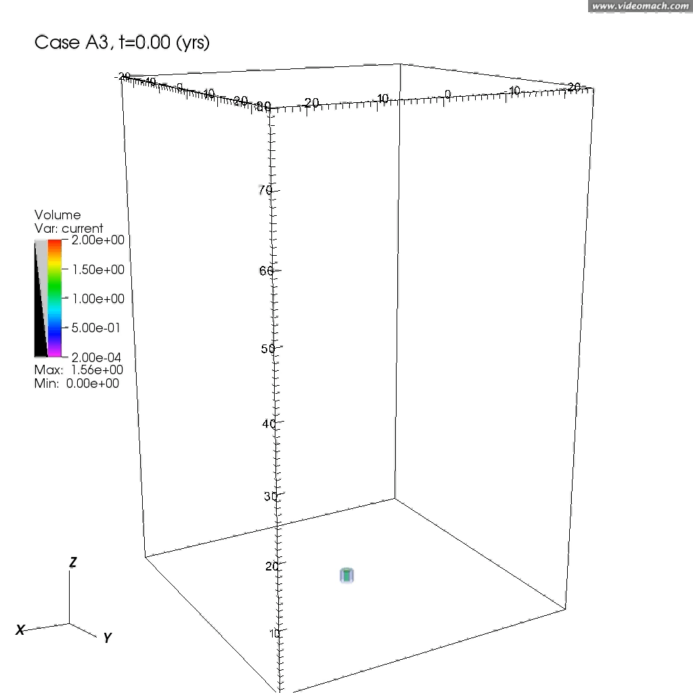

What about Current-Driven instabilities?
Dissipation & Particles acceleration: from the acceleration process we expect that
the toroidal magnetic field component is important → this may lead to current driven
instabilities → formation of current sheets and magnetic reconnection region
→ Particles acceleration
Jet morphologies: 3D simulations on a relativistic jet with a toroidal magnetic field
show a complex dynamics with bendings and wigglings of the jet head.
Bodo+2013,2016,2019,2021,2022; Mignone+ 2010; Massaglia+,2019,2022

Slide 20
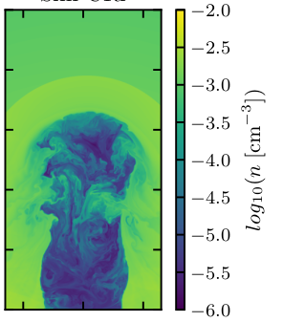
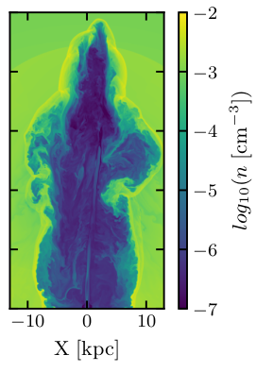
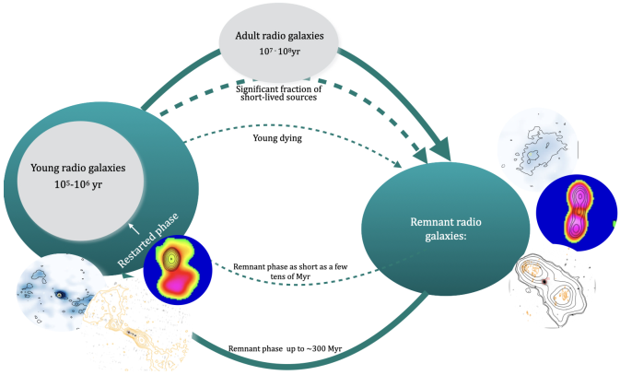
Termination phase
Jets deposit their energy either at the head (FRII) or gradually along their trajectory (FRI).
this process has an impact on the ambient medium and may have consequences both
for the host galaxies and for the intergalactic medium (jet feedback).
There are recent observational evidences that jets can have active recurrent phases
Morganti+ 2023
Ratnaparkhi+ 2026

Slide 21
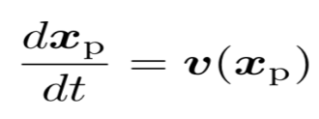
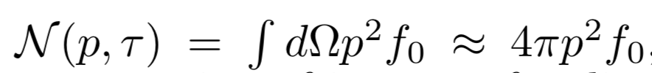

From macro to micro physics
Jets with new hybrid scheme: macro-particle* + fluid
*to each macro-particle we associate a
distribution function of non-thermal
relativistic particles
Macro-particles move at the fluid velocity
Evolution equation for the
distribution function
+
Energy losses, synchrotron, inverse Compton
Sub-grid model for acceleration at shocks (we take into account shock strength, orientation of magnetic field etc.)
Dissipation
regions
Sub-grid model based on PIC
simulations
Collisionless relativistic shocks
Relativistic magnetic reconnection
Transport eq. for cosmic rays Parker1965, Jokipii &Parker 1970,
Skilling 1975, Webb 1989.
Vaydia+ 2018
Mukherjee+ 2021

Slide 22

How the RMHD models can talk to radioastronomers
RMHD eqs + particle transport eq
Spatial evolution
They move at fluid velocity
+
Spectral evolution
Radiative losses+sub-grid model for acceleration at shocks
Observational properties

Slide 23
… next
Bridging the gap between dynamical and radiative properties of jets is fundamental
for comparing simulations with observations
This represents a challenge because of the huge scale differences.
Continuing to investigate sub-grid models in order to improve and to keep
updated with the latest microphysical results.
Developing a sub-grid model for particles acceleration at magnetic reconnection
(Nurisso+ 2023, Suriano+ 2026)
……

