Slide 1



From plasma physics to electric propulsion: magnetic reconnection for future space thrusters
GIULIA BECATTI¹, Nicola Orsini¹, Fabrizio Paganucci¹, and Dan M. Goebel³
¹Department of Civil and Industrial Engineering, University of Pisa, Pisa, Italy
²Jet Propulsion Laboratory, Pasadena, California, US

Slide 2
Presentation Outline
Introduction: space electric propulsion
Introduction: Magnetic reconnection thruster
Review of existing concepts for MR thrusters
Concept based on multi flux-ropes collisions
Expected performance parameters
Experimental campaign preliminary results
Next steps toward validation
Conclusions

Slide 3
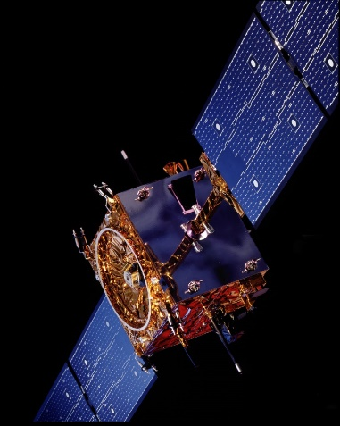
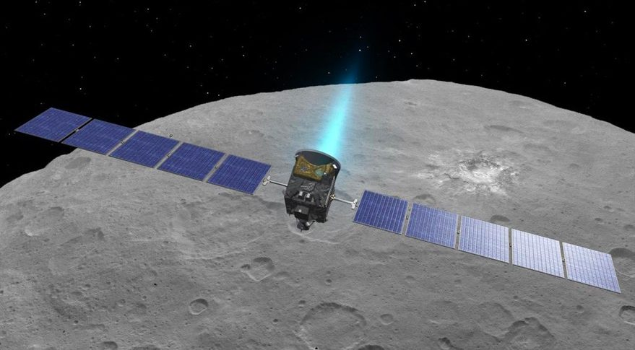
Introduction
Plasma Propulsion
Credit: ESA Smart 1
High values of efficiency and exhaust velocities an order of magnitude higher than typical chemical systems
Significant reduction of the propellant needed to perform a given mission.
Current applications of EP
  attitude control, station keeping, de-orbiting of satellites
  orbit raising of platforms to GEO, mission to Moon/Mars
  deep space exploration missions (e.g. DEEP SPACE 1, DAWN, SMART1, Bepi Colombo, Psyche …)
Credit: NASA DAWN

Slide 4
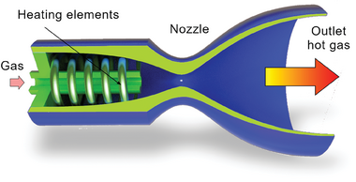
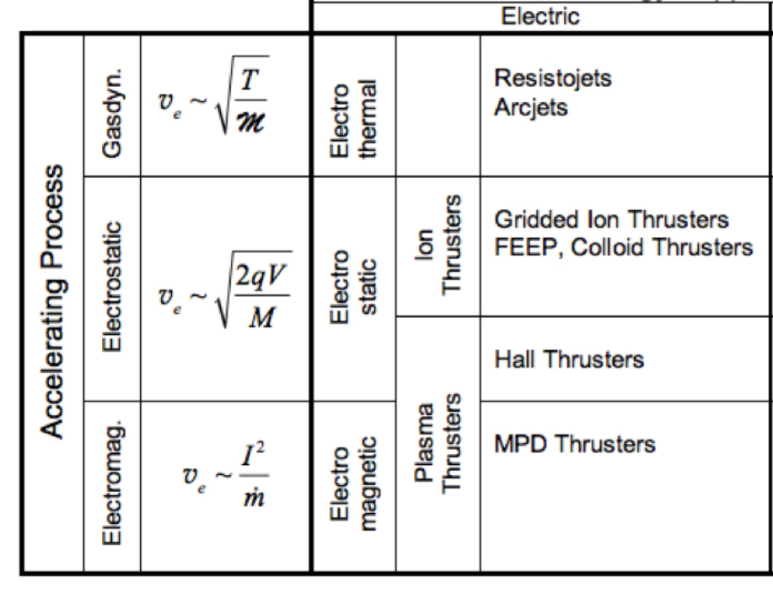
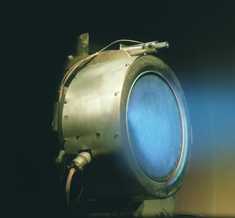
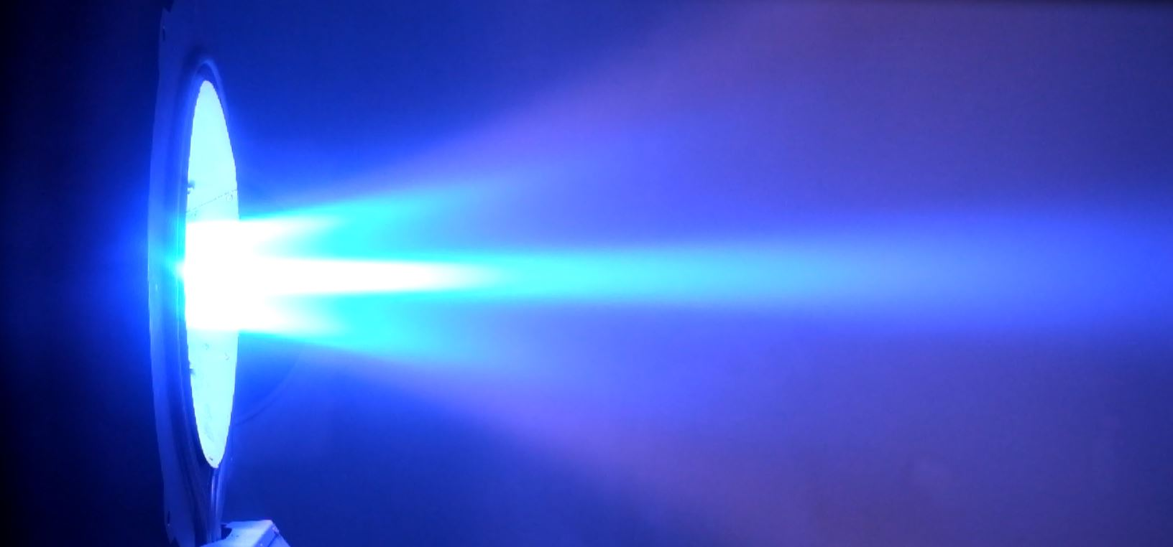
Introduction
Electric thrusters classification
Resistojet
Ion thruster
Hall thruster
AF-MPDT

Slide 5
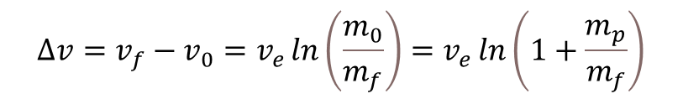

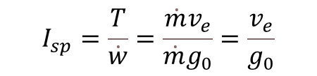
Introduction
$${∆v=v}_{f}−v_{0}=v_{e}\ln\left(\frac{m_{0}}{m_{f}}\right)=v_{e}\ln\left(1+\frac{m_{p}}{m_{f}}\right)$$
Tsiolkovsky equation of rockets
To achieve large $Δv:$ either burn a substantial amount of propellant ($m_{p}≈m_{0}$) or use a thruster able to generate a high $v_{e}$.
This second option leads to high $I_{sp}$ thrusters, where
* Depending on propellant used and applied mass flow
 | LEO-GEO | Nearby planets | Far-off planets
Delta-V required | 4.8 km/s | 5-8 km/s | 10-15 km/s
$$I_{sp}=\frac{T}{\dot{w}}=\frac{\dot{m}v_{e}}{\dot{m}g_{0}}=\frac{v_{e}}{g_{0}}$$
 | Resistojet | Arcjet | Ion thruster | Hall thruster | MPDT
Specific Impulse (s)* | 300 | 500-2000 | Up to 10000 | Up to 3000 | Up to 4500

Slide 6
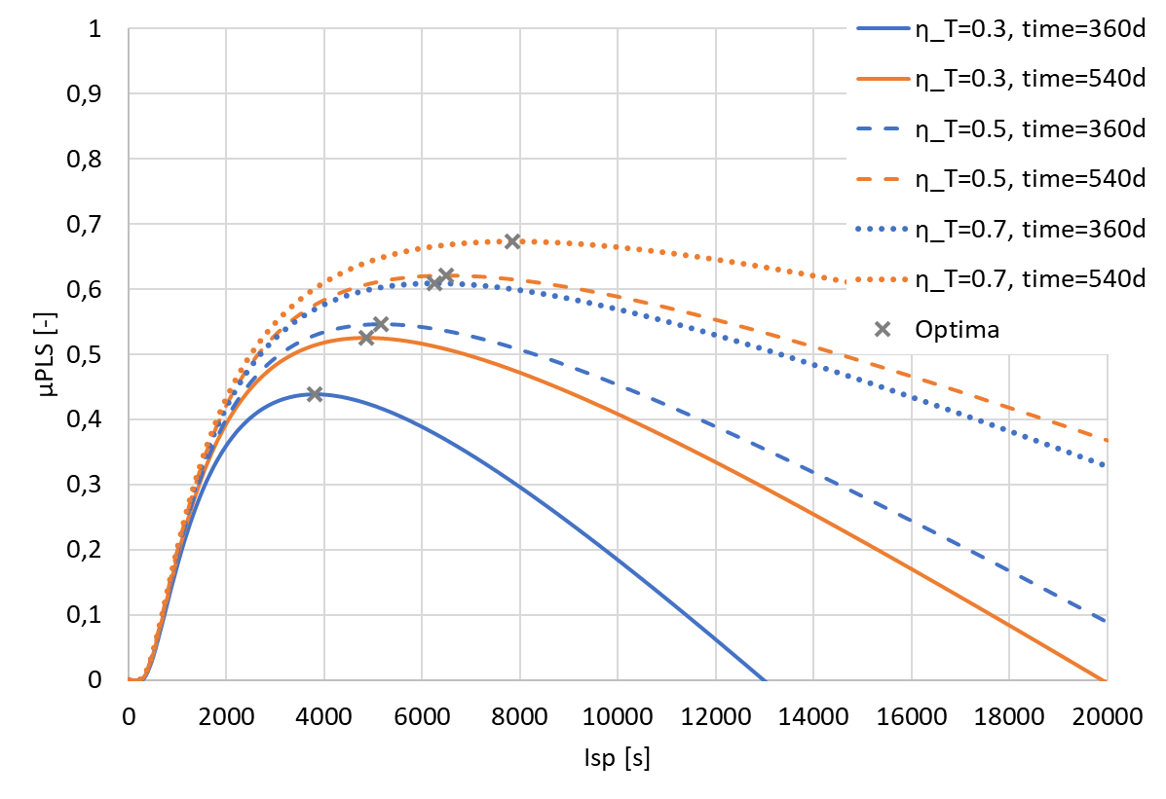
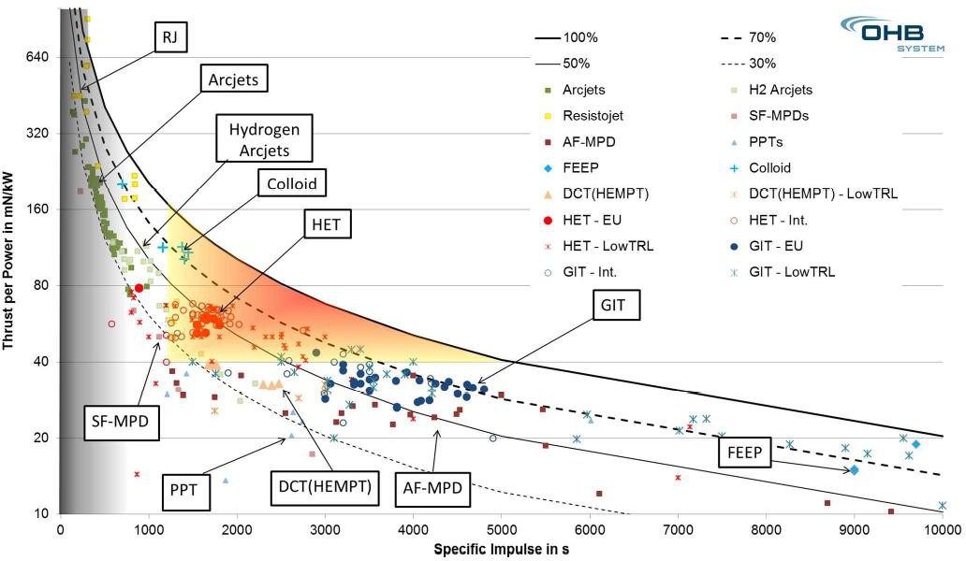
Introduction
By simply looking at the Rocket equation, one might be tempted to say that the highest I_{sp} the better it is…
Considering however the non-dimensional Rocket Equation we can find an optimal Isp for a given mission
Payload mass fraction
Peukert & Wollenhaupt EPIC 2014
Example: mission LEO to Ceres Orbit (between Mars and Jupiter)

Slide 7

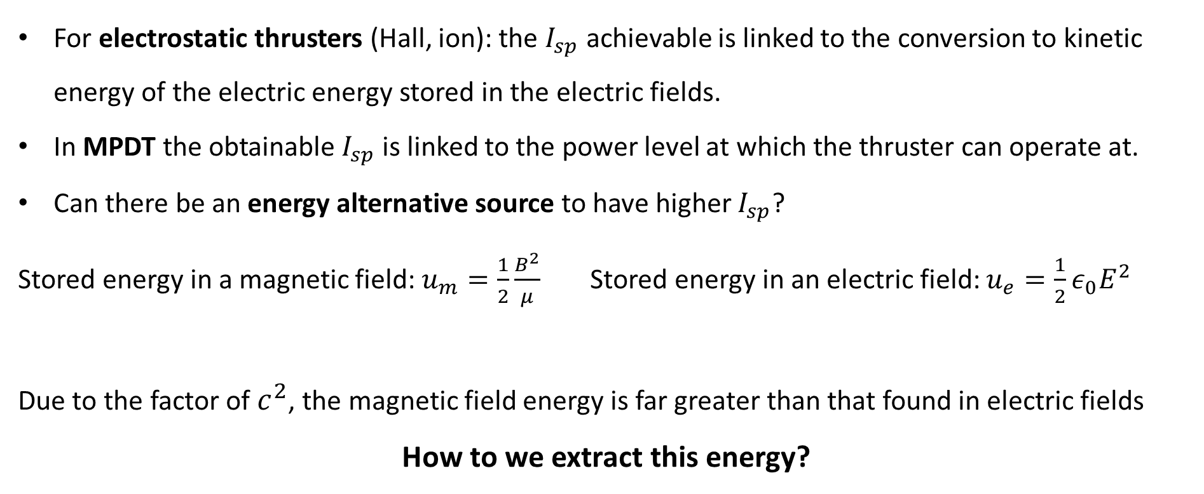
Introduction
For electrostatic thrusters (Hall, ion): the $I_{sp}$ achievable is linked to the conversion to kinetic energy of the electric energy stored in the electric fields.
In MPDT the obtainable $I_{sp}$ is linked to the power level at which the thruster can operate at.
Can there be an energy alternative source to have higher $I_{sp}$?
Stored energy in a magnetic field: $u_{m}=\frac{1}{2}\frac{B^{2}}{μ}$ Stored energy in an electric field: $u_{e}=\frac{1}{2}ε_{0}E^{2}$
Due to the factor of $c^{2}$, the magnetic field energy is far greater than that found in electric fields
How to we extract this energy?
$$\frac{u_{m}}{u_{e}}=c^{2}\frac{B^{2}}{E^{2}}$$

Slide 8
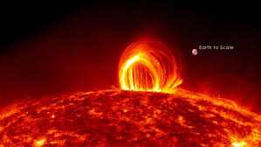
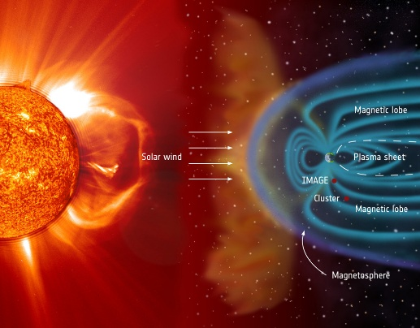
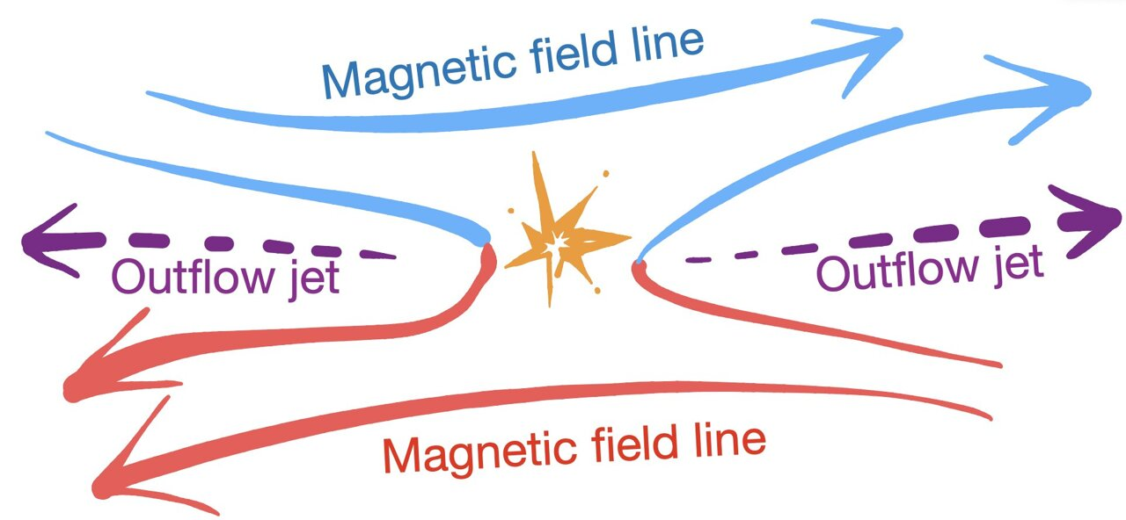
Introduction
The “easy” way comes from observing natural phenomena that continuously accelerate particles and plasma throughout release of the magnetic energy contained in the magnetic fields (Solar Flares, Coronal Mass Ejection)
Magnetic reconnection
Rearrangement of magnetic field topology of plasmas, in which magnetic energy is converted to kinetic energy and heat. Magnetic reconnection occurs when antiparallel magnetic field lines break and reconnect, converting the magnetic energy into kinetic and thermal energy and producing an outflowing plasma.

Slide 9
Introduction
The “easy” way comes from observing natural phenomena that continuously accelerate particles and plasma throughout release of the magnetic energy contained in the magnetic fields (Solar Flares, Coronal Mass Ejection)
Magnetic reconnection
Plasma accelerated up to the Alfvén velocity (~ 10⁵-10⁶ m/s in our case as we will see later) means that the I_{sp} can be up to 10⁴-10⁵ s
Using magnetic reconnection as main acceleration mechanism would lead to an innovative thruster capable of delivering a very high specific impulse and high level of thrust

Slide 10
Introduction
The “easy” way comes from observing natural phenomena that continuously accelerate particles and plasma throughout release of the magnetic energy contained in the magnetic fields (Solar Flares, Coronal Mass Ejection)
Magnetic reconnection
Plasma accelerated up to the Alfvén velocity (~ 10⁵-10⁶ m/s in our case as we will see later) means that the I_{sp} can be up to 10⁴-10⁵ s
Using magnetic reconnection as main acceleration mechanism would lead to an innovative thruster capable of delivering a very high specific impulse and high level of thrust
Problem: in 2D MR the outflow plasma is accelerated in both direction (no net thrust!) → we need ways to break this simmetry

Slide 11
Existing concepts
Bathgate, S. N., et al, University of Sydney, NSW 2006, Australia
Pair of coaxial coils to generate an axial magnetic field with oppositely directed field lines, and therefore a null surface, off-axis of the thruster, in a configuration similar to a theta-pitch accelerator
Plasma discharge is generated externally via Radio Frequency (RF) coils and accelerated through both theta-pitch effect and reconnection
A magnetic mirror is placed behind the RF coils to reduce plasma backflow from the reconnection region
Bathgate, S. N., et al., “A thruster using magnetic reconnection to create a high-speed plasma jet,” European Physical Journal Applied Physics, Vol. 84, No. 2, 2018, 20801.

Slide 12
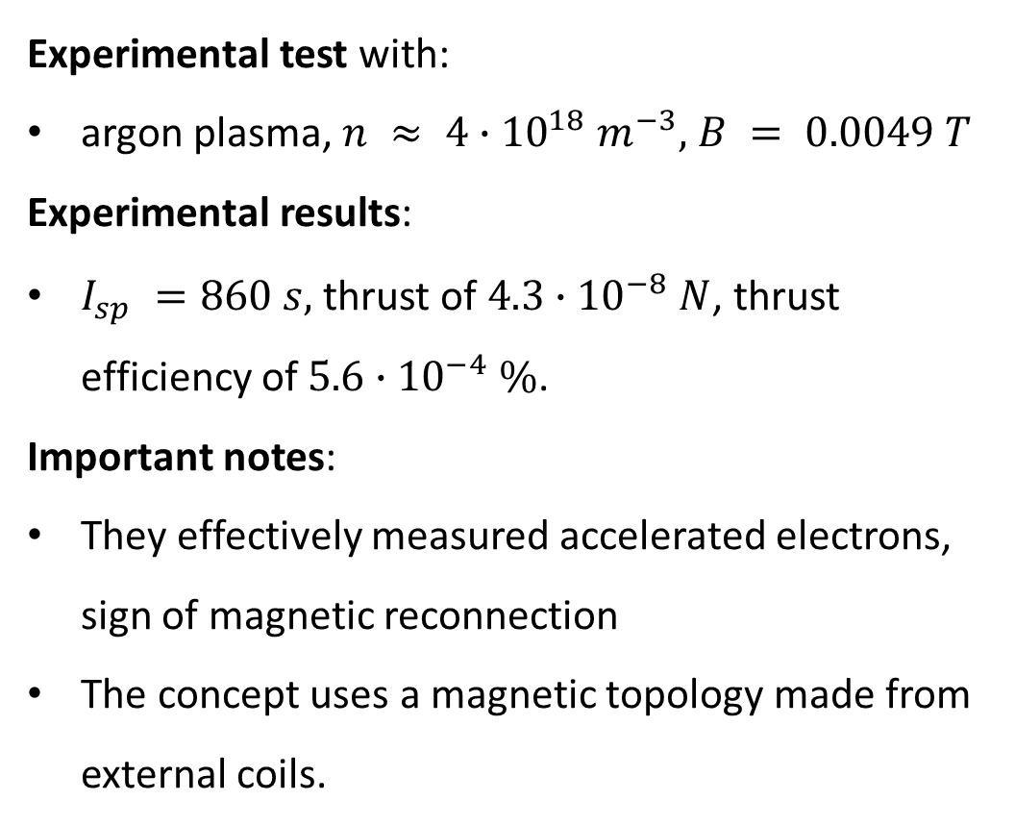
Existing concepts
Bathgate, S. N., et al, University of Sydney, NSW 2006, Australia
Experimental test with:
argon plasma, $n ≈ 4∙{10}^{18} m^{−3},$ $B = 0.0049 T$
Experimental results:
$I_{sp} =860 s,$thrust of $4.3∙{10}^{−8} N$, thrust efficiency of $5.6∙{10}^{−4} \%$.
Important notes:
They effectively measured accelerated electrons, sign of magnetic reconnection
The concept uses a magnetic topology made from external coils.
Bathgate, S. N., et al., “A thruster using magnetic reconnection to create a high-speed plasma jet,” European Physical Journal Applied Physics, Vol. 84, No. 2, 2018, 20801.

Slide 13
Existing concepts
Ebrahimi, F., Princeton University, US
Current is injected across two annular electrodes which flows along the open magnetic field lines between them.
This induces an azimuthal magnetic field, stretching the open field lines upwards via a Lorentz force on the plasma (frozen flow).
The central field loop is then compressed laterally by the external shaping fields. Due to the compression an axially elongated current sheet is formed, allowing reconnection to occur and eject a plasmoid from the thruster at the Alfvén speed.
At high Lundquist number (𝑆 > 10⁴): plasmoid (tearing) instability, continually forming and ejecting plasmoid loops.
Ebrahimi, F., “An Alfvenic reconnecting plasmoid thruster,” Journal of Plasma Physics, Vol. 86, No. 6, 2020, p. 905860614.

Slide 14
Existing concepts
Ebrahimi, F., Princeton University, US
Performances verified with a series of MHD simulations
Exhaust velocity of the order of 5 × 10⁵ ms⁻¹ at a field strength of 0.05 T to 0.06 T
Important notes:
Exhaust plasma is only ejected in one direction rather than symmetrically.
The discrete ejection of plasmoids rather than a continual flow does not generate any wall erosion
Magnetic configuration design does not include a reconnection point obtained from static externally applied magnetic fields. However, very large currents (1kA-100kA) are required to overcome the magnetic field line tension.
Ebrahimi, F., “An Alfvenic reconnecting plasmoid thruster,” Journal of Plasma Physics, Vol. 86, No. 6, 2020, p. 905860614.

Slide 15
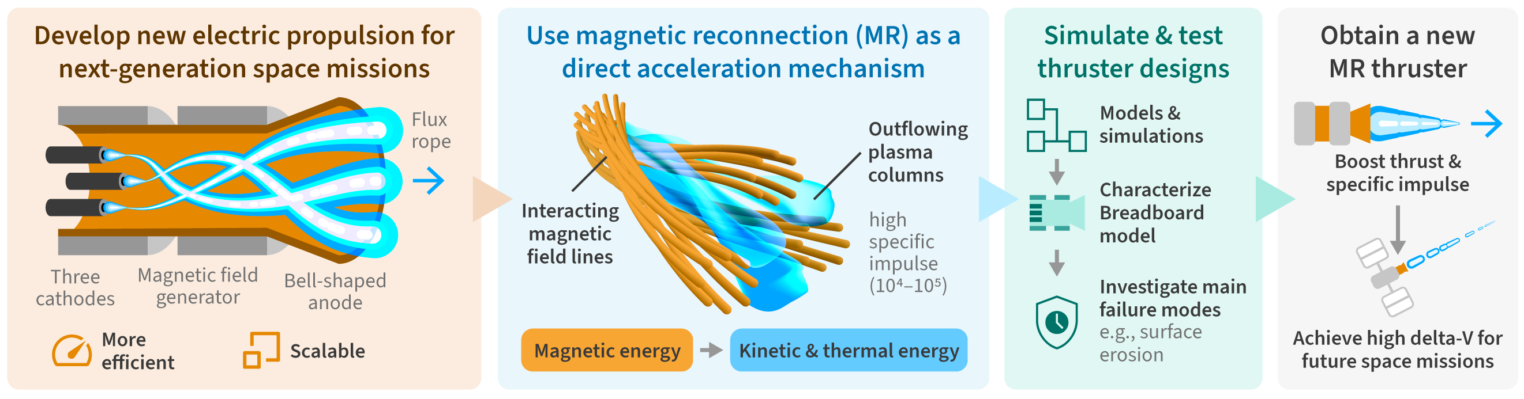
A multi flux ropes thruster
Generation of multi flux ropes by means of hollow cathodes
Flux ropes (or plasma channels) are magnetically confined by an axial external applied magnetic field
Bell-shaped anode close the circuit, and a magnetic nozzle is at the exit to further enhance the acceleration
At sufficiently high current the flux ropes become kink-unstable, interacts and collide on each other which leads directly to the reconnection of magnetic field lines.

Slide 16
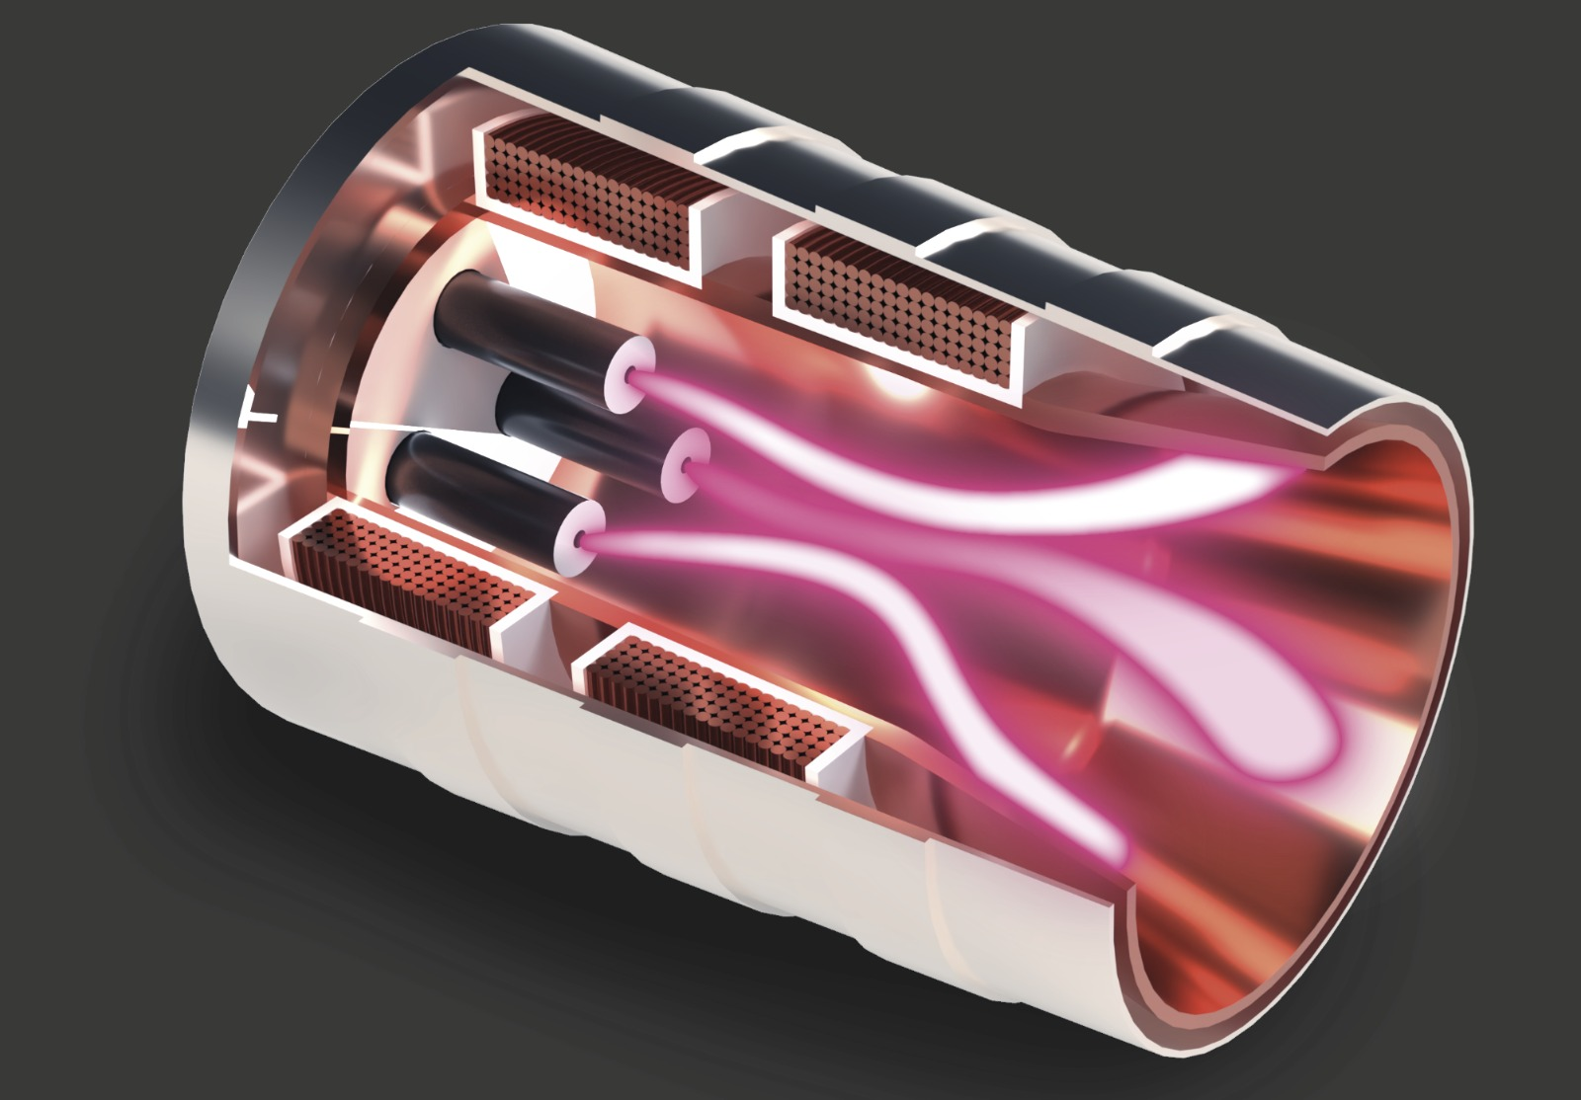
A multi flux ropes thruster
Coils
Generate the axial magnetic guide field
LaB6 Hollow cathodes
Plasma source and negative electrode for the discharge
Flux ropes
Kink unstable at current > I_{KS} twist and collide with each other favouring magnetic reconnection
Magnetic reconnection site
Flux ropes collisions generate multiple reconnection sites
Case
Shielding and protection of sensitive components
Anode
Positive electrode for the discharge
Aligns with magnetic nozzle

Slide 17
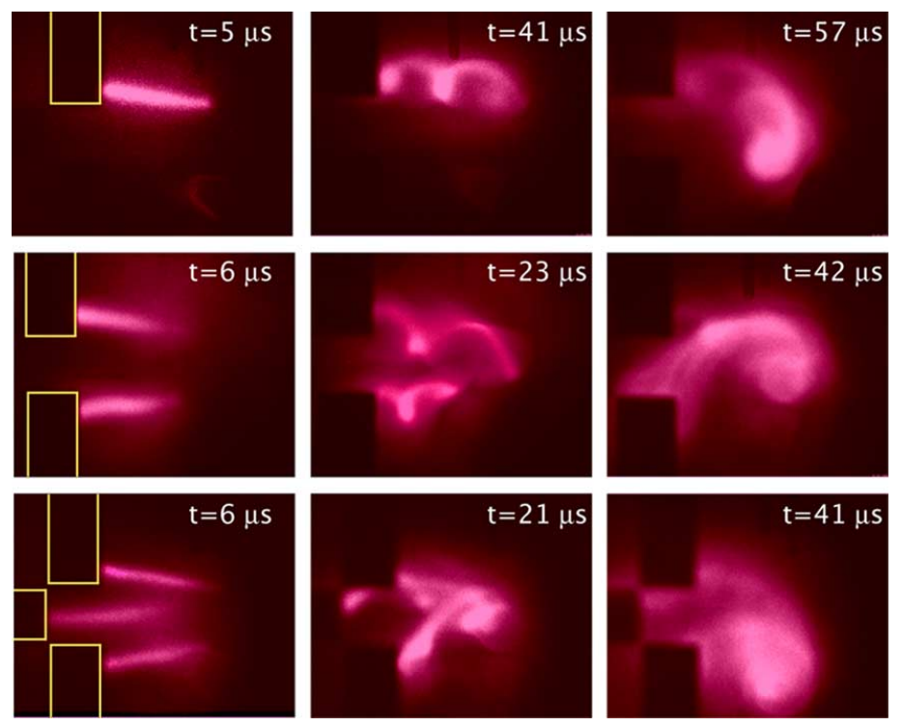
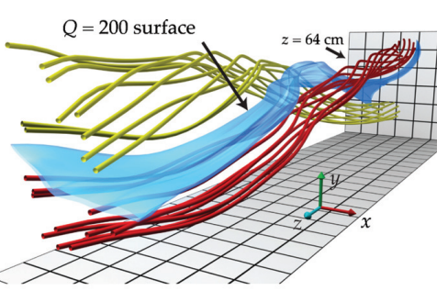
Relevant background
Flux ropes are current carrying columns of plasma that are abundant in space and play a major role in the study of astrophysical plasmas, such as those found in the solar photosphere and corona.
They can become kink-unstable by carrying a sufficiently large current (I > I_{KS}), which then causes the ropes to writhe, twist, and collide with each other, triggering magnetic reconnection.
Evidence of ion heating and acceleration can be observed during the reconnection events of solar flares and coronal mass ejections, and from ion flows within the Earth’s magnetotail.
In the LAPD experiment*, they studied the reconnection of two and three flux ropes and observed a field-aligned ion beam at sub-Alfvenic ion velocity.
Hemsing, E. W., Furno, I., & Intrator, T. P. (2005). Fast camera images of flux ropes during plasma relaxation. IEEE Transactions on Plasma Science, 33(2), 448-449.
*Gekelman, W., Lawrence, E., & Van Compernolle, B. (2012). Three-dimensional reconnection involving magnetic flux ropes. The Astrophysical Journal, 753(2), 131.
*Tang, S. W., Gekelman, W., & Sydora, R. D. (2023). Experimental observation of a field-aligned ion beam produced by magnetic reconnection of two flux ropes. Physics of Plasmas, 30(8).

Slide 18
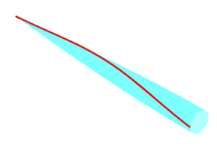
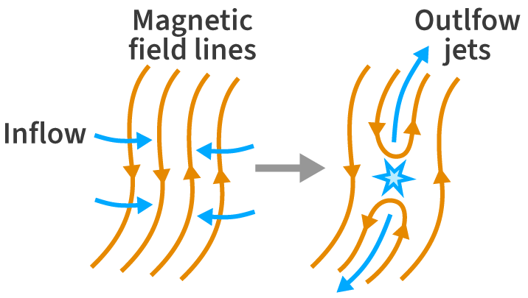
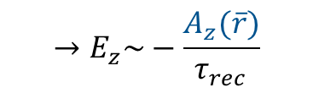
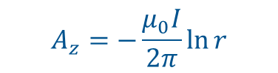


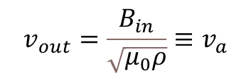
Expected performance
To estimate the performance of our thruster, we do an order of magnitude analysis from Maxwell’s equations
Hypothesis: the main acceleration mechanism for the ions in the axial direction (perpendicular to the poloidal plane) comes from the induced electric field from the reconnection point
J_{z}
B_{θ}
Reconnection point
$∇×E=−\frac{∂B}{∂t} →E_{z}=−\frac{∂A_{z}}{∂t}$
$$∇×A_{z}=B$$
J_{z}
E_{ind}, J_{z,ind}
where
$$→E_{z}\sim −\frac{A_{z}(\overline{r})}{τ_{rec}}$$
B_{θ}
In 2D (Sweet-Parker model) we would have on the poloidal plane:
In first approx. we consider the magnetic field as generated by a current carrying long wire, therefore the magnetic potential is:
$$A_{z}=−\frac{μ_{0}I}{2π}\ln{r}$$
$$v_{out}=\frac{B_{in}}{\sqrt{μ_{0}ρ}}≡v_{a}$$

Slide 19
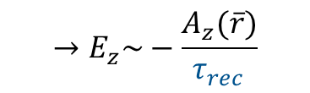

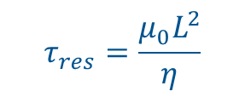
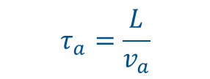
Expected performance
To estimate the performance of our thruster, we do an order of magnitude analysis from Maxwell’s equations
Hypothesis: the main acceleration mechanism for the ions in the axial direction (perpendicular to the poloidal plane) comes from the induced electric field from the reconnection point
J_{z}
B_{θ}
Reconnection point
$∇×E=−\frac{∂B}{∂t} →E_{z}=−\frac{∂A_{z}}{∂t}$
$$∇×A_{z}=B$$
J_{z}
E_{ind}, J_{z,ind}
where
$$→E_{z}\sim −\frac{A_{z}(\overline{r})}{τ_{rec}}$$
B_{θ}
In 2D (Sweet-Parker model) we would have on the poloidal plane:
The reconnection time is modeled as (Sweet-Parker):
$$τ_{rec}={τ_{a}}^{1/2}{τ_{res}}^{1/2}$$
$$τ_{a}=\frac{L}{v_{a}}$$
where
is the Alfvén time, and
$$v_{out}=\frac{B_{in}}{\sqrt{μ_{0}ρ}}≡v_{a}$$
$$τ_{res}=\frac{μ_{0}L^{2}}{η}$$
is resistive time

Slide 20


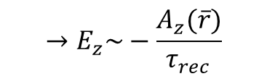
Expected performance
To estimate the performance of our thruster, we do an order of magnitude analysis from Maxwell’s equations
Hypothesis: the main acceleration mechanism for the ions in the axial direction (perpendicular to the poloidal plane) comes from the induced electric field from the reconnection point
J_{z}
B_{θ}
$$→E_{z}\sim −\frac{A_{z}(\overline{r})}{τ_{rec}}$$
Reconnection point
J_{z}
E_{ind}, J_{z,ind}
With the plasma parameters shown before we get:
B_{θ}
$τ_{A}\sim {10}^{−7}s$ $τ_{res}\sim {10}^{−3}s → τ_{rec}$ $\sim {10}^{−5}s$
In 2D (Sweet-Parker model) we would have on the poloidal plane:
and at $r = r_{column} →$ $A_{z}\sim {10}^{−5} Wb{ m}^{−1}$
$$v_{out}=\frac{B_{in}}{\sqrt{μ_{0}ρ}}≡v_{a}$$
$$→E_{z}\sim 1 V/m$$

Slide 21



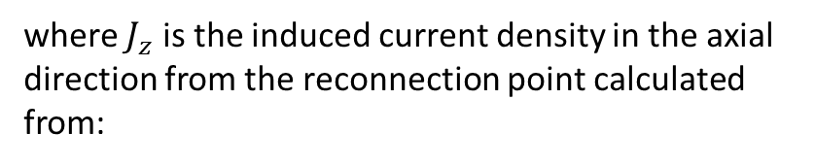

Expected performance
We can now approximate the energy (per unit volume) from the induced electric field (i.e. the work done by the induced electric field per unit volume)
$$ε_{rec}\sim {J_{z}∙E}_{z}{ τ}_{rec}$$
J_{z}
B_{θ}
where $J_{z}$ is the induced current density in the axial direction from the reconnection point calculated from:
Reconnection point
J_{z}
E_{ind}, J_{z,ind}
$$∇×B=μ_{0}J$$
B_{θ}
In 2D (Sweet-Parker model) we would have on the poloidal plane:
$${→J}_{z}=\frac{B_{θ}}{μ_{0}r}\sim {10}^{6}A/m^{2}$$
$$v_{out}=\frac{B_{in}}{\sqrt{μ_{0}ρ}}≡v_{a}$$
$$→ε_{rec}\sim 10 J/m^{3}$$

Slide 22


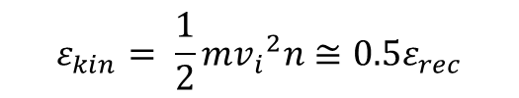
Expected performance
Assuming that about half of the computed energy is transformed into kinetic energy,
$$ε_{kin}= \frac{1}{2}m{v_{i}}^{2}n≅0.5ε_{rec}$$
J_{z}
B_{θ}
Reconnection point
we can estimate the velocity of the ions
J_{z}
E_{ind}, J_{z,ind}
$$v_{i}\sim {10}^{5} m/s$$
B_{θ}
and the I_{sp}
In 2D (Sweet-Parker model) we would have on the poloidal plane:
$$I_{sp}\sim {10}^{4} s$$
assuming $n={10}^{18}m^{−3}$ particles accelerated in the reconnection volume
$$v_{out}=\frac{B_{in}}{\sqrt{μ_{0}ρ}}≡v_{a}$$

Slide 23


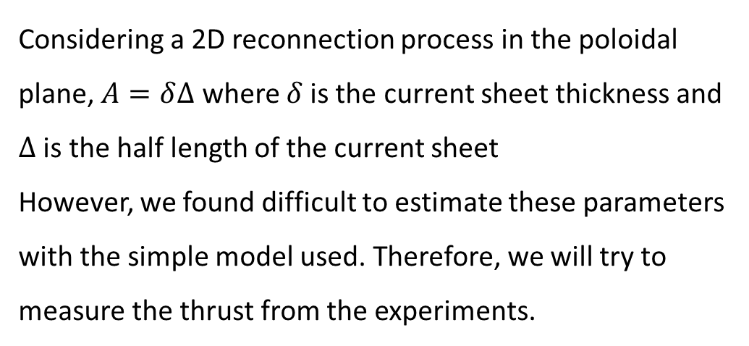
Expected performance
What about Thrust?
By definition, the thrust can be computed as
$$T=mn{v_{out}}^{2}A ≈mn{v_{i}}^{2}A$$
Where A is the cross section of plasma effectively accelerated, meaning the effective reconnection cross section
J_{z}
B_{θ}
Reconnection point
J_{z}
E_{ind}, J_{z,ind}
Considering a 2D reconnection process in the poloidal plane, $A=δ∆$ where $δ$is the current sheet thickness and $∆$ is the half length of the current sheet
However, we found difficult to estimate these parameters with the simple model used. Therefore, we will try to measure the thrust from the experiments.
B_{θ}
In 2D (Sweet-Parker model) we would have on the poloidal plane:
$$δ$$

Slide 24
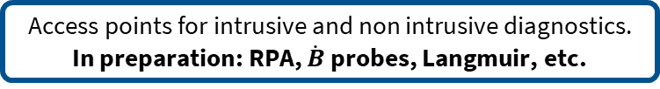
Ongoing experimental campaign
Axial external magnetic field generated by solenoids. B field peak = 500 G
Plasma generated by two Hollow Cathodes. Discharge current range 100-500 A
Cylindrical segmented anode with L=45 cm
Esternal probes mounted: RPA, Langmuir probes.
Access points for intrusive and non intrusive diagnostics.
In preparation: RPA, $\dot{B}$ probes, Langmuir, etc.

Slide 25
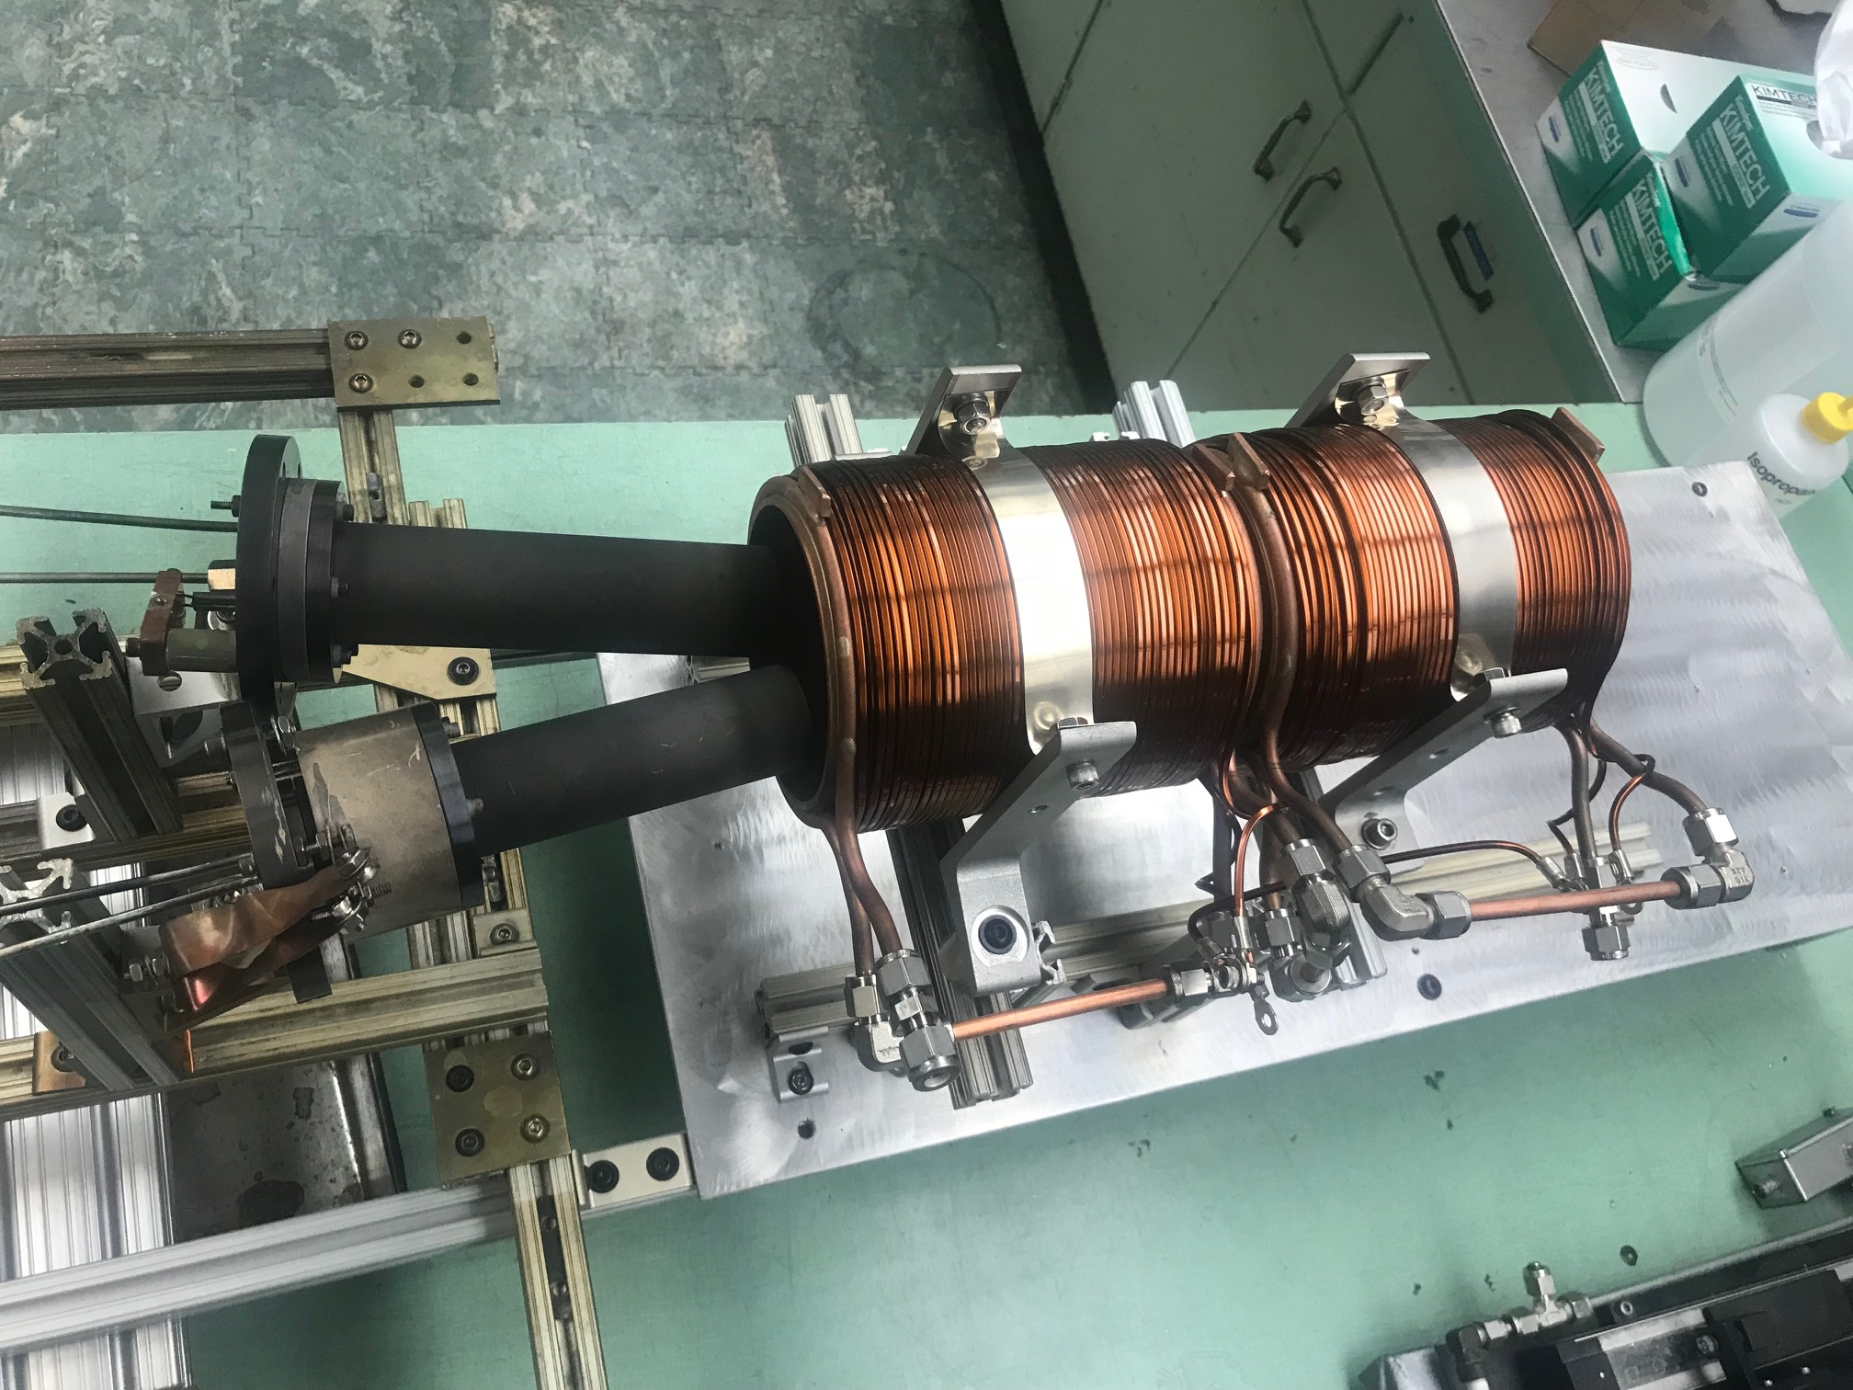
Ongoing experimental campaign
Working fluid: argon
External applied guide field: 100 – 500 G
Max applied current per column: 100 A
Ions partially magnetized --> ion Larmor radius approx. 2 cm at 250 G
Kink threshold at 250 G per plasma column: ~70 A
Column length (max): 45 cm
Plasma density 10¹² cm⁻³, electron temperature 5 eV

Slide 26
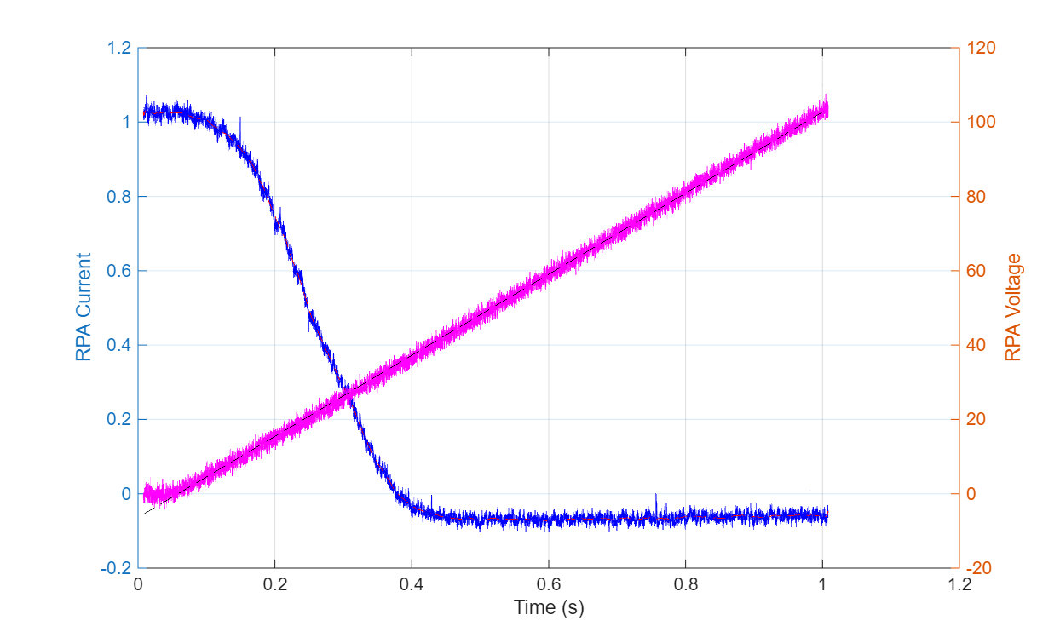
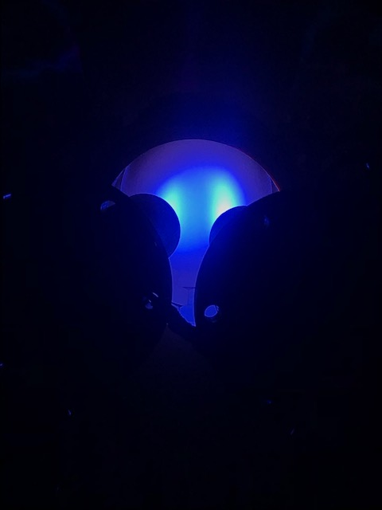
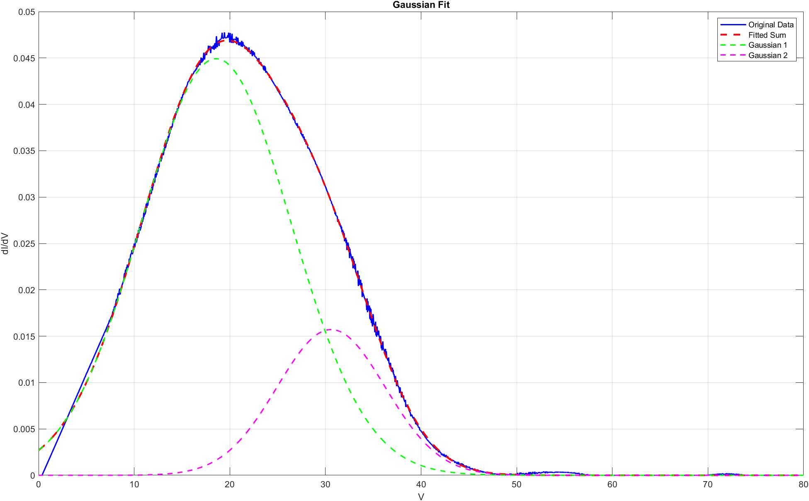
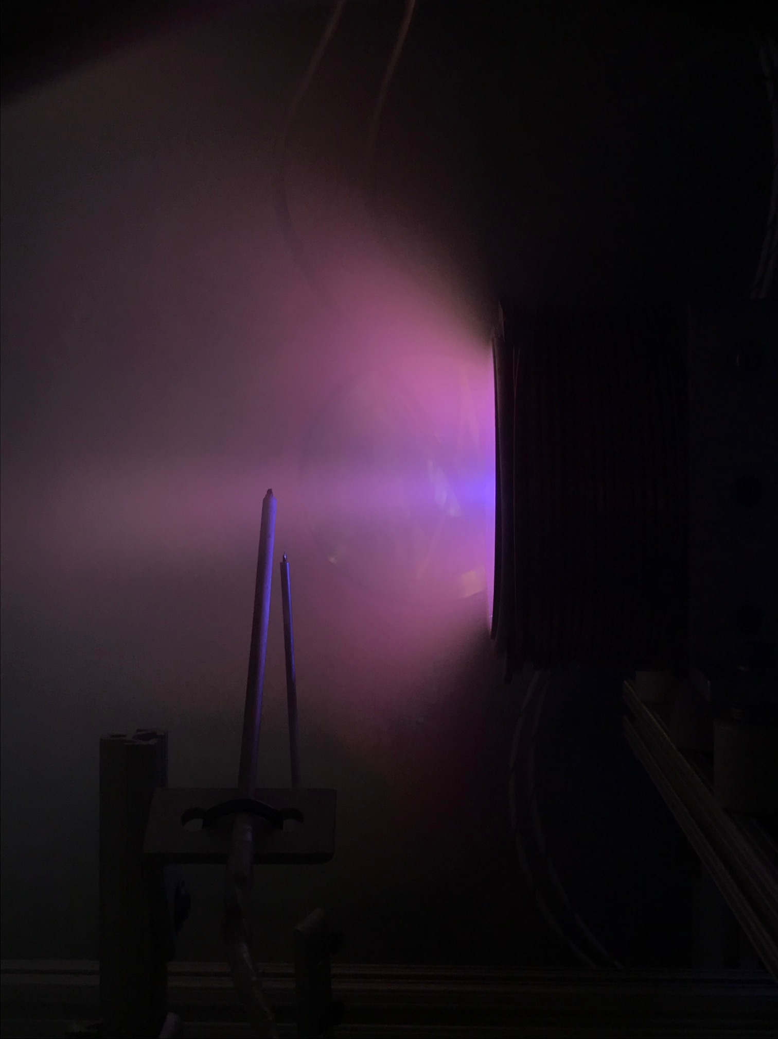
Ongoing experimental campaign
200A total, 250 G
Preliminary results:
Setup fully functional with 2 HC operated simultaneously
Miniaturized RPA placed at the end of the thruster capable of collecting ions energy data.
At 250 G and 200 A, we detect two ions populations at the exit of the thruster, with a distinct higher energy part.
We see different regimes at the various magnetic fields tested. The columns visually merge at low value of B field (100 G), with no sign of magnetic reconnection. At higher B field (250 G) the ropes are visually more separated and higher energetic ions are detected.

Slide 27
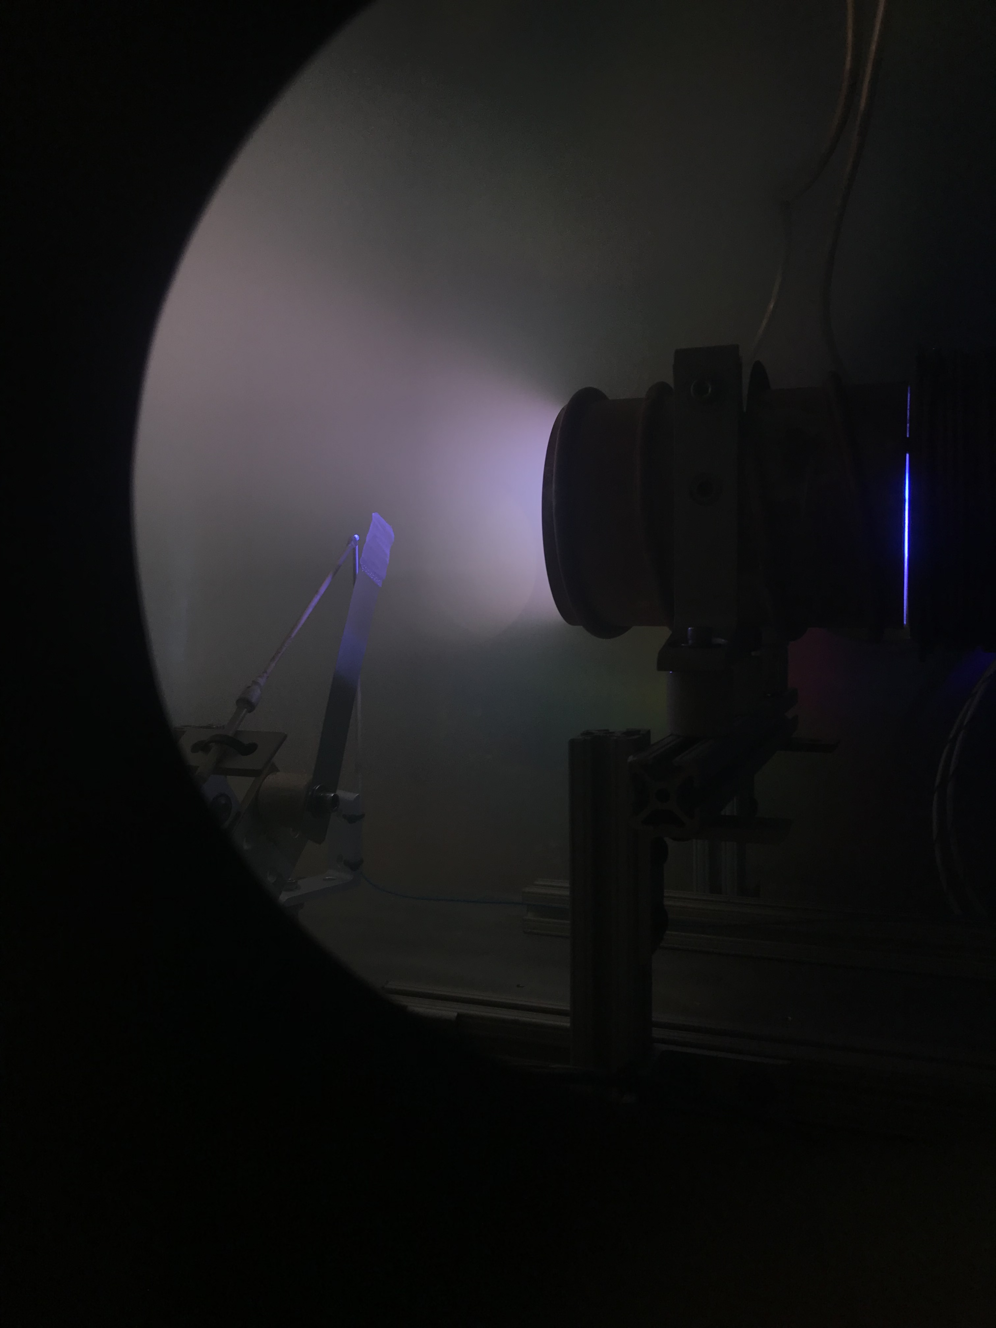


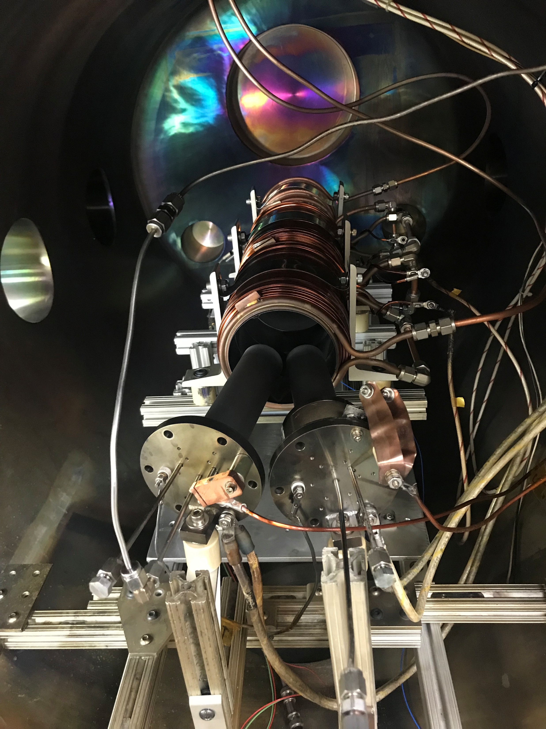
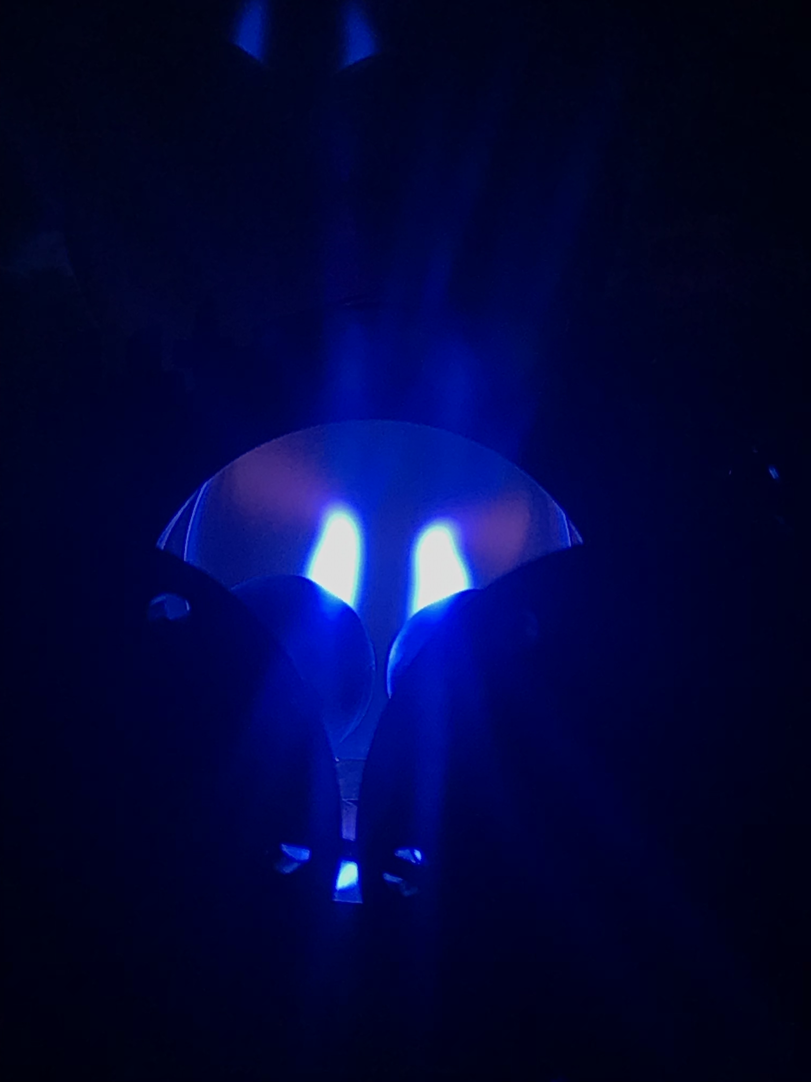
Next Steps toward Validation
Project currently funded with internal fundings and active collaboration with JPL
Experimental Campaign
Hydrogen will be employed instead of argon to favor full magnetization
Discharge current increased to 250 A per column
Diagnostics: RPA and magnetic probes on a 3 axis movable apparatus
Simulations
3D MHD simulations with g-PLUTO
Kinetic simulations in collaboration with Princeton University are investigated

Slide 28
Conclusions
Magnetic reconnection has the capability to accelerate particles at up to the Alfvén velocity of the plasma => it can be employed in innovative type of plasma propulsions for very high ∆v missions.
Different thrusters concepts based on MR as acceleration mechanisms have been proposed worldwide
We propose an innovative concept based on multi flux ropes. When the ropes are kink unstable they collide with each other triggering magnetic reconnection
The induced electric field and current can accelerate ions at velocities up to 10⁵ m/s
The experimental campaign is on-going. The setup is fully functional and tested with Argon.
Next steps include the test with hydrogen and the detection of magnetic reconnection.
3D simulations are under investigation.

Slide 29
Thanks for your attention
Giulia Becatti, PhD
Space Propulsion Laboratory
Department of Civil and Industrial Engineering
University of Pisa, Pisa, Italy
giulia.becatti@ing.unipi.it

