Slide 1


Low Temperature Plasmas: a bridge between Chemistry and Physics.
Tutorial/Overview in Conferenza Italiana sui Plasmi, Frascati, 3-6 Febbraio 2026
Maria Rutigliano and Vanni Antoni
CNR-Istituto per la Scienza e Tecnologia dei Plasmi
maria.rutigliano@cnr.it
vanni.antoni@igi.cnr.it

Slide 2
Outline
What is a Low-Temperature Plasma?
Generation of LTP and sources
LTP Features
LTP Theory and Modelling
LTP Diagnostics
LTP special classes:
Non-neutral plasmas
Dusty plasmas
LTP at work
LTP Italian Community
Conclusions
M.Rutigliano and V. Antoni

Slide 3
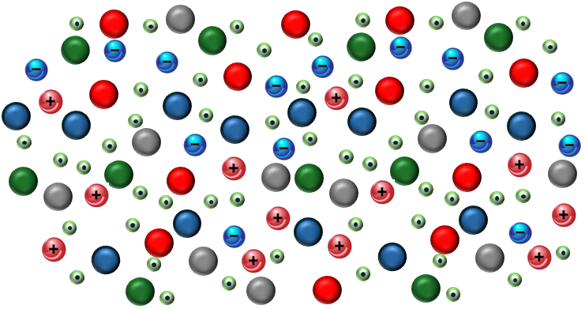
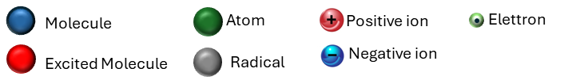
What is a Low-Temperature Plasma
Plasma is a unique state of matter composed of neutral atoms, molecules, radicals, excited states, ions and electrons.
LTP are partially ionized with low ionization degree: n_{e} /𝑵<𝟏%
Electron temperature: T_{e}~1-10eV
Ions and neutrals temperatures are near room temperature: T_{i}~ T~ 0.025eV
LTP
LTP span over 12 orders of magnitude for n_{e}
M.Rutigliano and V. Antoni

Slide 4
LTP bridge between chemistry and physics
Essentially, this plasma represents a highly non-equilibrium , with the electron temperature being higher than the ion temperature, even of orders of magnitude.
Even with energetic electrons, the average temperature of an LTP is low. Maintaining this non-equilibrium state is possible because energy transfer from electric fields to the electrons is generally much faster and more efficient than the subsequent collisional energy transfer between electrons and heavy particle.
Highly reactive plasmas can be generated near room gas temperatures
A large fraction of the electron energy can then be channeled into the production of electronically excited states, and, in molecular gases, vibrationally excited species and short-lived radicals, or for molecular dissociation generating a very rich and complex electrons-driven chemistry.
The generation of chemically reactive environments at low gas temperature is a defining property of LTP
M.Rutigliano and V. Antoni

Slide 5
Generation of LTP
LTP plasma can be generated in vacuum or at atmospheric pressure, as well as in gas and liquids.
In order to have a plasma, some energy needs to be high enough to cause an ionization. In LTP electric fields selectively accelerate electrons and plasma is sustained by electron-impact ionization.
Depending on the frequency of the electric field, the LTP plasma properties are different due to the different inertia of electrons and ions. In addition, the electrons and ions in a plasma can be manipulated by using magnetic fields, which may confine charged species, since they follow mainly the magnetic field lines. Depending on the frequency of the applied electric fields used for plasma generation one may distinguish different plasma types.
DC plasmas: plasma is generated between two electrodes and a direct current is flowing through the system, which is carried by the free ions and electrons in the plasma. The plasma density can be enhanced by using magnetic fields to insulate the charged species from the boundaries of the plasma.
AC plasmas (KHz): frequency of the electric field is low enough so that the electrons and ions are able to follow the oscillation of the electric field. AC plasmas are frequently used for high power and large scale applications. Both, electrons and ions contribute to the current at the electrodes.
RF plasmas (MHz): the frequency of the electric field is in the range of radio waves and is so high that only the electrons can follow the electric field, whereas the ions remain almost at rest. The plasma current is dominated by displacement current rather than by conduction current.
Wave heated plasmas (GHz and optical): the frequency of the electric field is so high that the electrons can just follow the electric field.
M.Rutigliano and V. Antoni

Slide 6
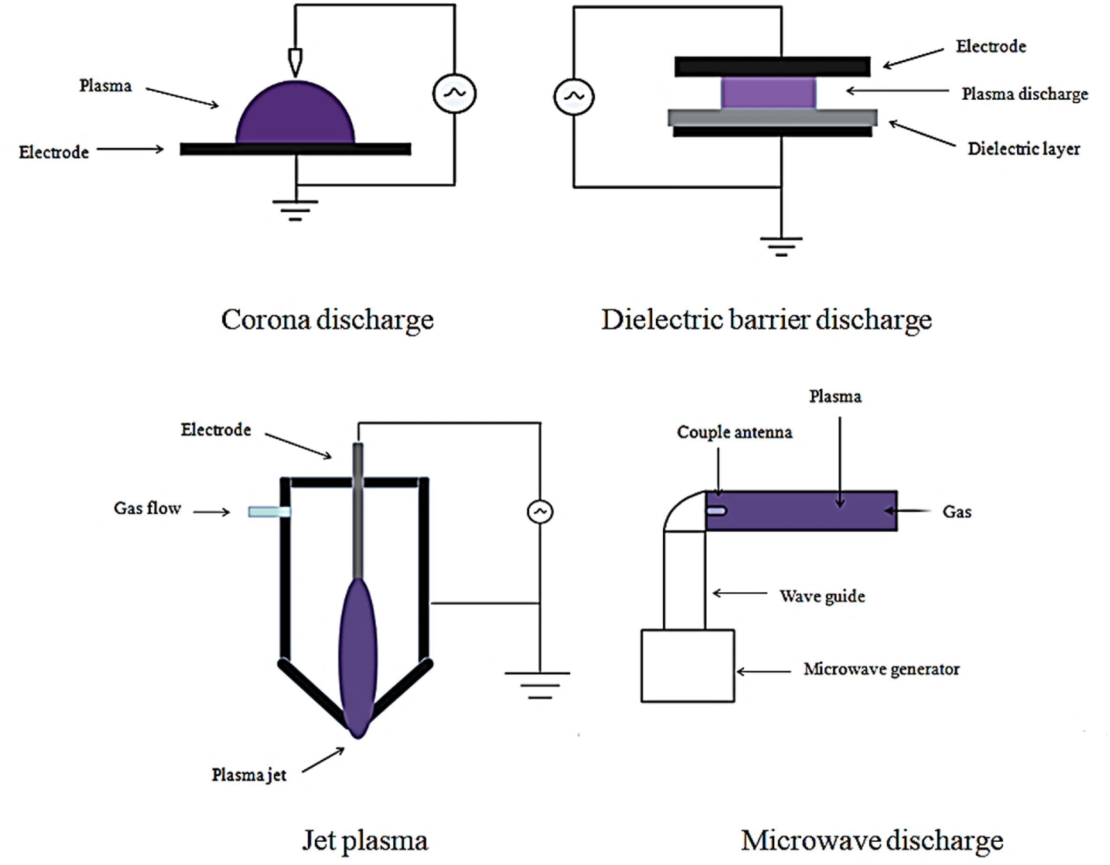
LTP Plasma Sources
LTP can be generated by different electrical discharge methods.
Corona Discharge: Corona discharge plasma is generated around the sharp-pointed electrodes (sharp points, pinpoints, wires) with a small diameter. The applied high voltage leads to the generation of a strong electric field concentrated at the surface of a highly curved electrode.
Dielectric Barrier Discharge: A dielectric barrier layer separates two independent metal electrodes from which plasma is generated.
Plasma Jet: A powered electrode generates plasma, which flows to another surface.
Microwave Discharge: For microwave discharge, there is no need for electrodes and plasma can be generated using the antennas or waveguide, while a shield is required.
S.Harikrishna et al. J. Agriculture and Food Research 14 (2023) 100747
M.Rutigliano and V. Antoni

Slide 7



Surface and Sheaths
Nearly all plasmas interact with surfaces that bound the plasma, either by the need to contain the plasma or intentionally to change the characteristics of those surfaces. In LTPs, the difference between neutral gas temperature and the electron temperature results in the ability to produce controllable fluxes of reactive species onto surfaces without excessively heating the surface.
sheaths
wall
The relatively high electron temperature and low electron mass leads to the formation of thin space charge regions, sheaths, at boundaries. The electric fields in the sheaths accelerate positive ions to surfaces which then provide activation energy for material changing reactions on surfaces. Sheaths have an important role for applications relevant to removal of surface material and ion implantation.
plasma bulk
M.Rutigliano and V. Antoni

Slide 8
Plasma–surface processes
Processes occurring at the surface include chemi- and physisorption of atoms and molecules, surface diffusion, desorption of atomic and molecular radicals, trapping of molecular fragments, sputtering and ion implantation. Each of these processes is active in a specific range of collisional energies according to the behaviour of the plasma species and surfaces involved in the interaction.
T Shirafuji et al., J. Phys. D: Appl. Phys. 37 (2004) R49–R73
Heterogeneous processes play a main role in plasma–wall interactions and plasma processing reactors where the main purpose is to etch or grow materials with well-defined functional properties.
The reaction kinetics of plasma systems is generally very complex due to the large number of collisional processes occurring in the plasma volume and at the plasma–surface interface; nevertheless, the rate-determining step that controls the kinetics overall is, very often, surface adsorption of molecules/atoms.
M. Rutigliano and V. Antoni

Slide 9
Atoms/Molecules at Surface in LTP
The chemi-/ physi-sorption of molecules and atoms on surfaces is responsible for two surface reaction processes that play a key role in the chemical reactivity of LTP plasmas, i.e.
molecular ( dissociative) adsorption of roto-vibrationally excited molecules:
Energy exchange with the wall
Molecules reflected in different states
[AB(v_{f}; j_{f})]_{gas} + S
[AB(v_{i} ,j_{i} )]_{gas} + S →
A_{ads}*S +B_{ads}*S
Surface reactions and modifications
Atoms diffusing from the wall into the plasma volume act as very effective collisional quenchers.
A_{gas}+ B_{ads} + S → AB(v; j)+S
Effective source of energetically activated molecules.
Important channel for surface atom abstraction and atom consumption in the plasma volume.
atom recombination at surfaces:
M.Rutigliano and V. Antoni

Slide 10
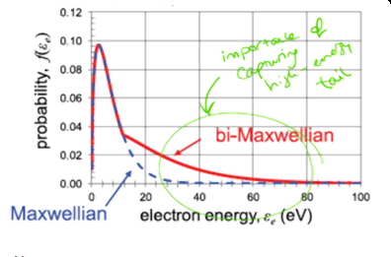
Kinetic Models and Distribution Function
Kinetic Theory describes the gas behaviour based on plasma species motion & interactions
Phase Space Representation (6D)
3D physical space (r)
3D velocity (momentum) space (v)
If f(r, v, 𝑡) is known all macroscopic values of n,p,T are known!
In equilibrium conditions, f follows a Maxwellian distribution
Boltzmann equation solution to find the eedf→ Non-Maxwellian
The high energy-tail is very important for the Chemistry!!
M.Rutigliano and V. Antoni

Slide 11
Electron impact reactions
Collisions between electrons and neutral particles play really important roles
Elastic Collision: e + A → e + A
Ionization: e + A → e+ A⁺+ e
Superelastic collisions: e + M* (A*) → e + M (A)
Electronic excitation: e+ A → e+ A*+ e (→e+ A+ photon)
Vibrational excitation: e+ M(v_{i} ) → e+ M(v_{f} )
Dissociation: e+ M→ e+ A1+ A2
Dissociative ionization: e + M → e + A1 + (A2)* + e
Attachment: e + M(A) → M⁻ (A⁻)
Dissociative Attachment: e + M → A1 +(A2)⁻
A=atom; M=molecule; A1(A2)= atoms making the molecule
M.Rutigliano and V. Antoni

Slide 12
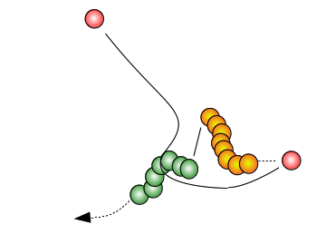
Atom/Molecules reactions
---> A + BC(v_{f}, j_{f}) non-reactive
---> B + AC(v_{f}, j_{f}) reactive
A+BC(v_{i}, j_{i})
---> C+AB(v_{f}, j_{f}) reactive
---> A + B + C dissociation
Roto-vibrational exchanges and dissociation
M.Rutigliano and V. Antoni

Slide 13
(most common) LTP Models
Kinetic models: describes the gas behaviour, based either on the solution of the Boltzmann equation or a statistical particle-in-cell PIC(-MCC) approach, with special focus on the description of the electron kinetics.
multi-fluid models: based on the solution to the hydrodynamic equations for the multi-fluid system of electrons, ions and neutrals. Fluid models provide an adequate compromise solution between the inclusion of fundamental phenomena accounting for the dynamics of species and a space– time description of the plasma excitation setup, keeping the calculation burden within acceptable limits.
global models (0D chemical kinetics models): based on the solution to the particle and energy rate-balance equations for the main plasma species, usually including a very complete reaction chemistry. In these approaches the conservation equations for the number density of the various plasma species, are reduced to simple balance equations, based on production and loss terms as defined by the chemical reactions, hence typically neglecting the transport term, although methods have been developed to include the effect of transport losses.
M.Rutigliano and V. Antoni

Slide 14
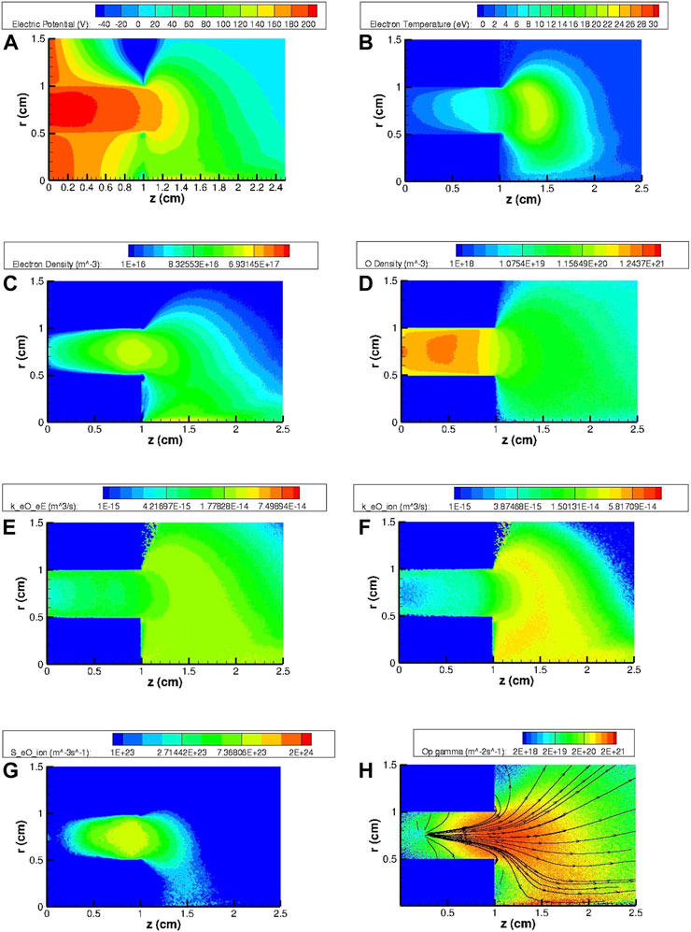




For most applications, PIC models give an accurate computational description of a LTP..
Application to an air-breathing, low-power Hall thruster.
PIC models represent a relatively simple and elegant approach to solve the Boltzmann equation without restrictive assumptions about the structure of the velocity distribution function or the coupling of the particle motions with the fields. The main limitations of the method are those related to the solution of this equation, such as the discretization in the calculation of the fields and the fact of considering binary collisions in the PIC-MCC formulation. Despite the rather simple nature of the algorithm underlying this model, there is a high degree of theory behind it and, in addition, it can be efficiently implemented by using modern HPC technologies.
F. Taccogna et al. (2022), Front. Phys. 10,1006994
Two-dimensional maps of the most relevant HT plasma and gas parameters for the SPT20 nominal case using N₂ and O (case D) as the propellant: (A) electric potential ϕ (V), (B) electron temperature Te (eV), (C) electron density ne (m⁻³), (D) atomic density n_{O} (m⁻³), (E) and (F) electronic excitation and ionization rate coefficients, k_{eE,O} and k_{ion,O} (m³s⁻¹), (G) ionization source term S_{ion},_{O} (m⁻³s⁻¹) and (H) ion flux Γ_{O+} (m⁻²s⁻¹)
M.Rutigliano and V. Antoni

Slide 15
State-to-State Approach
The complex process occurring in the tail can be effectively studied through State-to-State models. In StS models the chemical species in specific states (electronically excited states, roto-vibrationally excited levels) are treated kinetically with independent master equations and characterized dynamically with state-resolved cross sections and rate coefficients, with the reliability of the models and their predictive capability critically depending on the accuracy of the dynamical information.
Non-equilibrium plasma kinetics assumes a strategic importance in molecular plasmas for describing the population densities of rotational, vibrational and electronic states which are strongly linked to the electron energy distribution function (EEDF) through so-called vibrational and electronic superelastic collisions. Energy stored in the vibrational excitation can be redistributed to V-T V-V and V-R collisions. StS approach is able to describe non-equilibrium vibrational distributions and non-Maxwell EEDFs.
Bari
M.Rutigliano and V. Antoni

Slide 16
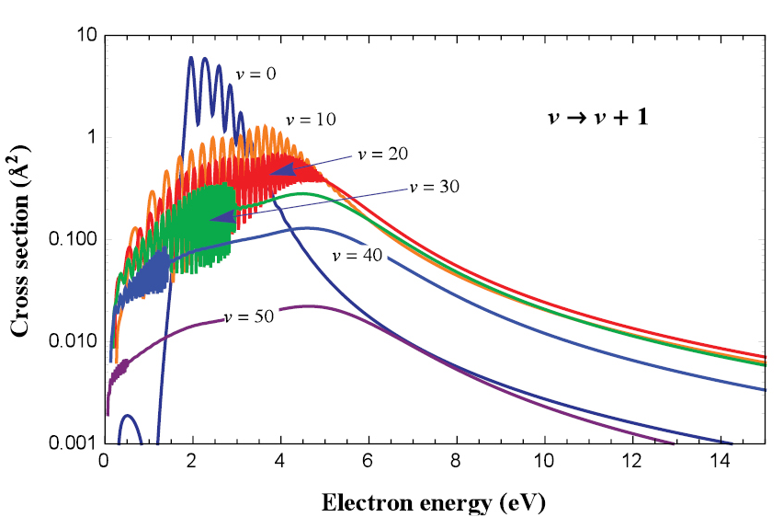
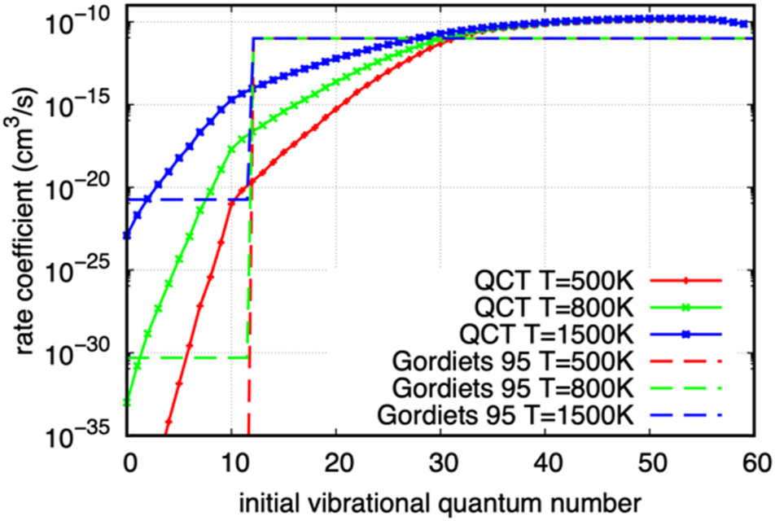
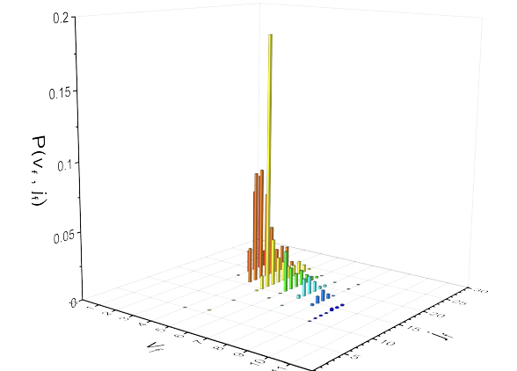
State-to-State Approach
N₂
e-molecule collisions
V. Laporta et al. PSST, 2014, 23 065002
O + N₂(v)→NO(v) + N
I. Armenise et al. JSR 37 (2000) 318
StS at work
atom/molecule collisions
F. Esposito, PSST 2022 31, 094010
H₂(v_{i} ,j_{i} ) /graphite
atom,molecule/surface collisions
M. Rutigliano et al. Chem.Phys. 2016, 479, 11
P. Minelli et al. Work in preparation
Bari
M.Rutigliano and V. Antoni

Slide 17
Diagnostics for LTP
LTP diagnostics involves various techniques to measure plasma properties such as n_{e}/T_{e}, species concentrations (radicals, ions, neutrals), electric fields, and T_{g}, crucial for optimizing applications in medicine, electronics, and agriculture.
Diagnostics are important to:
Understanding Non-Equilibrium: LTPs have electrons much hotter than ions/neutrals; diagnostics reveal this kinetic complexity.
Process Control: In manufacturing (e.g., semiconductor etching), diagnostics help define and maintain the "process window" for desired outcomes.
Application Optimization: For medicine or agriculture, tailoring reactive species (ROS, RNS) requires detailed chemical characterization.
Challenges
Complexity: Many parameters (pressure, power, gas mixture, humidity) affect LTPs, especially at atmospheric pressure.
Intrusiveness: Some probes perturb the very plasma they measure.
Resolution: Achieving high spatial, temporal, and spectral resolution simultaneously is difficult.
Key Diagnostic Techniques
Langmuir probes: Intrusive, but simple and cheap for measuring n_{e} and T_{e}, though modeling is needed.
Optical Emission Spectroscopy: Non-intrusive and versatile reveals crucial parameters such as n_{e} and T_{e} and plasma composition.
Mass Spectrometry: Identifies plasma constituents (ions, neutrals) but requires gas sampling, which can perturb the plasma
Other techniques:
Fourier Transform Infrared Spectroscopy (FTIR) : probing the gas phase and surface chemistry by identifying molecular bonds through their infrared absorption fingerprints.
In-situ Ellipsometry: powerful, non-intrusive technique that monitors thin film growth, etching, or property changes (like swelling, temperature effects) in real-time within a processing chamber.
M.Rutigliano and V. Antoni

Slide 18
Diagnostics for LTP
Laser-based Diagnostic Techniques Non- intrusive, spatially-temporally resolved, high-resolution, species-specific, complementary as can work with other tools (mass spec, probes) for a comprehensive picture of complex LTP chemistry and physics.
Laser Induced Fluorescence (LIF)/ Two-Photon LIF (TALIF): Highly sensitive, ns-resolved measurements of radical species (NO, OH, O) concentration.
Electric-Field Induced Second Harmonic (E-FISH): Measures electric fields inside the discharge with high spatial and temporal resolution.
Thomson Scattering: Scatters laser light off plasma electrons to determine n_{e} and T_{e}, a powerful non-perturbative method.
Rayleigh Scattering: Used to measure neutral gas temperature and dynamics by analyzing elastic scattering from neutral particles.
Laser-Induced Breakdown Spectroscopy (LIBS): Performes spectroscopic analysis on an untreated sample and on very short timescales. Advantages: high spatial resolution and microdestructivity.
M.Rutigliano and V. Antoni

Slide 19
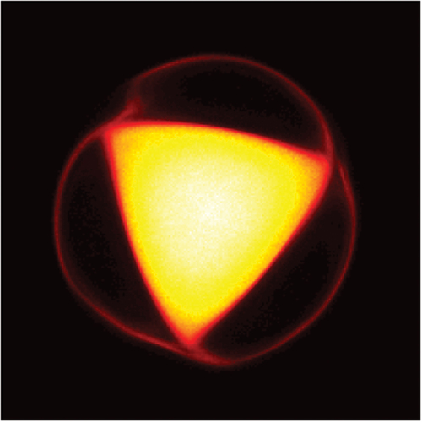



Non-Neutral Plasmas
Non-Neutral Plasma is an ensemble of charges whose net charge creates an electric field large enough to play an important or even dominant role in the plasma dynamics.
NNP single species have been created in laboratory experiments, including pure electron plasmas, pure ion plasmas, positron plasmas, and antiproton plasmas.
NNP can be confined for long periods of time using only static electric and magnetic fields in Penning Trap or in Malmberg-Penning devices
Maero et al. Advances in Physics X, 9 (2924) 2367438
NNP open different research opportunities as are quiescent and reproducible and this allows highly accurate comparisons of theory to experiment. They are useful to obtain relativistic electron beams and for sophisticated devices, like free electron lasers, gyrotrons, or other electromagnetic wave generators .
LNL
Bari
M.Rutigliano and V. Antoni

Slide 20
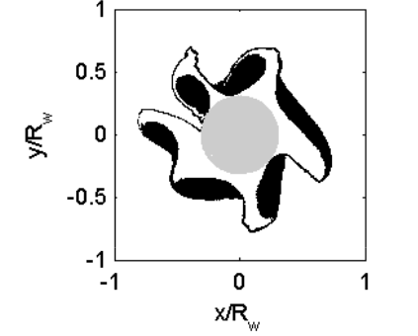
Dusty Plasmas
Dusty Plasmas are electrically quasi-neutral media that, in addition to all the constituent species of a plasma, contain solid or liquid particles with dimensions ranging from a few nanometers to a few micrometers.
Dust particles immersed in the ionized medium, get charged due to incoming fluxes of electrons and ions on their surfaces. Therefore, the charge, as well as the surface temperature of the dust is self-consistently coupled not only to electron and ion temperatures and densities but also to other parameters, such as collisionality, magnetization, dust density, dust shape, and surface conditions.
Romé et al. AIP Conf.Proc.1521 (2013) 273
Under laboratory conditions, DP are usually investigated in low-pressure gas discharges in which the dust particles can be either grown by chemical reactions or externally injected. Dust in a plasma leads not only to quantitative changes of plasma parameters but also to the appearance of new dust-induced phenomena such as void formation and low-frequency instabilities. Therefore, their study and characterization require more complex techniques for both modelling and diagnostics.
Bari, Milano
M.Rutigliano and V. Antoni

Slide 21
LTP
Experiment
Modelling
Diagnostic
Theory
Fisica
Chimica
Biologia
Medicina
Ingegneria
Material Science
M.Rutigliano and V. Antoni

Slide 22
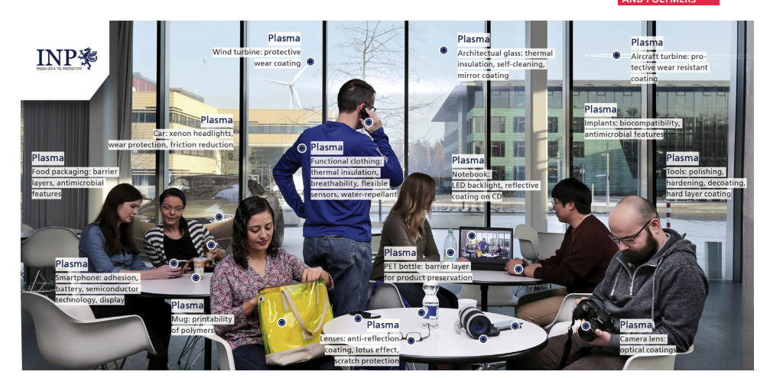
Plasma Technologies
Plasmas applied to materials treatments and electronics have fostered several technologies nowadays of common use in our daily life
M.Rutigliano and V. Antoni

Slide 23
LTP Applications
LTP’s offer the potential of a new wave of green eco-friendly technologies aimed to contribute to improve food security and safety, to protect the environment, to mitigate the climate change, to open new treatments in medicine and to investigate fundamental processes in living organisms so to foster innovative approach
To provide a feeling of these potentials a few applications will be presented grouped in four categories:
Food System
Plasma medicine
Signaling in plants
Environment and sustainability
For each category some examples of the applications will be presented mentioning, where present, the activities carried out by national research teams.
M.Rutigliano and V. Antoni

Slide 24
CAP Applications :General principles
LTP’s can be generated in vacuum or at atmospheric pressure using different gases including air.
At atmospheric pressure the interaction with materials occurs through the generation of a rich family of chemical species
LTP’s low temperature makes these plasma especially suitable for treatments of biological materials
LTP can interact with the materials directly or indirectly though activated liquids as a medium as the case of Plasma Activated Water (PAW)
The applications presented in the following refer to atmospheric LTP also called Cold Atmospheric Plasma (CAP) and will present direct and indirect treatments
M.Rutigliano and V. Antoni

Slide 25
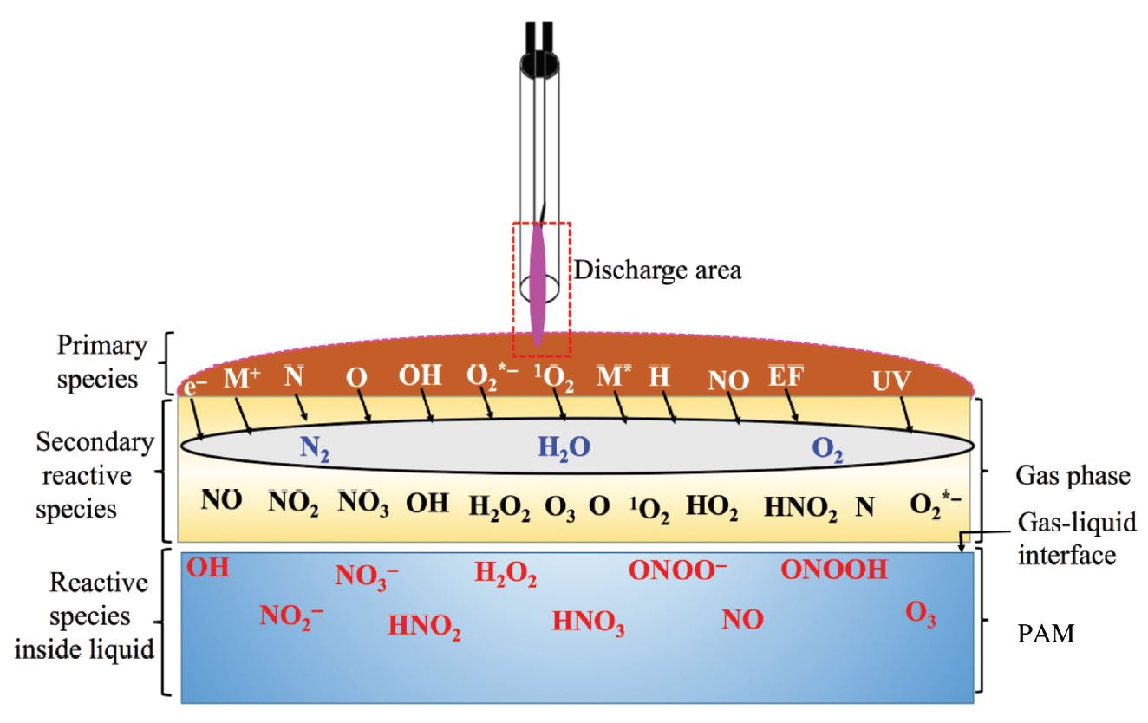
Chemistry of Plasma Liquid Interaction
Behind an activated liquid there is a complex network of chemical reactions as those shown in the diagram for an Argon plasma interacting with water (typically distilled or deionized) .
The interaction is governed by a complex interplay of physical and chemical processes
• Gas Phase Chemistry: energetic electrons collide with gas molecules generating the primary reactive species
• Liquid air boundary Transfer: The chemical species are transported across the gas-liquid boundary
• Liquid Phase Chemistry: a cascade of secondary chemical reactions
Weltmann K D et al Plasma Process Polym. 2019;16:e1800118.
M.Rutigliano and V. Antoni

Slide 26
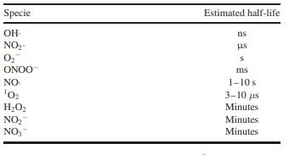
Dynamical network of chemical species alf life of chemical species
It is worth noticing that the chemical species present in PAW have different half life from nanoseconds to minutes and are generated in a continuous cascade therefore resulting in a dynamical non-linear evolving network of reactions
This simultaneous presence of different species interacting among them makes PAW a unique medium to interact with the materials so that for applications to biology, it is often referred as a key property behind the observed effects.
Another important property of PAW is that it can be stored preserving the chemicals for long times up to weeks depending on the storage temperature .
As a practical consequence useful for potential technological applications , PAW can be generated separately in different places and time before administration.
M.Rutigliano and V. Antoni

Slide 27

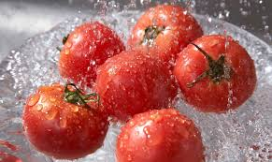
Food System : CAP applications
According to FAO, the Food System requires for more than 30% of the world energy consumption which being mainly from fossil sources implies an anlogous impact on emission of CO₂.
Morevoer the Agriculture is responsible for the present umbalance in the Nitrogen cycle given the excess in emissions
M.Rutigliano and V. Antoni

Slide 28
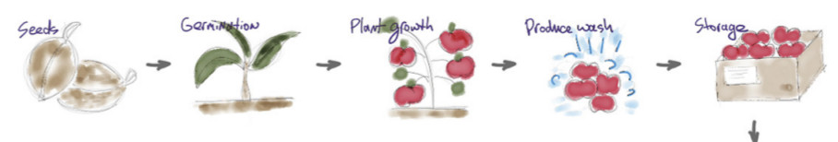
Food System : CAP applications
LTP’s could constitute a green alternative to present techologies and practicies increasing Agricultura productivity, minimizing energy water and chemicals consumption, improving food safety and extending shelf- life
Seeds treatments Germination rate Plant growth Sanifications Storage and Packaging
M.Rutigliano and V. Antoni

Slide 29
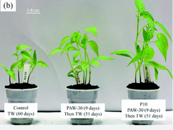
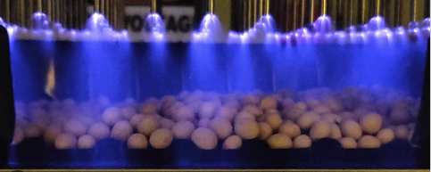
FOOD SYSTEM : Seed & Plant Treatment
Seed Germination : LTP Promote faster germination,
higher germination rates.
Plant Growth : LTP enhance nutrient uptake, stimulate plant growth,
and increase crop yield.
Disease Control: directly inactivates fungal spores and bacterial
pathogens on seed surfaces and plant leaves, reducing the need
for chemical fungicides and pesticides.
Control: not treated
PAW treated
M.Rutigliano and V. Antoni

Slide 30
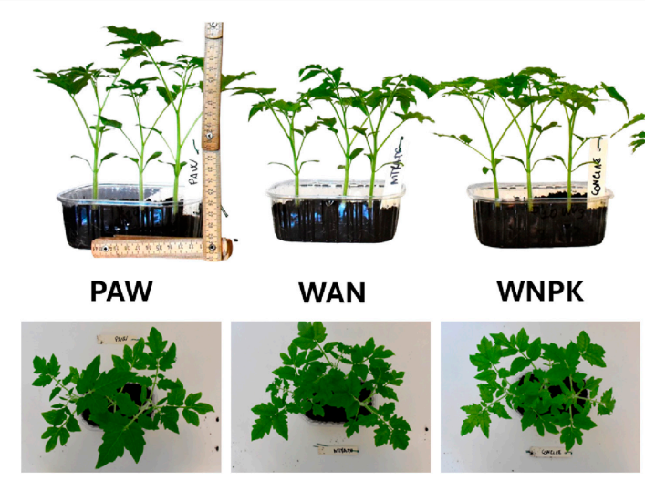
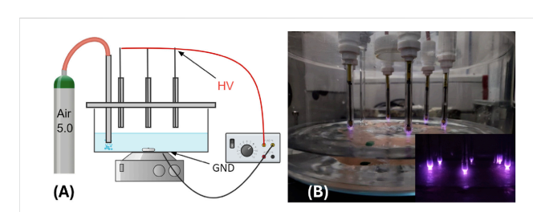
Plant Growth : Bari Group activities
Tomato seedlings have irrigated with PAW generated by DBD source and compared irrigation with conventional fertilizer.
Results indicate that PAW-irrigated seedlings exhibit significant growth enhancement compared to those receiving conventional fertilization (WAN ,WNPK).
Results indicate that PAW promote an improved photosynthetic activity.
At the same time gene expression analysis has shown an improved stress tolerance .
D. Aceto et al. 2024 Frontiers in Physics 12 DOI=10.3389/fphy.2024.1399910
M.Rutigliano and V. Antoni

Slide 31
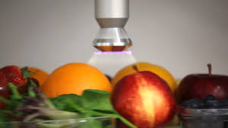
Food System: Sanification for Safety & Preservation
Contaminated food related diseases represents a global health challenge, causing more than 420000 deaths annually (WHO 2014).
CAP offer several application in this area in some case already at industrial level .
Surface Decontamination: reducing microbial and pathogens loads like Salmonella, E. coli, and Listeria.
Spore Inactivation: Effective against bacterial endospores (e.g., Bacillus), which are notoriously heat-resistant.
Delay of Ripening/Senescence: By inactivating ethylene-producing enzymes and surface microbes that cause spoilage, CAP can extend the shelf-life of fruits and vegetables by days or even weeks.
M.Rutigliano and V. Antoni

Slide 32
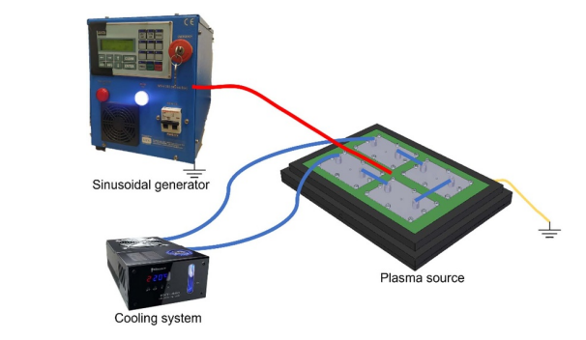
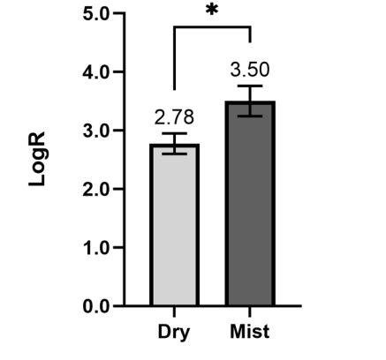
Sanification: Bologna Group Activities
A large-area surface dielectric barrier discharge source has been used to treat the contaminated samples.
Maccaferri C et al 2025 J. Phys. D: Appl. Phys. 58 055202
LogR = LogN0 − LogNt
N0 number of colony-forming units of control
Nt number of colony-forming units of plasma treated,
Results show a strong antimicrobial efficacy tests with abatements of order of magnitude by direct treatments.
It has been observed the effect is increased even more by the presence of mist suggesting that gaseous species reacting with water molecules in aerosol droplets can give significant contribution.
M.Rutigliano and V. Antoni

Slide 33
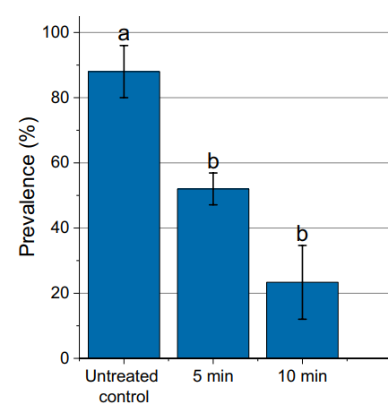
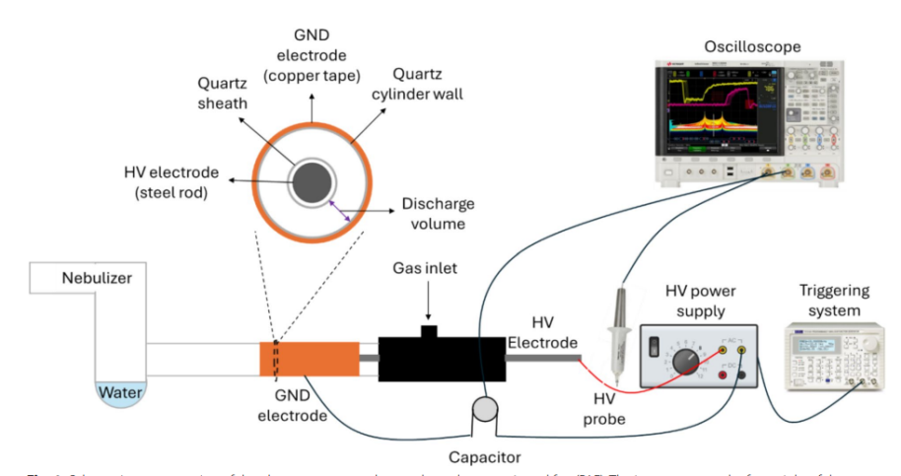
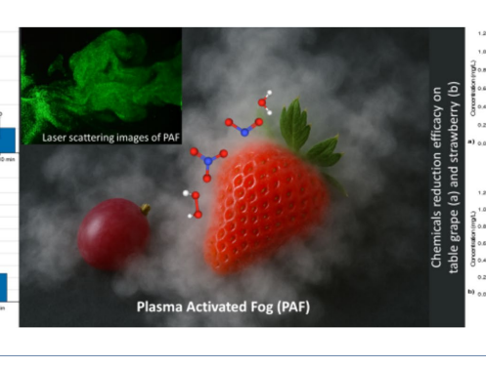
Sanification: Bari Group Activities
The effect of mist is coherent with the results on the efficacy of an aerosol made by droplets of water nebulized and activated trough a plasma discharge
This novel application named plasma-activated fog (PAF) has been shown able to completely inhibited fungal growth and reduced fruit rot, improving food safety and extending the shelf life of fresh products, significantly lowering at the same time pesticide residues.
Compared with the untreated control, both treatments with PAF significantly reduced rot symptoms by 40% and 74% after 5 min and 10 min of treatment, respectively.
D. Aceto, Chem. Biol. Technol. Agric. 2025, 12, 151
M.Rutigliano and V. Antoni

Slide 34
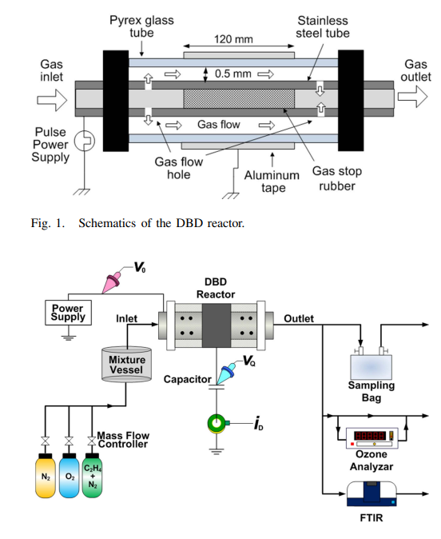
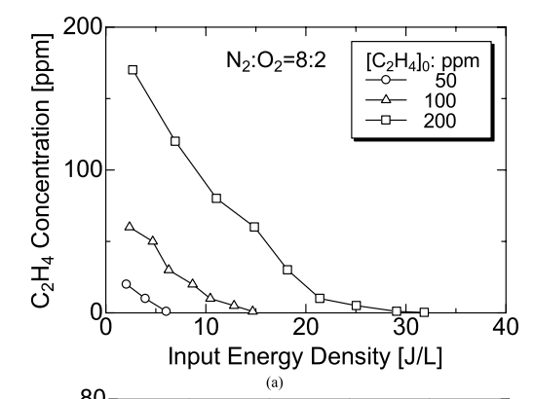
Food System Sanification : Etylene decomposition
It is interesting noticing that CAP can offer also alternative innovative approaches to the sanification as the case of ethylene decomposition.
Ethylene (C₂H₄) is a plant phytohormone that plays a crucial role in fruit ripening.
In a pioneering work decomposition of Ethylene was achieved using a Dielectric Barrier Discharge cylindrical reactor showing effective abatement and proposed as an alternative /complementary method to refrigeration for keeping freshness of fruits and vegetables during transportation
IEEE TRANSACTIONS ON PLASMA SCIENCE, VOL. 43, NO. 10, OCTOBER 2015 K. Takaki
M.Rutigliano and V. Antoni

Slide 35
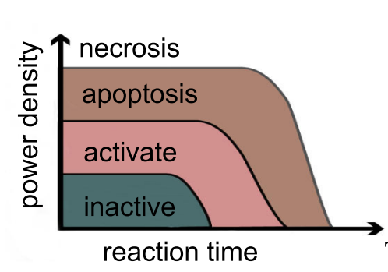
Plasma Medicine: interaction with cells
Whatever the treatment the effects observed in food system applications are all related to the presence of chemical reactive species.
This effects were initially found in plasma medicine studies so that Plasma Agricuture relies on this discipline
In particular it was observed that the effects were dose dependent so that the oxidative stress can lead from stimulation of cellular processes to cell death as in pioneering treatments for cancer.
M.Rutigliano and V. Antoni

Slide 36
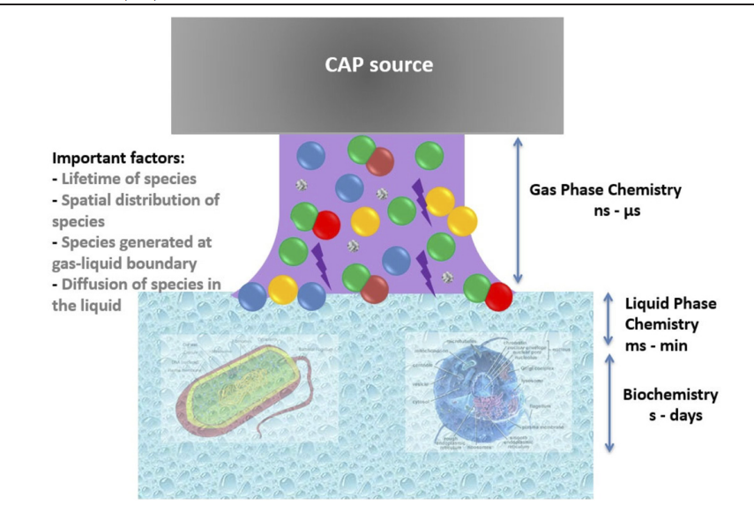
Plasma Medicine
In plasma medicine the biological targets are exposed to charged species, metastable species, and other atomic and molecular reactive species depending on the direct or indirect treatment.
When the liquid-dominated bio-interfaces enter in contact with these primary species , other secondary reactive species ae generated with strong oxidative properties
Schematic depiction of low temperature plasma interacting with biological targets.
Cells are typically covered by biological fluids, so the plasma first interacts with a liquid layer.
Secondary and tertiary reaction by-products generated in the liquid then interact with the biological cells.
T von Woedtke et al 2022 Plasma Sources Sci. Technol. 31 054002
M.Rutigliano and V. Antoni

Slide 37
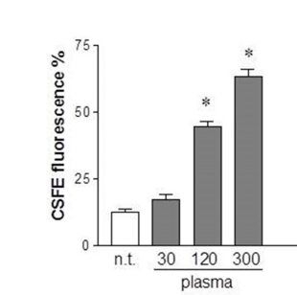
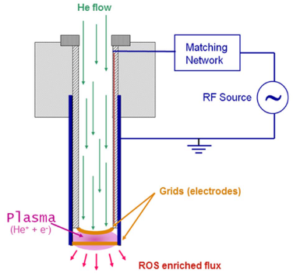
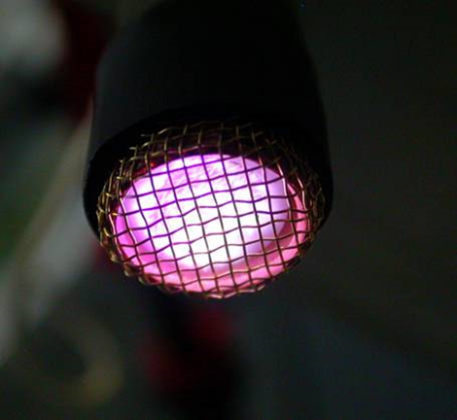
Coagulation Padova Group activities
Coagulation is a good example of a dynamic, well-organized process requiring cooperation of different intracellular signaling to repair lesions and damaged tissues.
CAP produced by applying a radio-frequency (RF) electric field to a flow of helium at atmospheric pressure has shown in-vitro effective promotion of proliferation of fibroplast i.e. the biological cells entering in the process of coagulation.
No treated l
Paola Brun,et al. Plasma Medicine, 5(2–4): 237–247 (2015)
M.Rutigliano and V. Antoni

Slide 38
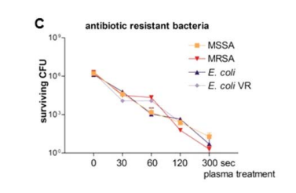
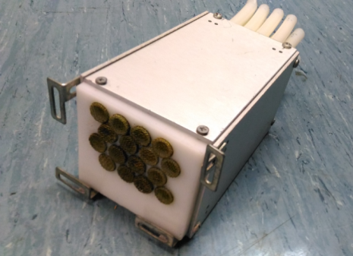
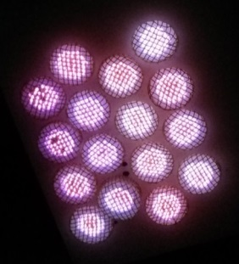
Wound healing and disinfection
CAP offers the possibility of new treatments were the conventional ones are poorly or not effective as in case of Infectious keratitis of the eye which is induced by proliferation and penetration of microorganisms in the cornea.
The same RF source in Helium has been applied showing effective inactivation of Gram-positive and Gram-negative bacteria including those antibiotic-resistant
P. Brun et al.Plasma Medicine, 7(2):147–157 (2017)
As an application of the faster coagulation and sterilization effectiveness a specific CAP source has been developed showing a faster wound closure time and a drastic reduction of the bacterial load in test on animals .
E. Martines etal.Clinical Plasma Medicine 17–18 (2020) 100095
M.Rutigliano and V. Antoni

Slide 39
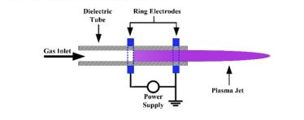
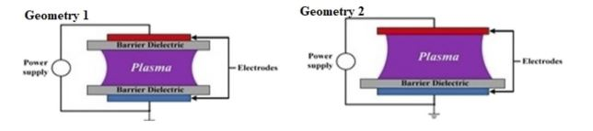
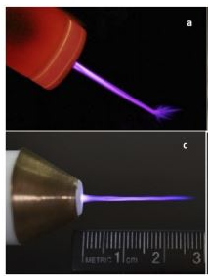
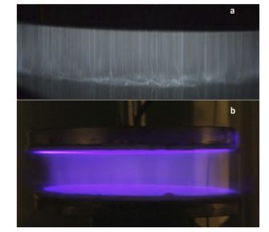
Plasma Medicine Sources
Teams working in plasma medicine are used to develop their own source so that it is sometime difficult to compare the results
In particular two types of low temperature plasma sources have been extensively used, the dielectric barrier discharge and atmospheric pressure plasma jets both in different configurations and geometries.
Both sources can also operate typically with noble gases (such as helium and argon) or gas mixtures (such as He/air, Ar/air, He/O₂, Ar/O₂, etc)
M.Rutigliano and V. Antoni

Slide 40
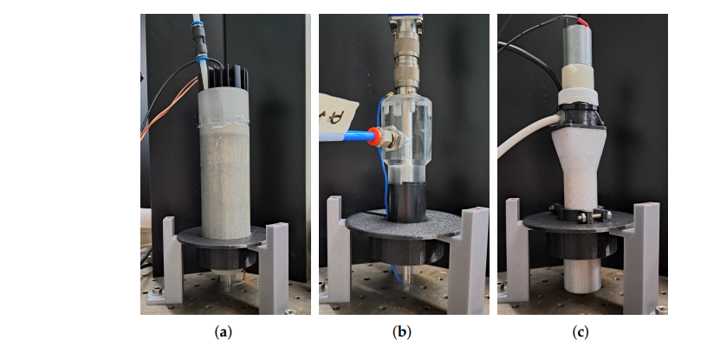
Plasma medicine : the quest for standard
The wide variety of sources and procedures make quite difficult defining a common standard which is mandatory for equipment approval in particular for medical equipment. It is therefore mandatory to compare the tools is same experimental conditions.
The Milano Group has done it for three different plasma sources relevant for biomedical applications: a micropulsed source, a radiofrequency source and a DBD source.
The three sources have been applied to the investigation of processes concerning the bactericidal properties of direct plasma treatments.
The results have allowed a first comparison of the effectiveness of the sources and at the same time has allowed to improve the understanding of the optimal mix of species for an efficient bactericidal effect.
L.Zampieri Appl. Sci. 2025, 15, 7037
M.Rutigliano and V. Antoni

Slide 41
Signaling pathways in biological cells
From Plasma Medicine research the simultaneous presence and interaction of long and short living species emerge as a key player to interpret the effects observed.
In particular reactive oxygen species (ROS) and reactive nitrogen species (RNS) which possess strong oxidative properties can trigger signaling pathways in biological cells as in the case of blood coagulation.
Therefore, going deeper in the biological signaling can contribute to better understand processes ultimately affecting the cells and in perspective to better control them.
The study of Calcium signaling in plants offers an example of the research on this field.
M.Rutigliano and V. Antoni

Slide 42
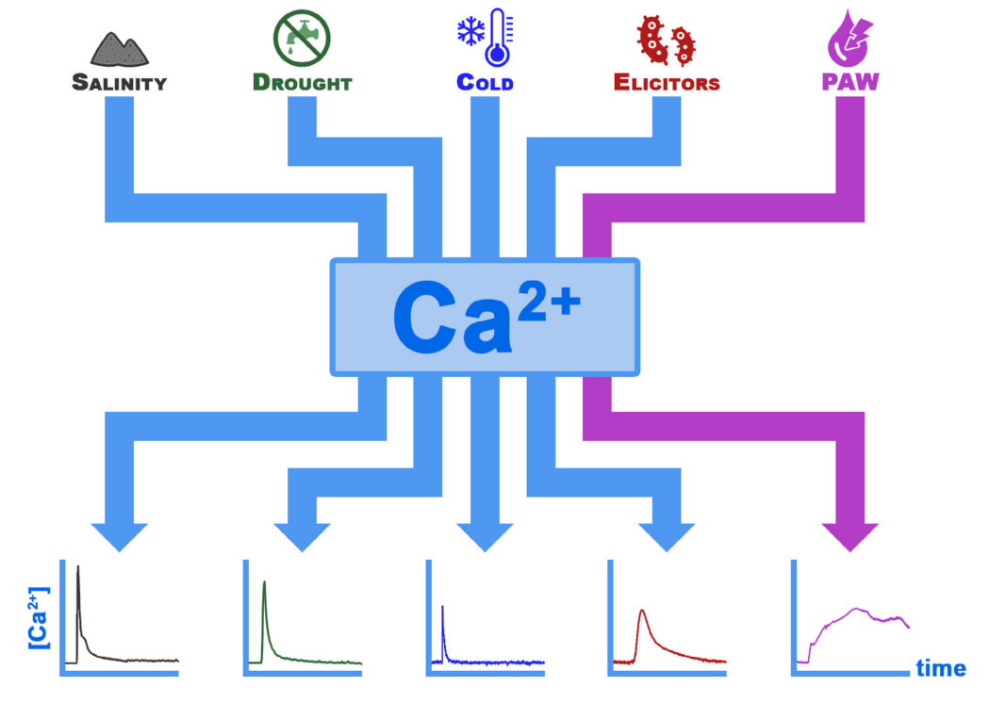
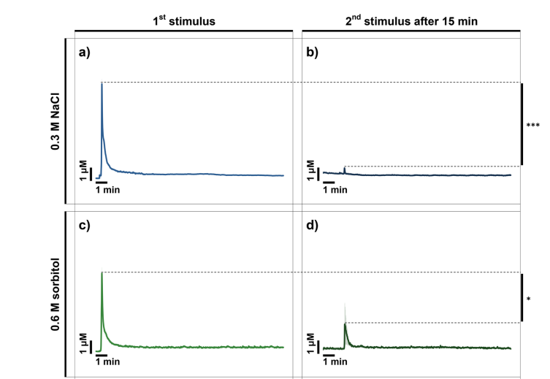
Plant Calcium signalling
Calcium signaling is involved in a wide range of physiological processes in all living organisms.
In plants, it plays a fundamental role as an intracellular transducer in a variety of signaling pathways, including those activated by abiotic stresses (such as cold/heat, salinity, drought)
and by biotic stress (such as during pathogen attack)
Experimental Calcium signal after administration of
sorbitol to mimic an abiotic stress.
M.Rutigliano and V. Antoni

Slide 43
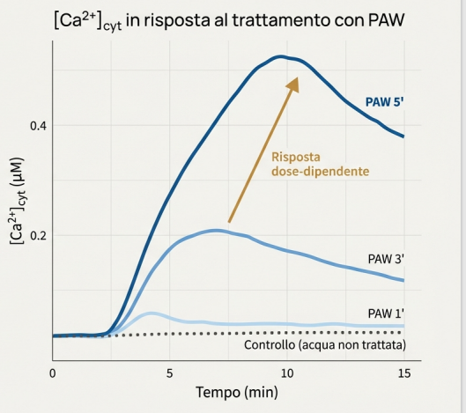
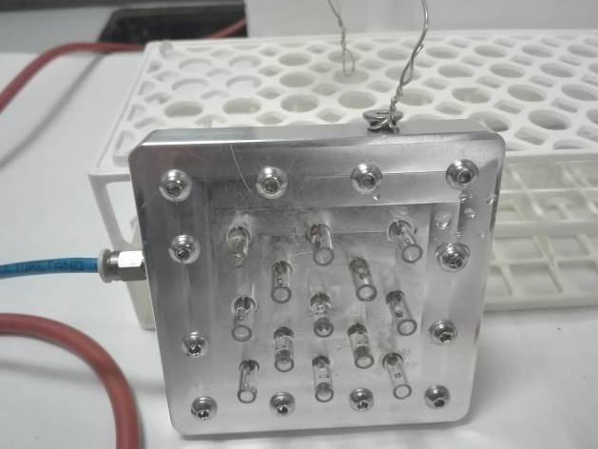
Calcium Signalling
The experiment has been carried out using seedlings of Arabidopsis thaliana genetically modified in order to became bioluminescent in presence of calcium.
The intensity of the bioluminescence measured by a luminometer results proportional to the calcium increase inside the cells.
Seedlings have been irrigated by PAW generated by a multi pin DBD source, showing a rapid and robust increase in the cytosolic concentration of Ca2+ with the intensity depending on the duration of the activation.
E. Cortese et al. . Plants. 10(11):2516. doi:10.3390/plants10112516
M.Rutigliano and V. Antoni

Slide 44
Stress resilience
As previously shown treated plants show a better resilience against pathogen . To verify how PAW works treated and non treated plants have been exposed to different stresses at diffrent times.
In this case an initial exposure to the stress is followed after 15min by a second, equivalent injection of the same stimulus. The smaller signal means some “priming” has occurred so that the plant is more protected against the stress.
M.Rutigliano and V. Antoni

Slide 45
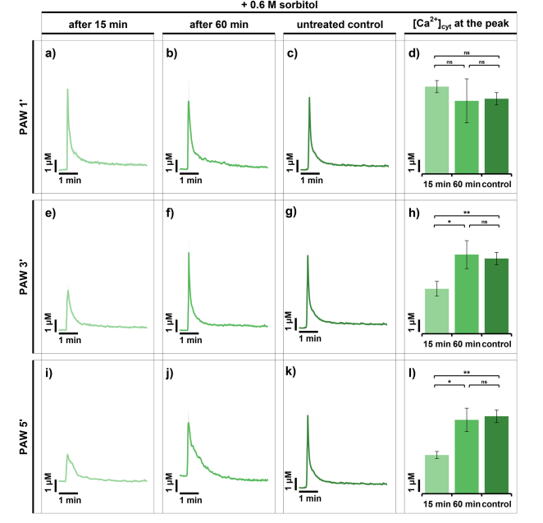
Stress resilience induced by PAW treatment
The plant has been treated by PAW before being exposed to the same stress of the untreated plant
The smaller signal in the treated plant similar to that of the untreated second stimulus suggest the plasma treatment can help the plant to increase the plant stress tolerance ( sort of vaccination in case of biotic stress)
Cortese E. Plant Biosystems 2025 DOI: 10.1080/11263504.2025.2554071
M.Rutigliano and V. Antoni

Slide 46
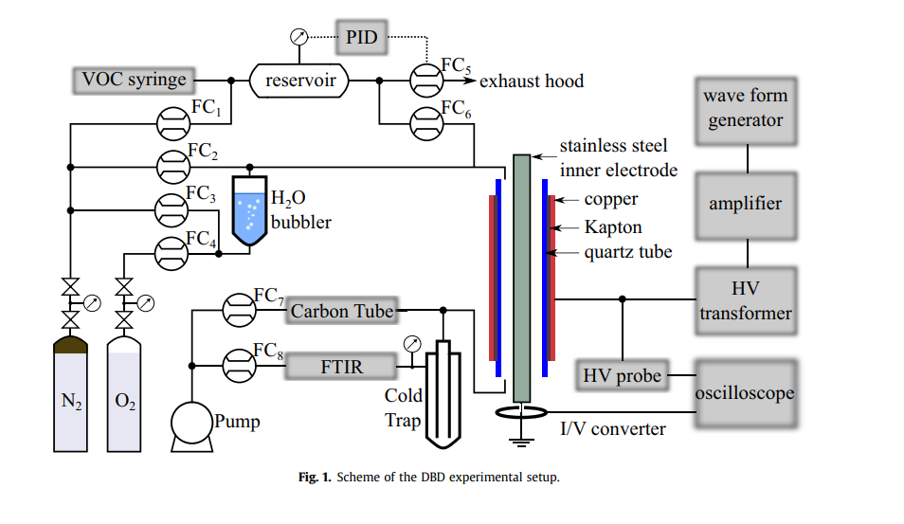
CAP Waste treatments: activities of Trento Group
CAP can be used to treat solid, liquid and gaseous waste.
Examples are the test reactor to treat the volatile organic compounds (VOCs) in the atmosphere, which has shown affective abatement.
The experimental setup consists of a VOC generator, a DBD reactor, and the VOC and exhaust collection system.
L.M. Martini et al, J. Cleaner Production 2019, 230, 230-240
M.Rutigliano and V. Antoni

Slide 47
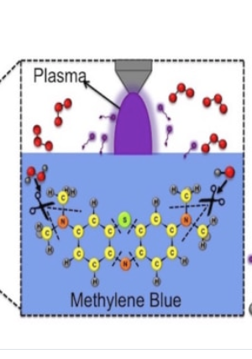
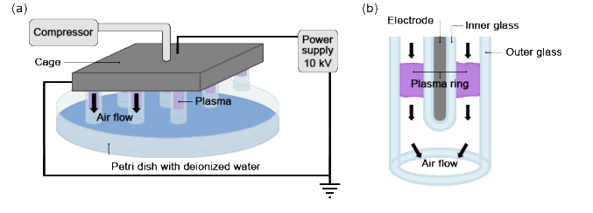
Liquid waste treatment : Padova Group activities
In the framework of a regional project for the treatment of tannery waste preliminary test on sample molecules has been carried out showing that plasma generated by a DBD source is quite effective in destroying the molecules in this case Methylene blue.
M.Rutigliano and V. Antoni

Slide 48
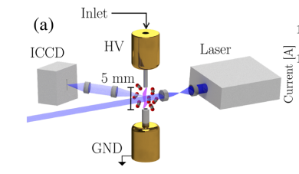
CO₂ dissociation: the activities of the Trento Group
Dissociation of CO₂ by LTP is studied as potential technology to transform CO₂ into synthetic fuel and valuable chemicals.
Though in principle a carbon neutral technology , if combined with CO₂ sequestration could be a way to to reduce the carbon footprint
The facility in operation at Trento University in collaboration with CNR-ISTP (Bari) consists of an atmospheric nanosecond repetitively pulsed discharges.
The facility is equipped with a time-resolved laser-induced fluorescence (LIF) to measure the CO₂ dissociation in the range od μs interval after a nanosecond discharge
The system has shown a relatively high efficiencies in converting CO₂
C. Montesano et al. J. Phys. Chem. C 2023,127, 10045-10050
M.Rutigliano and V. Antoni

Slide 49

Plasma driven chemical processes: modelling
CO₂ dissociation by plasma offers a good example how important is modelling and deep understanding
of the chemical processes. Indeed though the splitting of CO₂ can be summarized as follows:
However, the CO₂ dissociation occurs through a complex network of more then 200 chemical reactions and involves 25 species. In particular molecule vibrational states are believed to play a key role as the primary dissociation pathways is driven, and can be enhanced, by molecular-excitation kinetics, pointing to a role for vibrational mediated processes.
L.D. Pietanza et al .Plasma Phys. Control. Fusion 2023, 65, 044004; Aerts, R., et al ., 2012, 116, 22941
It results therefore of primary importance to develop accurate modelling of the chemical networks generated by the plasma as proved also by the case of nitrogen fixation where CAP promise a new synthesis technology for N fertilizers instead of energy consuming the Haber-Bosch process.
F. Esposito Plasma Sourc. Sci. Technol 2022, 31,094010.
M.Rutigliano and V. Antoni

Slide 50


LTP in Vacuum : a bridge between sectors and an example of national collaboration
Negative ion sources play a key role in the development of Neutral Beam Injectors for ITER. At RFX there are three negative ion RF sources: SPIDER, MINION and NIO1.
As an alternative to the present sources based on filaments or RF, it has been proposed an alterative one based on the same scheme of a Hall Thruster as based on initial PIC simulation carried out in Bari
To improve its effectivness the source has been equipped with a Hollow Cathode and has allowed the test of the innovative diamond coated hollow cathode under development within a PRIN project
The Activity is an example of how LTP can establish a bridge between different sectors in the case Aerospace and Fusion and how it can enlarge the collaboration network among in this case the groups in Pisa, Bari, Milan and Padova
M.Rutigliano and V. Antoni

Slide 51















LTP Italian Community
Trento
Milano
Padova
Bologna
Firenze
Pisa
Roma
Napoli
Bari
Cosenza
M.Rutigliano and V. Antoni

Slide 52
Conclusions
LTP research is a lively research area with the potential of developing new eco-friendly technologies in several key sectors of primary interest and concern as agriculture and environment protection and remediation also fostering new approaches as CO₂ dissociation and Nitrogen fixation.
LTP research offers new tools to investigate fundamental processes in living organisms to foster deeper understanding and at the same time to explore new approaches fo their control as in medicine and biology.
All LTP applications require a multidisciplinary approach so that LTP resarch consitutes a preferential area to establish scientific collaborations with other disciplines like chemistry engineering biology, medicine, cultural heritage and others.
Nowadays, the significant advancement of HPC enables accurate predictions and rationalizations of laboratory/industrial process. This can be achieved through chemical-physics models that comprehensively describe the complete set of processes occurring at the atomic level, which ultimately determine the outcome of the investigated process.
The present review of some activities carried out by national teams, tough incomplete, however reveals a small but dynamic comunity covering several research topics and showing an excellent effectivnes in establishing collaborations among different entities.
M.Rutigliano and V. Antoni

