Slide 1
Updates on DTT Theory activities
M. V. Falessi
On behalf of DTT Theory & Simulation group
TCM 48 June 2025

Slide 2
Theory and simulations research topics
Within the theory and simulations area 4 topics are actively pursued:
Integration of Theory, Simulation and Experiments: IMAS database and workflows for equilibrium, MHD stability and transport studies;
Global and Hybrid Gyrokinetic simulations;
Particle losses due to Ripple and Alfvénic fluctuations;
EP distribution function modelling;

Slide 3
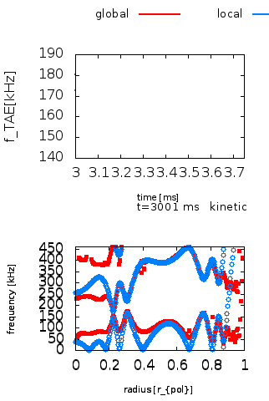
Integration of Theory, Simulation and Experiments
Critical for the scientific exploitation of the machine and for predictive capability in reactor relevant plasmas;
Requires comparison of simulations, experiments and reduced models;
Accurate modelling of magnetic geometry, kinetic profiles, fluctuation modes structures and EP distribution functions are required;
Only a centralized IMAS database can ensures integration and consistency;
Automated IMAS workflows operate on the database.

Slide 4
Integration of Theory, Simulation and Experiments
Critical for the scientific exploitation of the machine and for predictive capability in reactor relevant plasmas;
Requires comparison of simulations, experiments and reduced models;
Accurate modelling of magnetic geometry, kinetic profiles, fluctuation modes structures and EP distribution functions are required;
Only a centralized IMAS database can ensures integration and consistency;
Automated IMAS workflows operate directly on the database.

Slide 5
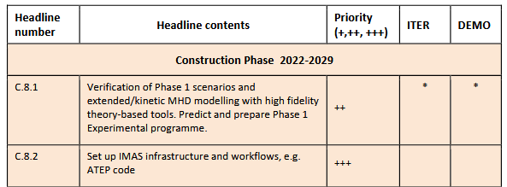
DTT Research plan

Slide 6
IMAS equilibria for DTT
No IMAS equilibria were available at the start of this activity;
Also no agreement between ENEA and ITER on the usage/development of IMAS;
A database entry has been created for the DTT full power scenario using the kinetic profiles by the T&M group and a new magnetic equilibrium;
The ITER cluster has been used to store data and maintain numerical workflows;
Both Theory and Simulation and T&M groups have dedicated accounts on the cluster;
Collaboration with ITER allow to have always updated libraries and workflows;

Slide 7
HYMAGYC workflow
HYMAGYC has been modified to:
Read equilibrium from an IMAS database and compute a high resolution version suitable for MHD and EP studies;
Read EP (model) distribution function and kinetic profiles;
submit a parallel batch job executing HYMAGYC;
It is possible, but not yet tested, to use the same workflow substituting HYMAGYC with MARS for MHD stability studies

Slide 8
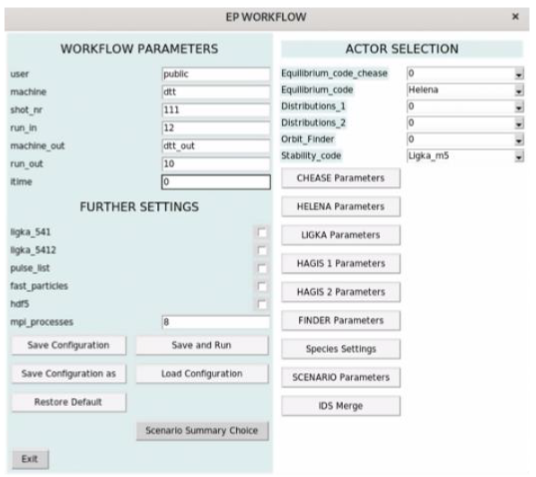
IMAS equilibria for DTT

Slide 9
Next steps
The JINTRAC transport code can now write directly to IMAS databases;
A collaboration with Paola and the T&M group is underway to generate a set of database entries for various DTT scenarios;
Development of a MAXFEA interface to IMAS;
In the future, IMAS database and workflows should be migrated to a dedicated DTT HPC facility

Slide 10
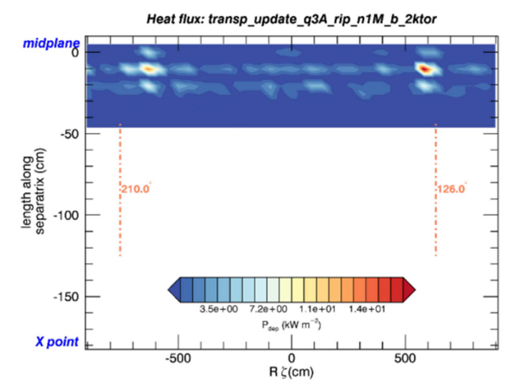
Losses due to Ripple and Alfvénic fluctuations
Preliminary analysis show low EP particle losses though poloidally localized;
TAEs and other modes may significantly enhance EP losses;
A general workflow has been developed to compute fluctuation induced fast ion losses in DTT, using MARS results as input for the ORBIT code;

Slide 11
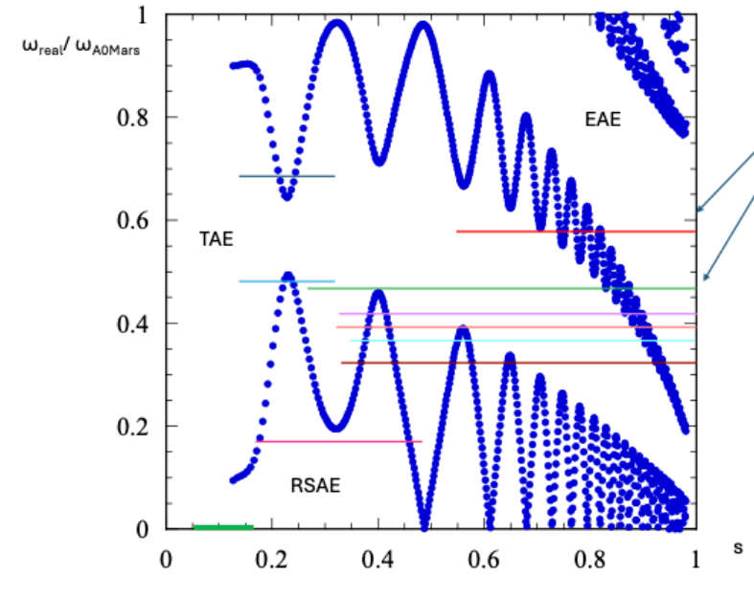
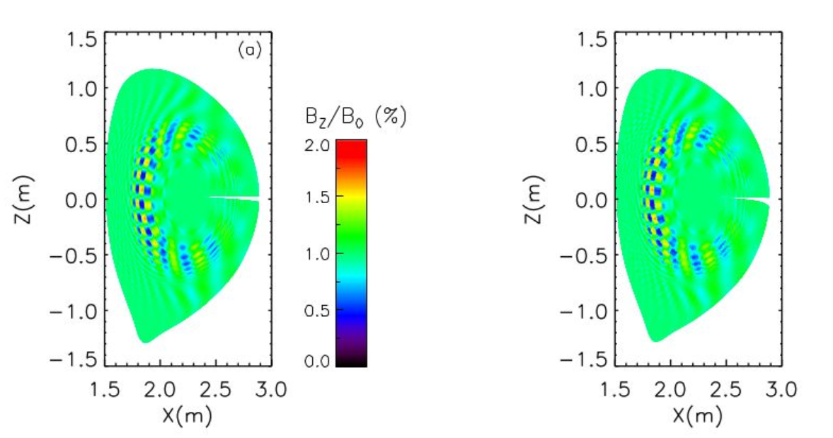
Losses due to Ripple and Alfvénic fluctuations
Spectrum and radial profiles of TAE determined by DAEPS/FALCON, MARS and HYMAGYC codes (n=10)
remapping the perturbed TAE fields from MARS into the guiding center code ORBIT Boozer coordinates
SELECTED CASE

Slide 12
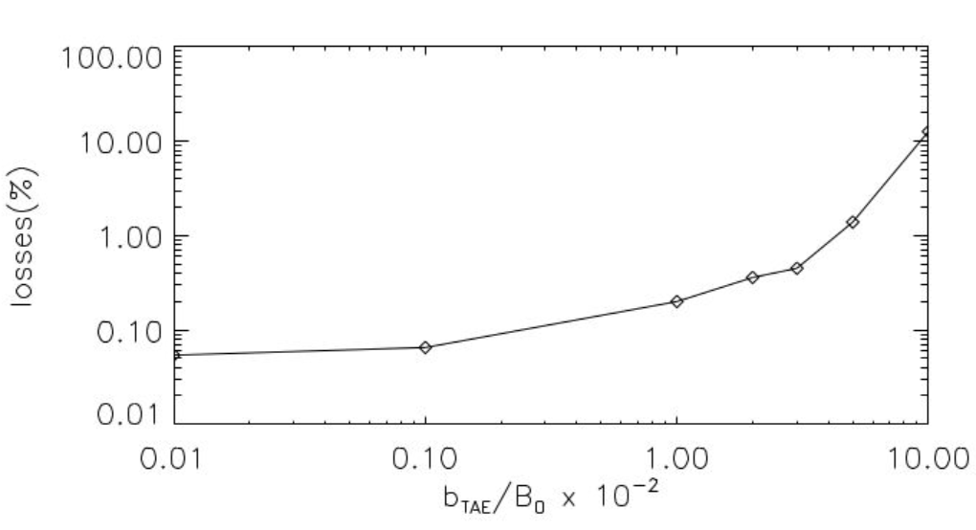
Losses due to Ripple and Alfvénic fluctuations
Equilibrium with R0 = 2.19 m (JETTO PPF=1184)
NNBI parameters : E = 510 keV, 1 beam@10MW
3D TRANSP distribution with 10k test particles

Slide 13
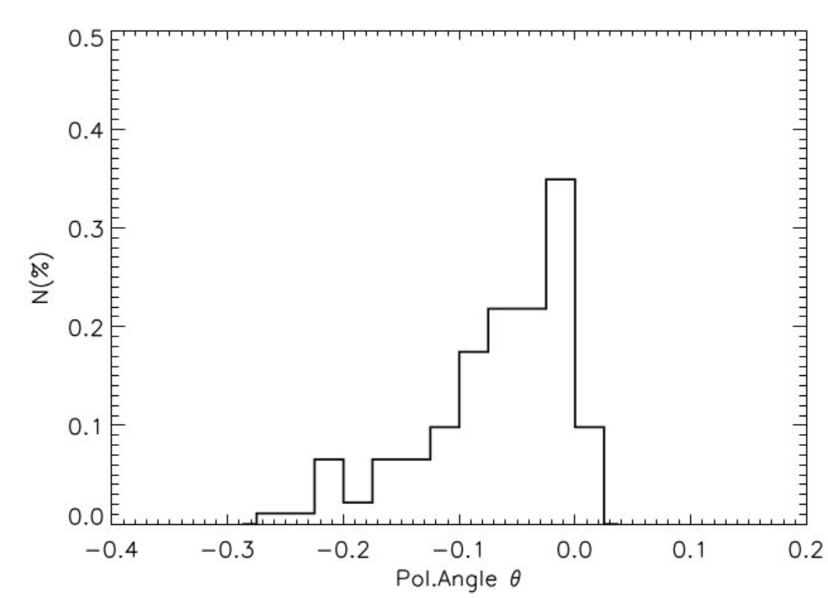
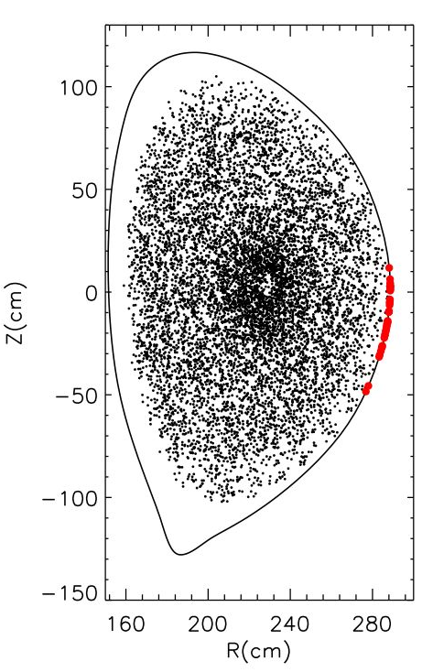
Losses due to Ripple and Alfvénic fluctuations
losses mainly close to $θ=0$in the bottom half of device (LFS);

Slide 14
Next steps
High-statistics simulations with 1 million test fast ions are underway to evaluate the heat power deposition map
Inclusion of multiple TAEs as calculated by MARS is in progress
Apply this workflow to the latest version of the E scenario;

Slide 15
Equilibrium EP distribution function modelling
Study of beam NBI EP distribution functions in various DTT plasmas:
different I_{p}/B_{t} values
NBI simulated on plasmas of scenarios A, C, E
Steady-state beam EP distribution functions is given as input for nonlinear GK simulations, i.e. HYMAGYC
EP distribution analysis in COM space (DTT Research Plan)
A, C scenarios do not foresee NBI, though NBI will be used in similar plasmas during DTT operation phases

Slide 16
Next steps
Provide, upon request, fast ion distribution functions to other groups (e.g., to HYMAGIC, for MHD studies, and for diagnostics studies – e.g., Collective Thomson Scattering)
Depending on the advances with ASCOT-RFOF and DTT IMAS implementation, preliminary ICRH+NBI simulations can be set
Investigate the importance of using first wall as a boundary condition for EP losses and not the LCFS to correctly estimate the fraction of EP prompt losses

Slide 17
Thank you for your attention!

Slide 18
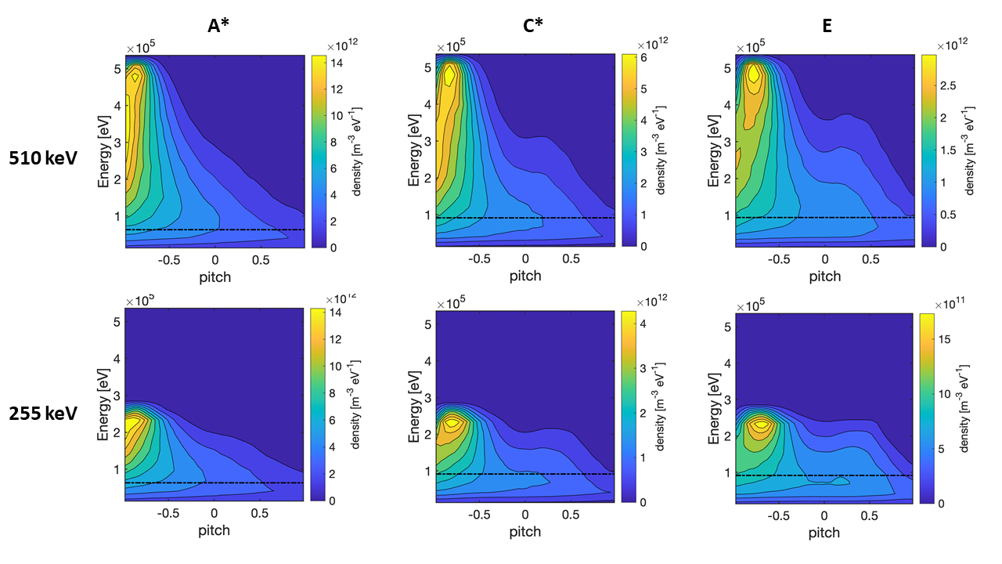
Collisional slowing down simulated with ASCOT:
Steady-state beam EP distribution functions
Collisional losses
Absorbed power, current-drive, torque
Take-home messages for DTT:
Collisionless beam EP analysis:
Passing orbits dominate ref. scenario E
Passing/trapped orbit ratio varies with plasma density and NBI energy
Small fraction of stagnating orbits
Importance of using the first wall as a boundary condition for EP losses (ASCOT) and not the LCFS (CoM) to correctly estimate the fraction of EP prompt losses
Collisional slowing down of beam EPs:
Efficient beam coupling, slightly reduced at high NBI energy at low plasma density
NBI current drive of 0.24 MA in ref. scenario E
NBI provides torque to the plasma of some Nm
Off-axis beam power deposition due to vertically shifted injection geometry
Relevant ion heating between 40% and 55% of the absorbed power, depending on NBI energy and plasma kinetic profiles
This work contributed to the DTT research plan and constitutes an input for other DTT studies (e.g. MHD)
De Piccoli C et al., Front. Phys. 12:1492095, 2024, doi: 10.3389/fphy.2024.1492095

Slide 19
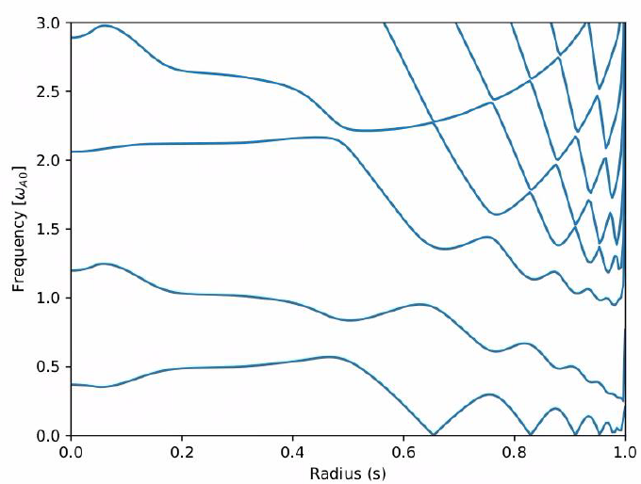
IMAS equilibria for DTT

Slide 20
Losses due to Ripple and Alfvénic fluctuations
First analysis show low EP particle losses (but poloidally localized);
TAEs and other modes may enhance them;

Slide 21
IMAS equilibria for DTT
HYMAGYC has been modified to:
No IMAS equilibria when this activity studied;
A database entry for the DTT full power has been created and the workflow has been sucesfully tested;
JINTRACK transport code is now capable of writing directly IMAS databases. A collaboration with Paola and the T&M is taking place to create a set of databases for different DTT scenarios;
ITER cluster is used to store data and maintain numerical workflows.

Slide 22
3 main issues tackled recently:
Develop a full power Hybrid scenario with q>1 to avoid large sawtooth crashes (two upcoming conference presentations EPS and TTF)
Revise flux consumption by including two elements previously neglected (L-H threshold scaling for metallic machines and use of EC current drive)
Revision of EM equilibria with v16-v17
Continue studies of negative triangularity scenarios ( one invited talk at TTF)

