Slide 1
Tangential phase-contrast imaging diagnostic
for JT-60SA
S. Coda¹ , K. Tanaka² , M. Noël¹
¹EPFL-SPC, ²NIFS TCM-43, 21.5.2025

Slide 2
Phase-contrast imaging on JT-60SA
Will provide localized density fluctuation measurements across the minor radius and in all plasma regimes
  δn/n~10⁻⁵, 0.06<kρ_{i}<12 (ITG/TEM/ETG)
  high spatial resolution in the center and at the edge (very favourable configuration on JT-60SA)
First real opportunity to study turbulence and turbulent transport, and validate models, in a reactor-grade device
Gyrokinetic modeling support proposed in parallel, with comparisons mediated by a synthetic diagnostic (ongoing gene work)
Europe/NIFS collaboration, with Japanese funding (JSPS) already secured
S. Coda et al, Nucl. Fusion 61, 106022 (2021), DOI:10.1088/1741-4326/ac2081

Slide 3
Principles of PCI
PCI is an internal-reference interferometer: measures line-integrated density but only by manipulating and recombining beam components
It is more sensitive than an interferometer
(∫δn dl~10¹⁴ m⁻²  δn~10¹⁵ m⁻³) but cannot measure absolute phase shift (long wavelength cutoff ≈ size of beam)
An image is created across the beam, and spatial resolution is limited only by the number of detector elements
Localization along the beam is achieved in a tangential-launch geometry by selecting the direction of the measured wave vector
(by optical filtering)

Slide 4
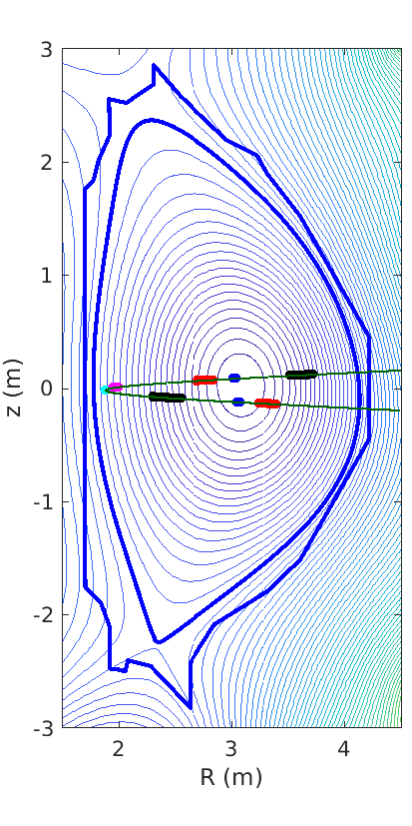
Localization on the flux surface
While well-localized in ρ, at mid-radius the measurement picks up signal from both the HFS and LFS
HFS and LFS can be resolved separately by doubling the detection system
(splitting the transmitted beam to create two separate images)

Slide 5
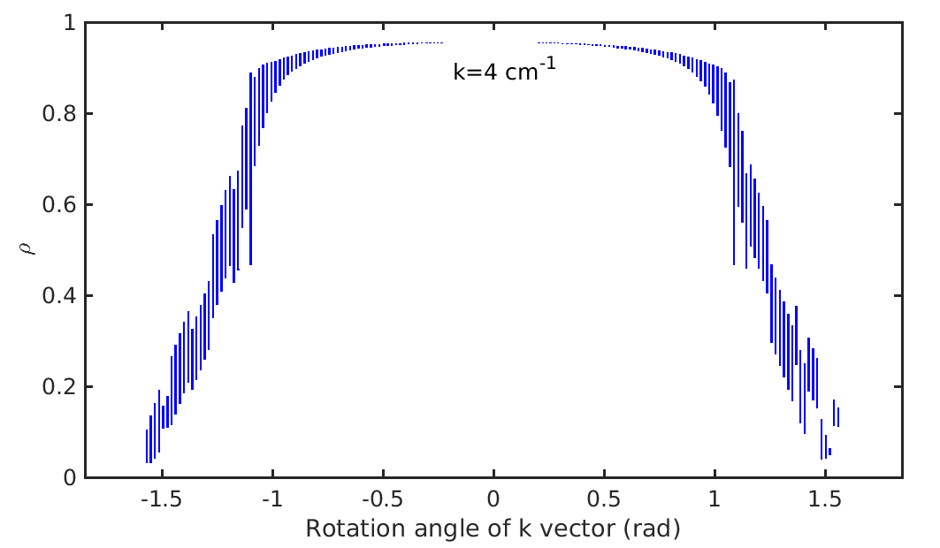
Radial localization
A physical rotating filter allows sampling the entire profile vs time within a shot
A similar result can be achieved with a 2D detector (filtering in data processing)

Slide 6
Hardware layout
~50-50 cost split between F4E and NIFS, with procurements already started
Beam generation
  CO₂ laser of ~60-100 W power
  Beam expansion by telescopic arrangement
  Relay mirrors all off-vessel (max 32-cm diameter)
Vacuum interfaces
  ZnSe windows
Beam collection
  Relay mirrors all off-vessel (max 45-cm diameter)
  Reflective-refractive focusing and imaging system:
  must be close to vessel since scattered components diverge rapidly
Data acquisition under floor in PIG room

Slide 7
Hardware layout: detection options
2D detector allows all locations to be resolved at once, with typically reduced spatial resolution (16x8 pixels is perhaps the limit)
With 1D detector, spatial scan requires multiple shots or a rotating spatial filter, but spatial resolution is better (64 or 128 pixels possible)
2 linear 32-detector arrays to be brought from NIFS to image the HFS and LFS separately; a third, 2D 48-detector array planned to be used in addition for coarse but complete instantaneous scan of spectrum

Slide 8
Hardware layout: auxiliary systems
Absolute calibration possible with sound waves in air
System to be 1-week maintenance-free.
Remote-controlled rotation and translation stages to be used in conjunction with simple Webcams for alignment corrections
Mechanical vibrations may or may not be an issue. Some compensation may be required and is proposed from the start as a risk mitigation measure. We can leverage extensive experience with feedback focusing control on DIII-D and TCV.

Slide 9
Procurement splitting
NIFS will provide
  detectors (multiple, recycled from LHD)
  LN2 generator and fueling system (purchased, under test at NIFS)
  neutron and γ shielding assemblies (purchased)
  ADCs
F4E will provide [most components scoped and nearly finalized]
  CO2 laser with associated chiller, alignment laser
  optics and mounts (around torus hall + on optical table), including beam expander
  optomechanical components, feedback beam alignment system
  vacuum windows
  optical table for torus hall
  mechanical supports (initial ones fabricated and sent to Naka)
  acoustic calibration equipment, cables

Slide 10
Current status and planning
Three Design Review Meetings held, with the final one on 12.5.2025 to finalize the Procurement Agreement
Detailed mechanical and optical design (including all mirror boxes, supports, tubing, etc.) at an advanced level
Procurements have begun on the NIFS side (LN2 filling station, radiation shielding) and on the European side (combined supports for TS and TPCI beam tubes)
NIFS is also proposing reuse of LHD equipment (detectors, etc.)
It is possible and desirable to install and commission in M/E-1. We aim at a finalized design by September to generate the installation procedure and allow budgeting and scheduling the installation.
Postdoc position advertised by EPFL-SPC for this project

Slide 11
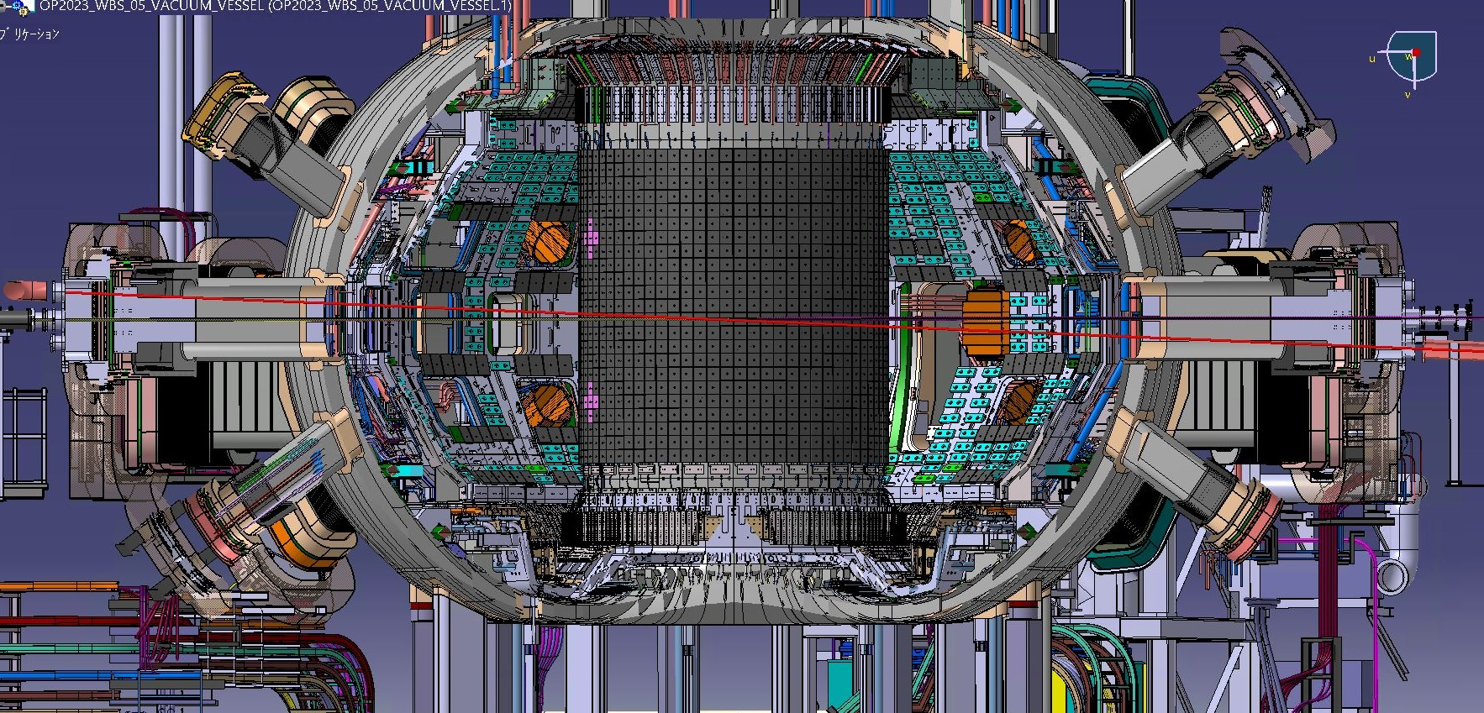
Optical-path design
P01H
CO2
PCI
CO2
YAG
P08H
PCI
P01H
CO2
YAG
PCI
YAG
P08H
11

Slide 12
Radiation shielding
Detectors to be shielded by 15 cm polyethylene and 1 cm lead (based on MCNP analysis)

Slide 13
Gyrokinetic simulations
Aylwin Iantchenko (former EPFL Ph.D. student) has now published two papers on
  (a) the TPCI synthetic diagnostic
  (DOI 10.1088/1361-6587/aca4f7)
  (b) the first complete gene nonlinear flux-tube simulation of a high-β (DND) scenario
  (DOI 10.1088/1741-4326/ad0c0a)
Oleg Krutkin (EPFL) is continuing the modeling effort with
single-null scenario 2 (paper to be submitted soon)

Slide 14
ADDITIONAL SLIDES

Slide 15
How is spatial localization achieved?
At every location, measurement selects wave vectors that are perpendicular to the magnetic field (since k_{par}~0) and to the laser beam (else canceled by integration), i.e.
k ∝ B x k₀
Selecting the direction of k by spatial filtering, we select a spatial location
In JT-60SA, best spatial localization is achieved near the magnetic axis and in the pedestal (on the HFS)

Slide 16
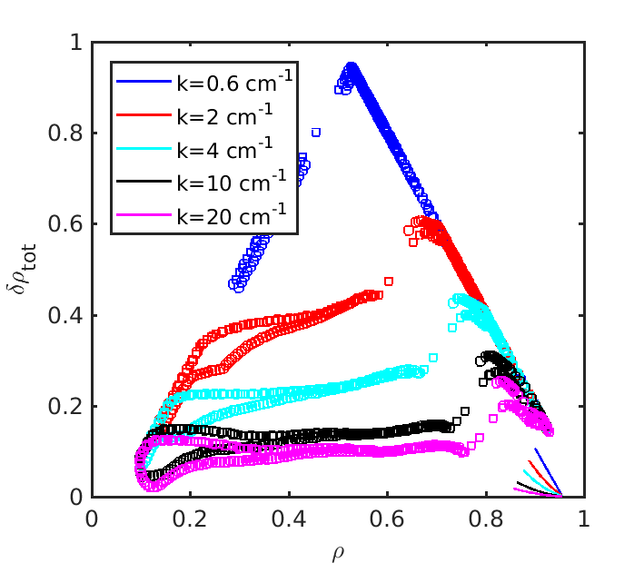
Localization improves with increasing k
k direction:
predominantly k_{ρ}
in center,
k_{ρ} and k_{θ} in two
separate edge
measurements

Slide 17
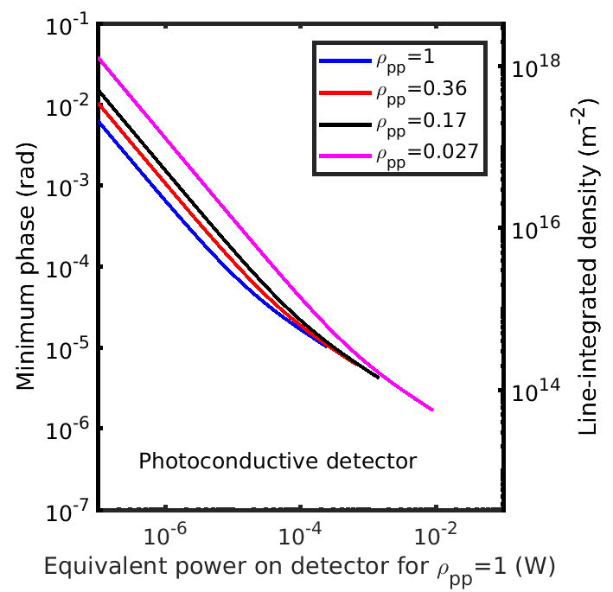
Sensitivity is crucial
Depending on
integration length,
densities as low as
10¹⁵ m⁻³ can
be measured

Slide 18
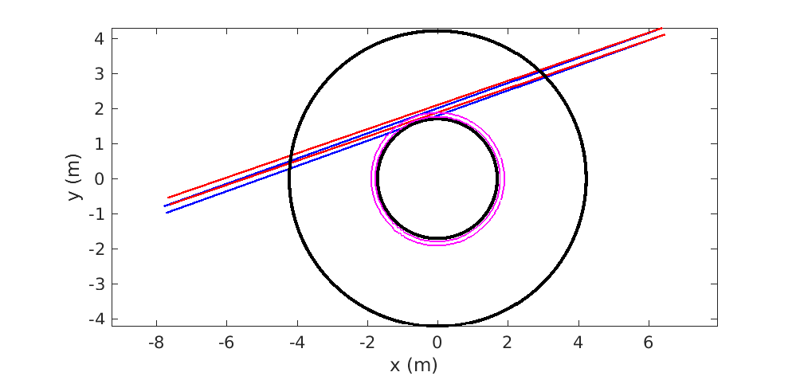
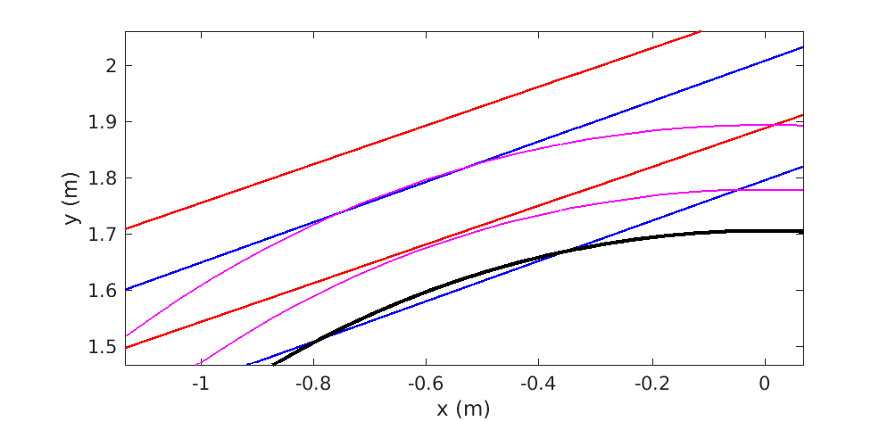
PCI port choice
The inclined option is needed to avoid running into inner wall
Inclined
Straight

Slide 19
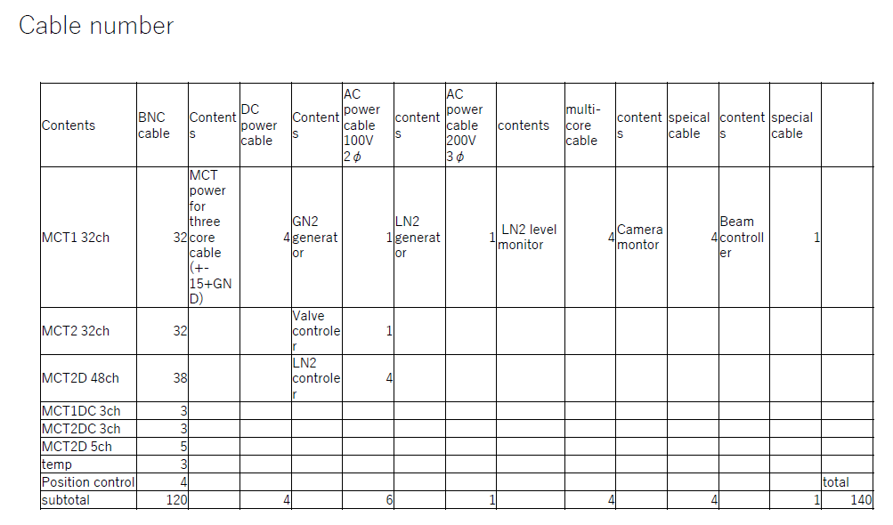
Cabling
Cabling to go to space below floor

Slide 20
Gyrokinetic modelling (gene)
Linear analysis shows importance of retaining full physics, including impurities, collisions, e.m. effects
e.m. modes coexist
ETG appear
minor in
this scenario
ITG
TEM

