Slide 1
Cryopump installation status
K. Fukui
JT-60SA Magnet system group

Slide 2
Index
1. The cryopump support installation
2. The cryopump assembly
2.1 Dimensional check of vertical ports
2.2 Piping assembly
3. Whole schedule and Conclusion

Slide 3
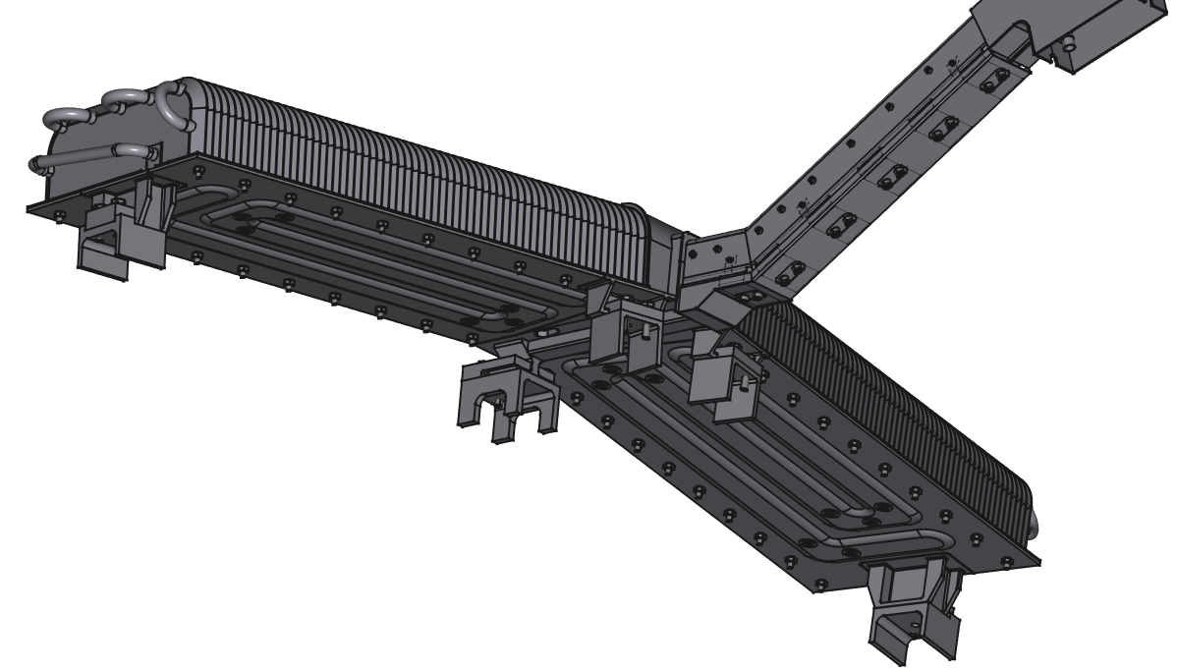
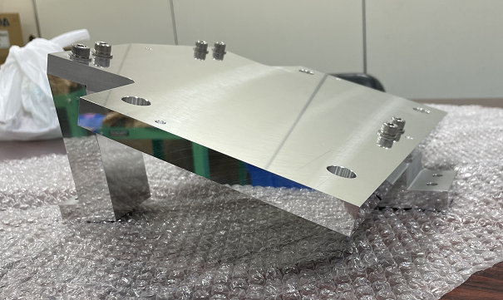
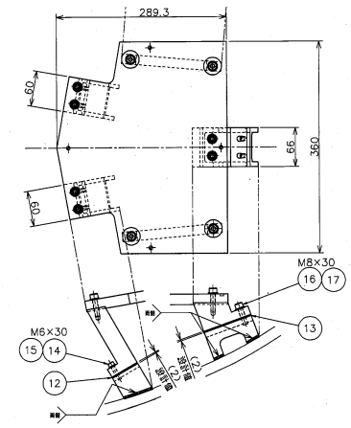
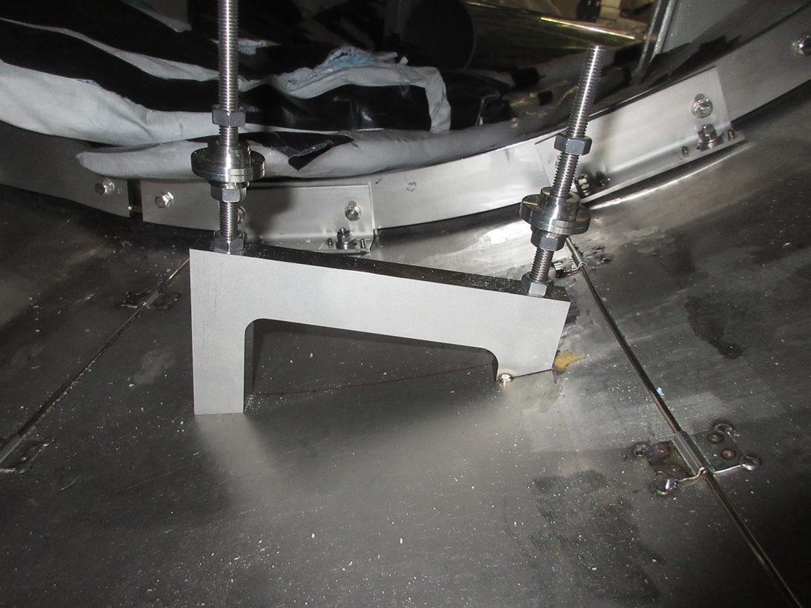
1. The support installation
Positioning plate
Holes for a laser tracker
VV wall
The 3 supports will be adjusted by using a positioning jig.
Tolerance to horizontal axis will be adjusted to be within 1 mm.
Installation will start from the end of May.
Jig support
VV wall

Slide 4
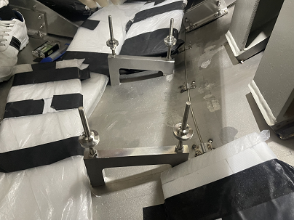
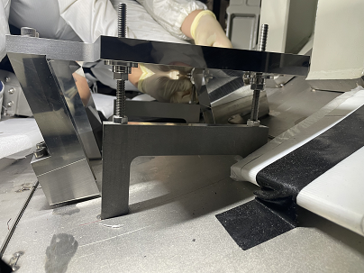
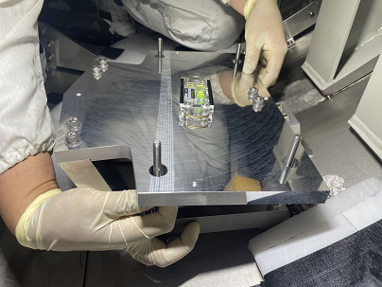
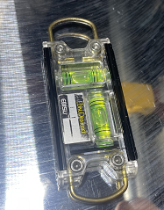
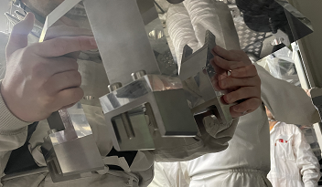
1. Jig to adjust support position
① Jig supports on VV wall
② Jig installation
Jig plate
Jig supports
Cryopump support
③ Jig adjustment
3 of cryopump supports can be mounted on the jig plate
The supports installation is planned to start from the end of May.

Slide 5
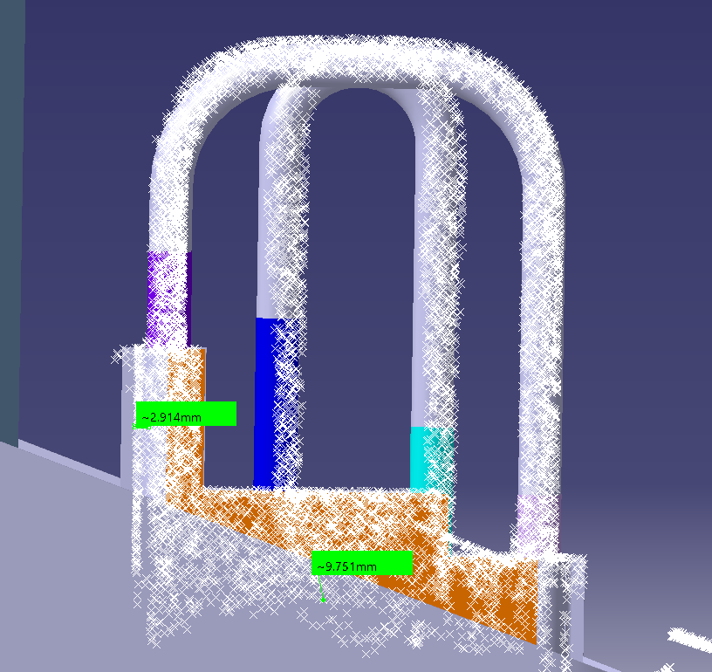
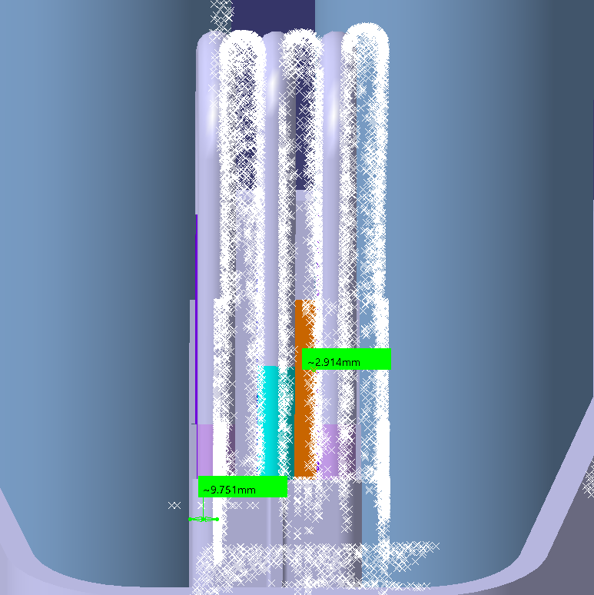
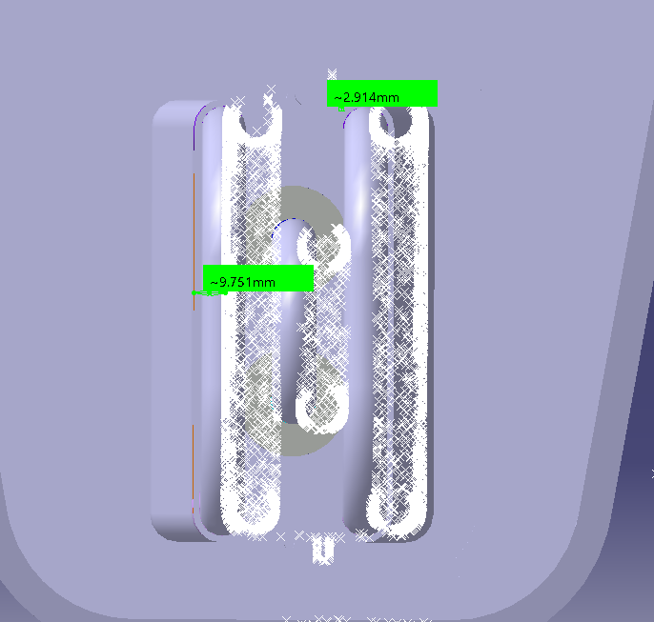
2.1 Dimensional check
To confirm misalignment of the vertical supports, dimensional check was conducted.
In case of P15
Cryopump
Toroidal
Radius
Toroidal
 | Error of the vertical pipes [mm]
Port No. | Troidal axis | radius axis
1 | -3.8 | +4.1
3 | -2.4 | +5.5
5 | -2.1 | +3.9
7 | -7.3 | +4.8
9 | -1.5 | +1.9
11 | +7.5 | -2.1
13 | +6.1 | +4.3
15 | +9.8 | +2.9
17 | +1.8 | -10.9
Cryopump
QST performed 3D scan of the vertical piping.
The largest error of the Toroidal direction is 9.8mm at P15.
The installation misalignment of the vertical pipes will be adjusted by straight and elbow pipes.

Slide 6
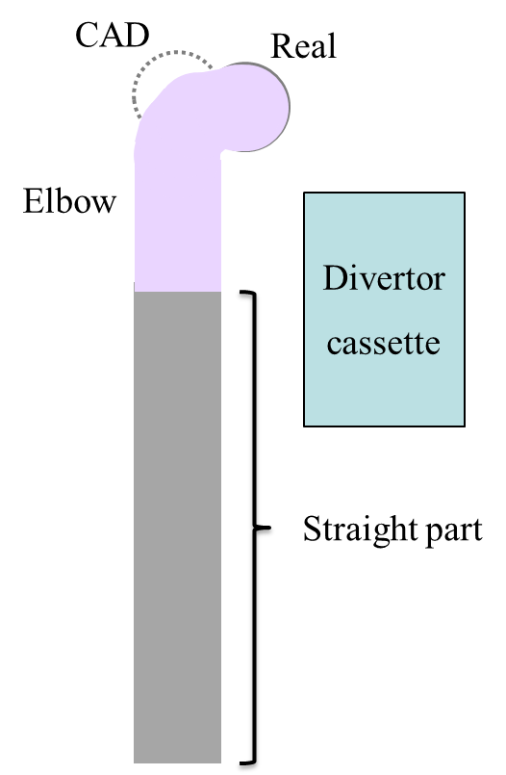
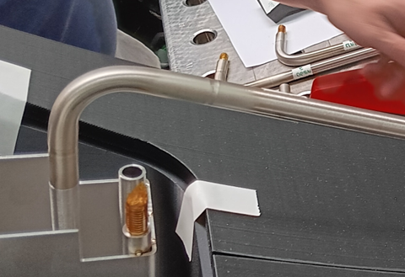
2.2 Piping assembly
Bird view of a vertical pipe
The major misalignment of vertical pipes will be controlled by bending straight part.
At P7, P11, P13 and P15, the distance between pipe and divertor cassette is too short. Therefore, the misalignment will be controlled by adjusting elbow pipe.
CAD
Real
Elbow
Straight part

Slide 7
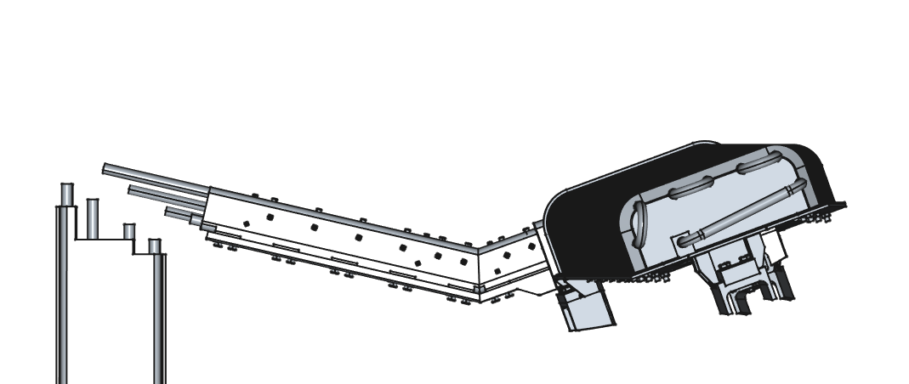
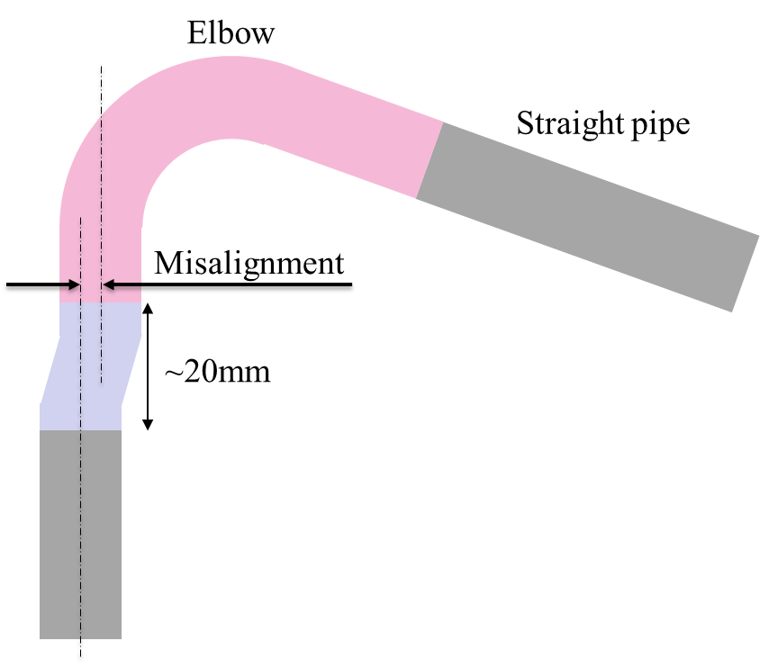
2.2 Cryopump piping assembly
Short pipe
Joint part
A minor misalignment such like ~1mm is expected at the point to be welded at the end.
The installation error will be measured and a short pipe to control misalignment is planned to be prepared in situ.
The mockup test to demonstrate joint part welding is under planning.
The test is scheduled in Jun. The cryopump assembly will start from the middle of Jun.

Slide 8
3 Installation schedule
Cryopump PA was finished in Dec. 2024.
The support installation including mockup test will take a place from the middle of May to the beginning of Jun.
The piping assembly is scheduled by the end of Jun.
The schedule of cryopump installation in VV is under discussion between subcontractor.

