Slide 1
DTT diagnostic design status
DTT-THM-DIA Team¹
Presented by Marco Ciotti²
DTT Consortium, Rome, Italy¹, ENEA- «Plasma studies and DTT machine» Division, NUC-PLAS²
1st ENEA-KFE remote meeting, 28 November 2024

Slide 2
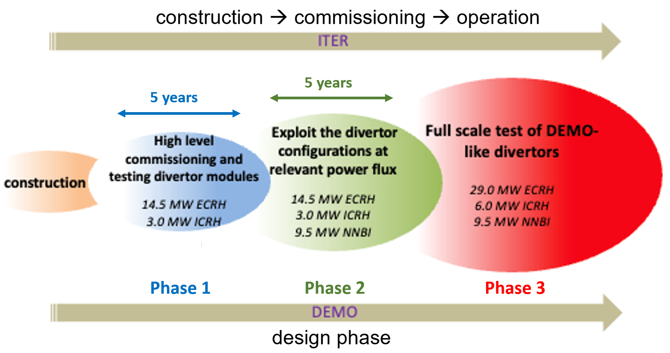
DTT diagnostic strategy
AIM ➔ diagnostics to cover the DTT scientific mission
DTT
Equipment for Machine/Divertor Protection and Plasma Control have the priority in the diagnostic procurement plan
Final selection and development of the other diagnostics (physics studies) will follow closely the Research Plan (PHASE 1 and PHASE 2 equipment)
End 2030
DTT
About #80 diagnostic techniques are planned in full power operation
About #160 systems were allocated
30% (about 25 systems) phase1 equipment to guarantee machine protection and plasma control
Marco Ciotti- KFE-ENEA Meeting- 28-11-2024

Slide 3
DTT diagnostic environment
DTT is:
a compact, superconducting machine;
with a substantial amount of external heating power (up to 45MW);
equipped with actively cooled components;
intensive remote handling is required.
Design of IN-Vessel diagnostic lay-out and cables routing
are particularly challenging ➔
Compatibility with very narrow space (compact) between First Wall or Divertor Cassette and Vacuum Vessel
Withstand: Thermal load during plasma operations and high temperatures during baking operations, low cryogenic temperatures (superconducting)
High level of neutron flux and fluence,
EC stray radiation
Diagnostic integration activities and interface issues are demanding ➔
integration effort must include both PHASE 1 and PHASE 2 diagnostic packages (according to the scientific programs)
Marco Ciotti- KFE-ENEA Meeting- 28-11-2024

Slide 4
DTT diagnostic equipment strategy
DTT – THM – DIA - WBS IV |  | Project Leader | 2023 DTT Shareholder Services & WPDIV-IDTT
DTI | Tomography and SXR imaging | G.M.Apruzzese | ENEA, INFN, RFX, CNR, UNIMIB, UNITOV
DSP | Active and Passive Spectroscopy | F.Bombarda | ENEA, RFX, CNR, POLITO, UNIMIB
DIP | Interferometry and Polarimetry | D.Fiorucci | ENEA, RFX, UNITOV
DTS | Thomson Scattering systems | L.Giudicotti | RFX, ENEA
DMA | Magnetic Sensors | G.Artaserse M.Baruzzo | ENEA, CETMA, CREATE, RFX, UNICA | IPP-Prague-Czech Republic (IPP-CR)
DWI | Embedded, Infra-Red and Visible cameras and other PWI Diagnostics | M.Iafrati | ENEA, RFX, CNR | CEA-France (CEA)
DEE | Electron Cyclotron Emission Diagnostics | C.Sozzi a.i. | CNR, RFX
DRE | Reflectometric Measurements | G.De Masi | RFX, INFN | IST-Lisbon-Portugal
DGN | Neutrons and Gammas diagnostics | D.Marocco | ENEA, CNR, UNIMIB
DRA | Run Aways Diagnostics | B.Esposito | ENEA, UNITOV, CREATE | VR-KTH Stockholm-Sweden (VR)
DPF | Fast Particles Diagnostics | M.Nocente | UNIMIB, CNR | Universitad de Sevilla-Spain (CIEMAT)

Slide 5
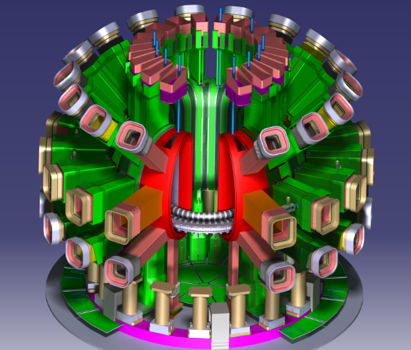
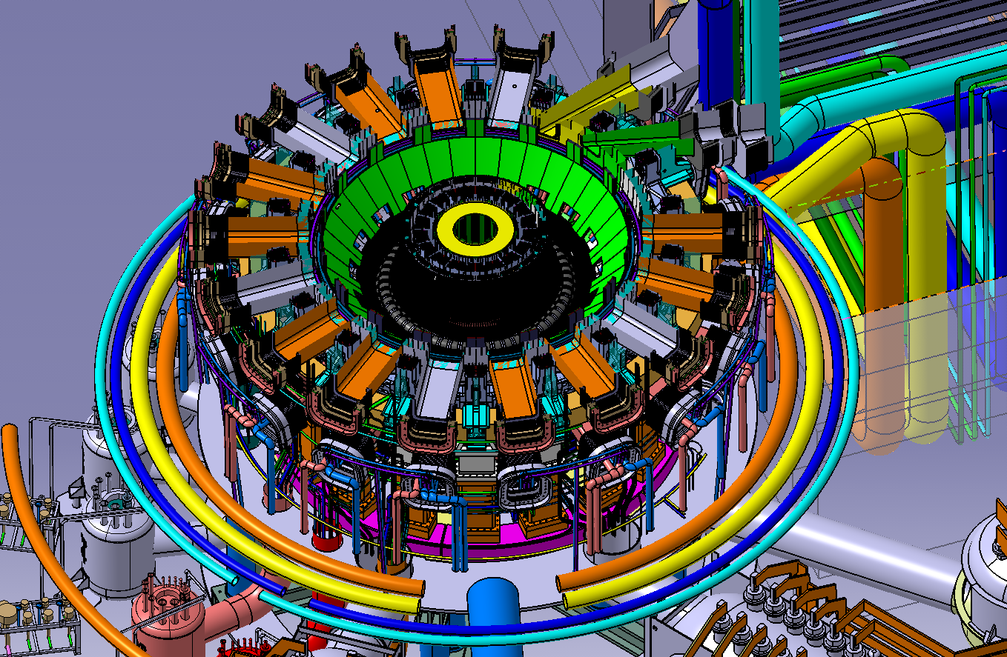
Equatorial Ports Heating+RH
10
11
9
12
8
7
13
5
14
15
4
3
16
Remote Handling Sectors
17
Ion Cyclotron
Electron Cyclotron
Neutral Beam Inj.
1
2
18
Marco Ciotti- KFE-ENEA Meeting- 28-11-2024

Slide 6
DTT diagnostic equipment: eq. ports
Phase 1 Diagnostics
Sector 9 | Interferometer Tangential
 | IR/VIS Cameras
 | REIS Spectrometer
 | NGA & OGA
 | Cherenkov Probe
 | Charge Exchange (CXRS)
 | Electron Cyclotron Emission Turbulence Coherent
Ion Cyclotron Heating
Electron Cyclotron Heating
Neutral Beam Injection
Remote Handling Sectors
Charge Exchange (CXRS) | Sector 10
Interferometer Tangential
Reflectometry Plasma Position
Diagnostic Neutral Beam Inj.
Reflectometry Density Profile Reconstruction
10
9
8
Bolometer Tomography | Sector 15
SXR Tomography
Interferometer Tangential
IR/VIS Cameras
Sector 8 | Thomson Scattering LIDAR
 | SXR imaging
 | SXR Crystal Spectrometer
5
15
17
3
Sector 5 | Electron Cyclotron Emission Imaging
 | Phase Contrast Imaging
 | Visible Fast Camera
 | ECE Eterodyne Radiometer
1
VUV Spectrometer | Sector 17
XUV Spectrometer
Time-Of-Flight Neutron Spectrometer
Thomson Scattering Divertor and Pedestal
Phase Contrast Imaging
VUV Spectrometer Edge
Sect. 3 | Interferometer Vertical
 | IR/VIS Cameras
 | Visible: Z_{eff}-Bremmsthralung profile / Spectrrometer Survey&Divertor
Sector 1
Radial Neutron Gamma Camera

Slide 7
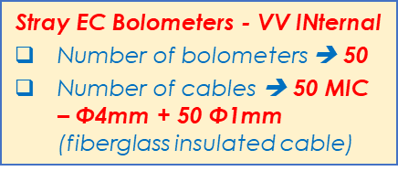
DTT: EC Stray Sniffer Probe PHASE 1
P1
P3
Sector 9
Withstand Stray EC Radiation is a critical aspect of the Diagnostic Design
Sniffer Probe allocation ➔ monitor and interlocking functionality
P4
Sector 10
10
11
9
8
P1 | Sect. 11
12
7
6
Sect. 6 | P1
 | P4
13
14
5
P4 | Sect. 13
15
4
16
3
17
2
Sect. 4 | P4
P1 | Sect. 14
18
1
P3 | Sect. 15
Sect. 3 | P1
 | P3
P1 | Sect. 16
P4
Sector 18
P1
Sector 1
P4
Marco Ciotti- KFE-ENEA Meeting- 28-11-2024

Slide 8
DTT PHASE 2 Diagnostic Equipment Allocation
Imaging Neutral Particle Analyzer | P4 | Sector 9
Fast-Ion Deuterium alpha (FIDA) | P2
IR Camera | P2
Cherenkov Probe | P3
Charge Exchange (CXRS) | P3
Electron Cyclotron Emission Turbulence Coherent | P3
Charge Exchange (CXRS) | P2
Beam Emission Spectroscopy | P2
Interferometer Divertor | P4
Sector 8
Sector 7 | P1 | Laser Induced Breakdown Spectroscopy (Divertor)
 | P2 | VUV Spectrometer Imaging Divertor
Charge Exchange (CXRS) | P1 | Sector 10
Bolometer Cameras (Tor. Asymm.) | P1
Reflectometry Plasma Position PPR | P1, P3
Reflectometry Turbulence TR | P2, P4
Diagnostic Neutral Beam MSE Optics | P2
Diagnostic Neutral Beam Inj. | P3
Reflectometry Dens. Prof. Reconstr. DPR | P3
10
11
9
8
12
7
13
Sector 5 | P1 | Bolometer Cameras (Tor. Asymm.)
 | P3 | Electron Cyclotron Emission Oblique
 | P3 | Phase Contrast Imaging
 | P3 | Event Detec. Visible Fast Camera
 | P4 | Sample Introduction System
14
5
Electron Cyclotron Emission Radiometer in Line | P2 | 11
Fast Ion Loss Detector FILD | P4
15
4
IR Camera | P1 | 12
16
3
17
2
IR Camera | P2 | 13
18
1
Gas Puffing Imaging | P4 | 14
Sect. 4 | P2 | IR Camera
 | P4 | Thermal He Beam
Collective Thomson Scattering | P2 | 15
Collective Thomson Scattering. | P4 | 16
Sect. 3 | P2, P3, P4 | Interferometer Vertical
 | P3 | Visible Multi Spectral Imaging System
XUV Spectrometer Divertor | P2 | Sector 17
IR Camera | P2
Time-Of-Flight Neutron Spectrometer | P3
Thomson Scattering Divertor and Pedestal | P2, P3
Phase Contrast Imaging | P3
VUV Spectrometer Edge | P4
Sector 1
Bolometer Cameras (Tor. Asymm.) | P1
Radial Neutron Gamma Camera | P3
Laser Induced Breakdown Spectroscopy
Sector 2 | P2 | Electron Cyclotron Emission Radiometer in Line
 | P2 | Laser Blow Off
 | P4 | Langmuir Probes Reciprocating
Marco Ciotti- KFE-ENEA Meeting- 28-11-2024

Slide 9
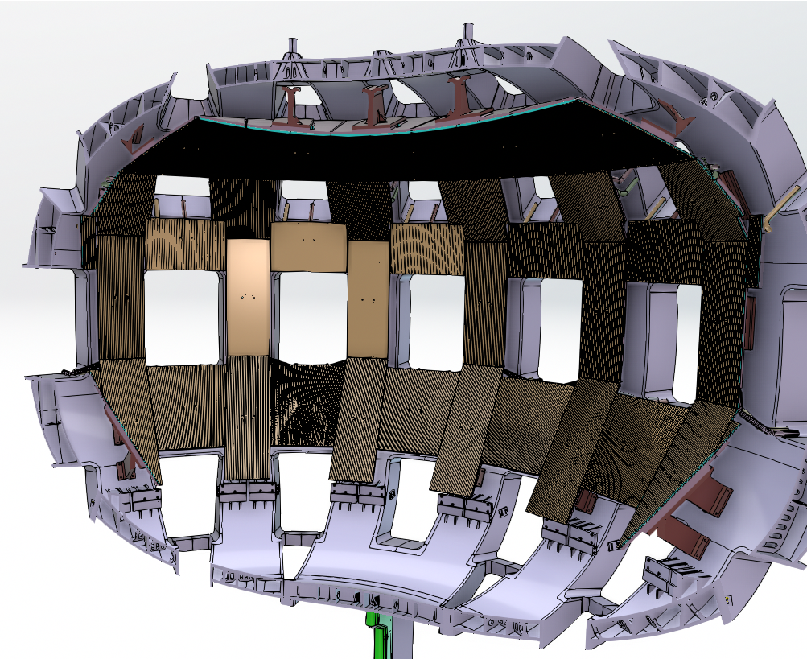
First Wall Inner and Outer: instrumentation and cables routing
Long Term Samples (LTS) (Passive) - Limiter Module
Part. Rogowski & Current Shunt (Active) – FW locking brackets
Microbalance Redeposition Probe (Active) – HFS FW Standard Module
Langmuir Probes & Thermocouples - (HFS FW Limiter Module)
Marco Ciotti- KFE-ENEA Meeting- 28-11-2024

Slide 10
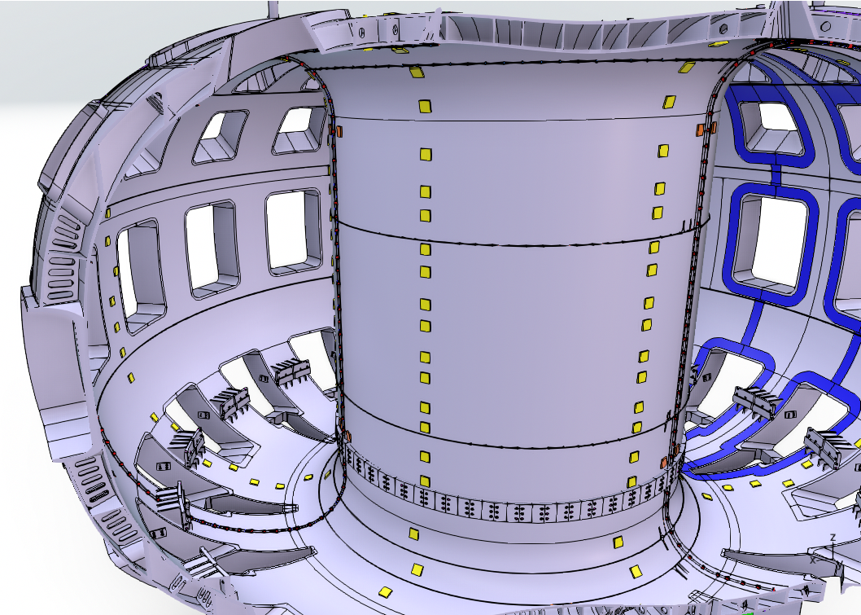
Vacuum Vessel sensors: internal and external
Diamagnetic Loops | Optic Fiber Current | Rogoski Coils | BiaXial Pick up Coils | Monaxial Pick up Coils | FluX Loops | Saddle Loops | Hall Probes
 |  |  |  | High Frequency Pick up Coils
BiaXial Pick up Coils | FluX Loops | Monaxial Pick up Coils | Diamagnetic Loops
Magnetic Sensor – VV EXternal
Number of magnetic sensors ➔ 444
Numbers of cables ➔ 681
Magnetic Sensor – VV INternal
Number of magnetic sensors ➔ 352
Numbers of cables ➔ 695
Marco Ciotti- KFE-ENEA Meeting- 28-11-2024
Notes:
FIBERGLASS INSULATED CABLE

Slide 11
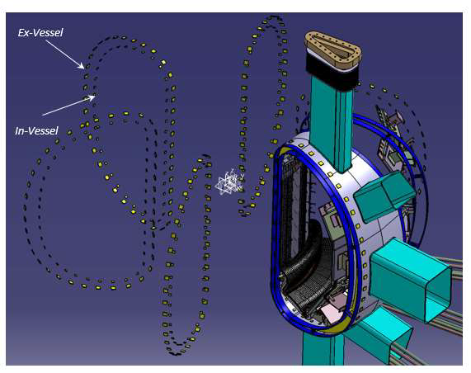
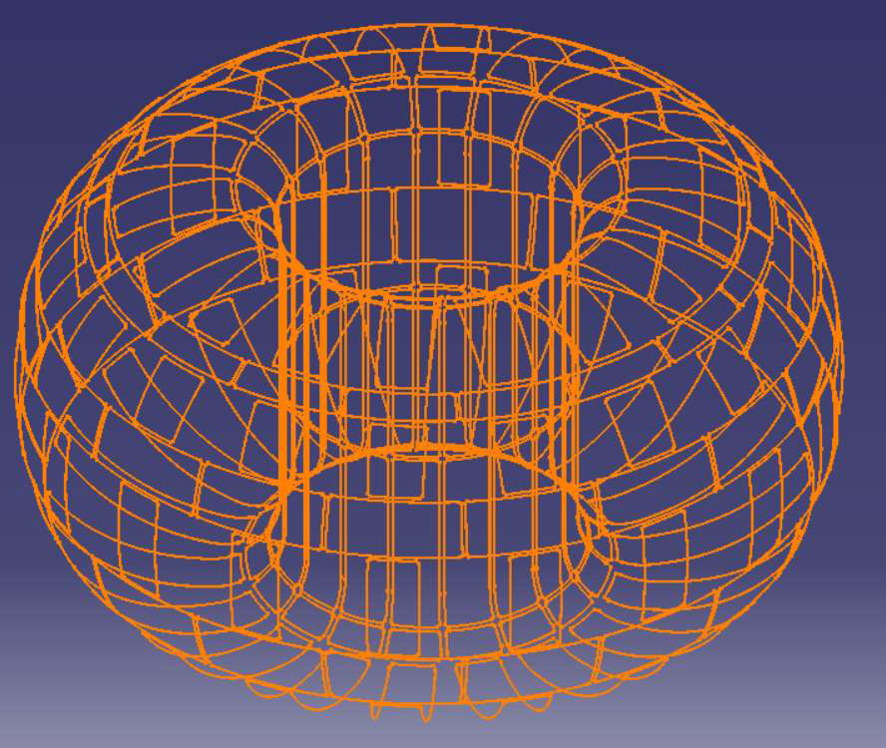
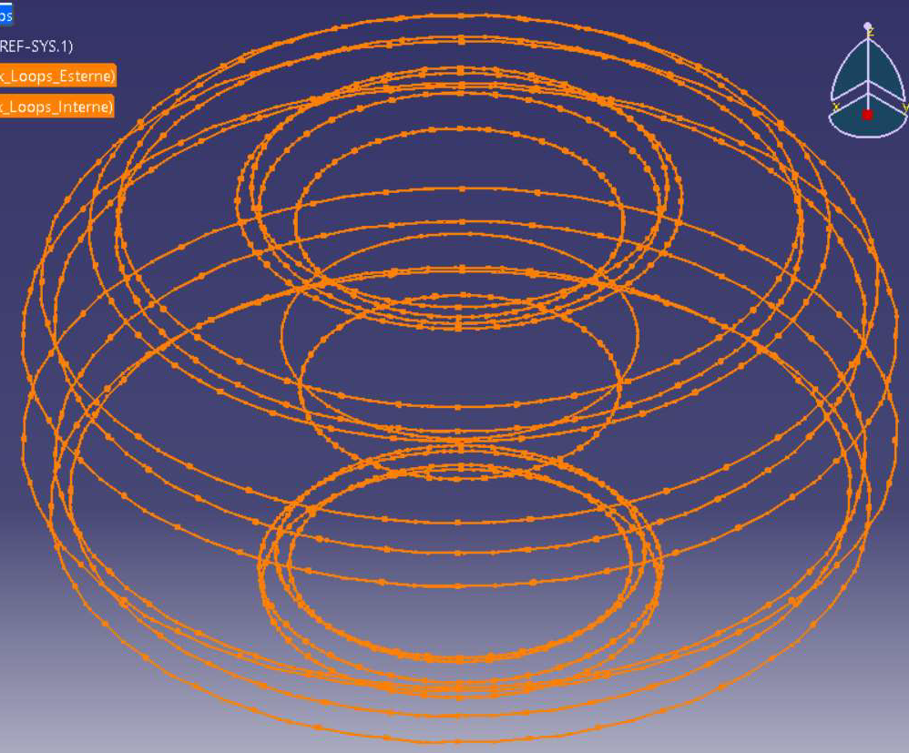
Vacuum Vessel sensors: internal and external 2
Internal & External Pick-Up Coils
External Saddle Loops
Internal & External Flux Loops
Critical aspects:
tight space available
in-vessel obstacles (other subsystems services)
Critical ➔ In-Vessel signal cable choice:
Neutron irradiation and heating can generate spurious output (additional tiny voltage) corrupting the final signal
Suitable EC stray protection
Marco Ciotti- KFE-ENEA Meeting- 28-11-2024

Slide 12
Magnetic Sensors
Sensor types chosen to cover DTT Operation and Experimental program needs
Loops |  |  |  |  | Pick-up Coils |  |  |  |  |  |  | Current Rogowski Coils |  |  | Special Sensors
Flux |  | Saddle | Diamagnetic |  | Tangential Bi-Axial |  | Toroidal mono-Axial |  |  | HF Bi-Axial | Bi-Axial | Plasma | Halo |  | Hall | Hybrid | Fiber Opt. FOCS | Shunt
Shape Equilibrium loop voltage Eddy current |  | Error field Equilibrium Plasma shape current & centroid position | Plasma magnetic energy |  | Plasma current & centroid position & shape and equilibrium Vertical speed |  | Plasma magnetic energy |  |  | Vertical speed Plasma shape & equilibrium MHD fluctuation | Plasma shape & equilibrium | Plasma current Eddy currents | Halo & eddy currents |  | Bi-axial magnetic field |  | Plasma current | Halo currents, ELMS
VV-INT | VV-EXT | VV-EXT | VV-INT | VV-EXT | VV-INT | VV-EXT | VV-EXT | VV-INT | DIV | VV-INT | DIV | VV-EXT | FW | DIV | VV-EXT | VV-INT | VV-EXT | DIV | FW
9 | 11 | 156 | 3 | 3 | 204 | 240 | 12 | 12 | 8 | 124 | 52 | 3 | 60 | 32 | 16 | TBD | 3 | 16 | TBD
964
Positioning of INternal and EXternal Vacuum Vessel magnetic sensors have been optimized over the main DTT scenarios XD, SN-NT, SN ➔ reconstruction capabilities of plasma current, plasma centroid, plasma shape
Shape reconstruction, in presence of measurement errors ➔ estimated errors $\sim$ cm especially for the advanced divertor configurations
Number and position of proposed divertor cassette sensors optimized to improve reconstruction capabilities of equilibrium reconstruction codes, x-point and strike point positions

Slide 13
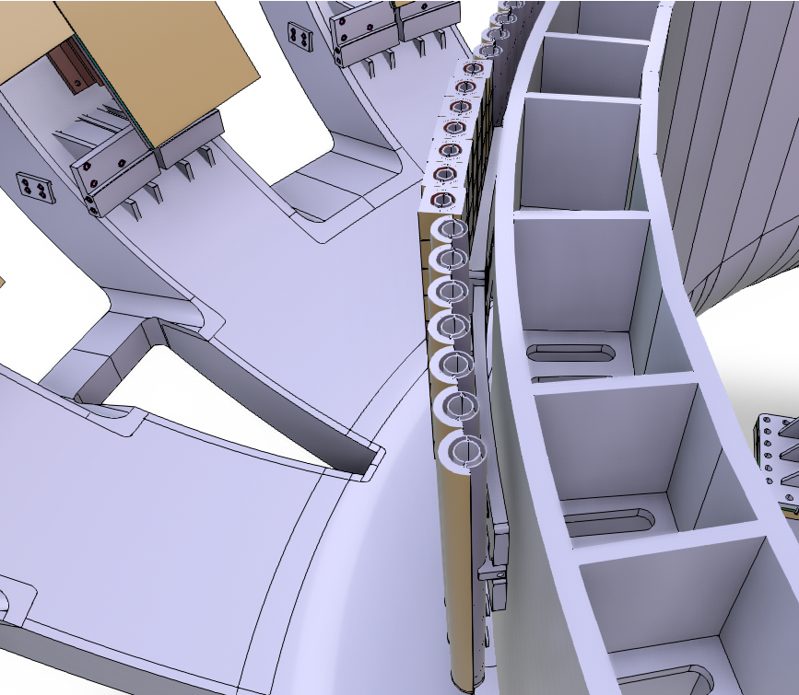
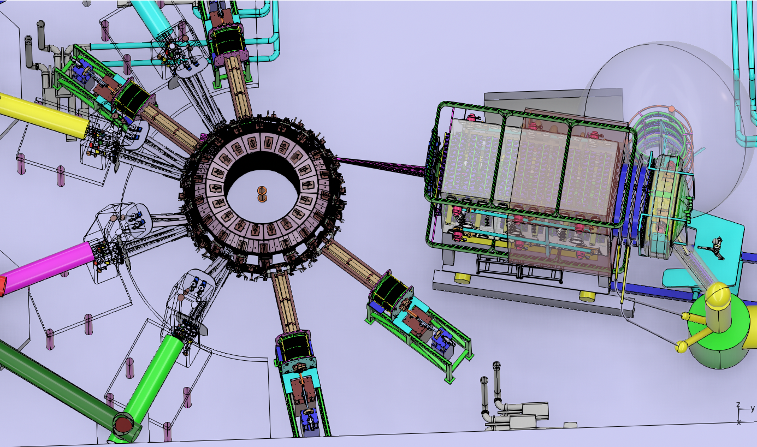
High Field Side First Wall: standard module customized to host diagnostics components
10
3
Marco Ciotti- KFE-ENEA Meeting- 28-11-2024

Slide 14
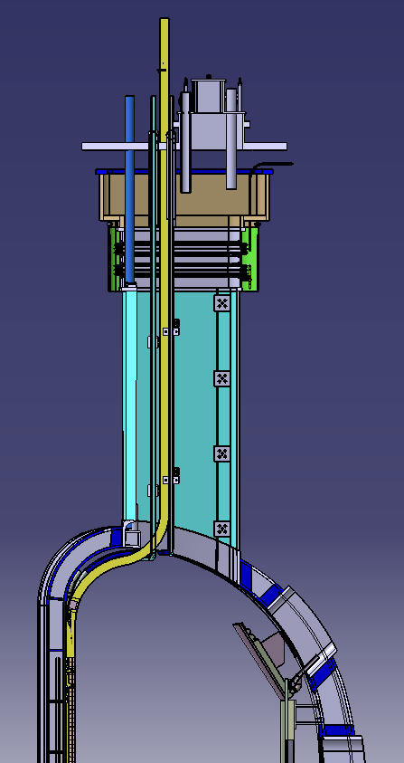
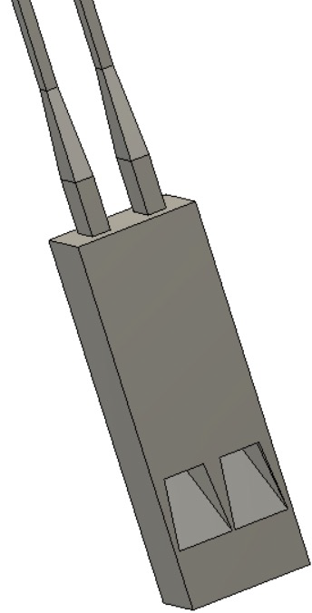
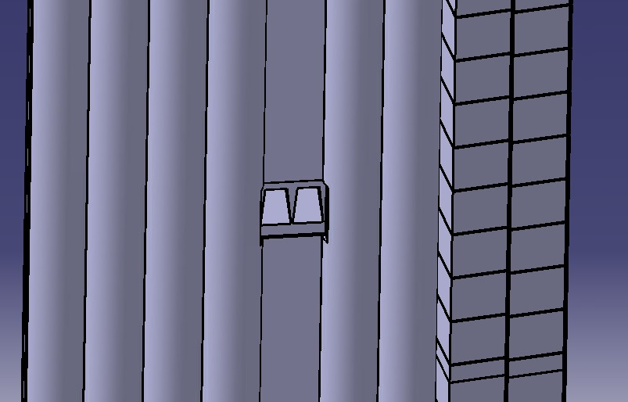
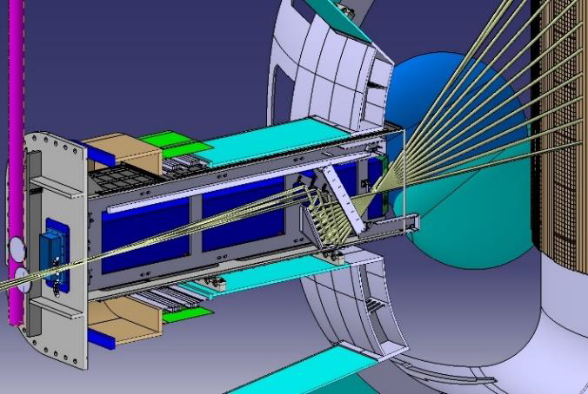
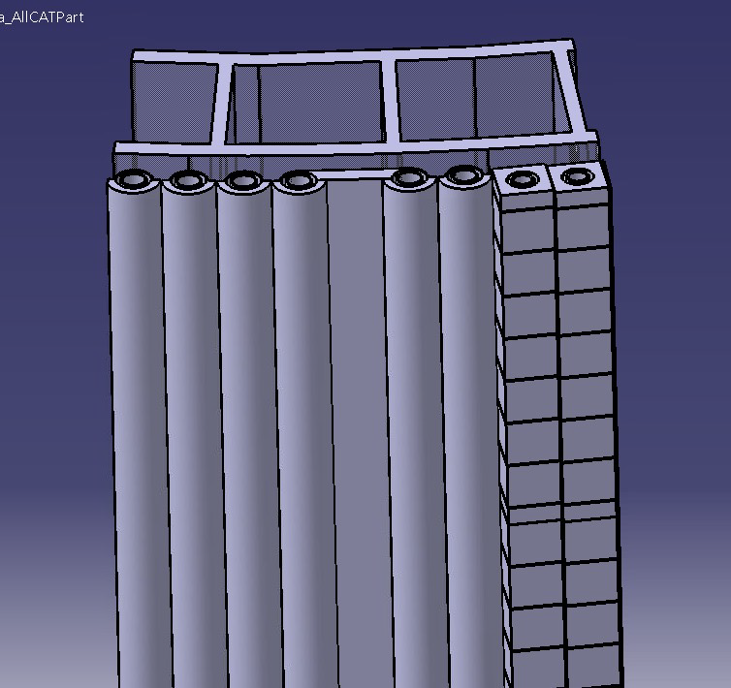
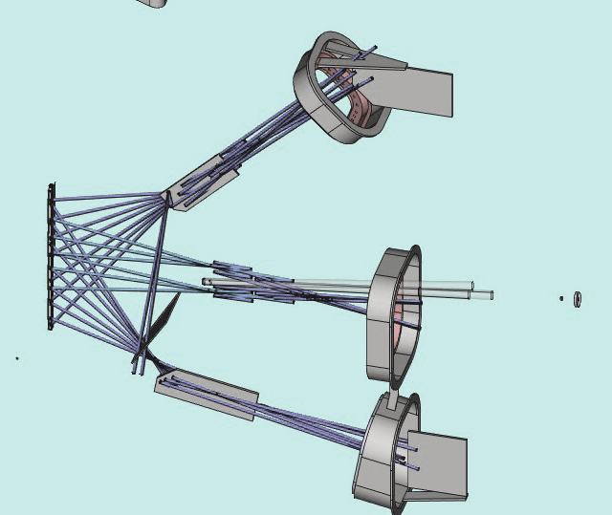
Vertical Interferometer/Polarimeter and Z_{eff} profile
Sector 3
Plasma Position Reflectometer (PPR)
Sector 10
Z_{eff} LOS profile Dumps (minimize reflection)
Single Wave Guide pair ➔ 3 LOS & pairs of antennas
Local modifications to create windows for the PPR LOS
Vertical Interferometer/Polarimeter Corner Cube back reflectors
Thermal bridge replacing a cooling tube of the standard module
HFS-FW Standard Module Customization preliminary design ➔ under assessment
Critical ➔ compatibility with First Wall HFS Cooling System requirements
Critical ➔ withstand plasma thermal load, neutron effects, EC stray radiation

Slide 15
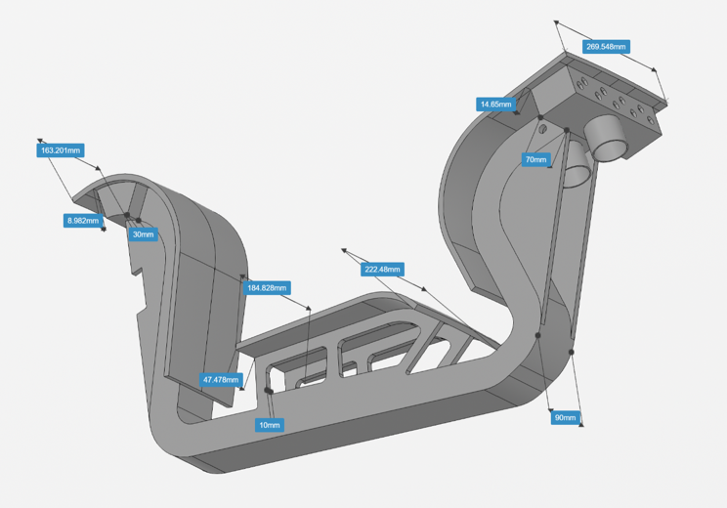
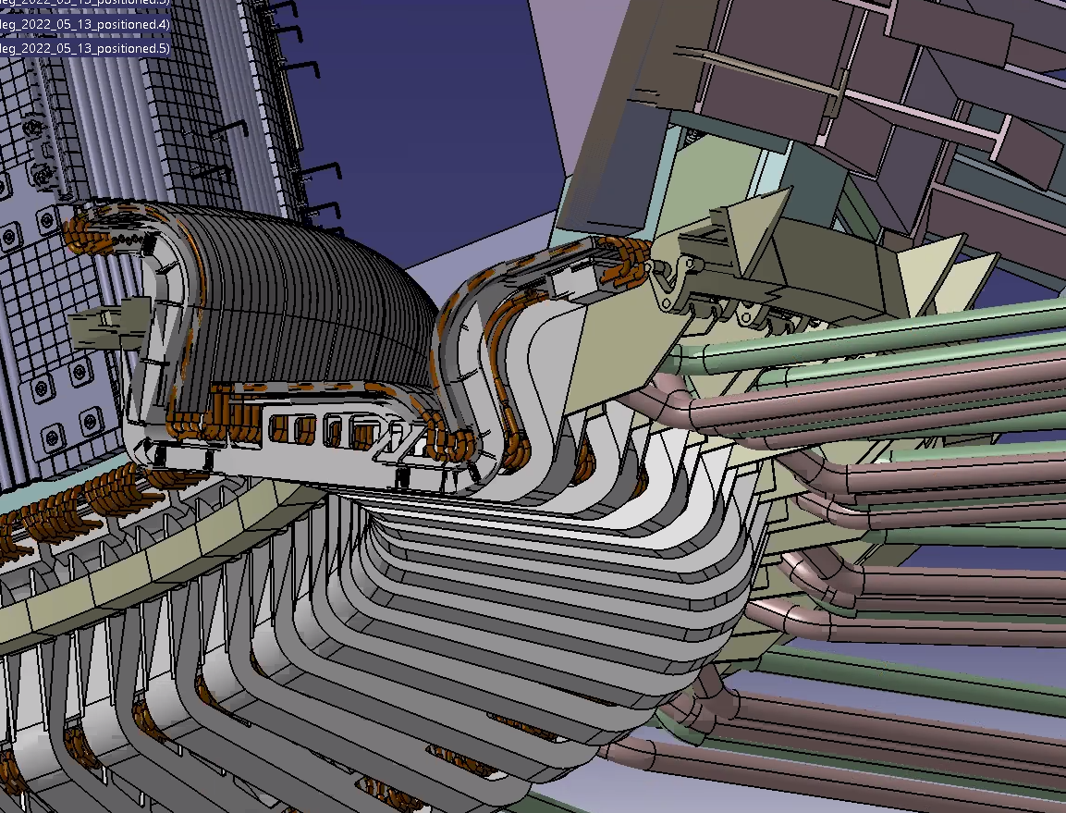
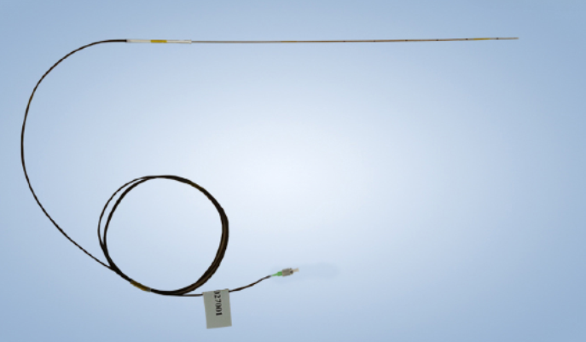
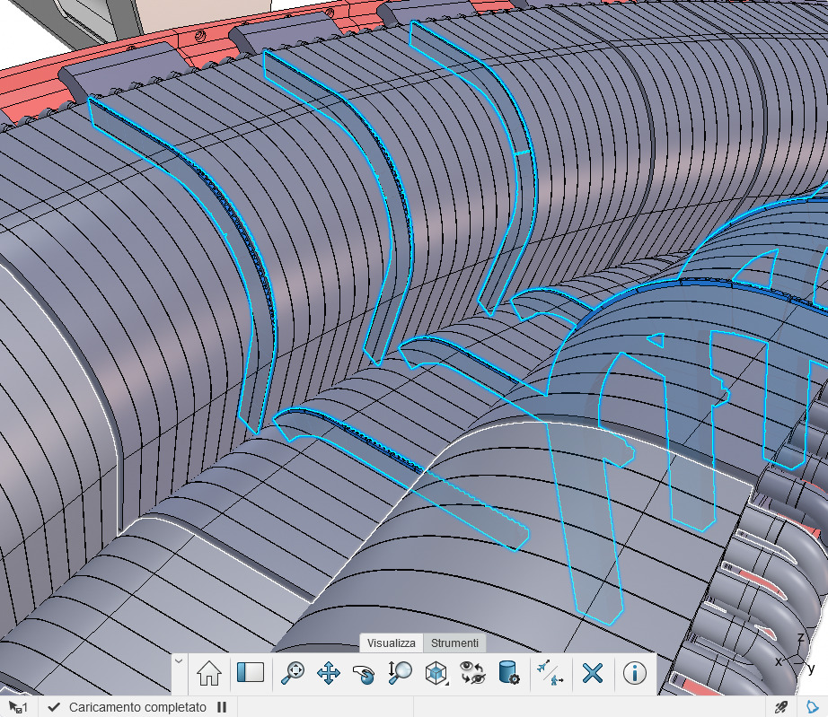
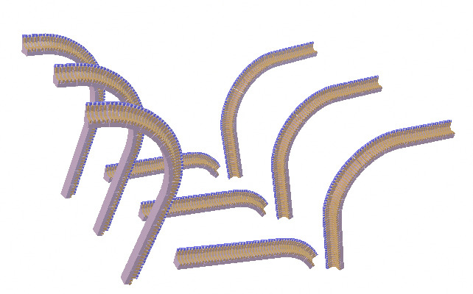
Divertor Test module diagnostic instrumentation
Measurements ➔ in contact points between cassette and divertor rail
Bi-axial Pick-Up Coil
Mono-axial Pick-Up Coil
Hybrid Hall probe
Sensor's topology optimized for reconstruction of the X-point and strike points positions
Partial Rogowski coils around divertor cassette structure (poloidal current measurement)
Magnetic sensors
FOS: Fiber Optics Sensors Array
Embedded: Langmuir Probes and Thermocouples
Optical Fibers installation scheme under assessment ➔ in a groove along the side
surface of the mono-block (below the top surface exposed to the plasma)
Highlighted regions potentially useful for the embedded sensors integration ➔ specific integration schemes under assessment
Marco Ciotti- KFE-ENEA Meeting- 28-11-2024

Slide 16
Divertor Test module diagnostic instrumentation and cables routing
 | Sector number | Magnetic sensors |  |  |  |  |  |  |  |  |  | Embedded |  |  |  | Fiber Optics Sensors (FOS)
Sensors/Array per sector | 1 | Bi-axial Pick up Coil | 13 | Mono-Axial pickup Coil | 2 | Hall Probe Hybrid | 1 | Halo current (Rogowski) | 8 | Current Shunt | 4 | Langmuir Probes | 600 | Thermocouples (Science) | 150 | FOS Array | 5
 | 5 |  | 13 |  | 2 |  | 1 |  | 8 |  | 4 |  | 150 |  | 150 |  | 5
 | 10 |  | 13 |  | 2 |  | 1 |  | 8 |  | 4 |  | 150 |  | 150 |  | 5
 | 15 |  | 13 |  | 2 |  | 1 |  | 8 |  | 4 |  | 150 |  | 150 |  | 0
Cables | Type | MIC |  |  |  |  |  |  |  |  |  | MIC/fiber glass insulated conductors |  |  |  | Optic fiber
 | Diameter | Φ 4mm |  |  |  |  |  |  |  |  |  | Φ 4/1,5mm |  |  |  | Φ 8mm
 | Cable per sensor | Bi-axial Pick up Coil ➔ 2x, Others ➔ 1x |  |  |  |  |  |  |  |  |  | 1x |  |  |  | 1x
 | Total Number | 41 => sector 1, 5, 10 and 15 |  |  |  |  |  |  |  |  |  | 750 => Sector 1 300 => Sector 5, 10 and 15 |  |  |  | 5 => sector 1, 5, 10
Confirmed
To be confirmed

Slide 17
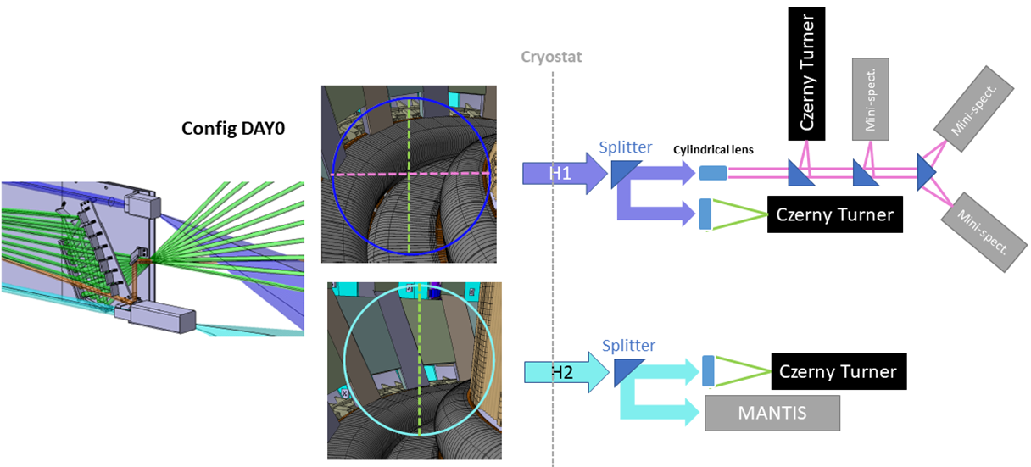
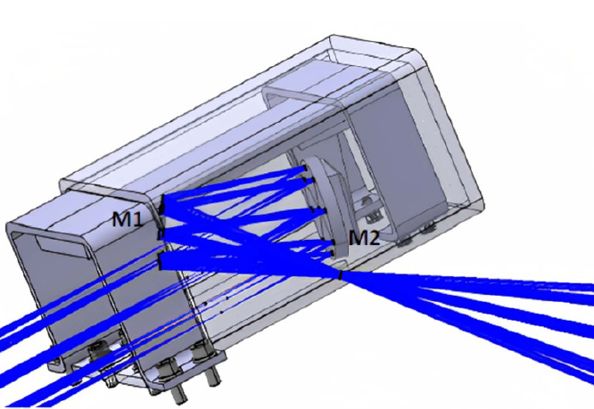
Divertor Visible Imaging
The design aims to maximum coverage of the divertor region
Two telescopes to optimize Divertor view:
UPPER ➔ an almost perpendicular (darker blue)
LOWER more tangential (lighter blue)
Overview of the Divertor Visible Imaging (Zeff poloidal LoS profile in green color)
Collected light can be shared among different spectrometers and interferential filter devices:
UPPER VIEW: The “vertical integrated image” is directed to a high resolution (HR) CT spectrometer, while the “horizontal integrated image” is further split between HR and several low resolution (LR) spectrometers
LOWER VIEW: The image collected with the more tangential observation of the DIVERTOR and it is split between a Multispectral Imaging system (VFID) MANTIS-type (plasma detachment through tomographic reconstruction with high spatial resolution (<5mm)) and a HR CT Spectrometer.
Marco Ciotti- KFE-ENEA Meeting- 28-11-2024

Slide 18
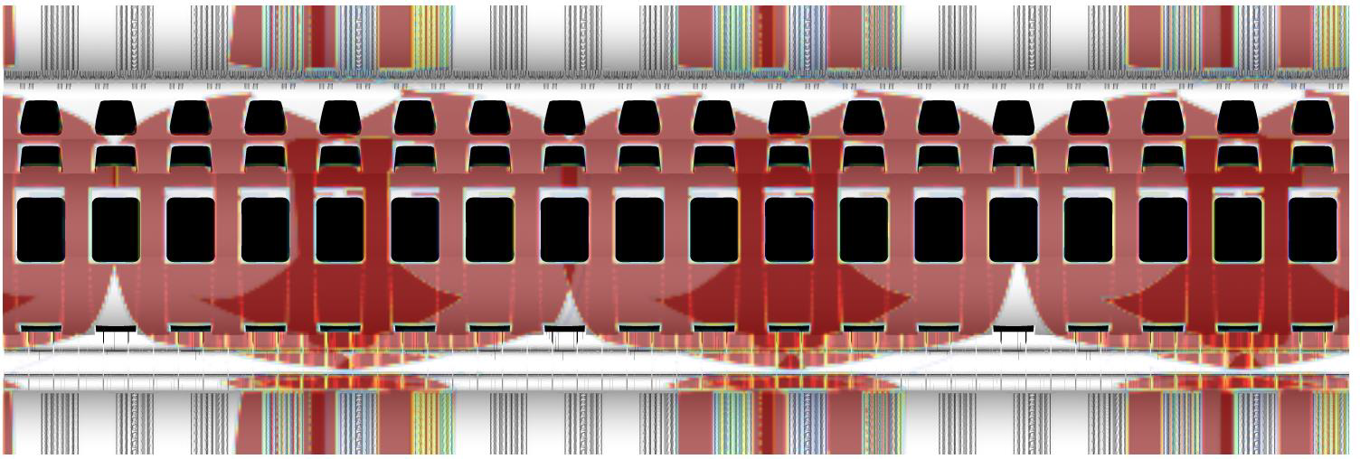
VIS/IR tangential views ➔ Tangential Viewing System (TVS)
TVS Optical Design
Optical Head
Dichroic
3 endoscope allocated; 120° toroidally spaced
Equatorial left and right view
VIS cameras
Wide Angle | 50-500 Hz
Fast | 10-50 Khz
VIS channel
(to be completed)
$\sim$ 3m
Cryostat Flange
Folding Mirrors
IR channel
IR cameras
Wide Angle | 50-100 Hz
TVS spatial coverage
Inner First Wall
Outer First Wall
Divertor
Inner First Wall
79m² of the chamber seen ➔ 73.7% of the chamber inner area
Overlapping surfaces 22.1m² (i.e. covered by 2 cameras)
TVS ➔ poor/limited coverage of the divertor area
Envisaged a periscope IR camera allocated on port5
Notes:
New detector dimensions considered: 1280x1024, 15µm pixel

Slide 19
Status of the design activities
PHASE 1 Diagnostic (and part of PHASE 2 Diagnostic impacting on assembly)
➔ Conceptual Design completed in March 2024
PHASE 2 diagnostic preliminary conceptual design in progress with particular attention to integration and interface issues
The DTT Research Plan (DTT-RP) has been completed and released on June 2024 (available online on the DTT Project website https://www.dtt-project.it/index.php/about/dtt-research-plan.html)
On May the 7th the DTT Diagnostics Design Review Committee (DTT-DIA-DRC) has been nominated
The scope of the DTT-DIA-DRC is to provide advices, regarding DTT diagnostic area (DTT-DIA), to the DTT management on the following aspects:
Consistency, completeness, and maturity of the design;
Incongruity of the costs, both hardware and human, exposed by the project leaders and adequacy of construction schedule;
Possible simplifications and/or reduction of scope to reduce costs;
Priority with respect to PHASE 1 and PHASE 2 of DTT operational program.
The panel report has been released on July 2024 where the envisaged DTT diagnostic equipment has been overall confirmed and the strategy of PHASE 1 and PHASE2 DTT diagnostic equipment has been refined following the DTT Research Plan
Marco Ciotti- KFE-ENEA Meeting- 28-11-2024

Slide 20
Concluding Remarks
Diagnostics planning and realization in a Tokamak is a complex issue, in DTT even more;
DTT consortium partners have a long tradition in diagnostic development;
Activities are ongoing in agreement with the research plan and DTT scientific targets;
Phase 1 diagnostics are progressing according to the project schedule;
Collaborations with Enea or DTT consortium are wellcome
Marco Ciotti- KFE-ENEA Meeting- 28-11-2024

Slide 21
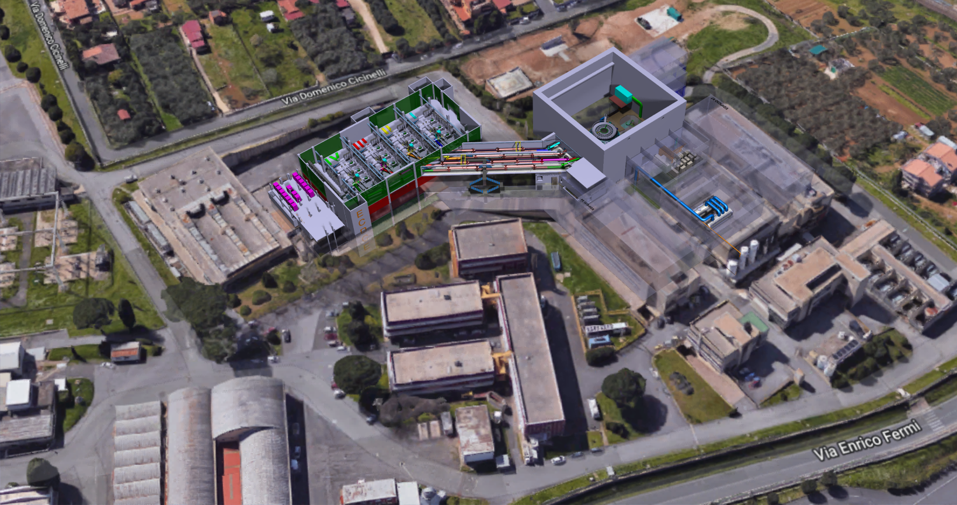
DTT Diagnostic Equipment Design progress status
KFE-ENEA meeting

