Slide 1
6th CNPS remote meeting – December 17, 2020
The ENEA – KFE collaboration framework
with focus on TSV activities
Fulvio Zonca1, Hogun Jhang2,
and CNPS Teams at ENEA and KFE
1Center for Nonlinear Plasma Science and ENEA C.R. Frascati, 00044 Frascati, Italy
2Korea Institute of Fusion Energy, Daejeon 34133, Republic of Korea
Acknowledgments: S. Briguglio, M. V. Falessi, Ph. Lauber, G. Meng, T. Rhee, G. Vlad,
and CNPS Teams at ENEA and KFE
Frascati, December 17th 2020

Slide 2
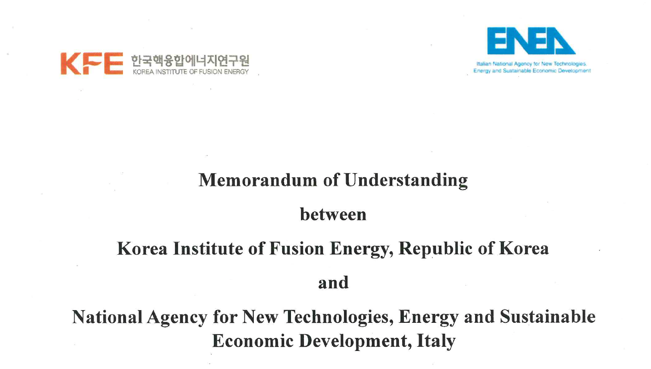
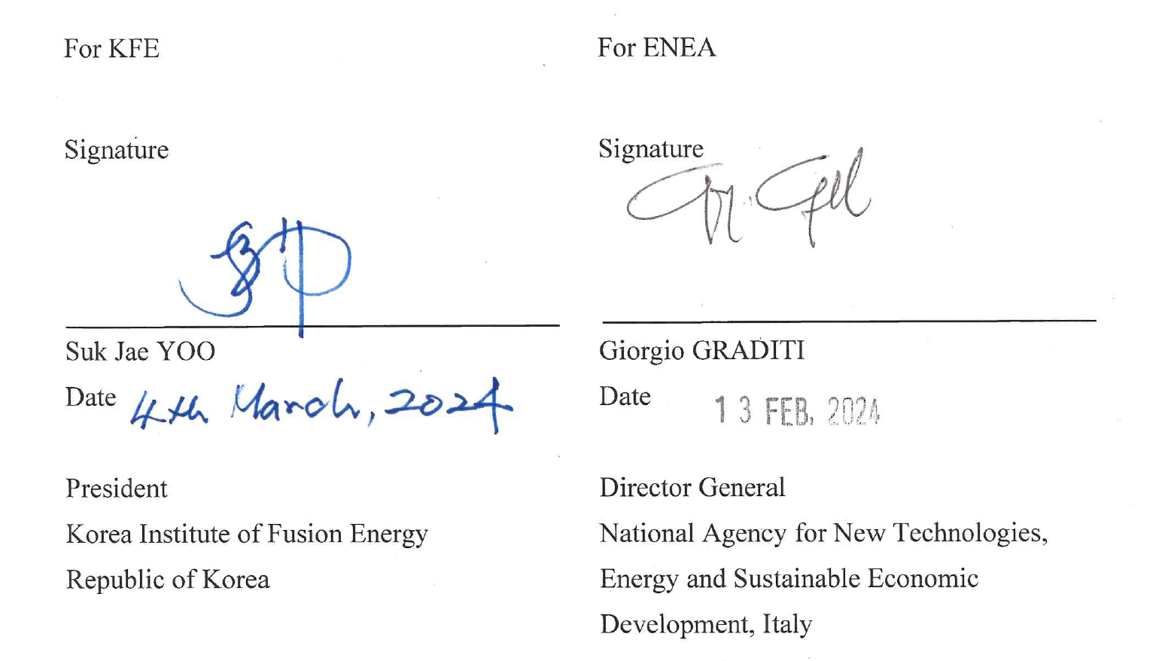
Collaboration framework ENEA - KFE
KFE hosts an official hub of Center for Nonlinear Plasma Science (CNPS) since 2023 by signing Letter of Intent; https://www.afs.enea.it/zonca/CNPS/
Memorandum of Understanding (MoU) between ENEA and KFE signed in 2024;

Slide 3
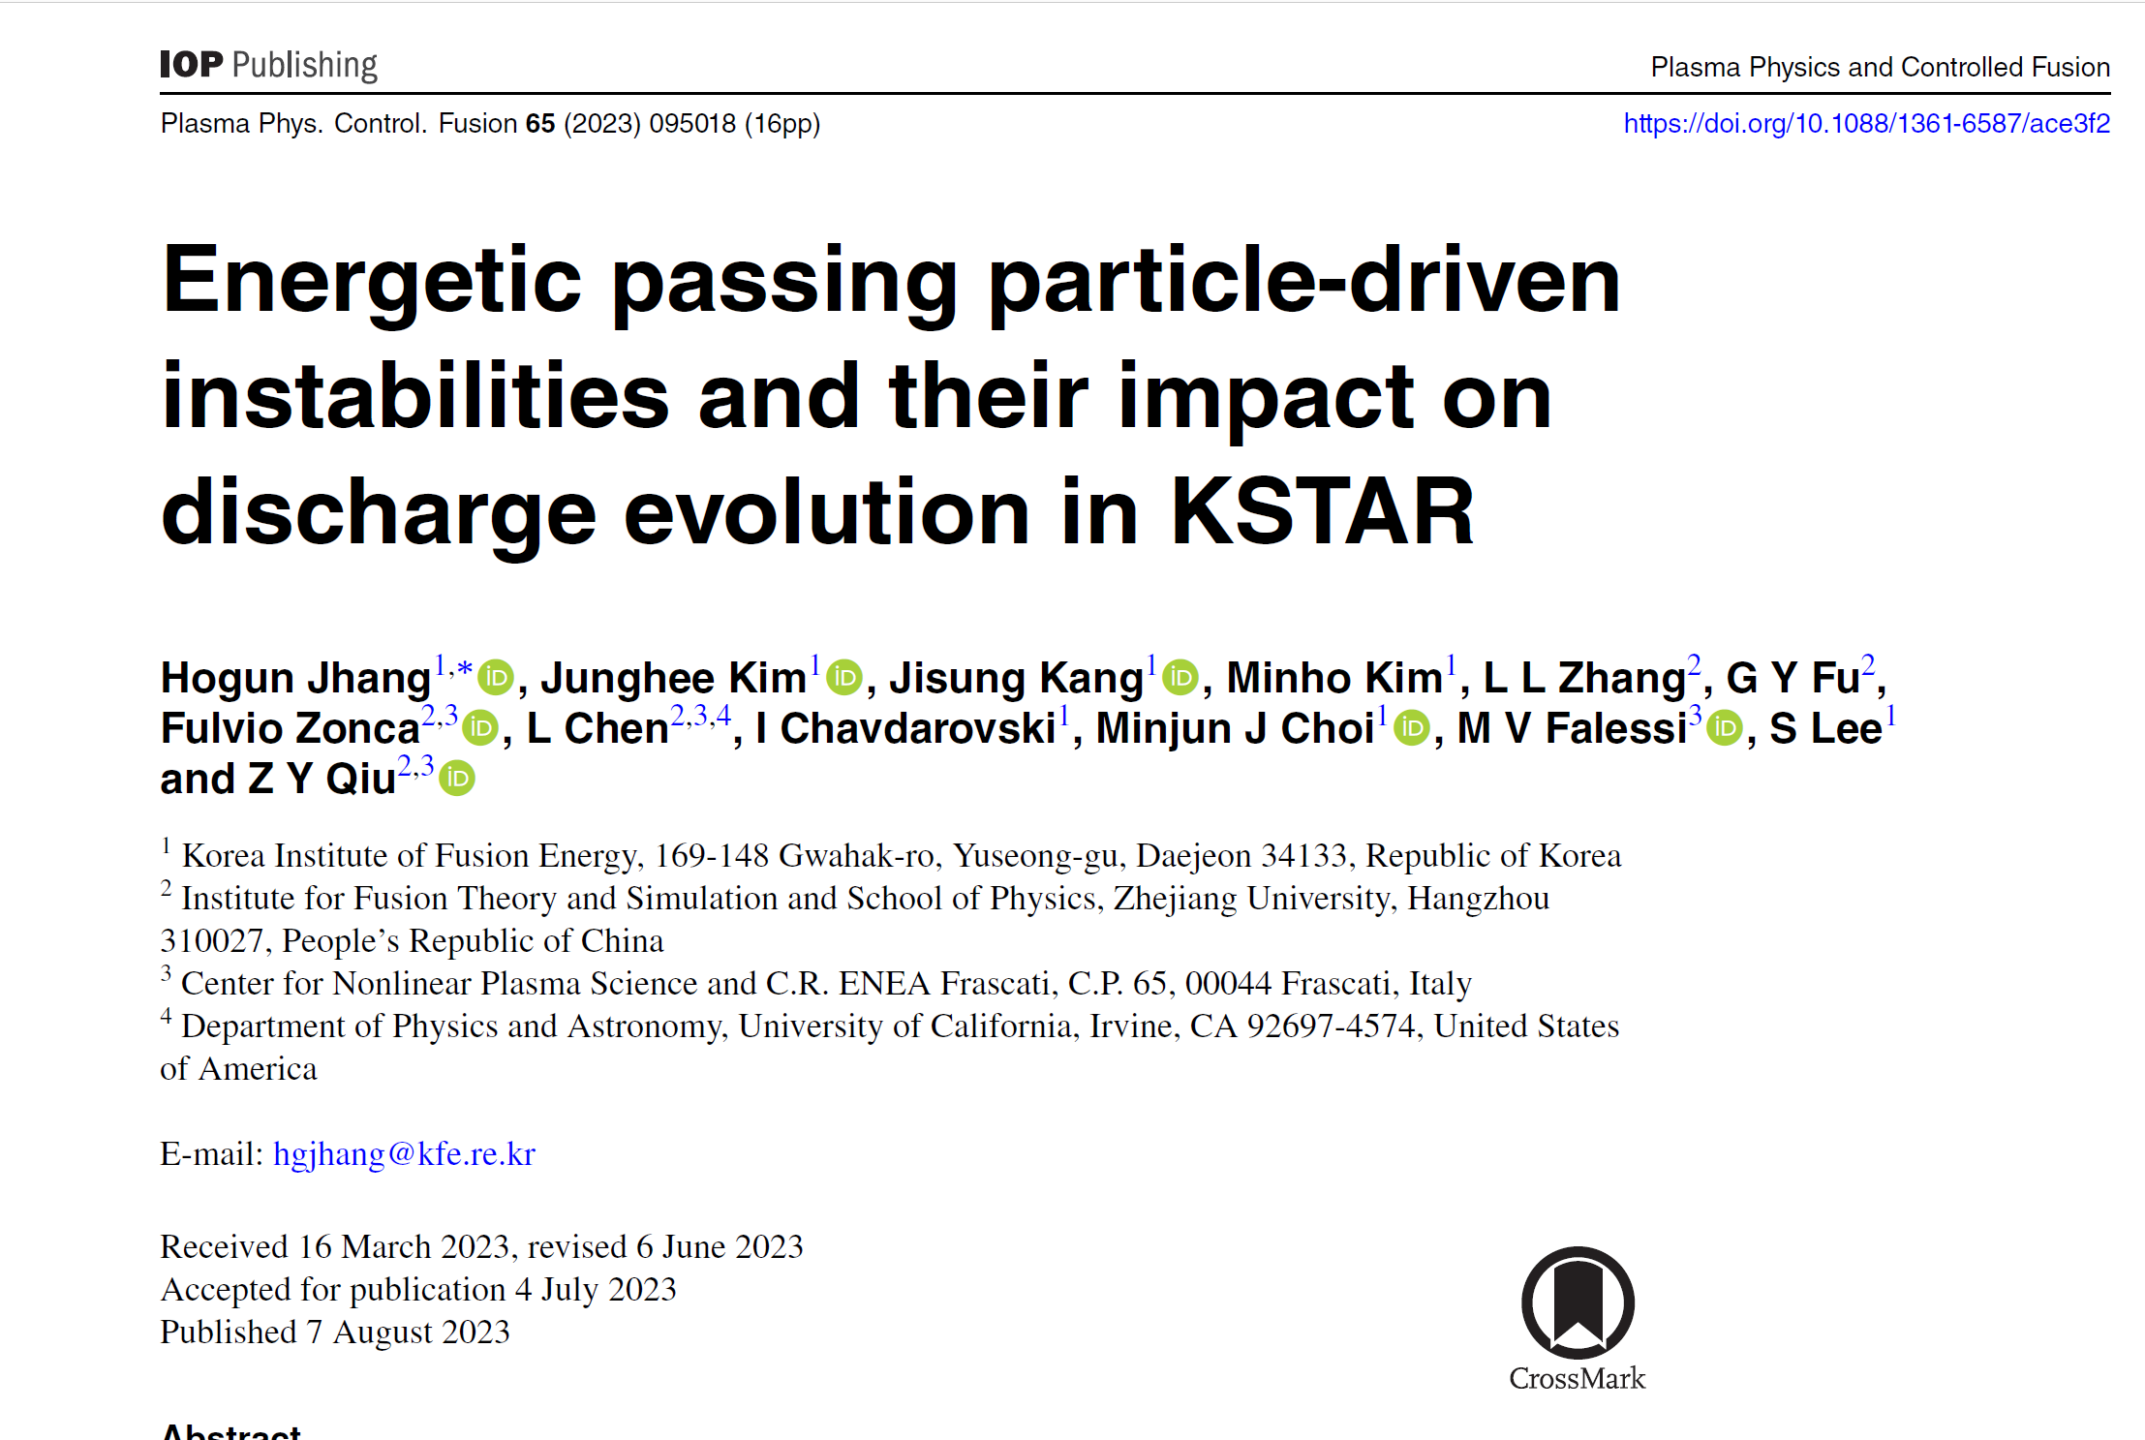
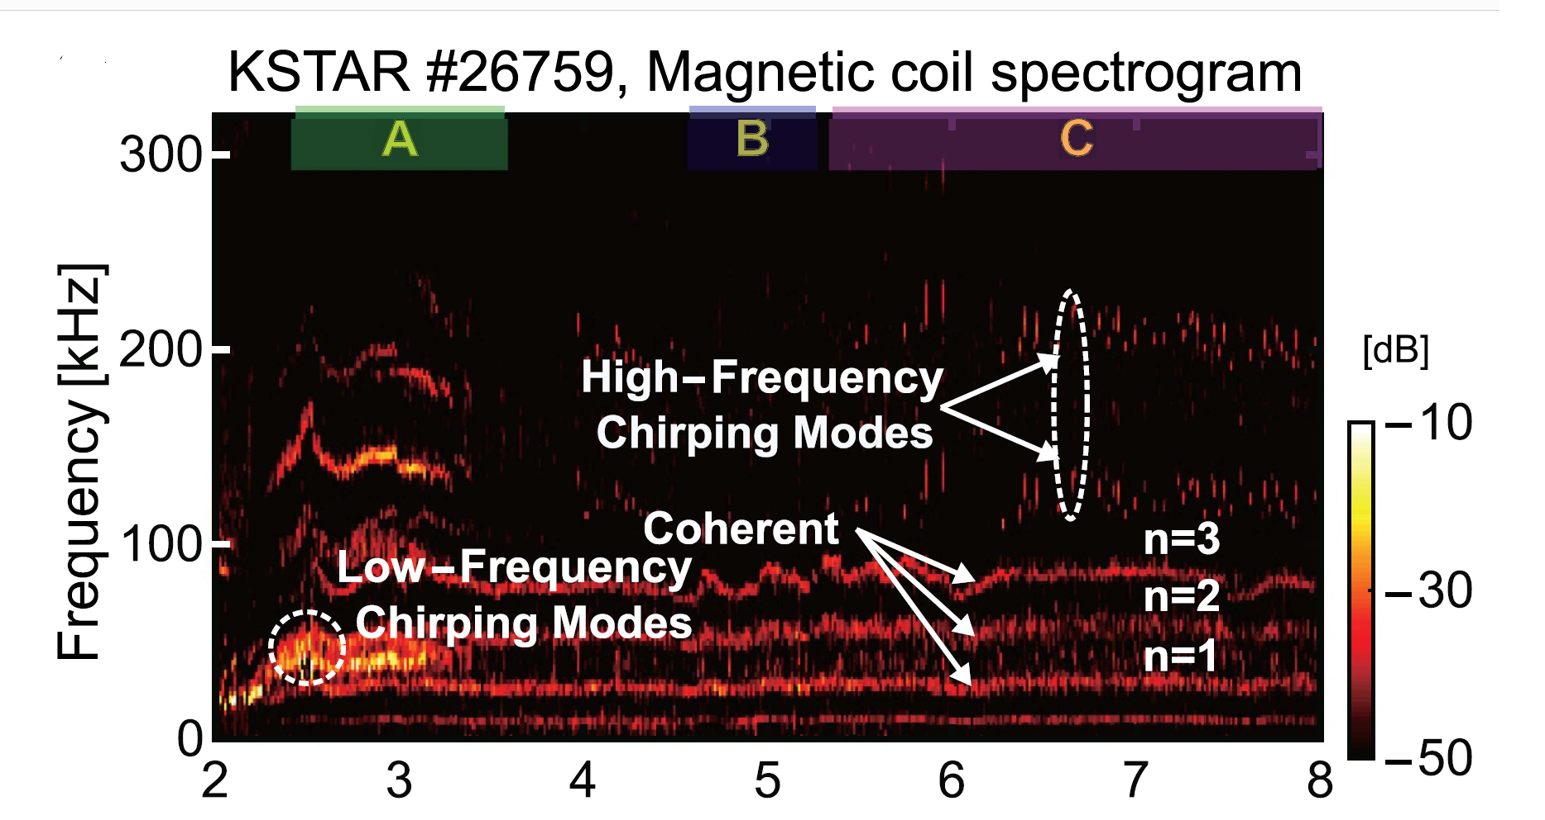
Collaboration in progress under CNPS framework
DTT-relevant experiments in KSTAR: Energetic particle (EP) confinement and evolution of energetic particle modes (EPMs) in EP-dominant high T_{e} discharges:
Quantify low frequency fishbone driven current profile regulation
Discover high frequency synchronized EPMs: (1) n=1 BAE-fishbone branch (2) n=5 EPMs

Slide 4
Collaboration in progress under CNPS framework
Computation of Lagrangian Coherent Structures (LCS) of energetic particles in the presence of resonant magnetic perturbations (RMPs)
- Reveal hidden structures in phase space & transport barriers
- Use the NuBDec code at KFE under a close collaboration with ENEA theory group
Courtesy of T. Rhee
and M. Falessi
LCS for different values of normalized magnetic moment (0.2, 0.4, 0.6 from the left)

Slide 5
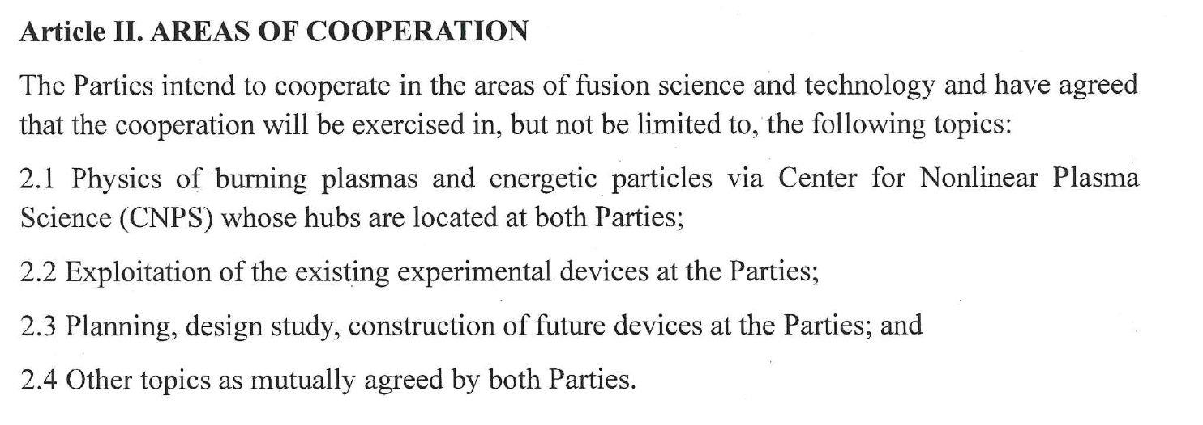
MoU: Collaboration framework ENEA - KFE

Slide 6
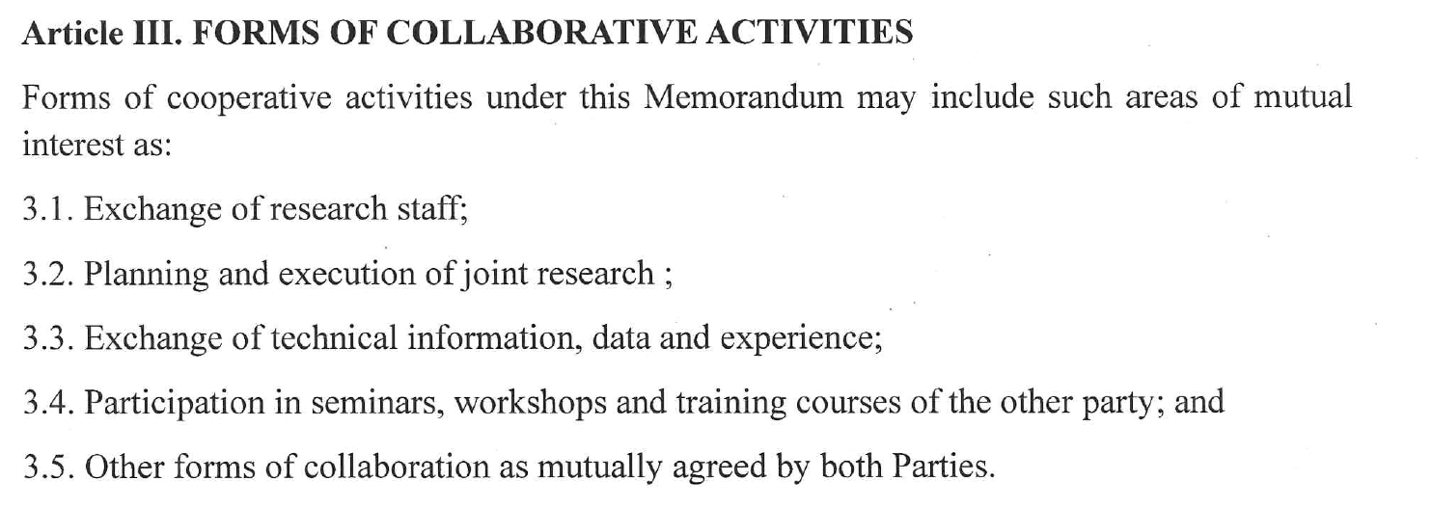
MoU: Collaboration framework ENEA - KFE

Slide 7
Kick-off of ENEA-KFE MoU
FZ visit at KFE, Daejeon, in March 2024: three colloquia
- The Role of the Divertor Tokamak Test Facility in the Italian and European Magnetic Fusion Programs
- Advanced energetic particle transport models
- Nonlinear gyrokinetic theory of Alfvénic fluctuations and energetic particle transport
Fruitful discussions with KSTAR management and Research Groups [Y.U. Nam, J. Ko]
Opened communication channel between DTT and Enable Fusion [F. Romanelli,
G.S. Lee, G.M. Polli]
Kicked off research projects of common interest [J.M. Kwon, M. Ciotti, H. Jhang, FZ]

Slide 8
Kick-off of ENEA-KFE MoU
Prof. H.K. Park (UNIST) colloquium @ENEA 03/25: New Aspects of Confinement, Stability and Ignition of the Magnetic Fusion Plasma.
H. Jhang visit at ENEA, Frascati, in April 2024: four colloquia [J.M. Kwon]
- Introduction to KSTAR and some aspects of electron-heating dominant experiments
- Digital Twin Technology for Acceleration of Fusion R&D [J.M. Kwon]
- Progress in turbulence simulations at KFE and selected topics of zonal flow generation and its radial pattern formation
- Mesh and related simulation techniques for gyrokinetic code development [J.M. Kwon]
Prof. C.H. Choi visit at ENEA in May, 2024 (DTT-EF & ENEA-KFE) [G.S. Lee, F. Romanelli, E. Di Pietro, G.M. Polli]
High-level Korean Delegation visit at ENEA on November 7.th, 2024

Slide 9
Plan for further extension of the collaboration
Goal: resolve critical issues in burning plasma dynamics and development of reliable performance prediction for reactors;
Advanced Energetic Particles Transport Studies pioneered by Frascati group;
- Benchmark exercise using the KFE GK code
- Alfvén eigenmode saturation in the presence of background turbulence
Virtual Tokamak simulator (Virtual DTT) such as V-KSTAR
Edge/SOL modeling including turbulence coupled with core transport
Coordinated diagnostic development and installation, KSTAR/DTT

Slide 10
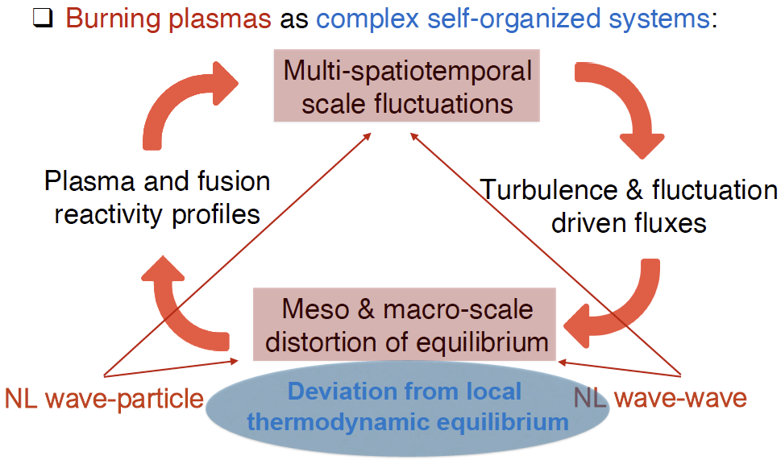
Burning plasmas as complex systems
[C&Z Rev. Mod. Phys. Review article]: Nonlinear gyrokinetic description
FZ – JPP Colloquium - (July 25, 2024): Structure formation and transport in magnetized fusion plasmas

Slide 11
Phase space transport - I
Proper nonlinear equilibrium
Long lived (undamped by collision) zonal e.m. fields and corresponding phase space zonal structures: Zonal State
Must self-consistently compute Zonal State in the presence of finite level of fluctuations
Separate macro-meso spatiotemporal scales from micro-scales
Renormalized equilibrium accounting for self-interaction
meso-macro
micro

Slide 12
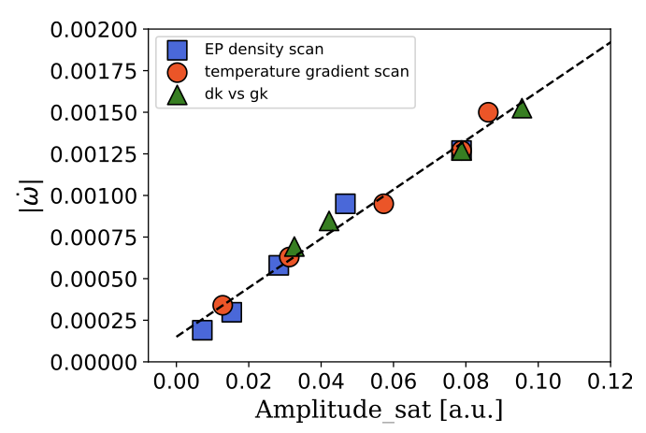
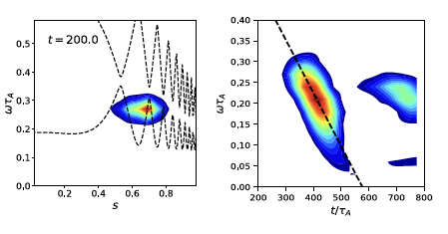
Phase space transport - II
Structure formation is favored when meso-macro temporal scale approches phase space transport time scale (e.g. EPM)
EPM chirping rate vs. saturation amplitude
[Courtesy of X. Wang; 2023]
[EPS 2023 invited; PPCF 2023]
ORB5 code
intensity contour plot
⬅ theory prediction ➔ Energetic Particle Avalanches

Slide 13
Phase space transport - III
Phase space zonal structure evolution equation (nearly integrable system) [Falessi et al NJP 2023]
Intrinsically full-F [Falessi et al NJP 2023] but reduced to the 3D action space (contants of motion)
Ready for implementation in non-linear GK codes, including thermal component if whole transport description is lifted to the phase space [S.J. Wang et al. PRL 2024, ITB by ITG]

Slide 14
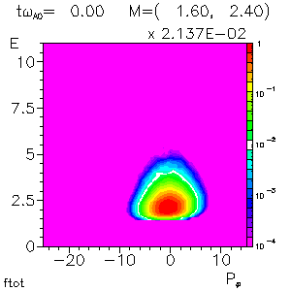
Phase space zonal structures
Numerical verification by HMGC + HYMAGYC codes [S. Briguglio
and G. Vlad, 2020 - EUROfusion project MET] - ongoing work within EUROfusion projects ATEP (Lauber/Falessi) & TSVV#10 (Mishchenko) [ORB5] [Bottino JPCS 2022]
Slow and fast spatiotemporal
responses of EP due to EPM
phase space flux

Slide 15
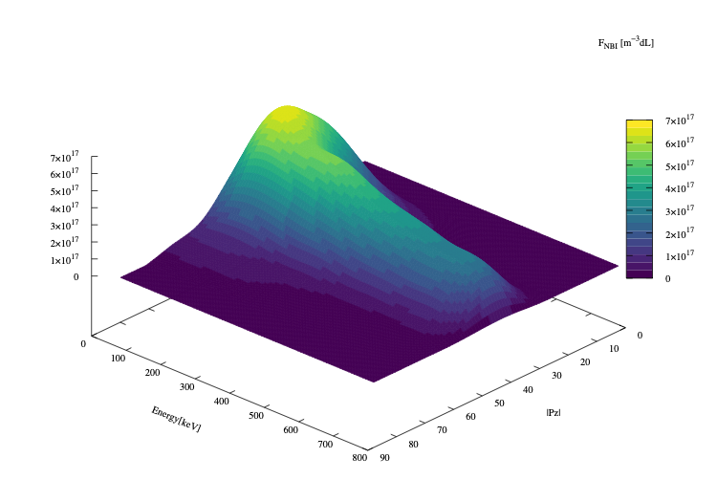
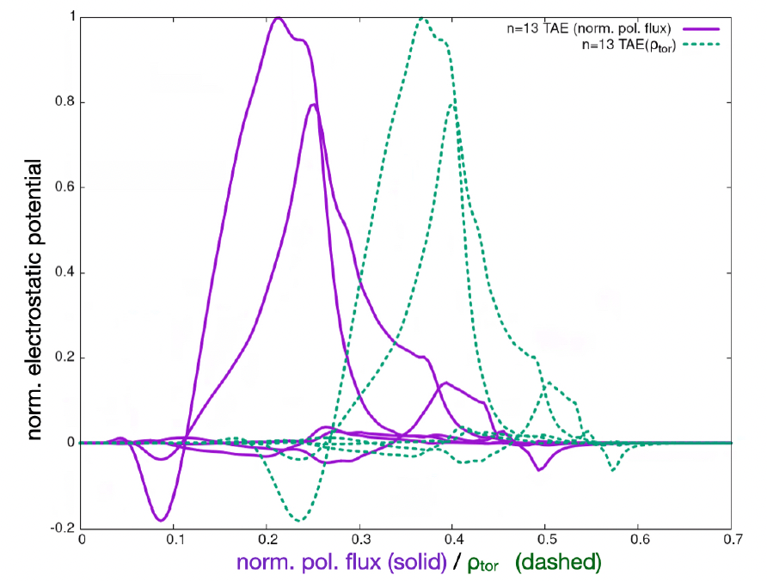
PSZS in LIGKA/HAGIS
ITER 15MA case;
TAE n=13
[Courtesy of Ph. Lauber; 2022]
[EFTC 2023 invited]
[Nuc Fus 2024 accepted]
f=75.5kHz
Computed by LIGKA
Using EP Workflow
ITER plasma from H&CD WF by M. Schneider

Slide 16
Distribution function representation
original marker data as calculated by the NEMO/SPOT package
[Courtesy of Ph. Lauber]
[Nuc Fus 2024 accepted]
Binning, smoothing and splining allow to construct regular derivatives in phase space

Slide 17
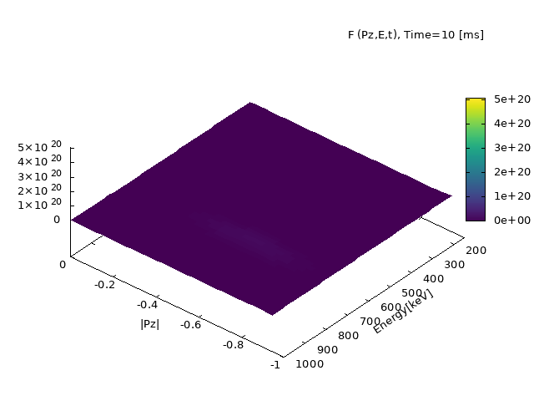
ATEP 3D code
Initial value problem solved with orbit averaged collision operator
[Courtesy G. Meng]
[Invited EPS 2024]
Source model: Gaussian function for NBI for comparison with SPOT
ATEP: Advanced Transport model
for Energetic Particles

Slide 18
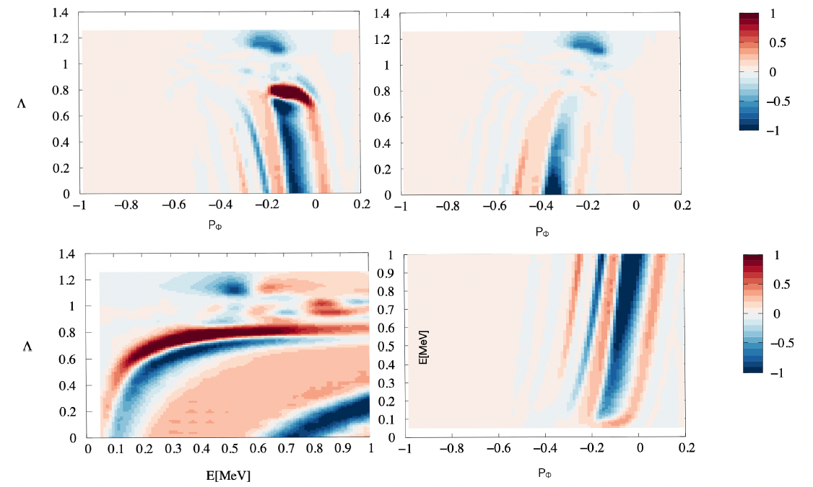
Phase space fluxes
ATEP code: solve transport equation for PSZS with sources and collisions
[Courtesy of Ph. Lauber]
[Nuc Fus 2024 accepted]
<dP_{φ}/dt>
outward
inward
E = 500 keV
co+trap
ctr+trap
P_{φ} = - 0.2
Λ = 0.12

Slide 19
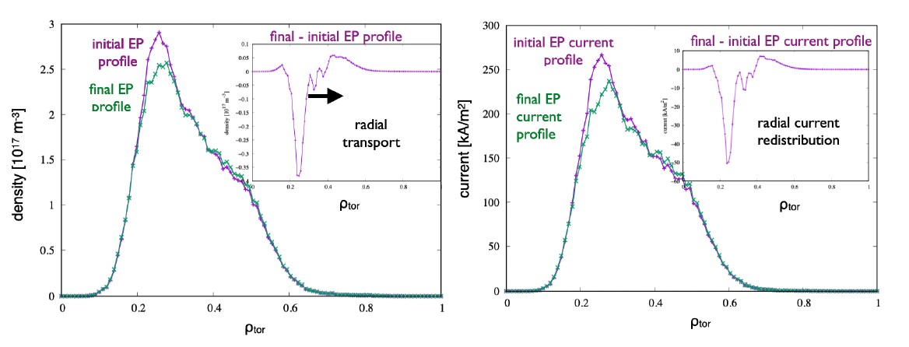
Off-axis beam relaxation in ITER
ITER 15MA case;
TAE n=13
[Courtesy of Ph. Lauber]
[Nuc Fus 2024 accepted]
Radial projection (ϱtor) of the distribution function of energetic
hydrogen particles, #100015/1, initial (as given by NEMO/SPOT) and final state after evolving the PSZS transport equation for 700ms (1000 time steps) with constant-amplitude TAE with δB/B = 10⁻⁵

Slide 20
Conclusion and Discussion
ENEA-KFE collaboration framework is well established and has started successfully with focus on:
➔ Burning plasma nonlinear dynamics, aimed at deploying a reliable predictive capability for reactor relevant plasmas
➔ Edge/SOL modeling including turbulence coupled with core transport: key
element for KSTAR and DTT
➔ Virtual Tokamak simulator (such as V-KSTAR)
Exploitation of existing/future devices (KSTAR/DTT)
Sharing experience in superconducting tokamak commissioning/fabrication
(Enable Fusion/DTT)

