Slide 1
MAG-S.01.01-T021-D001
Deliverable on 2024 CEA electromagnetic calculations – Magnetic field calculations on hybrid HTS/LTS CS design and possibly TF WP#4 (new baseline).
Q. Le Coz & CEA-IRFM team

Slide 2
Task Specification
2024 CEA electromagnetic analyses, focusing on CEA magnet designs
Activities will include the effective magnetic field calculations on the hybrid HTS/LTS CS design and possibly on the 2024 TF WP#4 design, if new baseline and associated CEA WP design are available.
Change: New Baseline EM calc

Slide 3
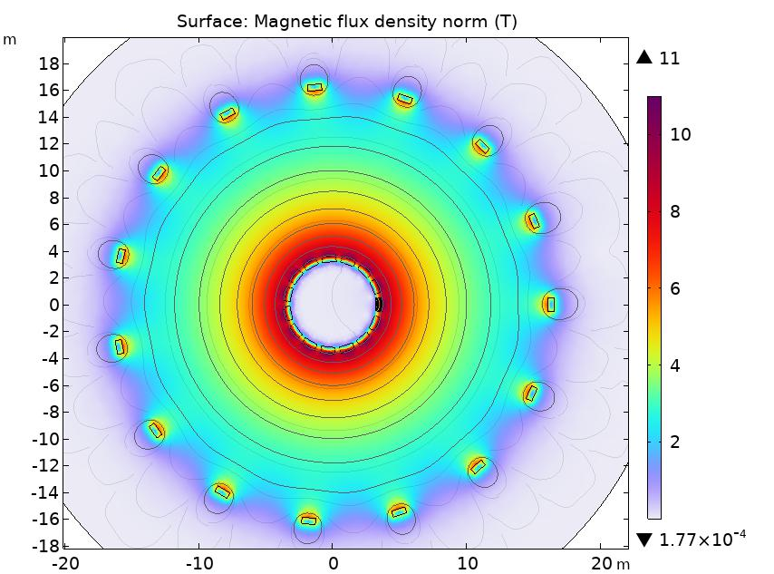
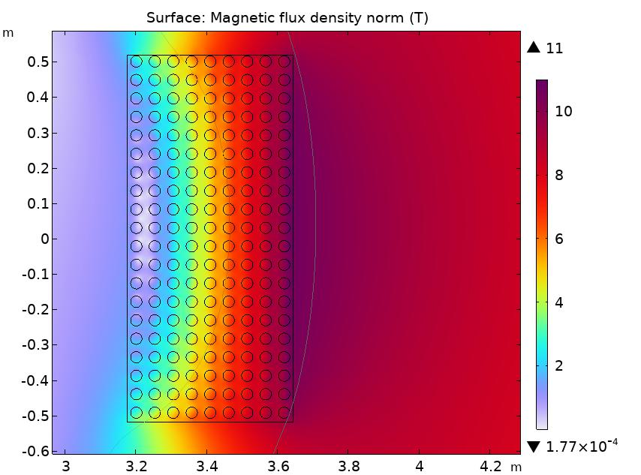
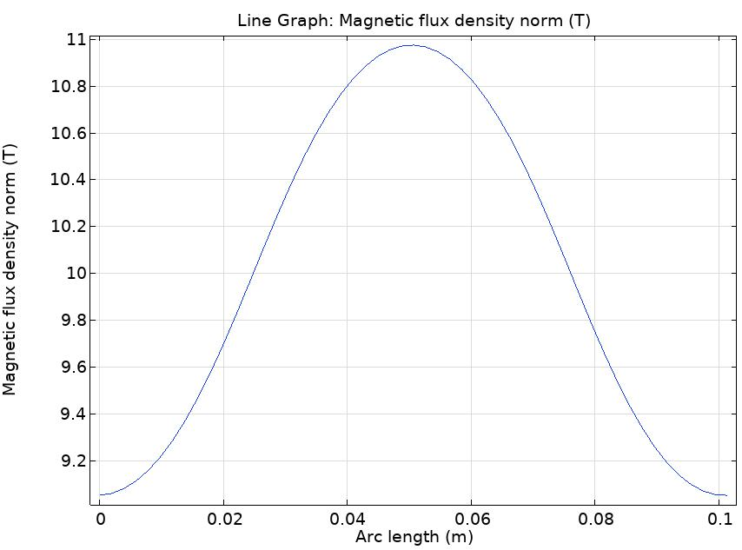
TF WP - 2024 EM Calculations
Preliminary calculations with COMSOL for cross-checks of max field
COMSOL model (using 66kA/180 turns as in PROCESS/BlueMira)
(Discussed briefly in Design presentation)
B_{max}~11T
Using about 0.3T to keep margin for PF/CS field and potential WP structure change, design B_{max}=11.3T

Slide 4
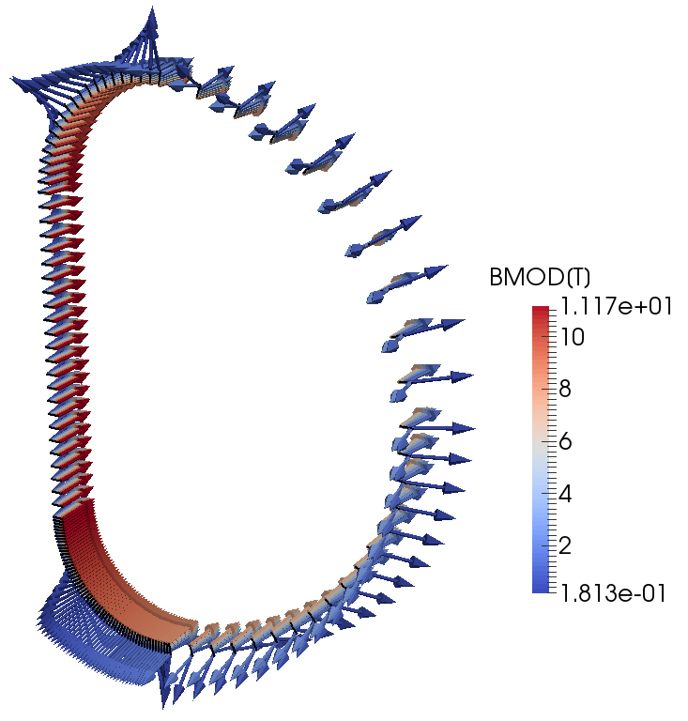
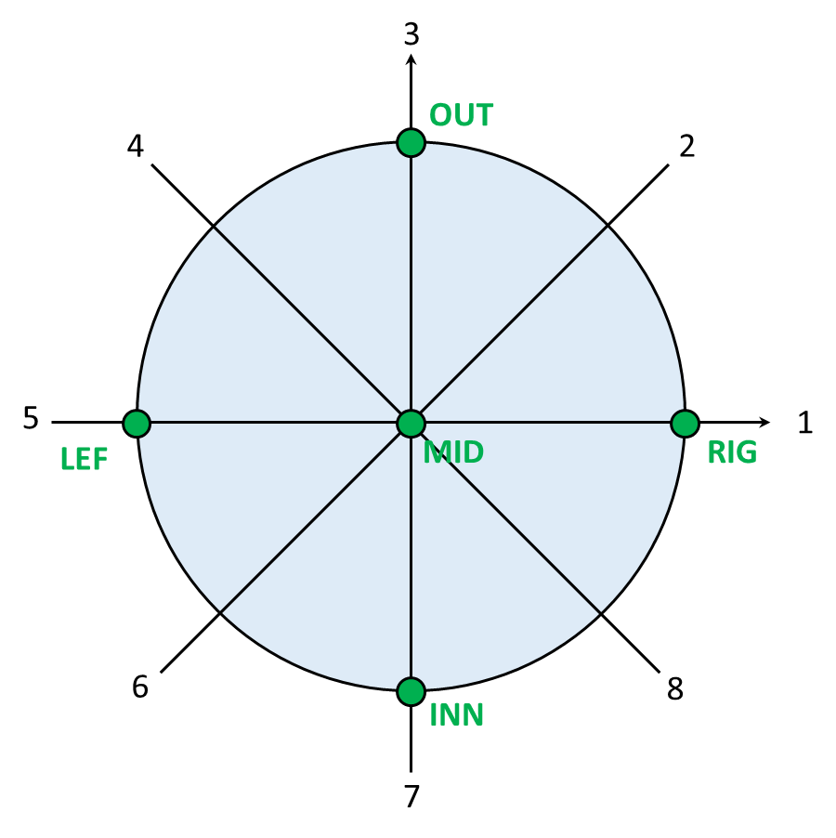
TF WP - 2024 EM Calculations
Using 2024 TF-WP4 Design: TRAPS models building and field maps
TF Only
Max field in top/bottom of straight leg
Conductor field gradient ~1.7T
Fine computation of B_{max}=11.17T (PF/CS field not included)

Slide 5
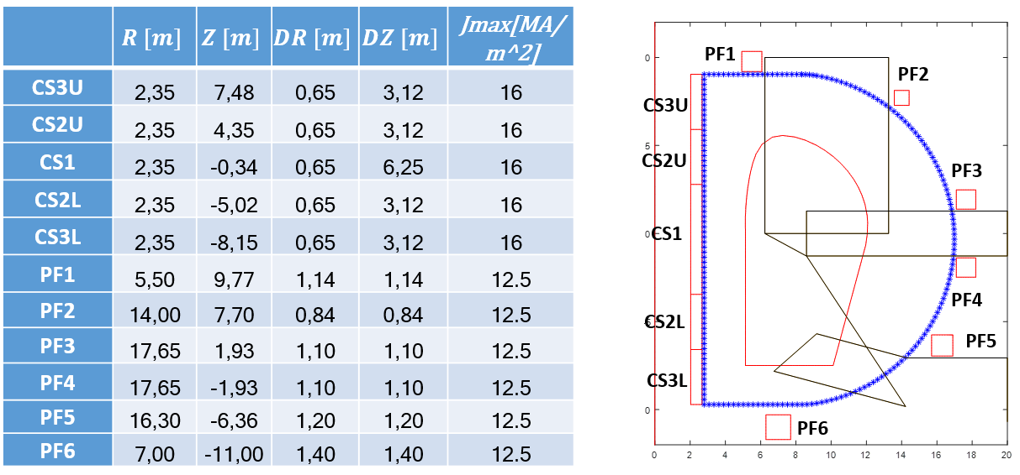
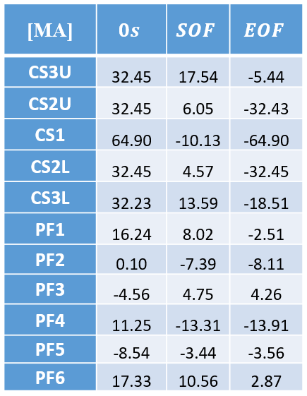
PF - 2024 EM Calculations
Based on CREATE doc: Initial_CREATE_equilibria_produced_for_t_2RRQYC_v1_0.zip
PF positions and currents

Slide 6
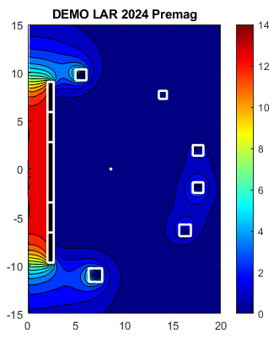
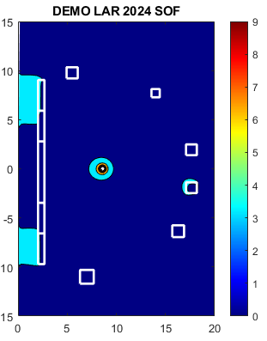
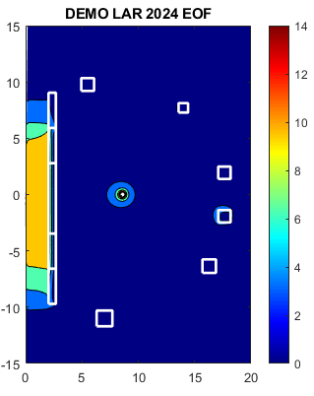
PF - 2024 EM Calculations
Based on CREATE doc: Initial_CREATE_equilibria_produced_for_t_2RRQYC_v1_0.zip
PF positions and currents - General Field Maps

Slide 7
PF - 2024 EM Calculations
Based on CREATE doc: Initial_CREATE_equilibria_produced_for_t_2RRQYC_v1_0.zip
PF positions and currents - EM Loads
Pre-estimation of the vertical loads that can be used later on tie rods dimensioning for CS pre-compression.

Slide 8
TF WP - 2024 EM Calculations
Using 2024 TF-WP4 Design: TRAPS models building and field maps
TF + PF @ PREMAG stage
PF field does not impact B_{max}
B_{eff} close to B_{mid} (10.6T)
Field maps now need to be "post-treated" for thermohydraulic calculations (following He-flow)

Slide 9
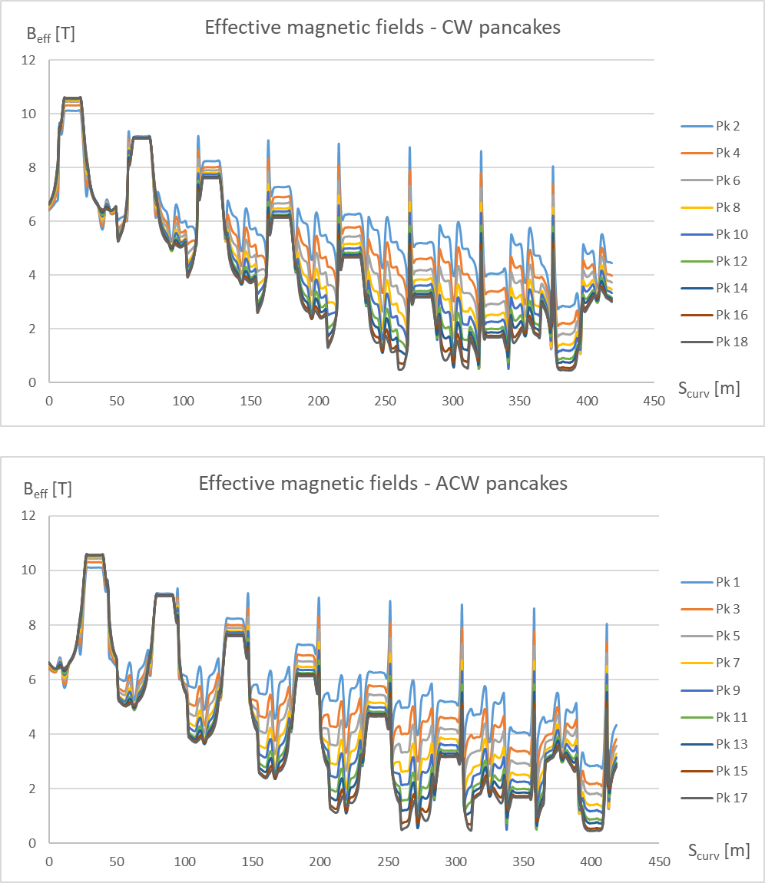
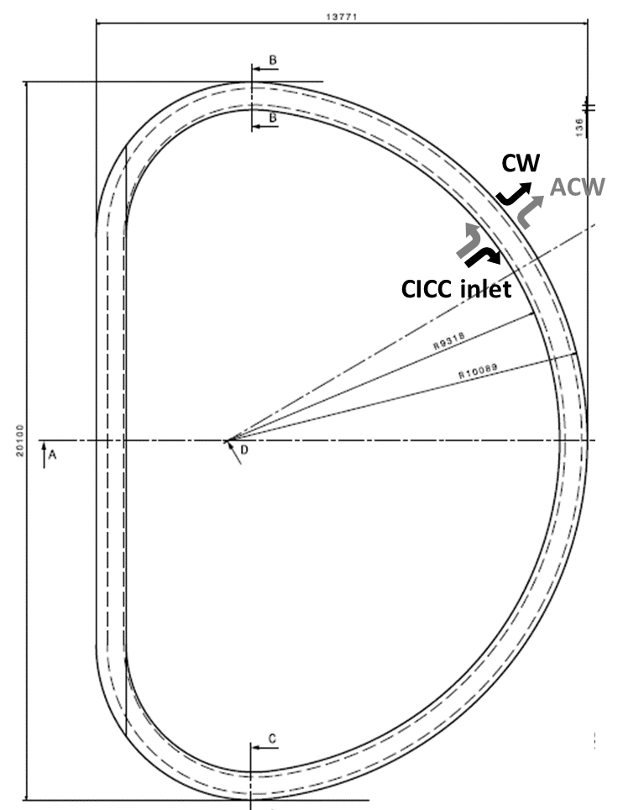
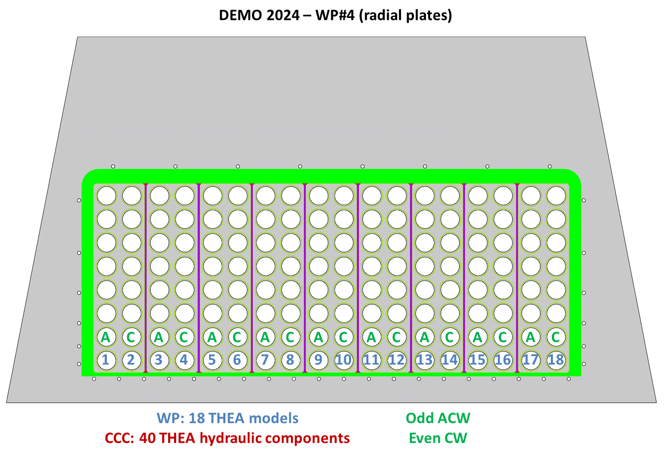
TF WP - 2024 EM Calculations
Thermohydraulic shift from He inlet for THEA models
+ inversion of the path for ACW pancakes:

Slide 10
TF Volumetric field map
For the integration of the field in ANSYS (S. Garitta), a preliminary volumetric load map was needed.
In the future, this will be streamlined with the usual TRAPS field map computation, but here a simple 1/r field decreased was implemented, only in toroidal direction, and the local IxB computed using the coil geometry.
All pancakes have the same volumetric IxB for the moment.
Max IxB~250MN/m³

Slide 11
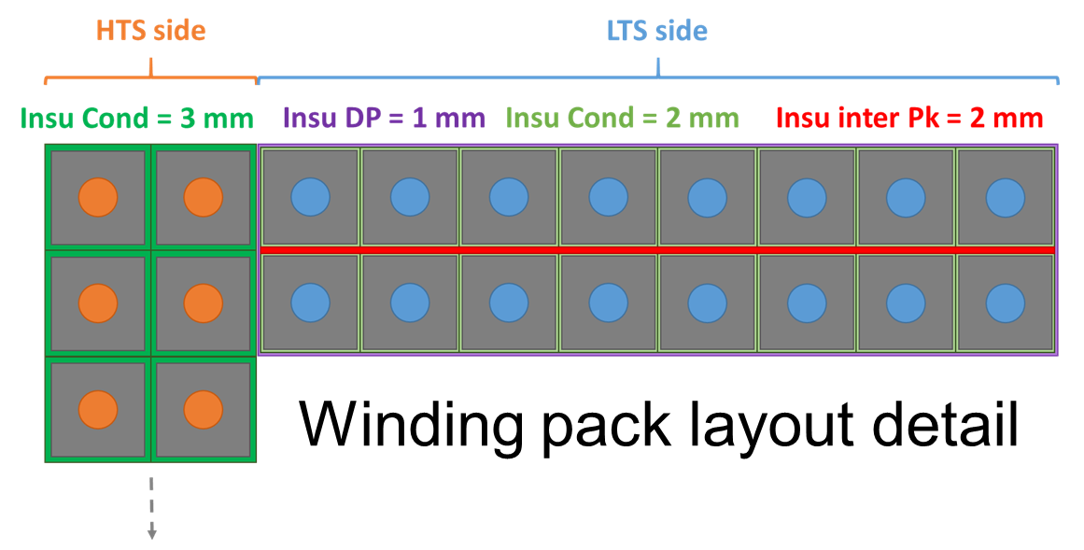
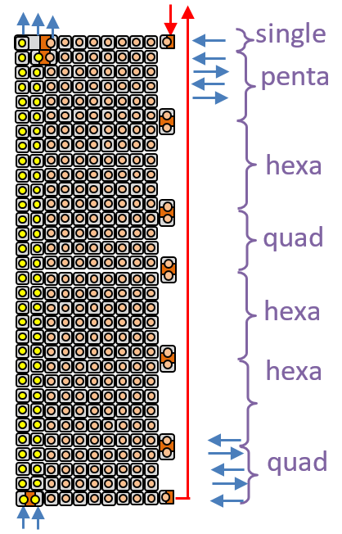
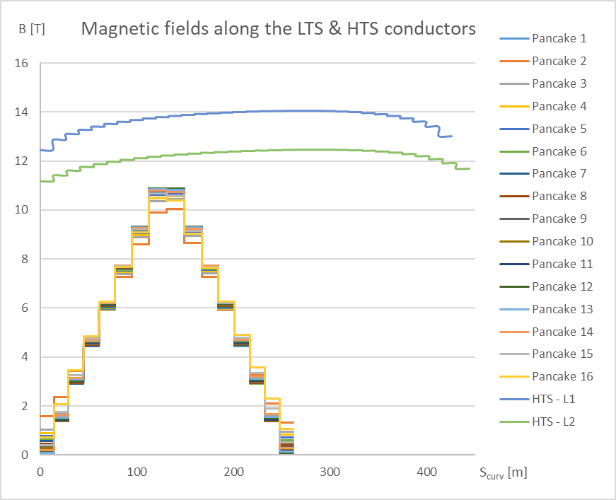
CS - 2024 EM Calculations
Using 2023 CS Design (based on 2018 DEMO baseline): TRAPS models building and field maps
CS field @ I_{max}
Hybrid HTS/LTS design
I_{cond} = 109.5 kA
NbTurns LTS = 8
NbLayers HTS = 2
NbPancakes = 32 / module
R_{e} = 2.96 m
R_{i} = 2.08 m
B_{max} = 14.8 T
Phi_{edge} = 281 Wb
LTS side – B_{max} = 10.88 T
HTS side – B_{max} = 14.04 T

Slide 12
Perspectives
2025 activities:
  Updates of the field maps on updated designs (if available).

