Slide 1
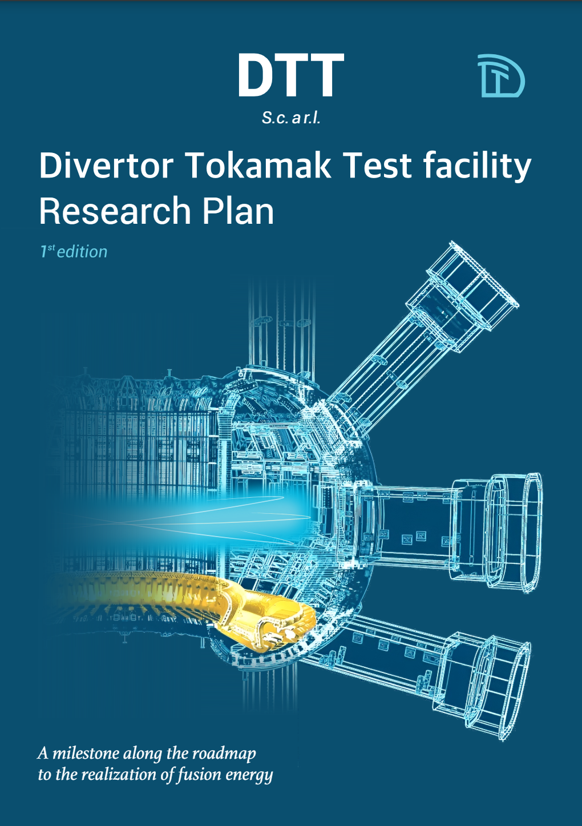
















DTT Research Plan – Version 1.0 (May 2024)
Public issue soon available at: https://www.dtt-project.it/index.php/about/dtt-research-plan.html
Voluntary participation by:
100 authors and contributors
20 Research Institutes
10 countries
9 Chapters
9 Appendices
195 pages

Slide 2
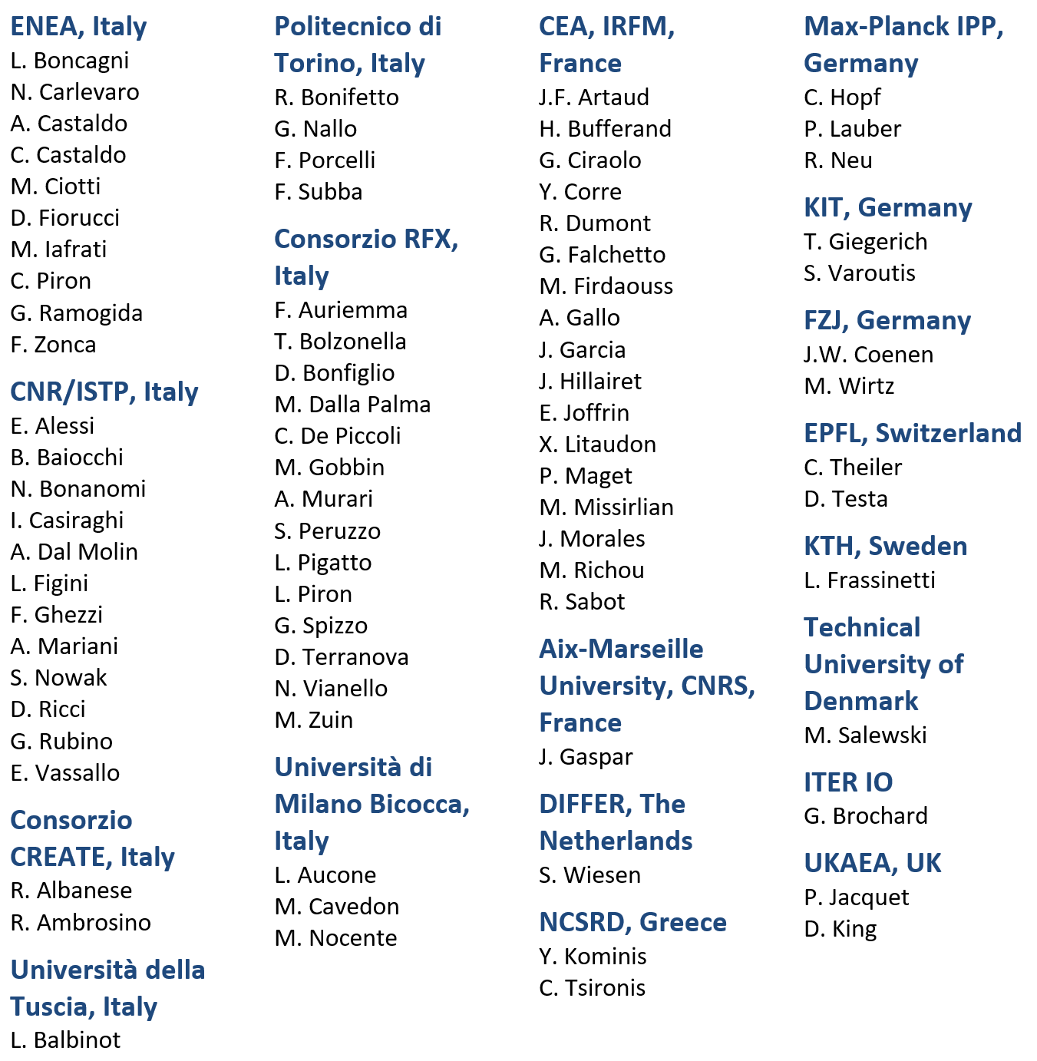
Coordinators + leading authors (DTT-RP Team) and contributors
Coordinators
F. Crisanti, G. Giruzzi, P. Martin
Leading Authors
Contributors
Chapter 1: DTT power exhaust strategy | F. Crisanti G. Giruzzi P. Martin | DTT S.C.a.r.l. & University of Tuscia, Italy CEA, IRFM, France DTT S.C.a.r.l., RFX & University of Padova, Italy
Chapter 2: Plasma scenarios | P. Mantica C. Angioni | CNR – ISTP, Italy Max Planck IPP, Germany
Chapter 3: Divertor and SOL physics, plasma-wall interactions | P. Innocente E. Tsitrone M. Wischmeier | Consorzio RFX, Italy CEA, IRFM, France Max Planck IPP, Germany
Chapter 4: Transport physics and integrated modelling | C. Angioni P. Mantica | Max Planck IPP, Germany CNR – ISTP, Italy
Chapter 5: MHD, disruptions and control | E. Nardon G. Vlad M. Falessi | CEA, IRFM, France ENEA, Italy ENEA, Italy
Chapter 6: Physics of heating, current drive and fuelling | C. Sozzi D. Van Eester P. Vincenzi D. Terranova | CNR – ISTP, Italy ERM/KMS, Belgium Consorzio RFX, Italy Consorzio RFX, Italy
Chapter 7: Energetic particle physics | G. Vlad M. Falessi E. Nardon | ENEA, Italy ENEA, Italy CEA, IRFM, France
Chapter 8: Theory and simulation | M. Falessi G. Vlad E. Nardon | ENEA, Italy ENEA, Italy CEA, IRFM, France
Chapter 9: Fusion technology developments | S. Brezinsek C. Day G. Dose | FZJ, Germany KIT, Germany ENEA, Italy

Slide 3
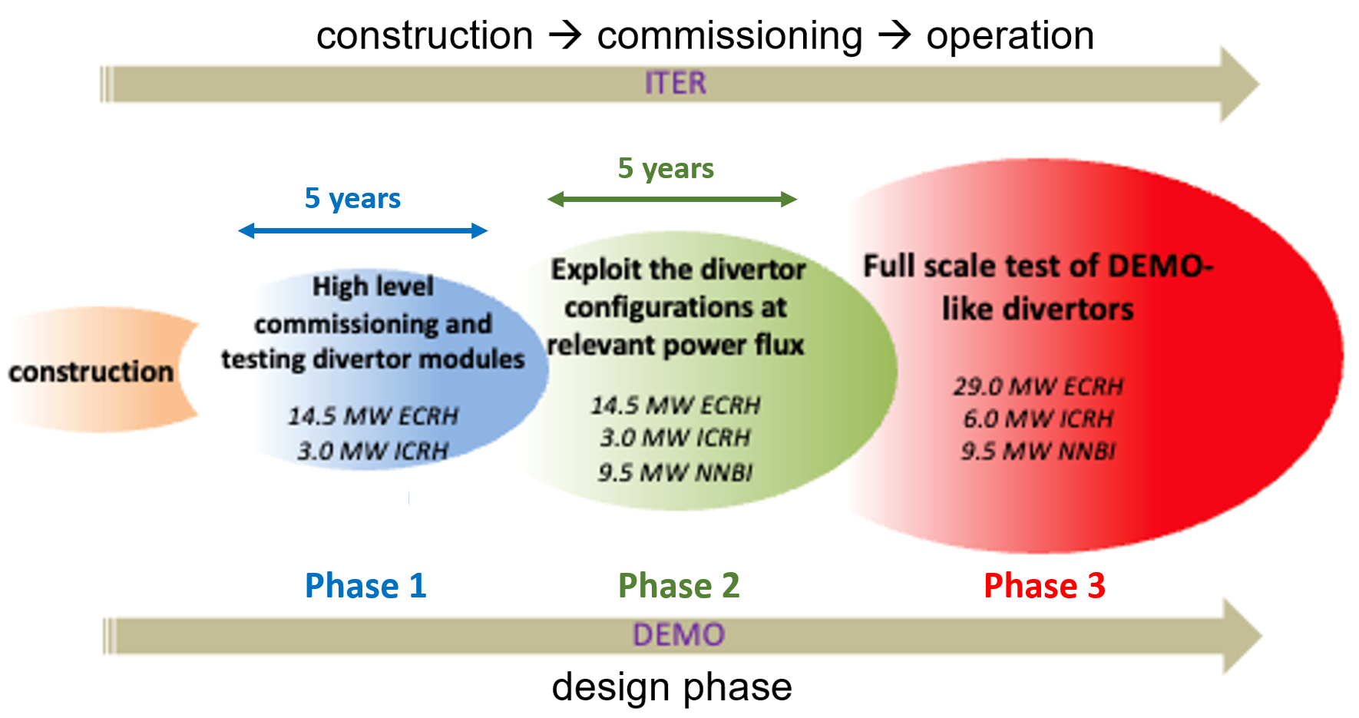
DTT Research Plan : characteristics and objectives
living document, to be regularly updated
basis for the DTT scientific programme
basis for subsequent device upgrades
describing the objectives and research strategy of DTT scientific exploitation
describing programmatic headlines in the main research phases
guide and catalyse DTT research activities in preparation of exploitation

Slide 4
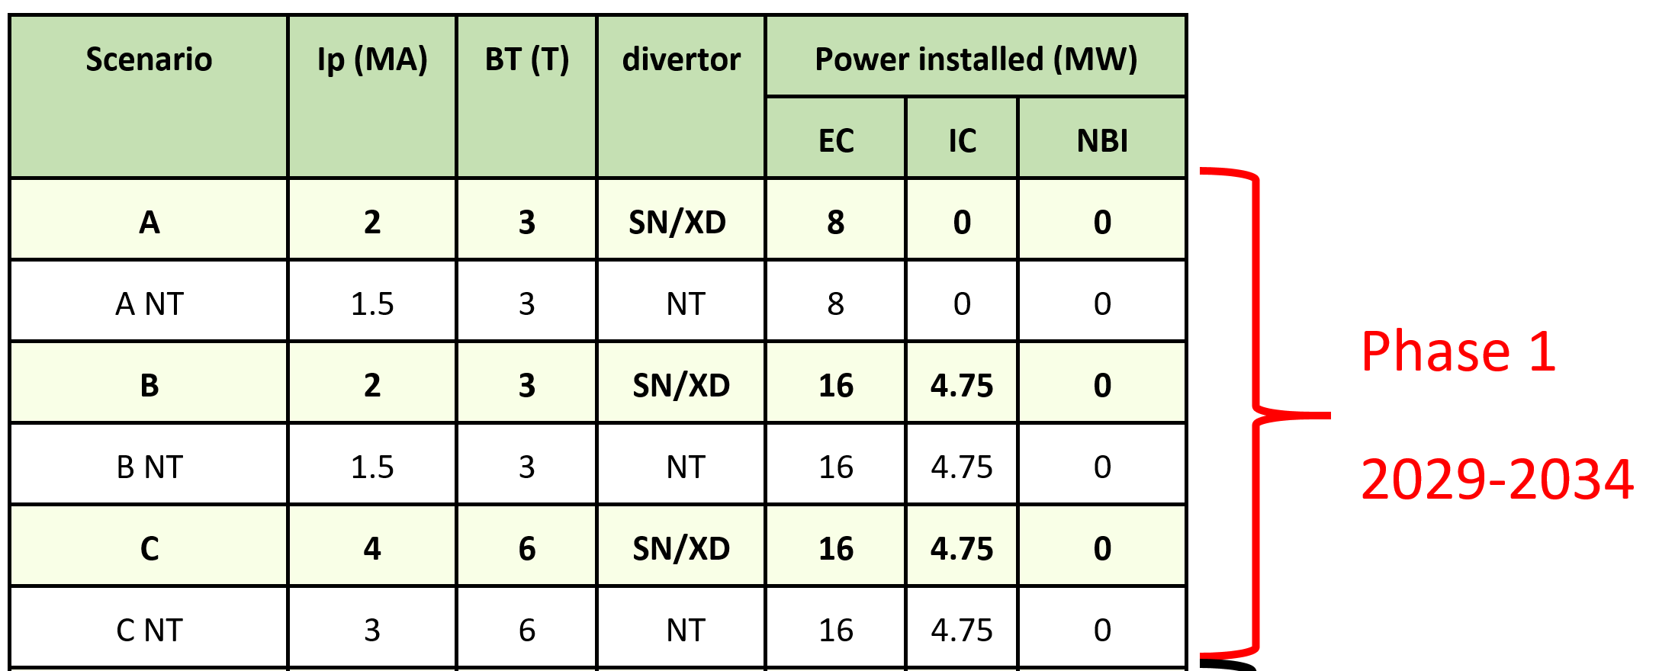
DTT Phase 1: 5 years (2029-2034)
> 20 MW of installed power
→ DTT already a "top-class" device
From DTT Research Plan – Chapter 2

Slide 5
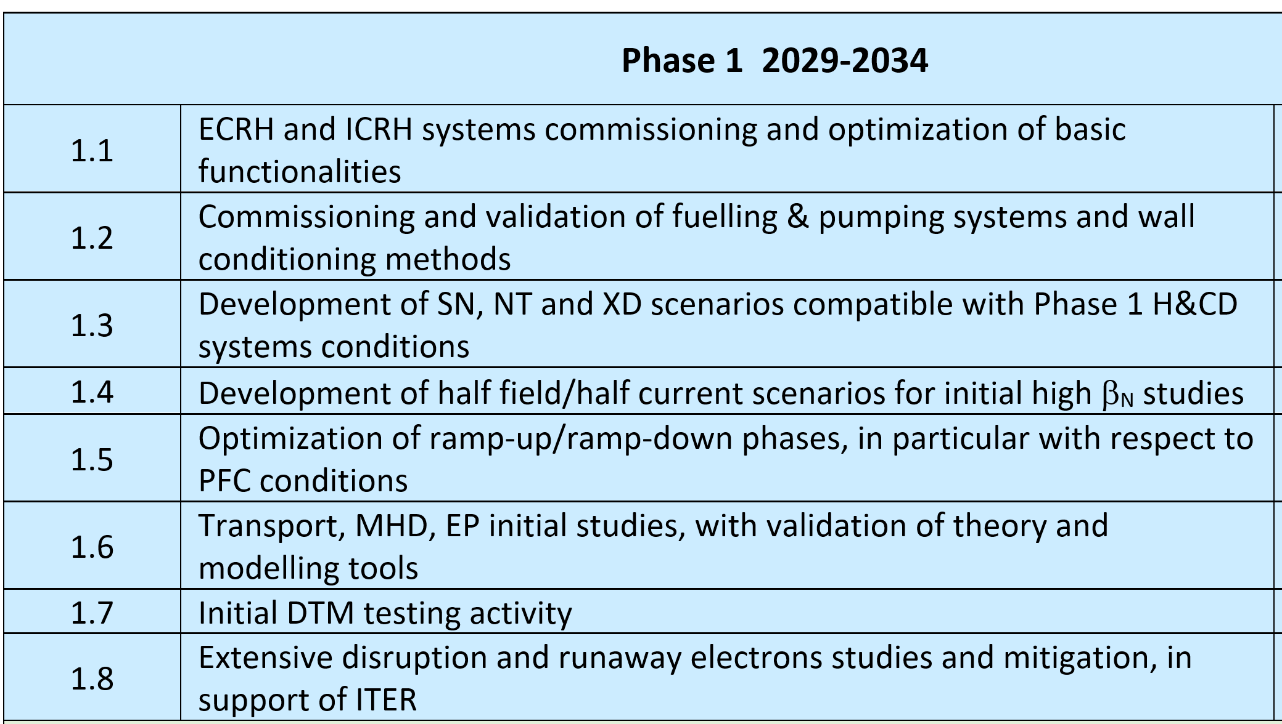
Phase 1 high-level programmatic headlines
Are diagnostics foreseen
for Phase 1 adequate
for these Programme headlines ?
From DTT Research Plan – Chapter 1

Slide 6
DTT-DIA-DRC panel activity
Input document received. Congratulations for their quality ! 14 May
Kick-off meeting – dates of meeting with PL agreed 14 May
Two panel online meetings 21 May & 3 June
  work method agreed; reading tasks shared
  template of Comments & Questions file produced
  exchange of first impressions, difficulties etc.
Agenda of this meeting defined 22 May
Comments & Questions collected and provided 6 June
This meeting 10-12 June
  agenda timing very tight: speakers please keep your times
  let's try to keep 1/3 of the time for presentations, 2/3 for questions and discussion
  in the presentations, try to take panel's Comments & Questions into account
Tentative release of panel report (difficult to guarantee…) end June

