Slide 1
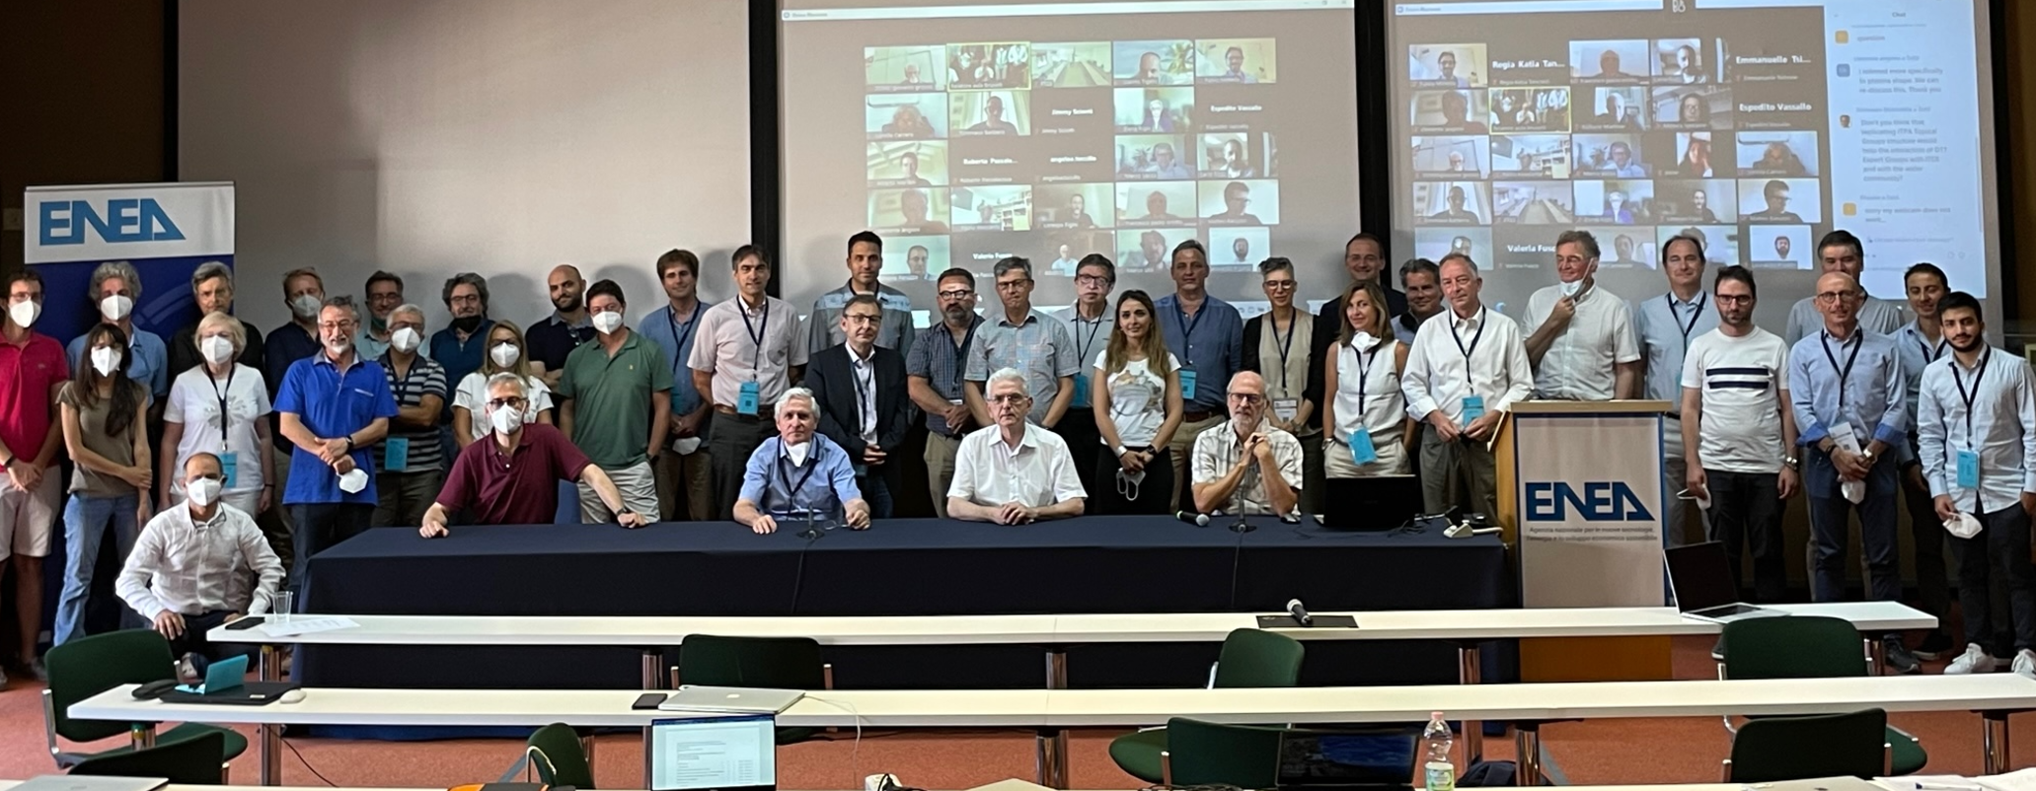
DTT Research Plan next step
Remember… starting point…
DTT Consortium (DTT S.C.a r.l. Via E. Fermi 45 I-00044 Frascati (Roma) Italy)

Slide 2
Terms of Reference for next DTT-RP activity
Revisit the present version of the RP by considering the theoretical evolution of the knowledge along the next years
Identify and propose possible experiments to be performed on the worldwide operating Tokamaks (scenarios, H mode, I mode, heating, optimization,...)
Identify and propose possible simulations to be done using the present codes and/or identify some important upgrades to be realised (non linear edge codes, integration of edge and bulk, fast particle codes,….)

Slide 3
Terms of Reference for next DTT-RP activity
Identify and propose possible tests on new materials for the DTT Divertor and or finalised to the best use of the DTT divertor test modules (sponge tungsten, liquid metals, new pumping systems.,,,,
Follow the evolution of the diagnostics apparatus and propose as best as possible their integration on DTT…(turbulence studies, material migration,,,)

Slide 4
DTT RP Structure
Four activity lines (plus the general one on RP revision)
Possibly 2-3 working group for each line (but the first one)
Identify and propose possible experiments…
scenarios
Disruptions
heatings

Slide 5
DTT RP Structure
Identify and propose possible simulations… some important upgrades….
Codes evolutions
Fast particles
Identify and propose possible tests on new materials…
Materials (sponge, liquid metal…)
Divertor test modules

Slide 6
DTT RP Structure
diagnostics apparatus and propose ….
Best use of the present diagnostics
New advanced diagnostics

Slide 7
Is it possible what we aim? Situation
Thanks also to our contribution DTT has been recognised as a fundamental part of the European program
Whatever will be the next European program and its funding, if it will be coherent it will have to consider the fact that DTT is “indispensable”
So we can hope and aim to have a more “official involvement” of the European Labs.
A strong interest has been shown from many other “international” Labs
A strong “overlap” with the new ITER and consequently with its new RP

Slide 8
Next Steps
On the 12th of June the RP will be presented within a EuroFusion Seminar
Next days the DTT-RP will be sent to the CTS
Considering the very positive ”opinion” on DTT we feel reasonable to think that EuroFusion (Bureau and GA) will reconsider its involvement in DTT, even, for instance, financing the RP activities.
Within the next July-September we should launch the call for the participation on the next version of the RP
Who is launching it?...

Slide 9
Next Steps
Around the middle of next September-November 1-2 days workshop to illustrate the present RP and to introduce the targets for the next RP version
Around the end of November/beginning of 2025 the first meeting of the new team
The revised RP ready around (at the latest) early spring of 2027

