Slide 1
Meeting agenda /3

Slide 2
Finalising the DTT-RP draft
The most recent version of the draft (v8) is on Alfresco in the DTT RP drafts section
A set of changes should be made by me, in particular those in Chap. 1
Other changes, discussed in the past two days, should be made by the Chapters' authors
Please send me the modifications in a recognizible form, in such a way that I can copy in the text
Deadline: end of next week (May 17).
Objective: finalise a pdf that can be put on the DTT website (public issue)
Then, there will be announcements that the DTT-RP is online (to… mailing list to be established)
Later on: design a nice cover and adjust the document for a printed version.
Copies of the printed version will be sent to all the leading authors + … list to be established

Slide 3
Further points to be discussed now
Is anything unclear or should be further discussed ?
Is there a way to publish the DTT-RP in some form ?
How to manage the lists of 1) Contributors 2) Chapters authors 3) DTT community
Any remark on the format of the document ?
I am listening to your proposals for points to be discussed now
Follow-up of discussions on SPI
Error fields

Slide 4
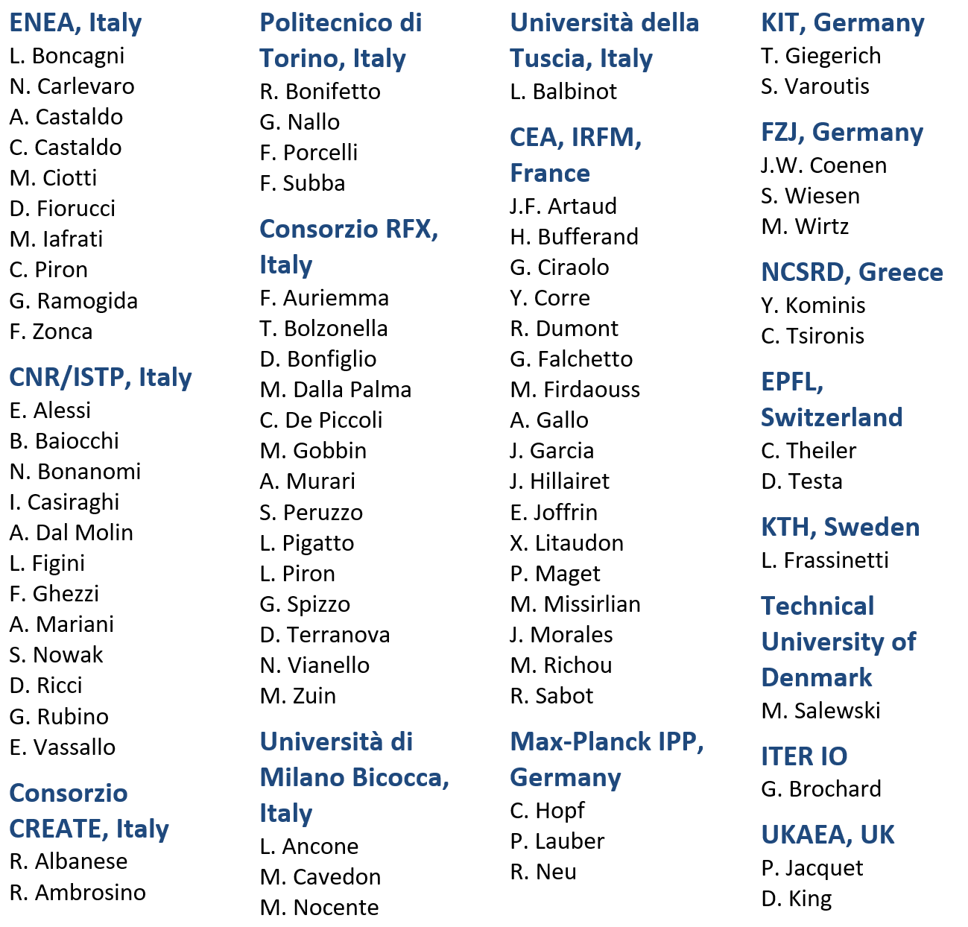
Coordinators, leading authors and contributors
Coordinators
F. Crisanti, G. Giruzzi, P. Martin
Leading Authors
Contributors
Chapter 1: DTT power exhaust strategy | F. Crisanti G. Giruzzi P. Martin | DTT S.C.a.r.l. & University of Tuscia, Italy CEA, IRFM, France DTT S.C.a.r.l., RFX & University of Padova, Italy
Chapter 2: Plasma scenarios | P. Mantica C. Angioni | CNR – ISTP, Italy Max Planck IPP, Germany
Chapter 3: Divertor and SOL physics, plasma-wall interactions | P. Innocente E. Tsitrone M. Wischmeier | Consorzio RFX, Italy CEA, IRFM, France Max Planck IPP, Germany
Chapter 4: Transport physics and integrated modelling | C. Angioni P. Mantica | Max Planck IPP, Germany CNR – ISTP, Italy
Chapter 5: MHD, disruptions and control | E. Nardon G. Vlad M. Falessi | CEA, IRFM, France ENEA, Italy ENEA, Italy
Chapter 6: Physics of heating, current drive and fuelling | C. Sozzi D. Van Eester P. Vincenzi D. Terranova | CNR – ISTP, Italy ERM/KMS, Belgium Consorzio RFX, Italy Consorzio RFX, Italy
Chapter 7: Energetic particle physics | G. Vlad M. Falessi E. Nardon | ENEA, Italy ENEA, Italy CEA, IRFM, France
Chapter 8: Theory and simulation | M. Falessi G. Vlad E. Nardon | ENEA, Italy ENEA, Italy CEA, IRFM, France
Chapter 9: Fusion technology developments | S. Brezinsek C. Day G. Dose | FZJ, Germany KIT, Germany ENEA, Italy

