Slide 1
Chapter 5: MHD, Disruptions and Control
E. Nardon, on behalf of the Chapter 5 team: E. Alessi, M. Baruzzo, A. Dal Molin, M. Falessi, M. Gobbin, Y. Kominis,
P. Maget, M. Nocente, L. Pigatto, L. Piron, F. Porcelli, C. Reux, D. Testa, G. Vlad, F. Zonca
Acknowledgments: R. Ambrosino, D. Bonfiglio, P. de Vries, L. Frassinetti, M. Hoelzl, M. Hoppe, S. Nowak, C. Paz-Soldan, G. Ramogida, L. Singh, F. Subba, N. Vianello
DTT Research Plan team meeting, Frascati, 6-8/05/24 (presented remotely)

Slide 2
Chapter rationale
The chapter discusses 2 aspects:
In what way MHD, Disruptions and Control (MDC) aspects impact the programme, e.g. by impacting/limiting plasma scenarios
What MDC-related research can be done in DTT.
Both aspects are discussed to some extent in each of the sections.
One key point is the strong similarity between DTT and ITER in terms of actuators for MHD control and disruption mitigation and operation timelines.

Slide 3
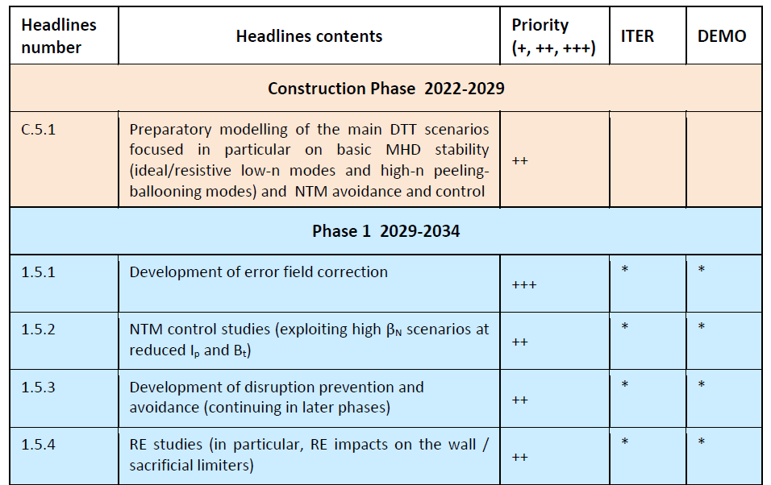
Headlines

Slide 4
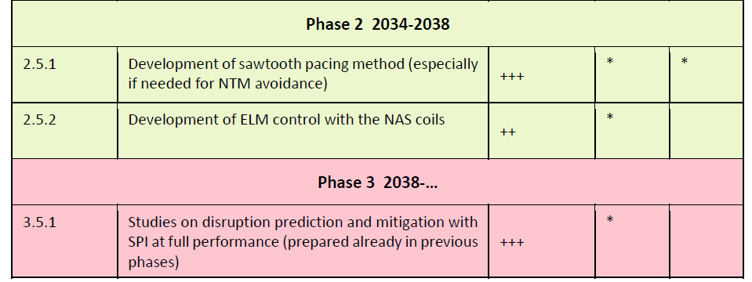

Slide 5
Ideas on follow-up activities and chapter development for the next versions
Estimate the risk of triggering NTMs for each scenario based on the predicted sawtooth period and β_{N} value, using the empirical scaling described in [Chapman NF 2010]
Model sawtooth pacing with ICRH/ECCD/NBI
Prepare real-time equilibrium reconstruction (possibly constrained by MSE) and island detection for NTM suppression
Model strategies to suppress locked islands, e.g. using the NAS coils to allow ECCD in the O-point region to suppress the mode [Volpe PRL 2015] or to force the island to rotate [Zohm IPP report 2022]
Perform modelling to assess whether RWM stability could be addressed in high β_{N} scenarios at reduced B_{t}
Perform modelling to assess existence domain of small/no-ELM regimes (Type II/QCE, EDA, QCE, …) (?)
Define how the NAS coils will be used exactly (several possible tasks: error field correction, ELM suppression, …)

Slide 6
Model disruption EM loads with JOREK and compare with MAXFEA/CarMa0NL/ANSYS results
Discuss with IO on possible collaboration on disruption prevention and avoidance (preliminary emails were exchanged suggesting that this could be of interest)
Continue SPI and RE modelling with JOREK
Plan recipe to produce an RE beam. Estimate whether SPI system is well dimensioned for RE impact mitigation by H SPI.
Work on the design and modelling of sacrificial limiters for REs in relation with DEMO team (JOREK work ongoing)

