Slide 1
EG-6 Fusion technology developments
S. Brezinsek⁽¹⁾, C. Day⁽²⁾, G. Dose⁽³⁾ on behalf of the Expert Group-6 of the DTT Research Plan
⁽¹⁾Forschungszentrum Jülich GmbH, Institut für Energie- und Klimaforschung-Plasmaphysik, Jülich, D-52425, Germany
⁽²⁾ Karlsruhe Institute of Technology, Karlsruhe (KIT), Germany,
⁽³⁾ University of Rome “Tor Vergata”, Industrial Engineering Department, Via del Politecnico 1, 00133 Rome, Italy
DTT Consortium (DTT S.C.a r.l. Via E. Fermi 45 I-00044 Frascati (Roma) Italy)

Slide 2
Outline
New topics?
9. Introduction
9.1 Plasma-facing materials
9.2 Plasma-facing components
9.2.1 Divertor test modules
9.2.2 Thermohydraulics
9.2.3 First wall module
9.2.4. The second, optimized divertor
9.3 Matter Control
9.3.1 Fuelling
9.3.2 Pumping
Diagnostics on the DTM and FW?
IR, 2 colour?,
Reflection tools

Slide 3
One needs to separate: needs for DTT „operation“ and needs for „material testing“ in the DTM and FWM.
Final set of materials for DTT second divertor as „first set“ is fixed (see WPDIV)
Other materials shall be open for future components.
Is the tool not ANSYS to simulate the thermal cycling loading
Proposal split into two parts or remove “final” set of testing.

Slide 4
DTM and FWM need to be designed and boundary conditions given (size, weight, geometry, temperature)
Identify the interfaces for exchange, the pre- and post-characterisation ideas, activation?
Identify „reference“ shapes of PFCs and PFMs used in the exposures (exchange only the material not design)
Simulations of „reference plasmas“ needs to be made to estimate the heat loads and particle fluxes at the locations
Issues appearing:
Some EUROfusion deselected materials are meanwhile „sold“ to companies
Offer the DTM and FWM in DTT as „user facilities“ for private companies?
Issues appearing:
Key person for fuelling and pumping left KIT => Kyoto engineering => test system without plasma foreseen
Role of KIT for DTT and KIT for EU-DEMO? New person named, but currently all a bit difuse
Exhaust modelling with DIVGAS not affected
Proposal split into two parts MATERIALS and FUELLING/PUMPING.

Slide 5
Simulation of results observed and comparison with reference PFC system?
Need to specify a basic set of materials to qualify regarding power handling?
Do we need to do “pre-damaged” and “repaired” already here? Low power handling sufficient.
What about the FWM system and tests there?

Slide 6
All reasonable, but do we want specify really DEMO here? DEMO-like to keep it open
DIVGAS needs plasma counter part

Slide 7
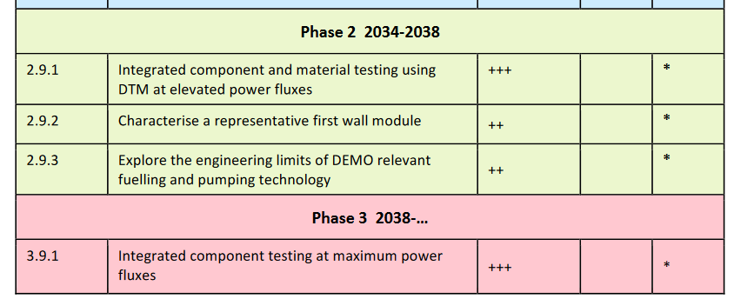
Need to consider 2nd divertor and first wall`
Neet to consider pre-damaged materials

