Slide 1
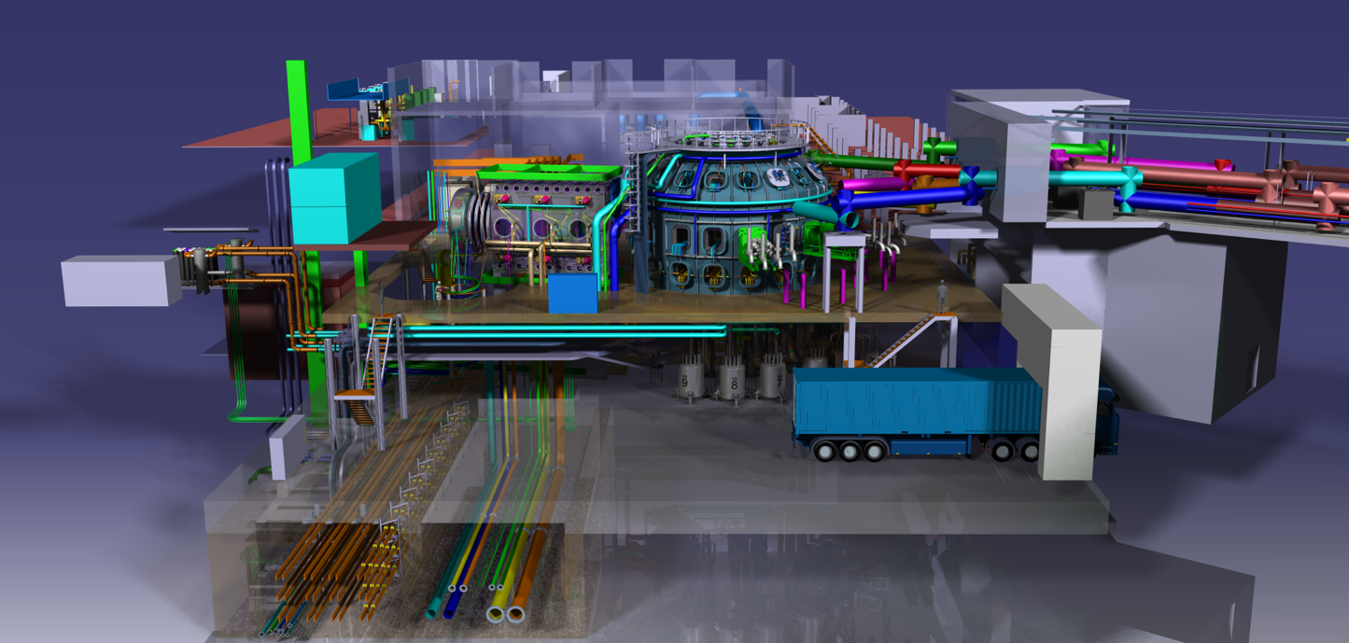
4th DTT-RP Team meeting
DTT-RP Chapter 1 (+ Foreword)
DTT Power Exhaust Strategy
F. Crisanti, G. Giruzzi, P. Martin

Slide 2
Output of the EU Facilities Review concerning DTT /1
Contribution of the DTT-RP Team to presentation of DTT at the Facilities Review (slides)
Panel Report issued Feb. 2024
Excerpts on DTT:
p. 3
p. 5
p. 4
Indispensable: the scope of activities within the foreseen R&D programme is sufficiently substantial that the programme goals cannot be realized on the required timescale without this facility

Slide 3
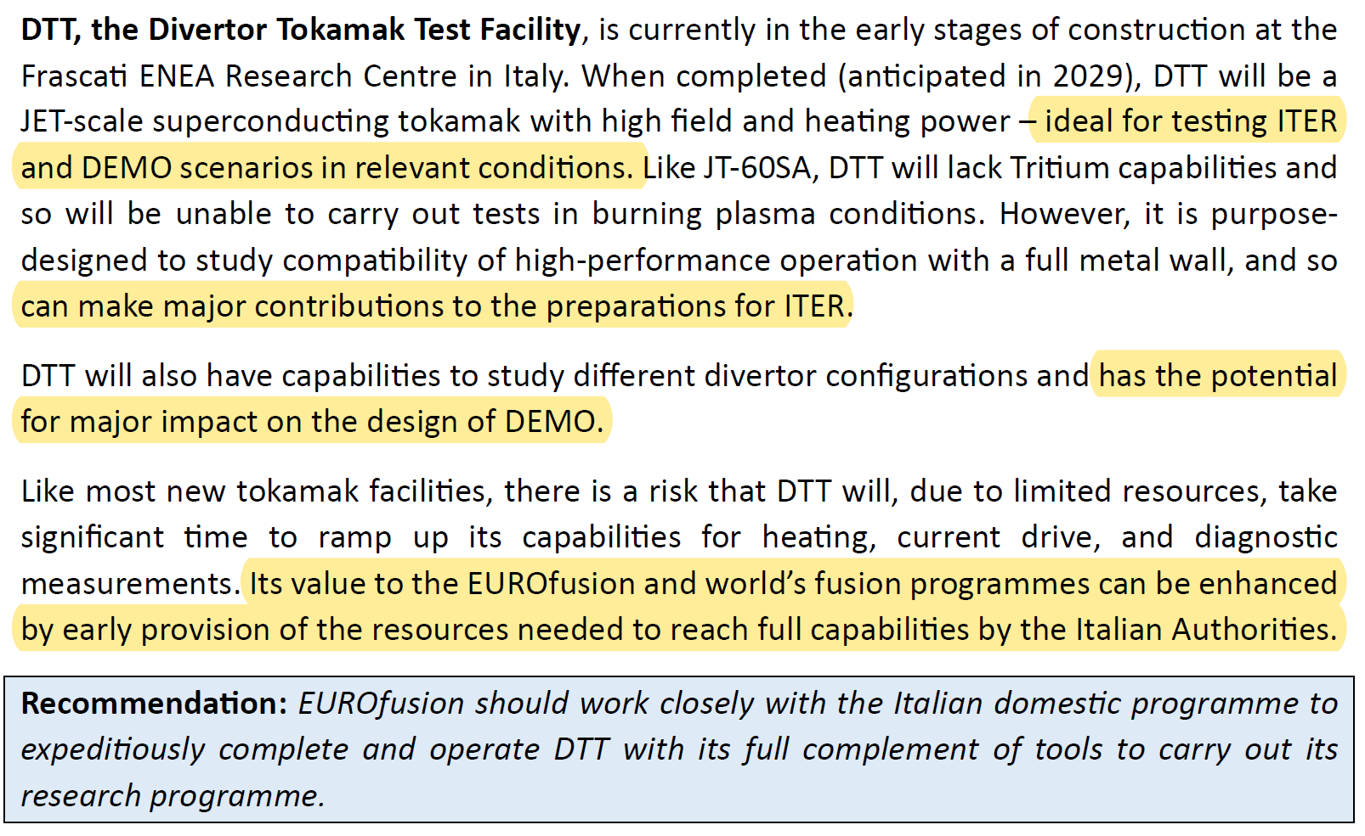
Output of the EU Facilities Review concerning DTT /2
p. 16

Slide 4
Output of the EU Facilities Review concerning DTT /3
p. 17
p. 23

Slide 5
Output of the EU Facilities Review concerning DTT /4
p. 56

Slide 6
Foreword: excerpts

Slide 7
Chapter 1 : rationale
Starting point: the problem of plasma exhaust for fusion reactors
pointing out that it is not just an issue of PFC and materials, but also of core-edge integration
→ concepts used for DTT design, based on dimensionless scalings and ITER similarity
Short description of DTT features, main parameters and magnetic configurations, compared with ITER and EU-DEMO
What is possible to do with DTT (before, in parallel with and in support of ITER)
Among the possible objectives, which ones are considered as the main ones and in what priority order
How the objectives are pursued in a logical timeline, taking into account the sub-systems evolution (heating, PFC, diagnostics, etc.)
→ Description of DTT programme phases in connection with ITER and with DEMO design
High-level headlines of the DTT Research Programme

Slide 8
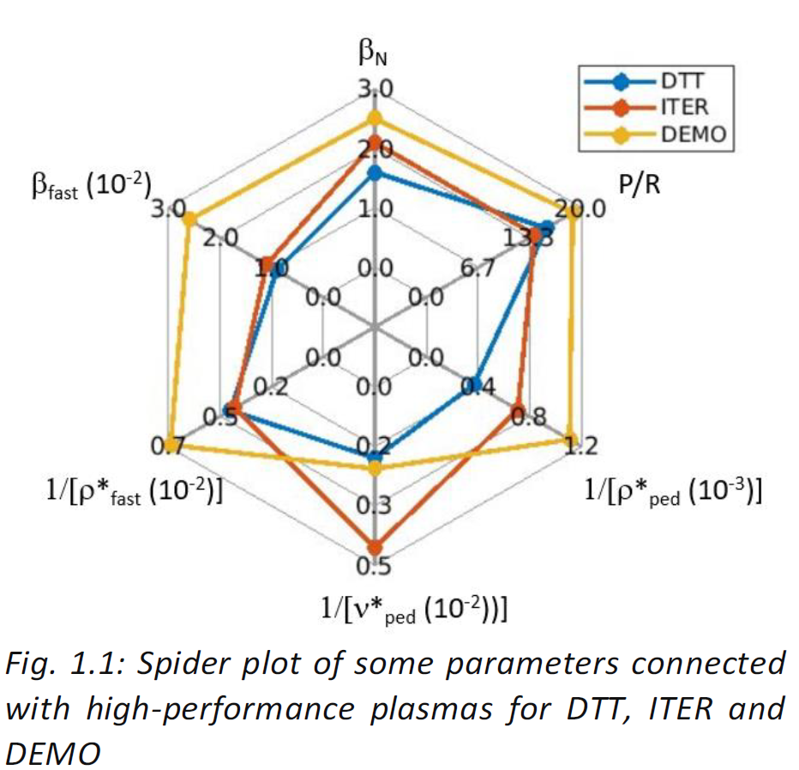
Chapter 1 : changes and improvements
Several specific changes suggested by EG-1
Updated spider plot →
Sentence added to Sec. 1.1: "This has provided a strong motivation for the Divertor Tokamak Test project (DTT), confirmed by a subsequent evaluation of the European fusion facilities by an international panel, which has classified the DTT device as "indispensable" for the EU fusion programme."
High-level headlines of the DTT Research Programme → summarizing the ensemble of the specific headlines given in the Chapters

Slide 9
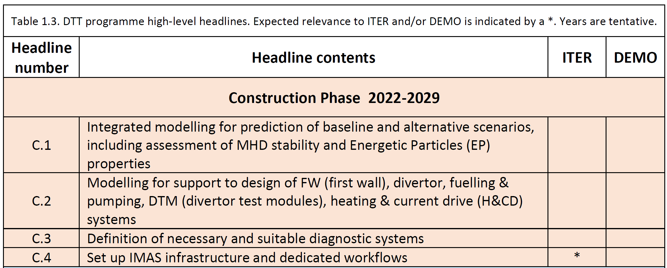
High-level headlines – construction phase

Slide 10
High-level headlines – Phase 1

Slide 11
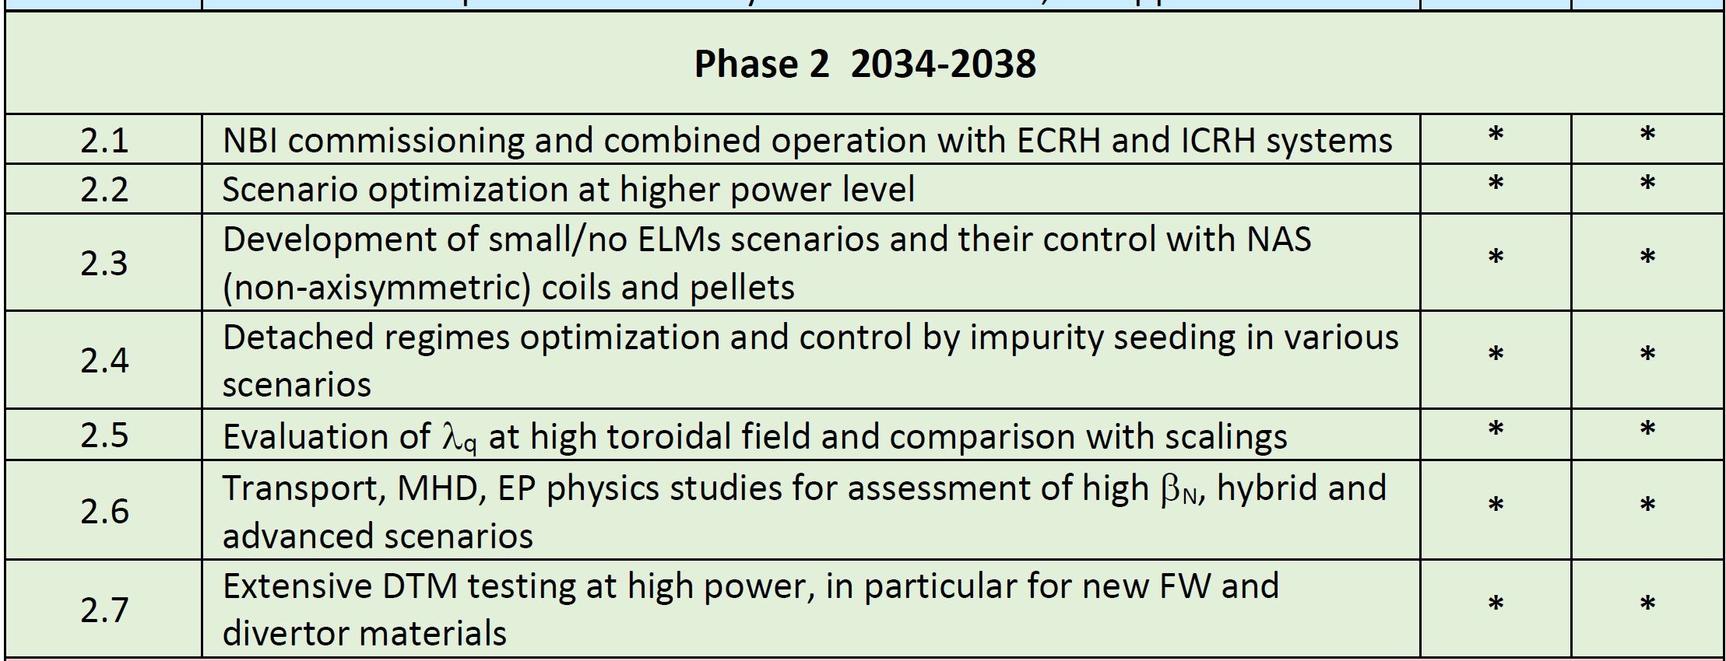
High-level headlines – Phase 2

Slide 12
High-level headlines – Phase 3

