Slide 1

Progress on DTT machine construction
DTT Team
Research Plan final meeting
DTT Consortium (DTT S.C.a r.l. Via E. Fermi 45 I-00044 Frascati (Roma) Italy)

Slide 2
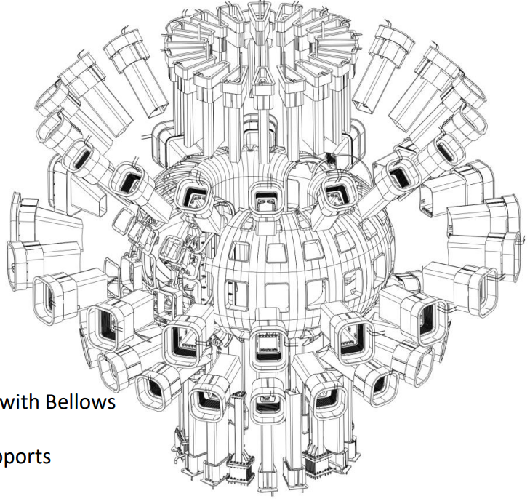
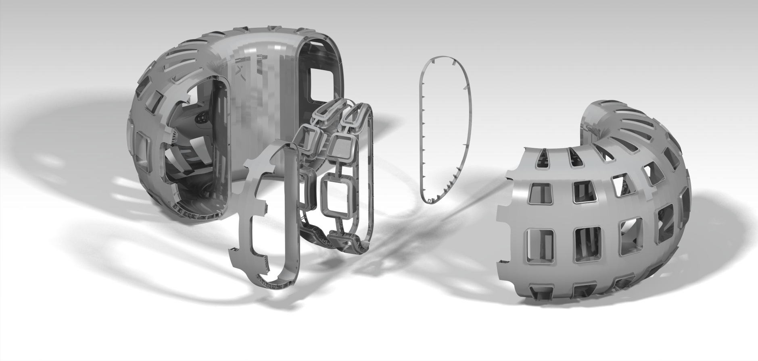
Vacuum vessel and ports
New call for tender to be launched within June 2024
Bellows geometry reviewed (4 types instead of 7)
A1.
The first deliverable will be a 30° sector to be used for qualification activity
Final location of support shall be finalized by the end of the mockup manufacturing when the Manufacturing readiness review will be held (about 18 months after the KoM)

Slide 3
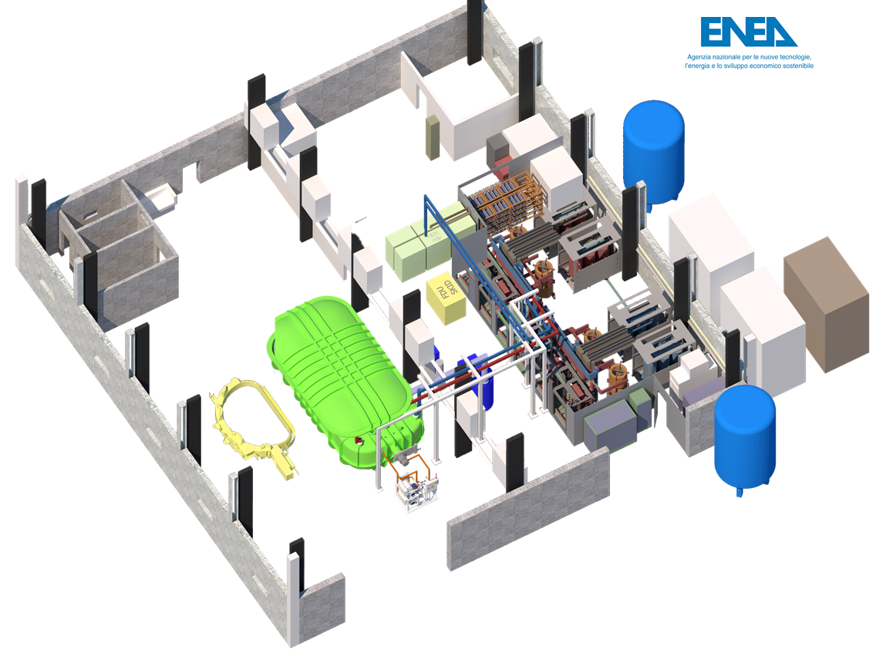
Frascati Coil Cold Test Facility -> CODAS
650 m² lab Area
100 m³ large cryostat
Pumping system
Cryogenic system
(LINDE Refrigerator + LN2)
TF power supply
  4.2 MVA, 42.5 kA
FDU system
Quench detection
Control room
TF power supply delivery expected in May
FDU expected in Autumn
Cryostat in mid 2025
CODAS will invest in the preparation of the facility during SAT of the power supply and then during commissioning

Slide 4
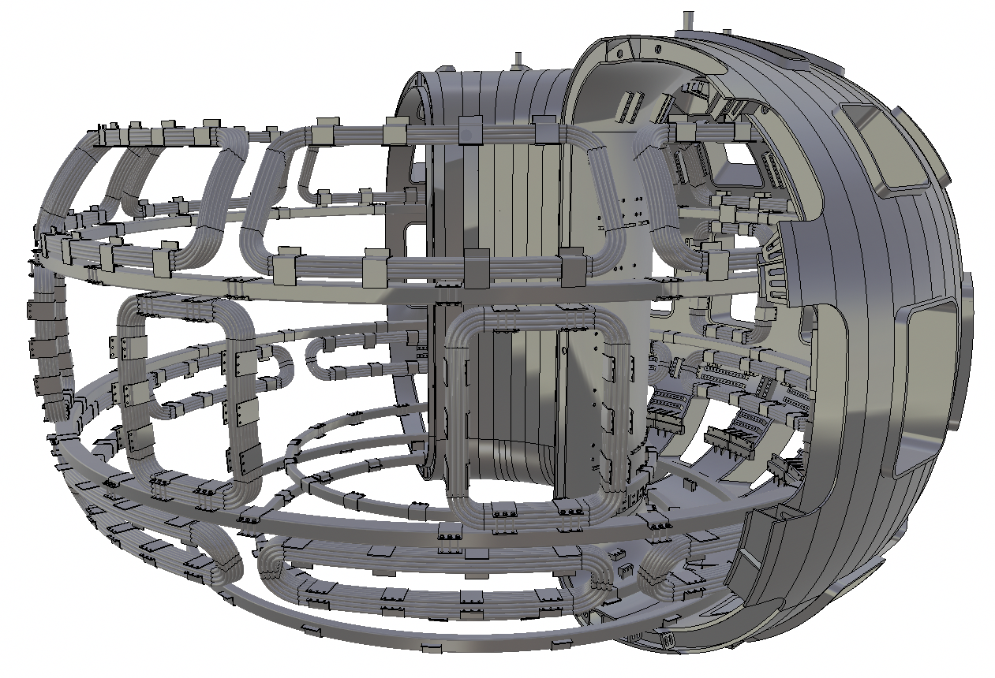
In-vessel coils and related power supplies
Contracts awarded to two different suppliers
KoM will be called in the next weeks
Power supplies will be delivered within the end of 2025
Conductors for in-vessel coils finalized
Conductors will be purchased this year also to perform mock-up in Building 87
Testing possible on final mock-up ADESX-U-like
A1.

Slide 5
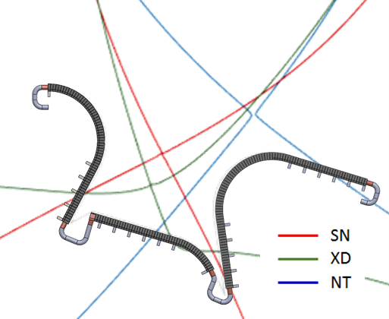
Divertor
Small mock-up testing completed
Interface with cooling circuit frozen
RHS requirements frozen
Expected soon:
Finalization of 3D model including toroidal shaping
Start of fabrication of the full scale mock-ups of the OVT (followed by the other PFU)
Cassette design to be finalized in order to launch call for tender

Slide 6
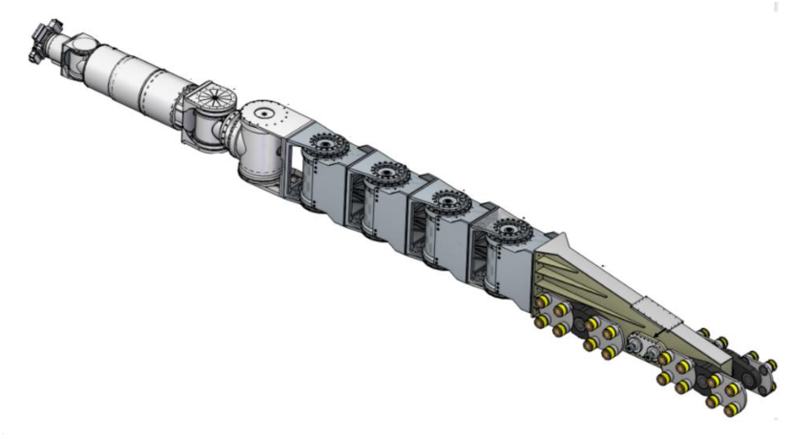
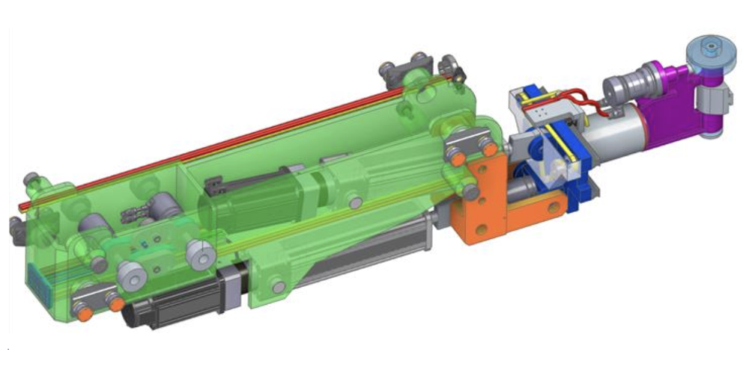
Remote Manipulation Systems
Contracts awarded to one single supplier
KoM will be called in the next weeks
HYRMAN
Interfaces with divertor are frozen
Interfaces with FW could be further developed due to the finalization of the end effectors
A1.
CMM

Slide 7
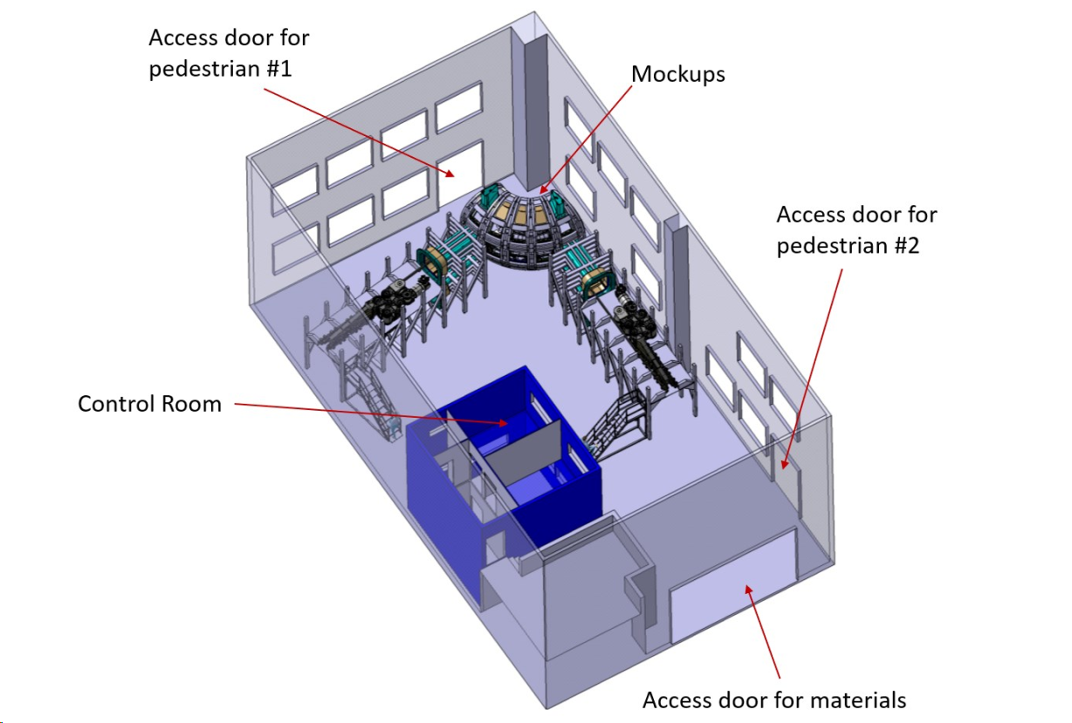
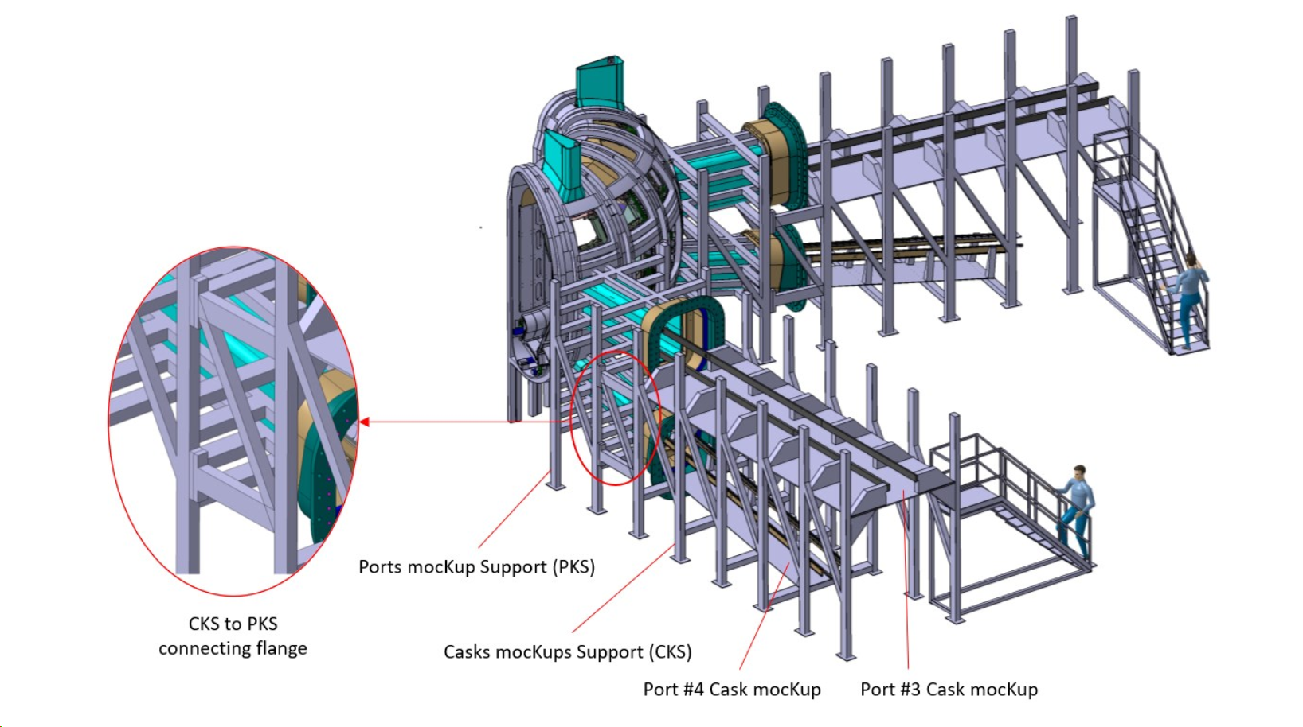
ENEA-DTT RH Training facility
Contract awarded and KoM already launched
Mockup of divertor and FW will be useful for testing alternative concepts of connections to the vessel compatible with RHS

Slide 8
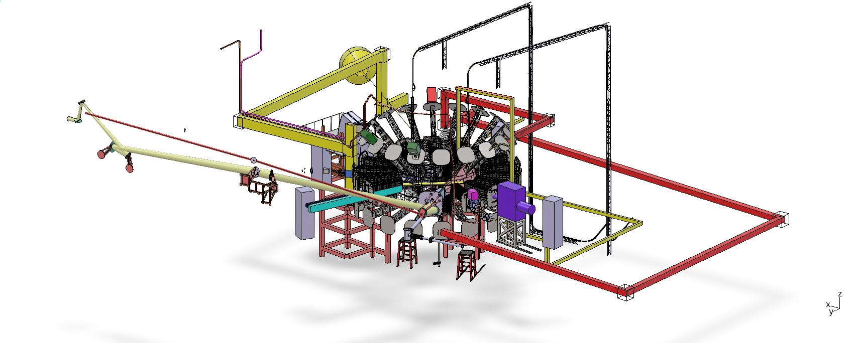
Diagnostics
Diagnostics conceptual design is under finalization
Interfaces will be locked (with cooling, ports, IVC, etc)
Engineering and procurement phase to be launched after review panel

Slide 9
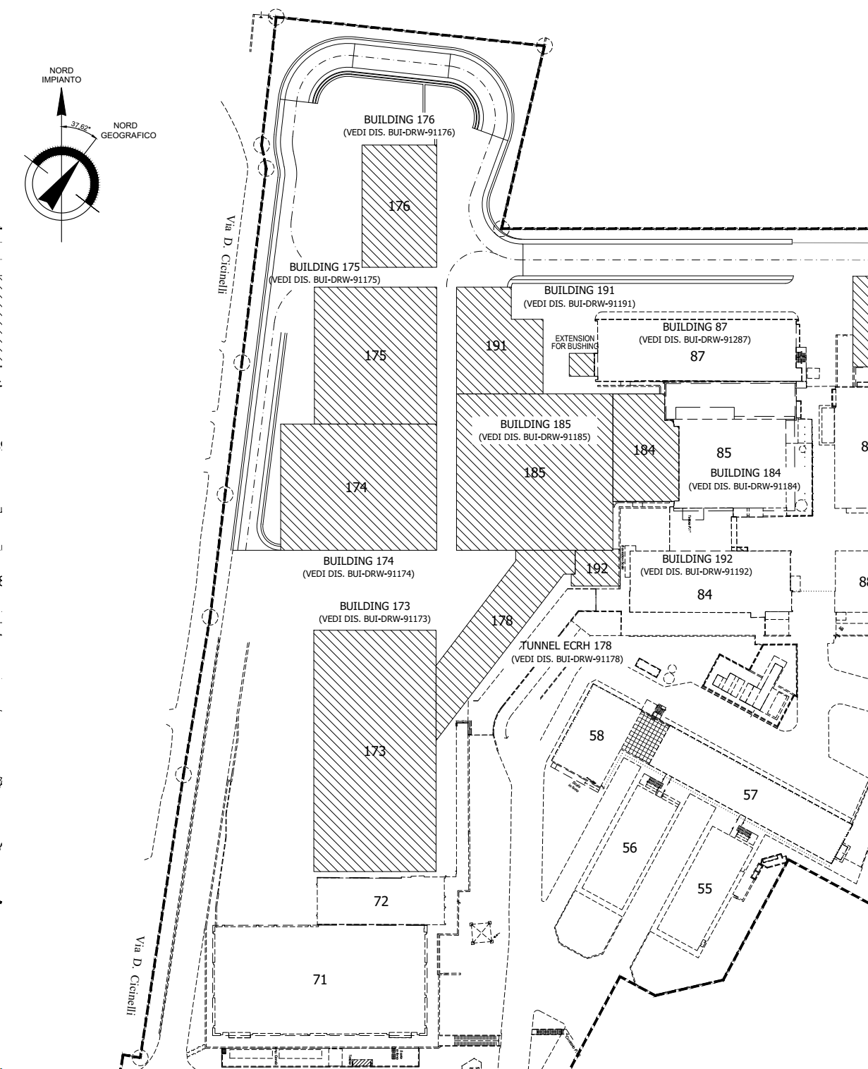
Assembly procedure
Assembly contract will have the following steps:
Engineering phase (procedure, design of tooling, material);
Tooling fabrication;
Pre-assembly;
Assembly
3 buildings have been reserved for the assembly activities: F87, F71, F185
F87 preassembly hall
F185 assembly hall
F71 CS pre-assembly

Slide 10
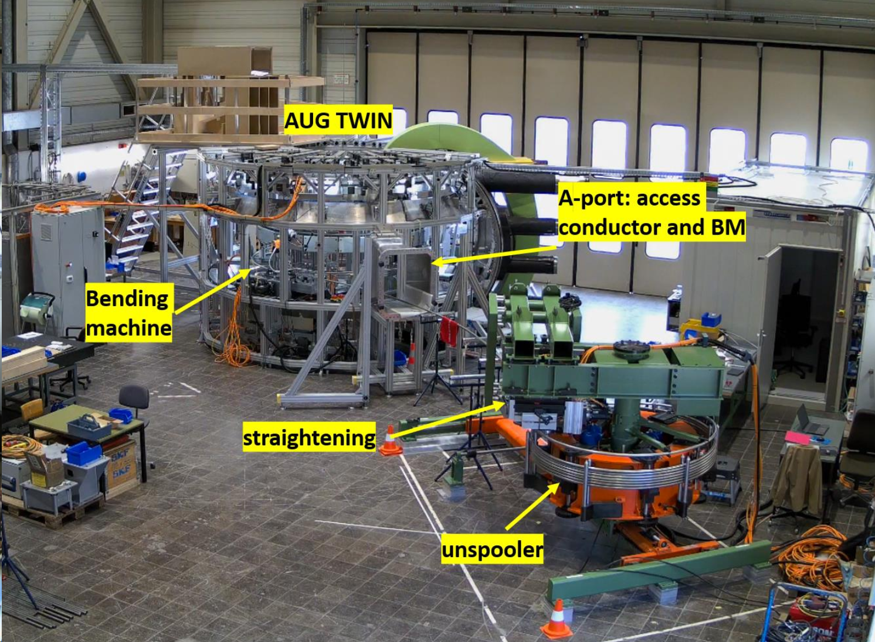
Assembly procedure
F87 will be devoted to:
Qualification activities with full scale mockup;
Storage of components
Pre-assembly activities
F87 preassembly
Courtesy of I. Zammuto, AUG mechanical twin and winding line

Slide 11
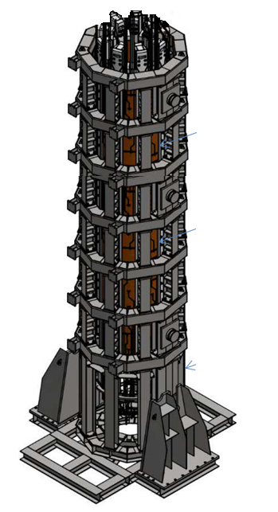
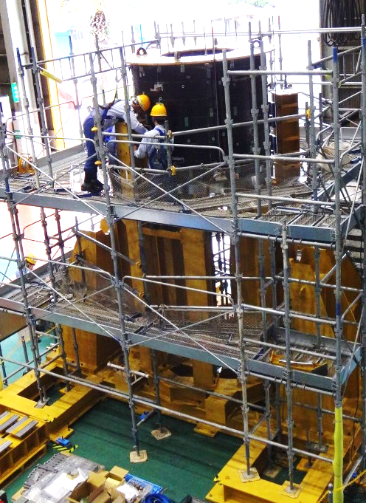
Assembly procedure
F71 will be devoted to:
CS Pre-assembly
Storage of components
F71 CS pre-assembly
Courtesy of JT-60SA, CS pre-assembly

Slide 12
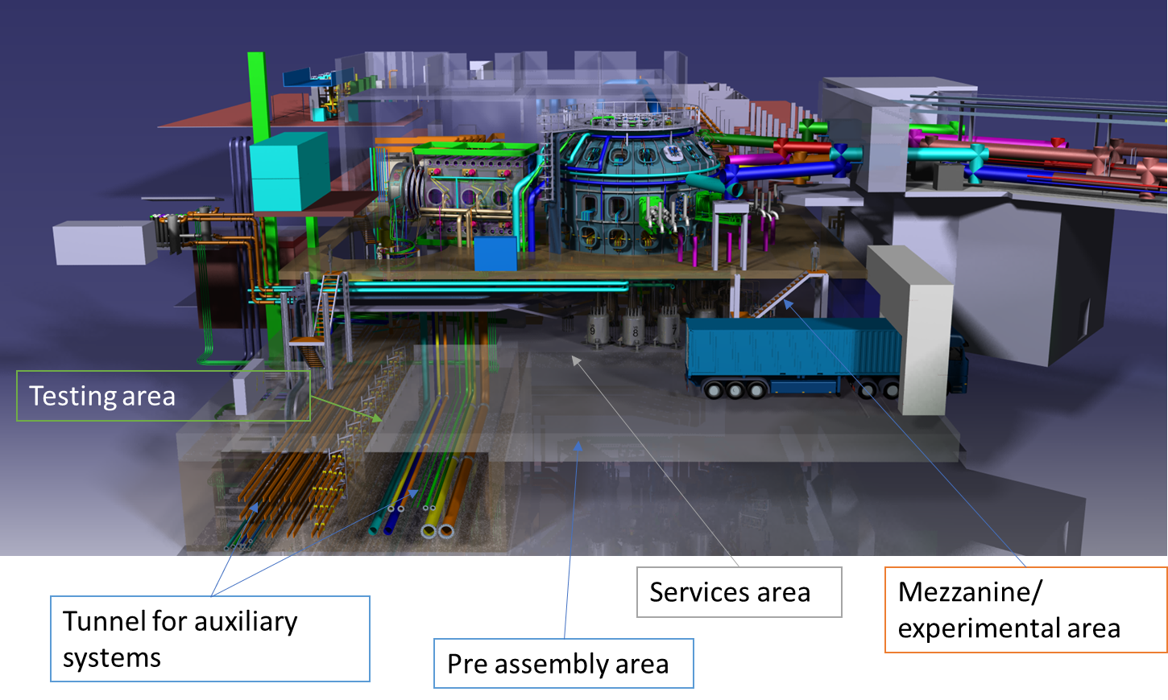
Assembly procedure
F185 will be devoted to:
Pre-assembly
Assembly
Storage of components
F185 assembly hall
Courtesy of JT-60SA, CS pre-assembly

Slide 13
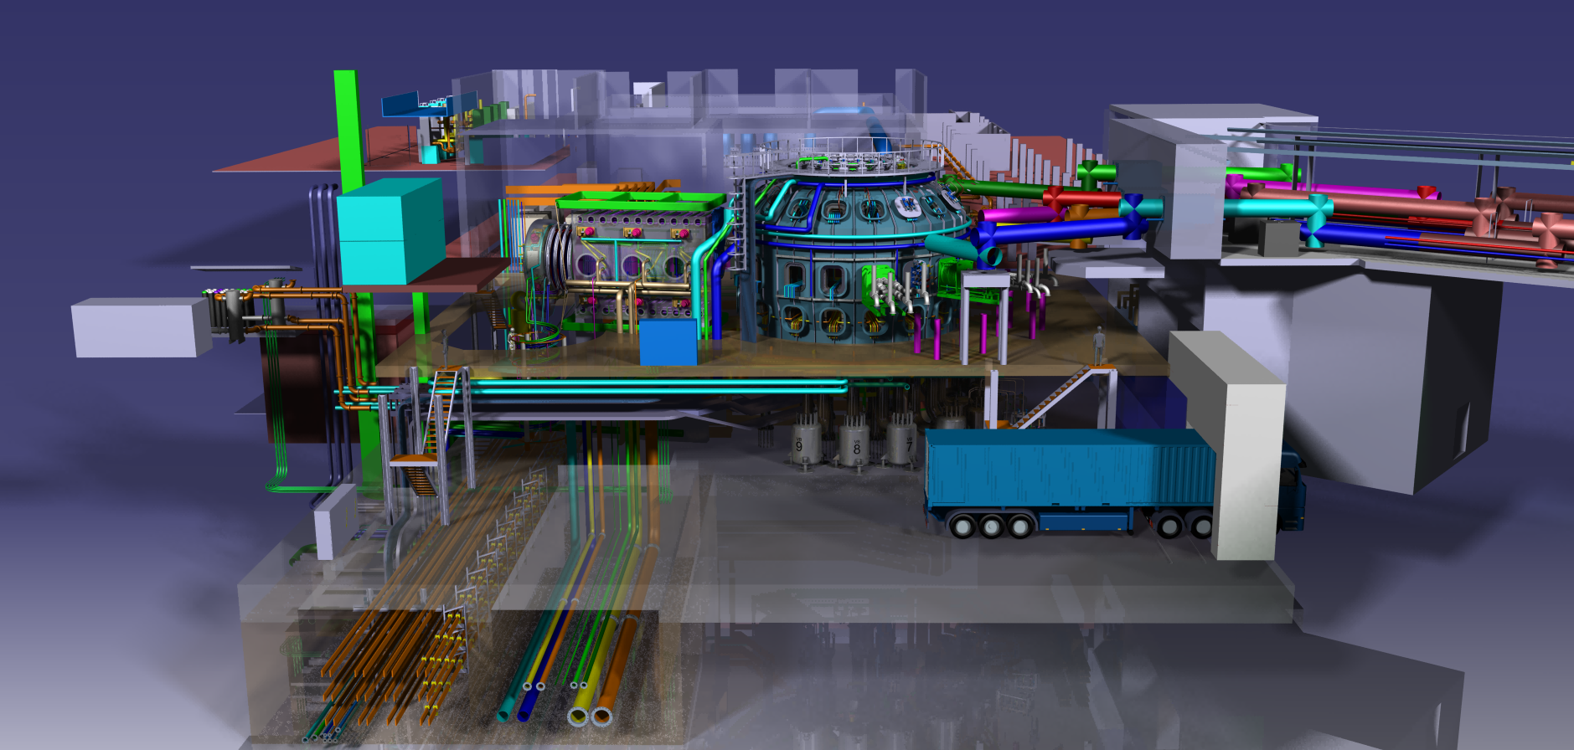
Thank you for attention
DTT Consortium (DTT S.C.a r.l. Via E. Fermi 45 I-00044 Frascati (Roma) Italy)

Slide 14
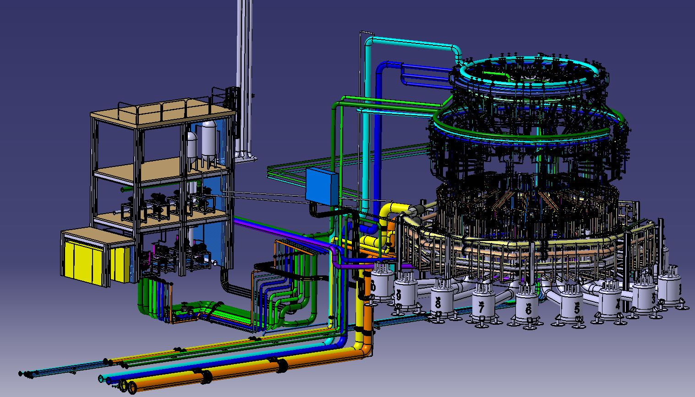
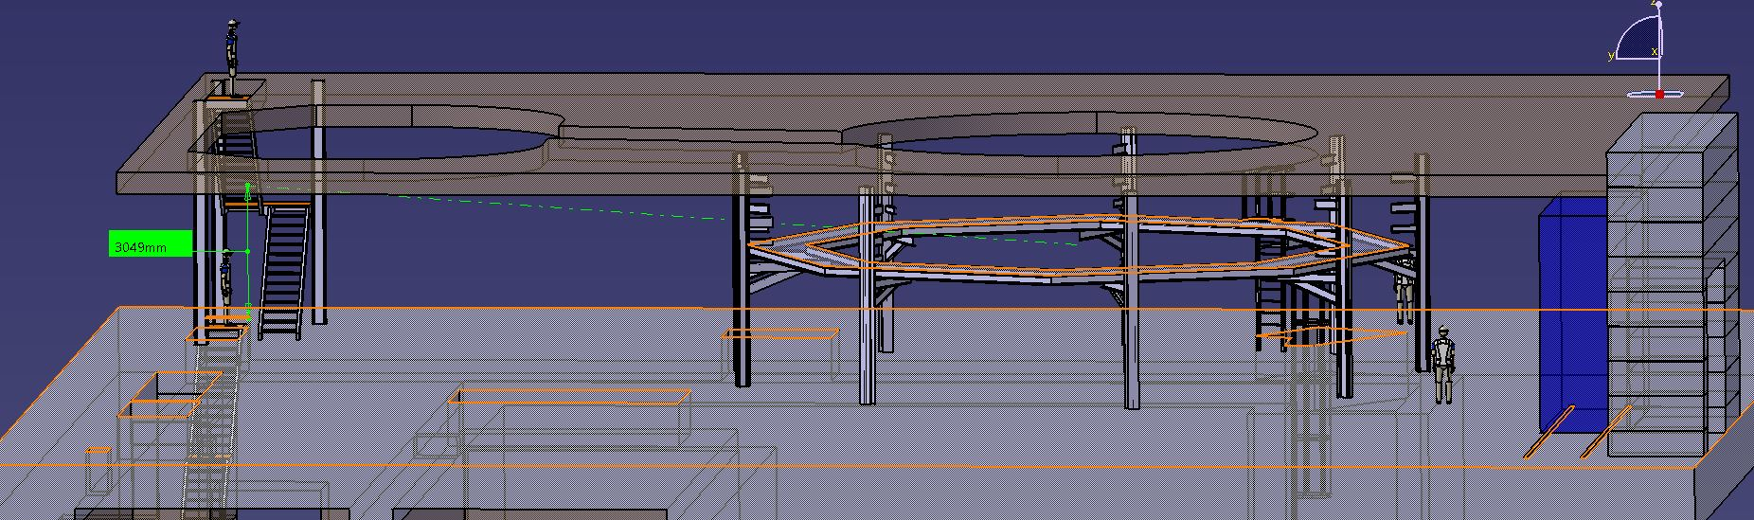
Assembly: scope of supply
Included in assembly:
WCS
mezzanine

Slide 15
Concluding remarks
Most of the system whose design has been developed within WPDIV is about or already under construction
Almost all interfaces have been frozen
Divertor prototype fabrication is expected to start in 2024
Assembly contract, whose tender will be launched within 2024, will guide the integration and will include a qualification phase where to test not only the assembly procedure but also the integration of many components

