Slide 1
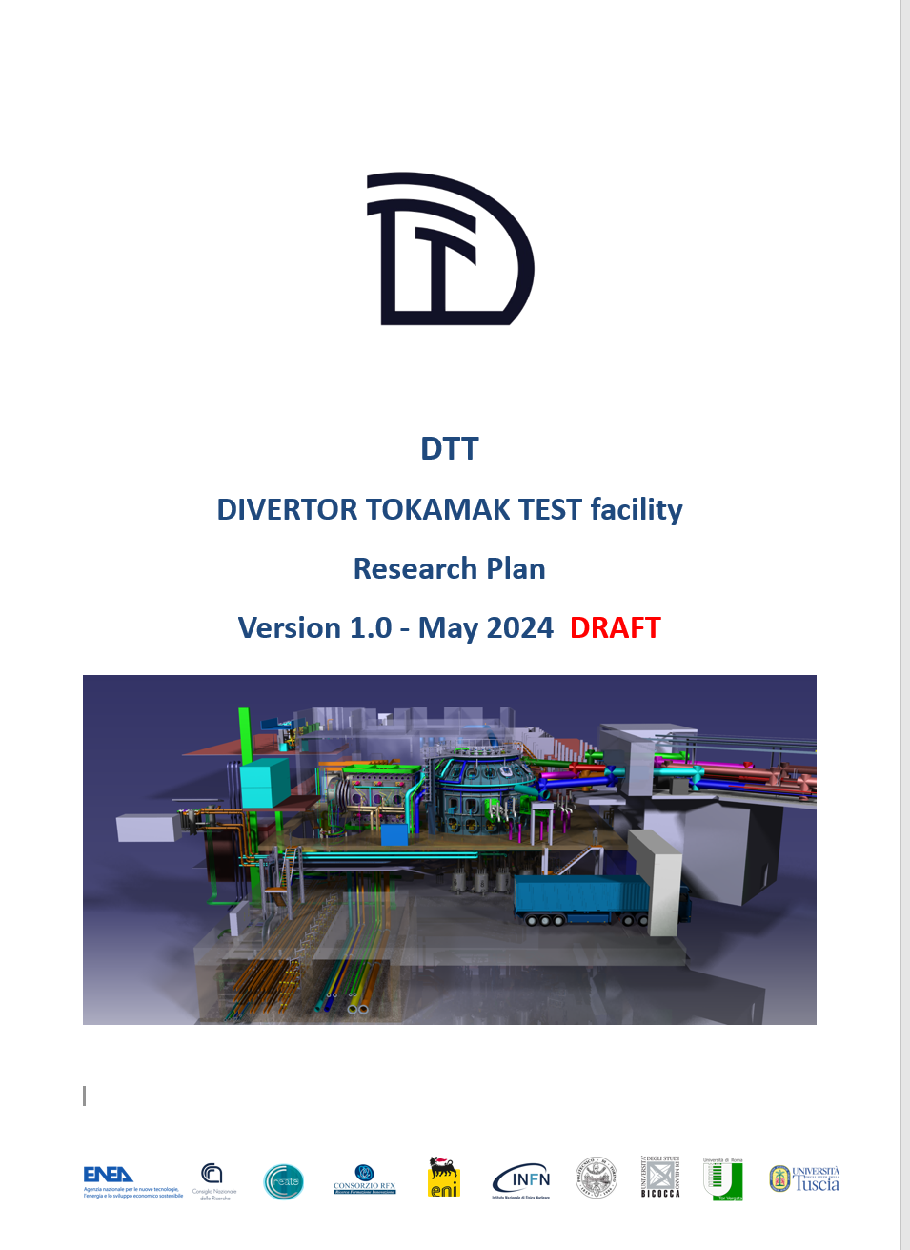














4th DTT-RP Team meeting – Scope of the meeting
DTT Research Plan
Version 1.0
9 Chapters
9 Appendices
191 pages
98 authors and contributors
18 Research Institutes
9 countries

Slide 2
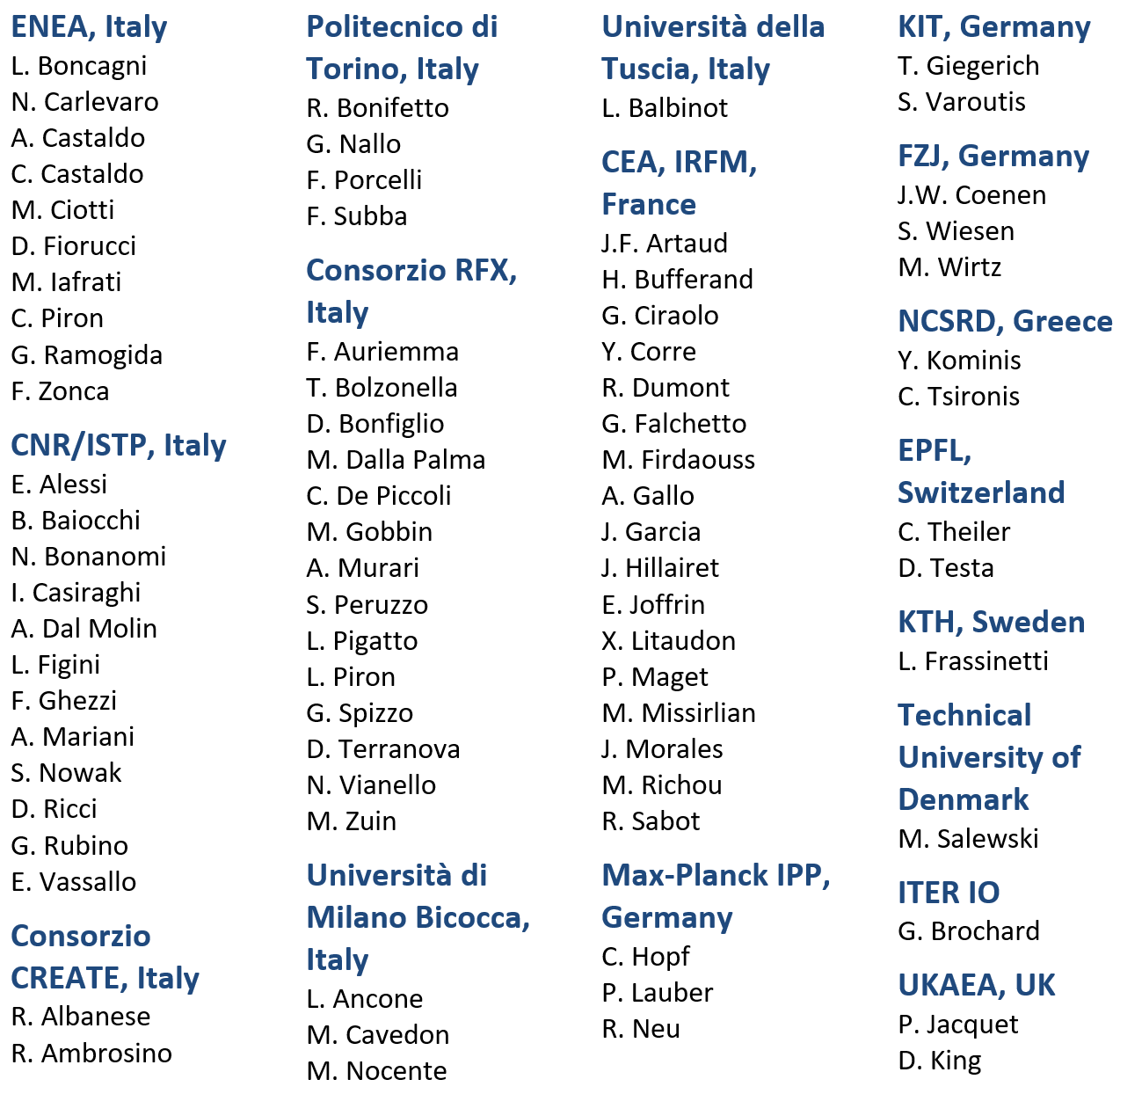
Coordinators, leading authors and contributors
Coordinators
F. Crisanti, G. Giruzzi, P. Martin
Leading Authors
Contributors
Chapter 1: DTT power exhaust strategy | F. Crisanti G. Giruzzi P. Martin | DTT S.C.a.r.l. & University of Tuscia, Italy CEA, IRFM, France DTT S.C.a.r.l., RFX & University of Padova, Italy
Chapter 2: Plasma scenarios | P. Mantica C. Angioni | CNR – ISTP, Italy Max Planck IPP, Germany
Chapter 3: Divertor and SOL physics, plasma-wall interactions | P. Innocente E. Tsitrone M. Wischmeier | Consorzio RFX, Italy CEA, IRFM, France Max Planck IPP, Germany
Chapter 4: Transport physics and integrated modelling | C. Angioni P. Mantica | Max Planck IPP, Germany CNR – ISTP, Italy
Chapter 5: MHD, disruptions and control | E. Nardon G. Vlad M. Falessi | CEA, IRFM, France ENEA, Italy ENEA, Italy
Chapter 6: Physics of heating, current drive and fuelling | C. Sozzi D. Van Eester P. Vincenzi D. Terranova | CNR – ISTP, Italy ERM/KMS, Belgium Consorzio RFX, Italy Consorzio RFX, Italy
Chapter 7: Energetic particle physics | G. Vlad M. Falessi E. Nardon | ENEA, Italy ENEA, Italy CEA, IRFM, France
Chapter 8: Theory and simulation | M. Falessi G. Vlad E. Nardon | ENEA, Italy ENEA, Italy CEA, IRFM, France
Chapter 9: Fusion technology developments | S. Brezinsek C. Day G. Dose | FZJ, Germany KIT, Germany ENEA, Italy

Slide 3
DTT Research Plan activity timeline /1
DTT Research Plan workshop July 2022
Call for participation July-Sept. 2022
Selection of DTT-RP participants (~90) and ROs of the 6 Expert groups: Sept. 2022
EG-1: DTT scientific exploitation strategy - EG-4: Heating, current drive and fuelling
EG-2: Divertor and SOL physics - EG-5: MHD and fast particles, theory
EG-3: Plasma scenarios and associated modelling - EG-6: Fusion technology developments
1st meeting (Kick-off) of the DTT-RP Team (in person, at ENEA/Frascati) 16-17 Nov. 2022
2nd meeting of the DTT-RP Team (in person, at ENEA/Frascati) 26-28 Apr. 2023
Production of document on the Central Solenoid options May 2023
Production of slides for the EU facilities review June 2023
Production of synopses of the DTT-RP chapters end July 2023
Production of drafts of the DTT-RP chapters (except Chap. 3) Nov. 2023
3rd meeting of the DTT-RP Team (in person, at Padova University) 13-15 Dec. 2023

Slide 4
DTT Research Plan activity timeline /2
First draft of the DTT-RP completed. Sent to ROs for final reading by Expert Groups end March 2024
Final comments by ROs/Expert Groups expected end April 2024
4th meeting of the DTT-RP Team (in person) 6-8 May 2024
Draft to be sent to CTS for comments (not for approval) mid May 2024
DTT-RP version 1 issued end May 2024
EUROfusion Science Meeting on DTT (including short presentation of DTT-RP) 12 June 2024
Call for new DTT-RP Team (to elaborate version 2) TBD
Workshop to present and discuss the DTT Research Plan to the fusion community TBD
1st meeting of the new DTT-RP Team autumn 2024
DTT-RP 2nd version issued autumn 2026

Slide 5
Meeting – general information
Zoom connection :
https://dtt-project-it.zoom.us/j/5050475751?pwd=azJiSXJyTlZ5elY0N3FlMHNPMHZodz09
Participants (in person):
F. Crisanti, P. Martin, G. Giruzzi, P. Innocente, P. Mantica, C. Sozzi, G. Vlad, M. Falessi
Participants (remote):
M. Wischmeier, E. Tsitrone, C. Angioni, D. Van Eester, D. Terranova, E. Nardon, S. Brezinsek, G. Dose
Observers (in-person or remote):
F. Militello (UKAEA), A. Loarte (ITER), E. De Marchi (ENI), F. Romanelli, E. Di Pietro, A. Pizzuto, M. Ciotti, F. Zonca
Transportations:
Public Shuttle bus (Schiaffini) to reach ENEA Labs from Frascati town. Bus stop in front of Bar Fondi, Piazza Roma 18. Cost of the ticket: 1.10 €.
Social dinner:
Today at 20:00. Ristorante "Pasquino", Via Sepolcro di Lucullo 6. Cost: ~30 €.

Slide 6
Scope of the meeting
Presentation by the EG-ROs of slides with the following content (suggested):
  Very short summary of the chapter rationale
  Changes and improvements with respect to the first version (if any)
  Presentation of the Headlines (they were elaborated after the previous meeting)
  How to develop the chapter for the next versions (new items, points to be developed, new simulations etc.)
  Ideas about the follow-up of the DTT-RP activity (work method, proposals of experiments on other tokamaks, code and simulation developments etc.)
First objective: final agreement on the contents before last revision and public issue
Second objective: discuss next steps of the activity, possible developments
Wednesday morning: final discussion, with the following objectives:
  agree on main changes and improvements of the draft
  agree on general format, lists of authors, contributors etc.
  agree on next steps and timeline

Slide 7
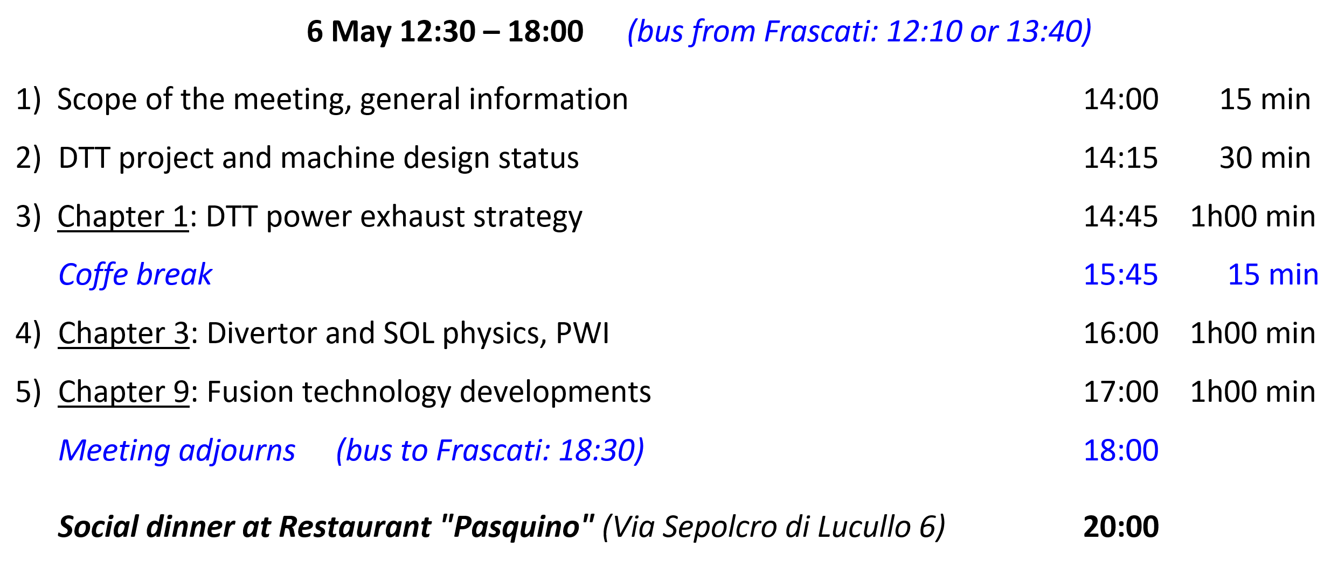
Meeting agenda /1

Slide 8
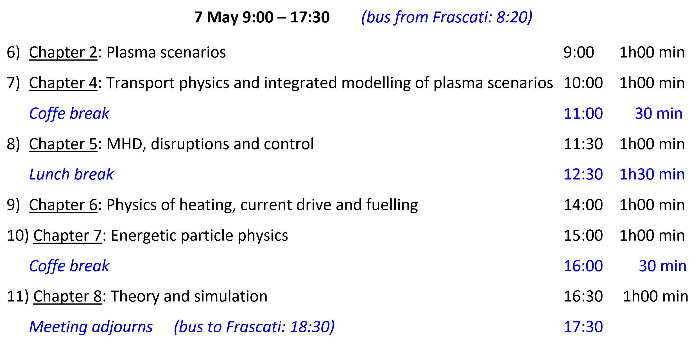
Meeting agenda /2

Slide 9
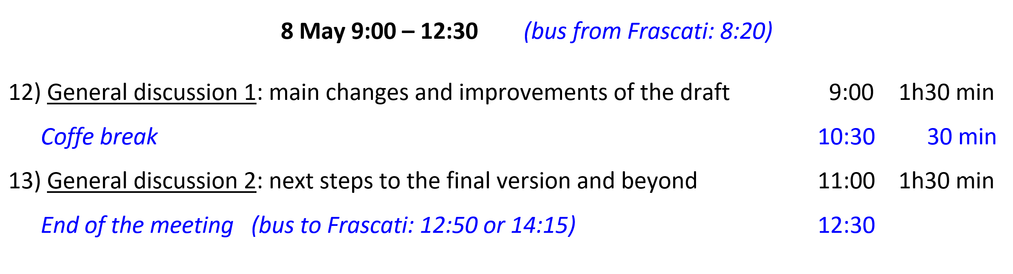
Meeting agenda /3

